Slide 2
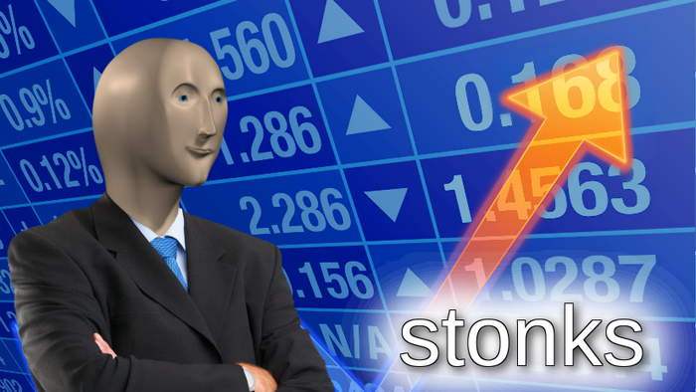
W OR L??

Slide 3
IDEA
Is it a good stonk or scam?
Scrape posts from r/WallStreetBets (Popular Subreddit)
Predict if given post is well-researched stock or spam/meme stock
Multiple models and architectures to attempt to predict quality of a Reddit post and the stock it speaks of.

Slide 4
HYPOTHESIS
Posts that have good research put into them will have more likely result in positive stock returns while meme stocks will most likely result in negative stock returns
For example:
Apple: Good stonk
Gamestop: meme stonk

Slide 5
DATA COLLECTION
Scrape WallStreetBets Posts
JB elaborate on what u did

Slide 6
DATA PREPARATION
JB elaborate on what u did

Slide 7
EDA
Dataframe shape(summary of dataset)
Wordclouds:
Good stonks
Bad stonks

Slide 8
NAÏVE-BAYES
Supervised type shi
Accuracy
Confusion matrix
Quick insights (if any)

Slide 9
K-MEANS
Unsupervised type shi
Silhouette score
Plot (cluster plot also)
Insights if any thru scatter plot

Slide 10
SIMPLE FEED FORWARD NETWORK
Big boi gang shi
Visualize arch. (draw)
Accuracy
Hyperparameter testing if any

Slide 11
LSTM
Big boi gang shi
Visualize arch. (draw)
Accuracy
Hyperparameter testing if any

Slide 12
SFFN vs LSTM – COST PLOTS vs ACCURACY
Side by side

Slide 13
CHAT-GPT4 TESTING
2-3 prompts to ChatGPT and get model to work with it

Slide 14
FUTURE STEPS
Other models
Better NLP preprocessing
More data duh
Drop $$$$$

Slide 15
TAKEAWAYS
NLP Project
Multiple Neural Nets
Big Data
Stonks and Financial Data
$$$$ moni $$$$

