Slide 1


Etour PG-DAC FEB 2020
Submitted By:
Group No: 01
Rani Shelke 1076
Aishwarya Jadhav 1004

Slide 2
Contents
Introduction
Problem Statement
Data Flow Diagram
Module Of Project
Project Screenshot
Future Scope
Conclusion
References

Slide 3
Introduction
The eTour is a web based application. The main purpose of “eTour” is to provide a convenient way for a customer to book a Tour for travel purposes. The objective of this project is to develop a system that automates the processes and activities of a eTour. In this project, We will make an easier task of searching places and get the details of travel with itinerary details.
The purpose of the functional requirement (or business requirement) document is to define and document a complete and accurate description of the requirements/specifications of the product to be developed for e-Tour.

Slide 4
Problem Statement
In the present system a customer has to approach various agencies to find details of places and to book tickets. This often requires a lot of time and effort. We provide approach skills to critically examine how a tourist visits and its ability to operate in an appropriate way when dealing with the consequences of tourism, locally, regionally, and nationally including visitor security and ecological influences. It is tedious for a customer to plan a particular journey and have it executed properly.
The project ‘eTour’ is developed to replace the currently existing system, which helps in keeping records of the customer details of destination as well as payment received

Slide 5
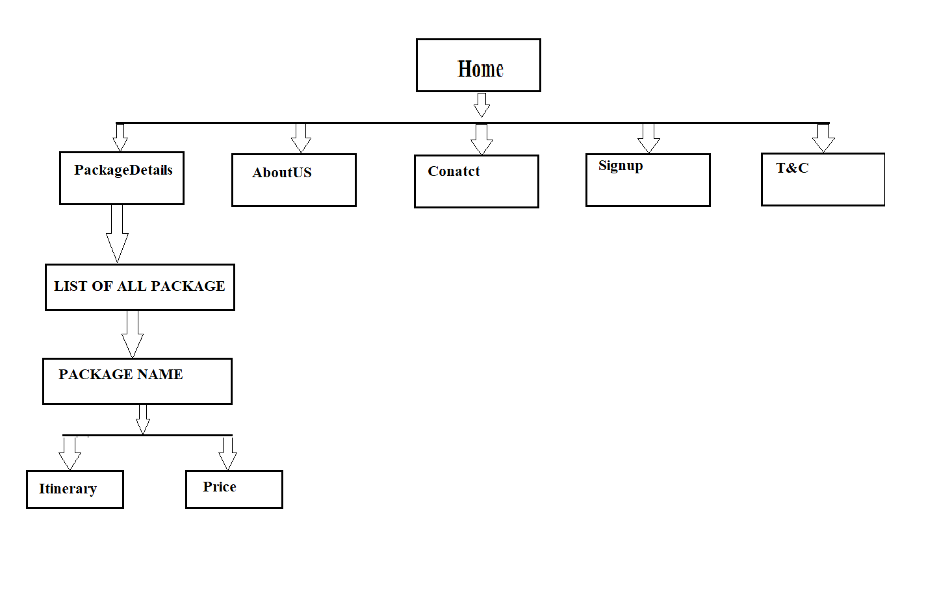
Data Flow Diagram

Slide 6
Module Of Project
Registration
Login
View Packages
Itinerary
Price Details
Date
Passenger Details

Slide 7
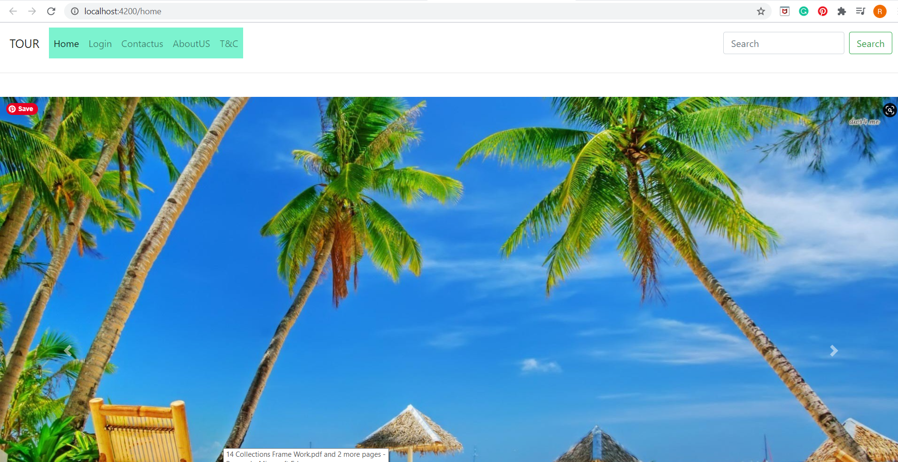
Project Screenshot
HomePage

Slide 8
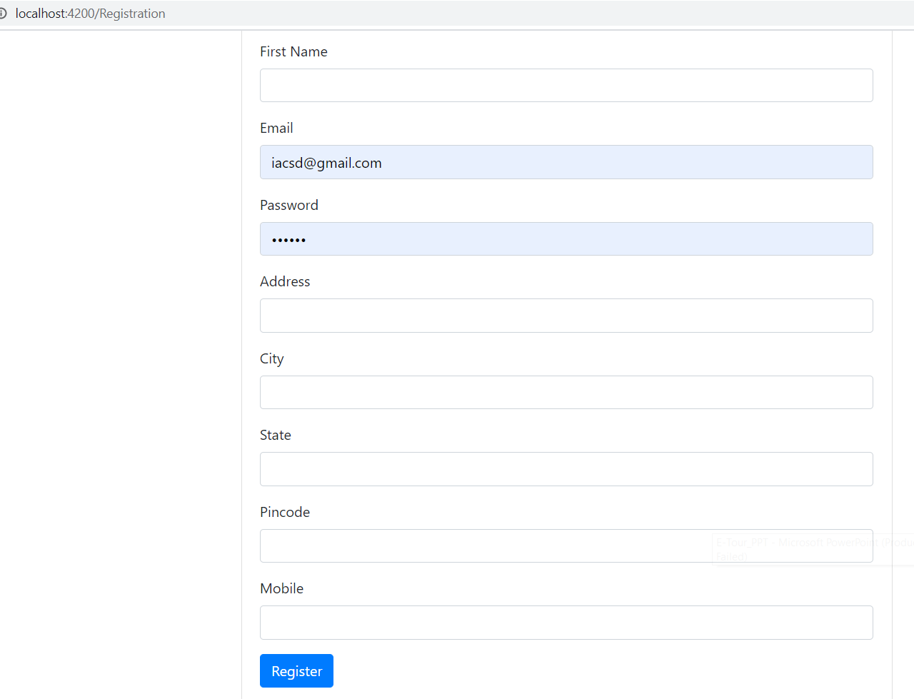
User registration
RegistrationPage

Slide 9
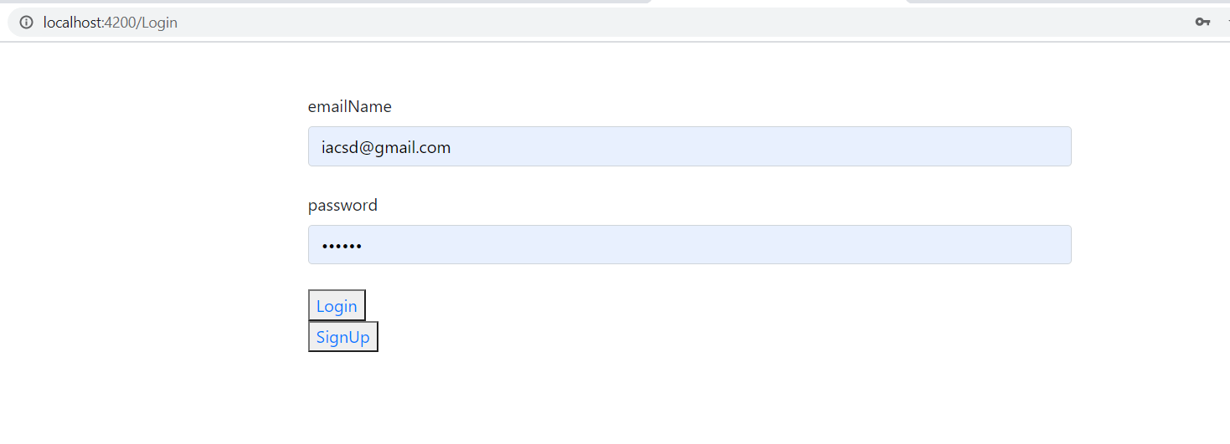
User Login
LoginPage

Slide 10
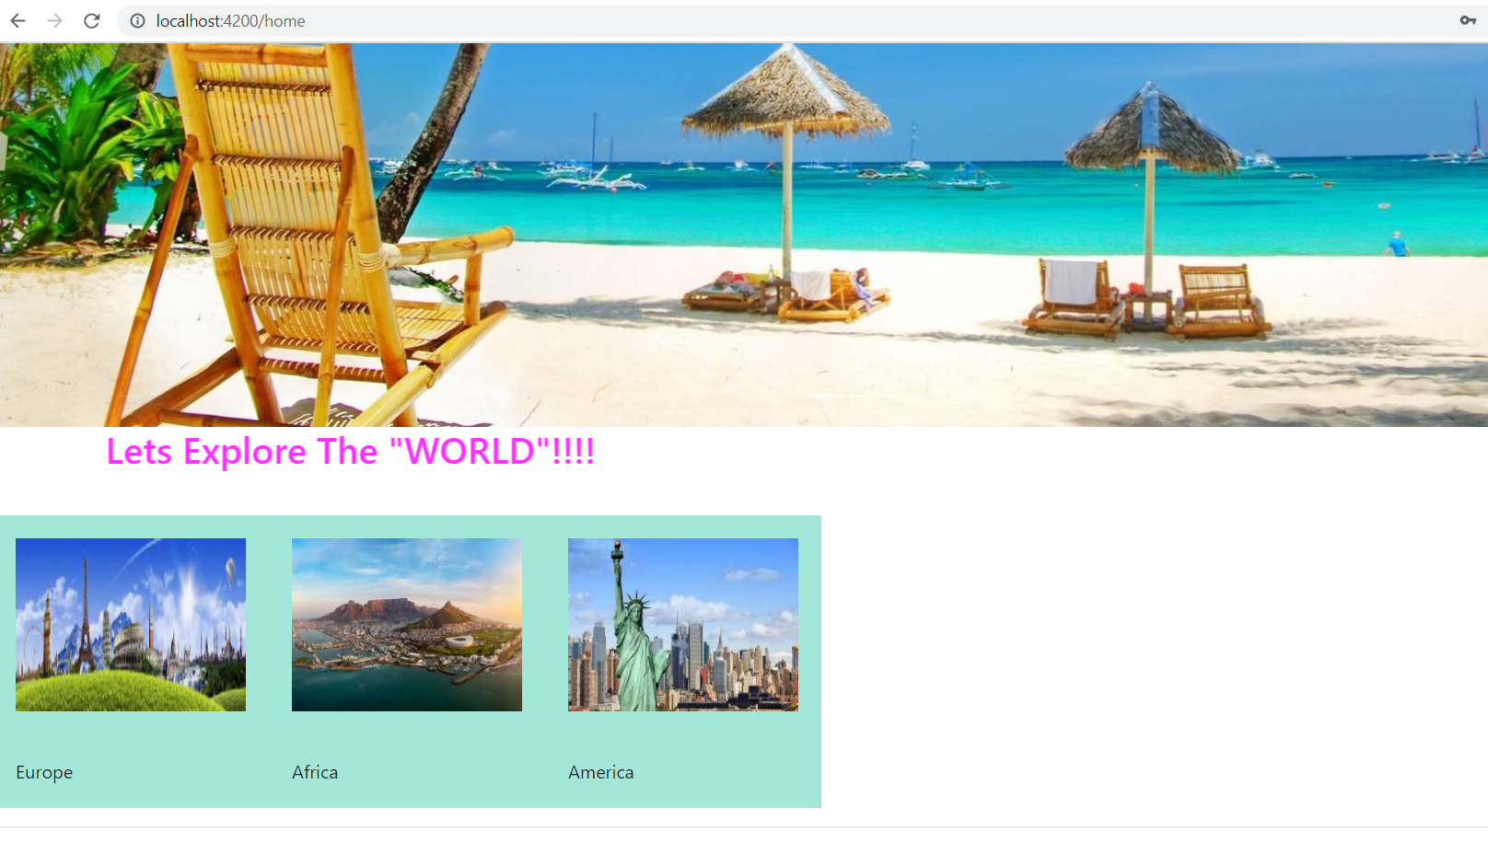
Tour Packages
PackageDetails

Slide 11
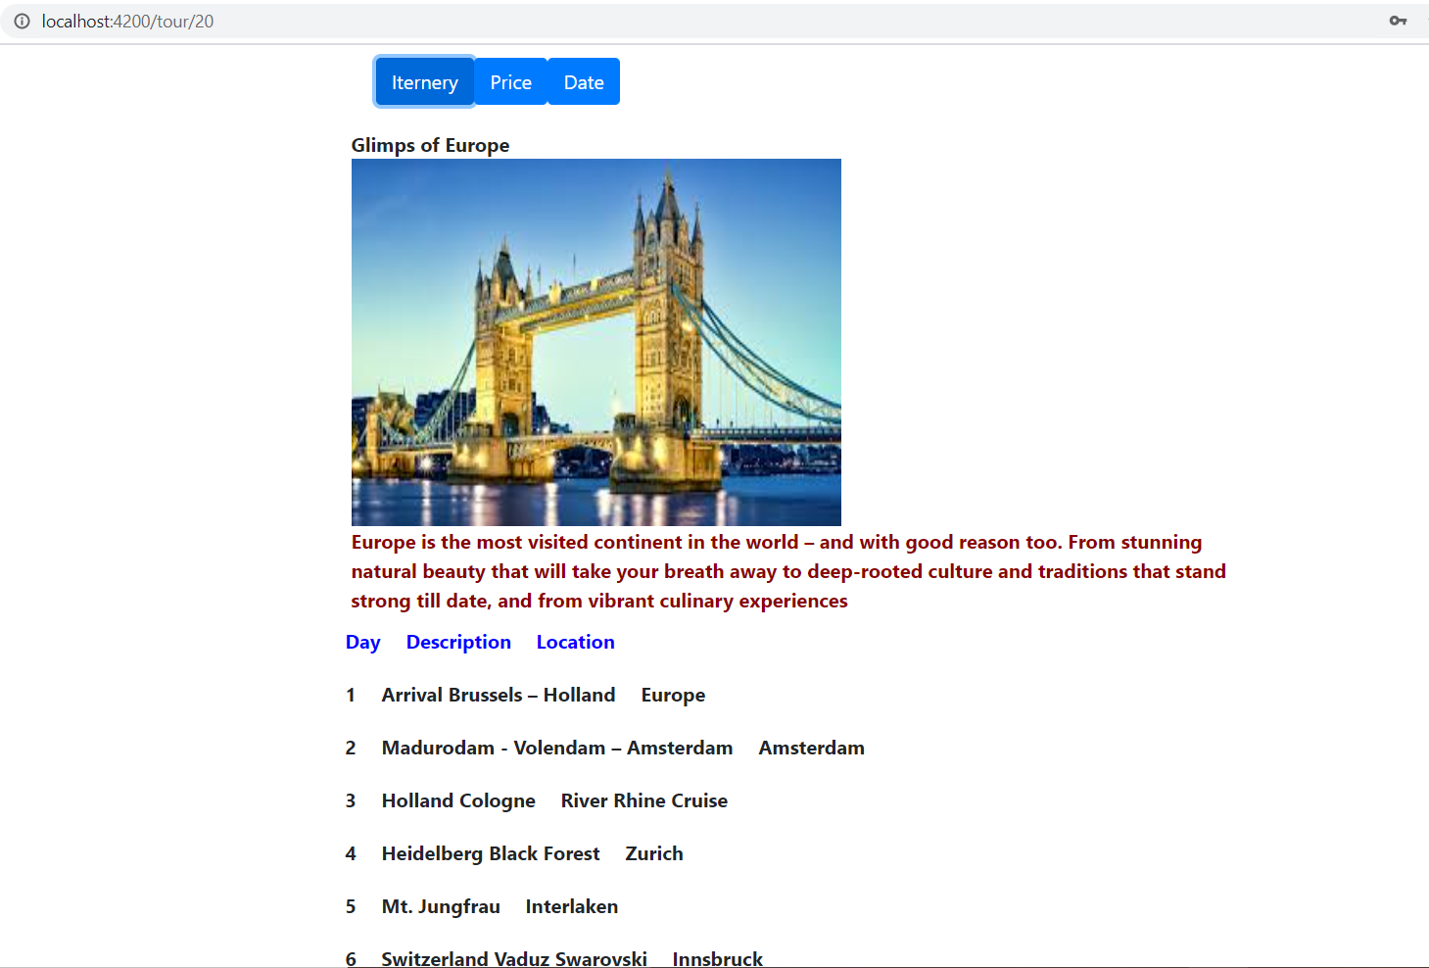
Itinerary details
Day wise description of package

Slide 12
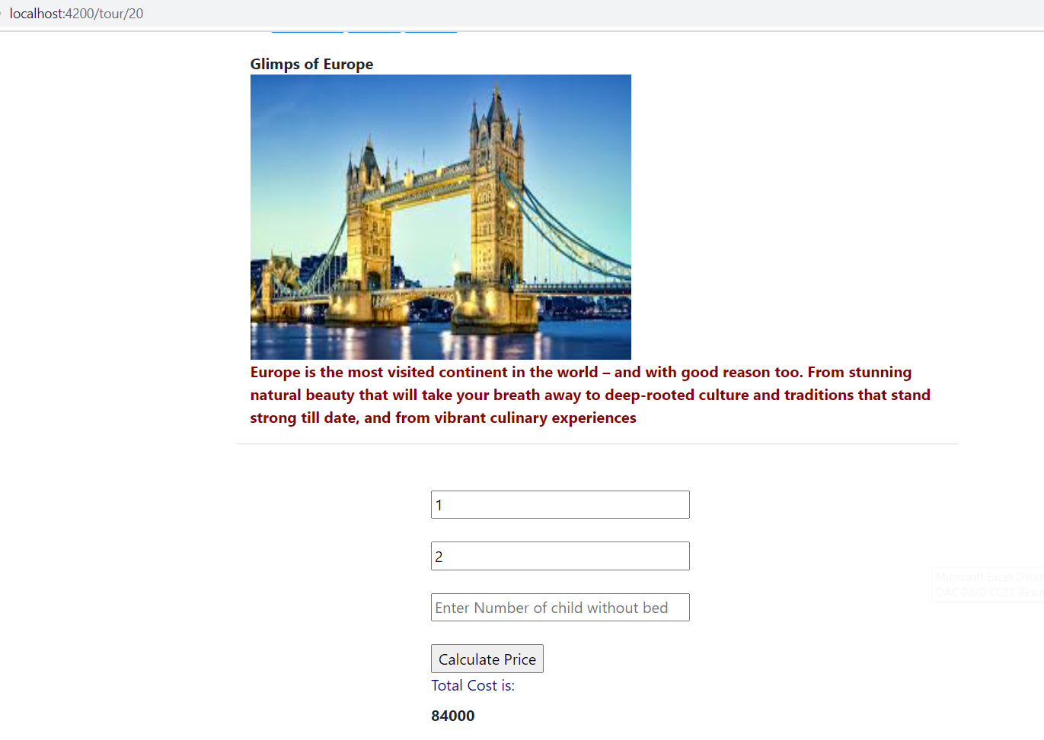
Price Details
Price details with respect to no of passenger

Slide 13
Future scope
Booking confirmation with mail is our next target.
We will include more functionality as per the user requirement.
We want to improve our Home page, as it is the main thing which attracts the user.
Not a single website is ever consider as complete forever firstly because there is always something new requirement also are growing day by day.

Slide 14
References
https://www.wikipedia.com
https://www.indiaToursOnline.com
https://www.kesari.com
https://www.realityToursandtravel.com

Slide 15
Thank You..

