Slide 1
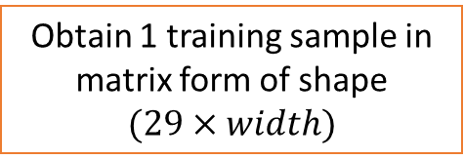
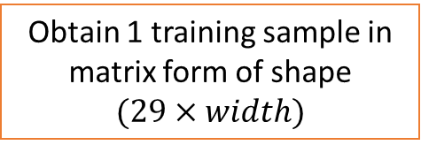

From the last meeting: generer 10^4 vecteurs de taille 29, par capteur , par fichier
29 frequency bands
Obtain 1 training sample in matrix form of shape
$$(29×width)$$
Width = 10^4 (to be set as argument)
# sample 1
28800 frames (corresponds to 1 hr duration)
Obtain 1 training sample in matrix form of shape
$$(29×width)$$
Width = 10^4 (to be set as argument)
# sample 2
Obtain 1 training sample in matrix form of shape
$$(29×width)$$
# sample iteration_per_csv_file
Width = 10^4 (to be set as argument)

