Slide 1
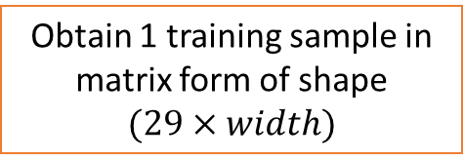
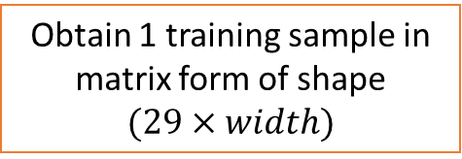
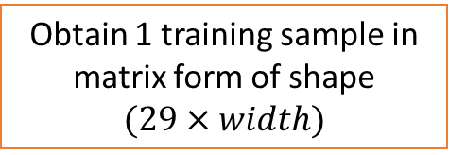
Obtain 1 training sample in matrix form of shape
$$(29×width)$$
# sample 1
Obtain 1 training sample in matrix form of shape
$$(29×width)$$
# sample 2
Obtain 1 training sample in matrix form of shape
$$(29×width)$$
# sample iteration_per_csv_file

