Slide 1
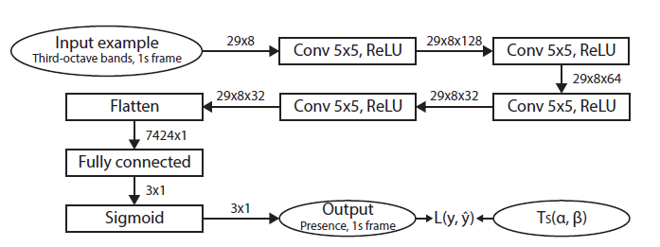
Adaptation to Felix Architecture
1st choice: Do I put the embedded vector here , and delete the CNN layers ?

