Slide 1
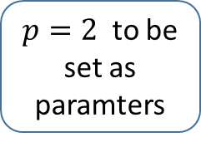

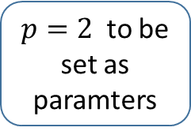
1 training sample of width (w)
Ind = 0
Ind = w -1
$p=2$ to be set as paramters
Patch de taille = $X_{0}=8$ (to be set as parameter)
$p=2$ to be set as paramters
29 lines
Past slices
Future slices
#-2
#-1
#1
#2
#...
#8
#1
#2

