Slide 1

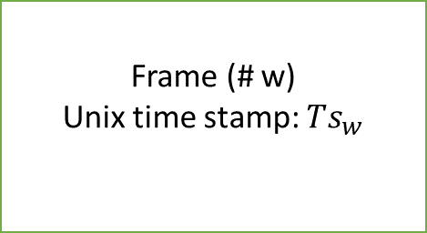

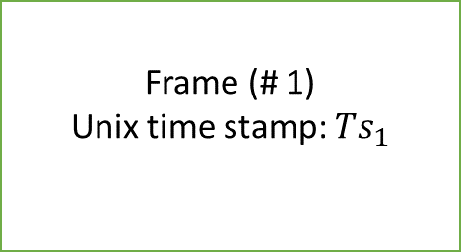
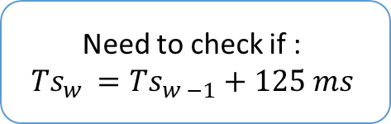
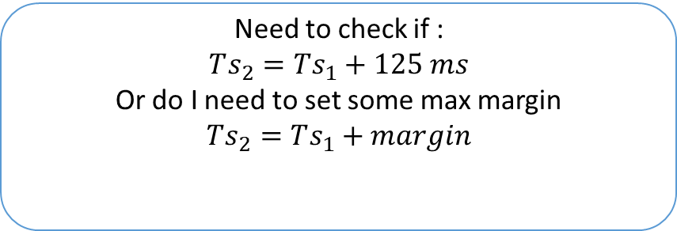
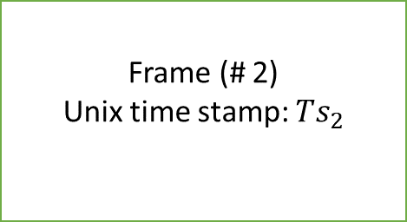

1 training sample of slice width (w)
Frame (# 1)
Unix time stamp: $Ts_{1}$
Frame (# 2)
Unix time stamp: $Ts_{2}$
Frame (# w)
Unix time stamp: $Ts_{w}$
$$margin$$
125 ms
125 ms
125 ms
$$Ts_{2}$$
Time axis
$$Ts_{1}$$
Need to check if :
$$Ts_{2}=Ts_{1}+125 ms$$
Or do I need to set some max margin
$$Ts_{2}=Ts_{1}+margin$$
Need to check if :
$$Ts_{w }=Ts_{w −1}+125 ms$$

