Slide 1
AI Interview Analyzer
Project Demo — Ranimai
Simple Streamlit prototype + LLM analysis

Slide 2
Problem & Solution
Problem:
  Interviews are subjective, inconsistent, and time-consuming.
Solution:
  AI Interview Analyzer: transcribes, scores, and provides feedback.

Slide 3
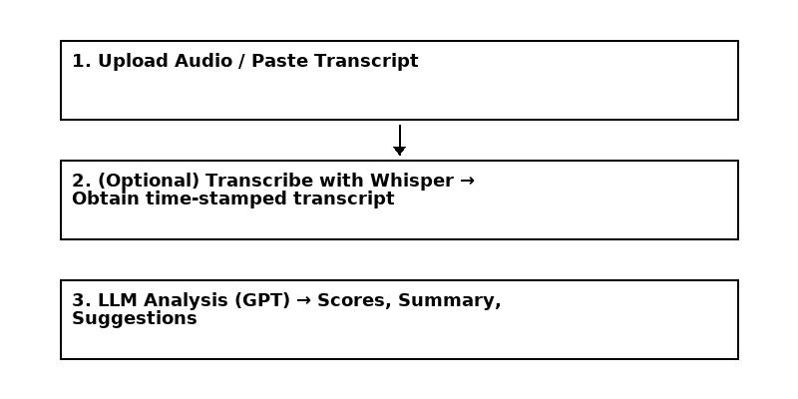
Architecture (3-step)

Slide 4
Features
Core Features:
  Upload audio or paste transcript
  Automatic transcription (Whisper)
  LLM-based analysis (scores & suggestions)
  Downloadable report

Slide 5
Demo (how it works)
1) Upload audio or paste transcript
2) Click Analyze
3) View scores, summary, and suggestions

Slide 6
Prompt Used
Prompt (shortened):
  You are an AI Interview Analyzer. Analyze the transcript and provide summary, tone, confidence (0-100), clarity scores, strengths, and suggestions.

Slide 7
Submission Checklist
  Streamlit app (app.py)
  Demo video (screen recording)
  Documentation PDF
  PPT slides
  Sample audio / transcript

