Slide 1
Marketing Analytics Project 1
E-COMMERCE CUSTOMER CHURN ANALYSIS

Slide 2
Content
Business Objective
Data Overview
Data Cleaning
Exploratory Analysis
Insights
Visualization
Correlation matrix
Data Preprocessing
Machine Learning Model
Model Evaluation
Conclusion
Recommendation

Slide 3

Business Objective
To Analyze the Customer Churn rate of the e-commerce platform, understand the factors that impact the churn rate, and take preventive measures to reduce churn.

Slide 4
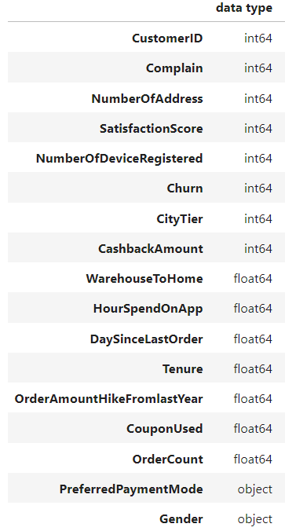
Data Overview
The data set belongs to a leading online E-Commerce company that wants to know the customers who are going to churn.
This data set has 5630 rows and 20 columns
Each row represents a customer, and each column contains the customer attributes.
It contains data about customer details like ID, satisfaction score, complaints, and order details
The data set shows customers’ preferred login devices and preferred order category

Slide 5
Variable Summary
Variable | DESCRIPTION
CustomerID | Unique customer ID
Churn | Churn Flag (Yes = 1; No = 0)
Tenure | Tenure of customer in organization (i.e. length of time using the service)
PreferredLoginDevice | Preferred login device of customer
CityTier | City tier
WarehouseToHome | Distance in between warehouse to home of customer
PreferredPaymentMode | Preferred payment method of customer
Gender | Gender of customer
HourSpendOnApp | Number of hours spent on mobile application or website
NumberOfDeviceRegistered | Total number of deceives registered to particular customer
PreferedOrderCat | Preferred order category of customer in last month
SatisfactionScore | Level of customer satisfaction with service
MaritalStatus | Marital status of customer
NumberOfAddress | Total number of addresses added on particular customer
Complain | Any complaint has been raised in last month
OrderAmountHikeFromlastYear | Percentage increases in order from last year
CouponUsed | Total number of coupons used in last month
OrderCount | Total number of orders placed in last month
DaySinceLastOrder | Days Since last order by customer
CashbackAmount | Average cashback in last month

Slide 6
Content
Business Objective
Data Overview
Data Cleaning
Exploratory Analysis
Insights
Visualization
Correlation matrix
Data Preprocessing
Machine Learning Model
Model Evaluation
Conclusion
Recommendation

Slide 7
Variable Summary
Variable | DESCRIPTION
CustomerID | Unique customer ID
Churn | Churn Flag (Yes = 1; No = 0)
Tenure | Tenure of customer in organization (i.e. length of time using the service)
PreferredLoginDevice | Preferred login device of customer
CityTier | City tier
WarehouseToHome | Distance in between warehouse to home of customer
PreferredPaymentMode | Preferred payment method of customer
Gender | Gender of customer
HourSpendOnApp | Number of hours spent on mobile application or website
NumberOfDeviceRegistered | Total number of deceives registered to particular customer
PreferedOrderCat | Preferred order category of customer in last month
SatisfactionScore | Level of customer satisfaction with service
MaritalStatus | Marital status of customer
NumberOfAddress | Total number of addresses added on particular customer
Complain | Any complaint has been raised in last month
OrderAmountHikeFromlastYear | Percentage increases in order from last year
CouponUsed | Total number of coupons used in last month
OrderCount | Total number of orders placed in last month
DaySinceLastOrder | Days Since last order by customer
CashbackAmount | Average cashback in last month

Slide 8
Data Cleaning
MissingValues
Replace with 0 :
Columns: CouponUsed', 'DaySinceLastOrder', 'OrderAmountHikeFromlastYear’
Reason: High likelihood that customers need not have used a coupon, ordered something new, or have increased their order counts from the previous year​
Replace with median:
Columns: WarehouseToHome
Reason: most customers are within the same radius from the warehouse
Replace with mean:
Columns: 'Tenure', 'HourSpendOnApp', 'OrderCount’
Reason: it makes logical sense that these variables are generally observed as an average.
Duplicate Records
Merged duplicate columns
Columns: PreferredLoginDevice(Mobile phone, Phone), PreferredPaymentMode(COD and Cash on Delivery, CC and Credit Card)

Slide 9
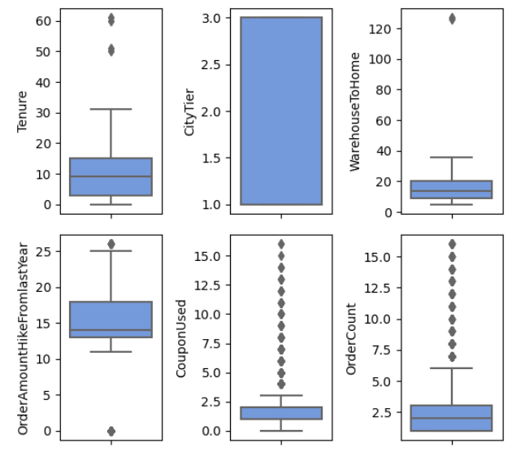
Data Cleaning
Handled Outliers
We identified outliers in our dataset using boxplot
Computed the Z-scores and marked data points with a Z-score greater than 3 as outliers.
0.23% Approx of the data(13 records) has been removed based on the Z-score threshold.

Slide 10
Exploratory Analysis
Analyze the distribution of the variables
Investigate the relationship between variables to identify any correlations or patterns.
Visualize the data to gain insights into the behavior and characteristics of the customers.

Slide 11
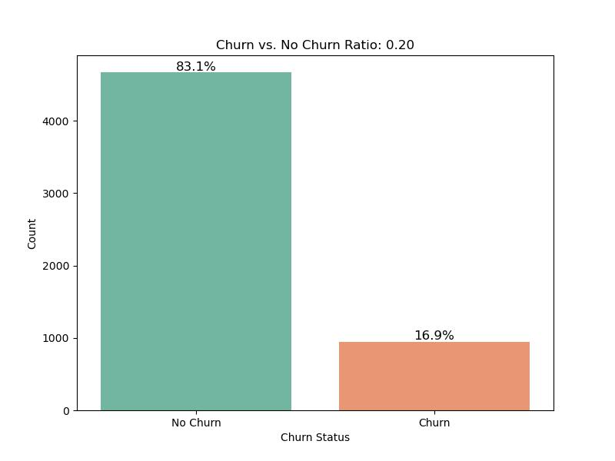
What are the percentages of churn and retained customers?
Churn Rate captures the number of people a business can retain at the end of a time.
Churned : Non-Churned = 1 : 5 = 0.20
The dataset exhibits a significant disparity in the distribution of retained and churned customers, with a ratio of approximately 5 to 1 in favor of retained customers. This suggests a notably low churn rate, where the majority of customers tend to remain with the service.

Slide 12
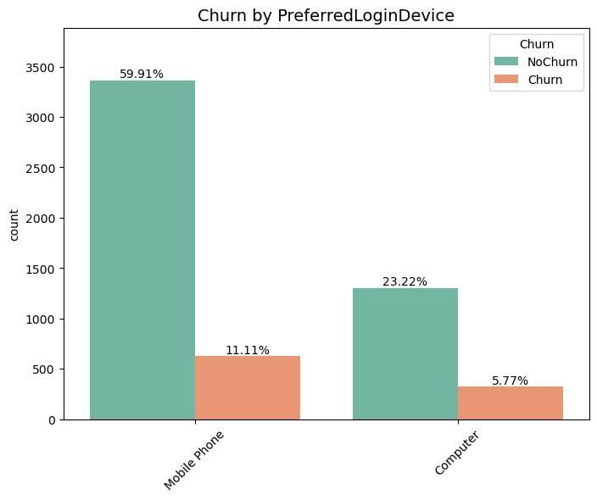
Which Preferred Login Devices Are Associated with Higher Churn Rates?
Approximately 70% of users prefer Mobile Phones as their login devices, whereas the percentage for computer users hovers around 28% to 30% indicative of a stronger preference for Mobile Phones among e-commerce users.

Slide 13
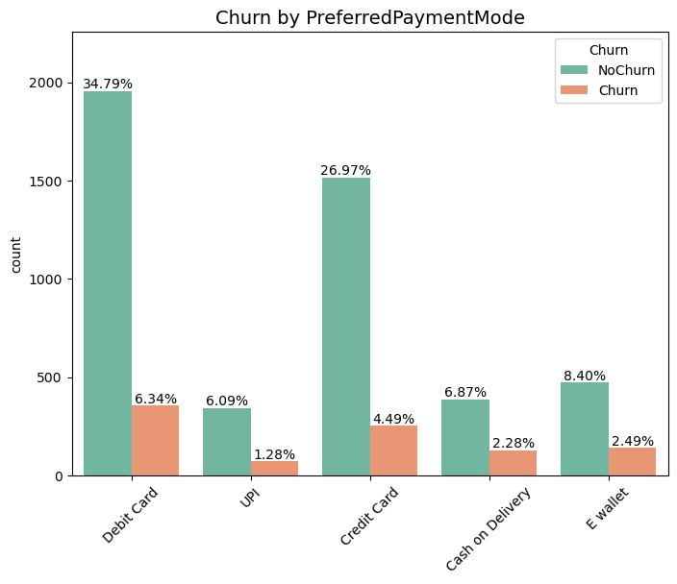
How Does Customer Churn Vary Across Different Payment Modes?
Among the payment options, Debit Card emerges as the most popular choice, accounting for approximately 40% of transactions and has the most churn rate.
Credit Card follows closely behind, with around 30% usage.
E-Wallets represent a smaller yet significant portion, making up about 10% of the payment preferences.
Conversely, Cash on Delivery (COD) and UPI are the least preferred payment methods

Slide 14
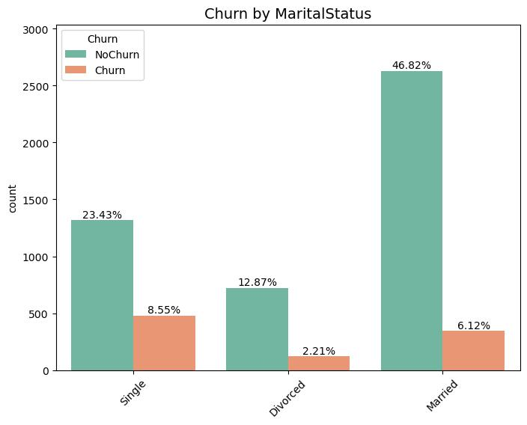
Which Marital Status has the highest Churn rate?
A major proportion of the customers are married, and they tend to churn the least.

Slide 15
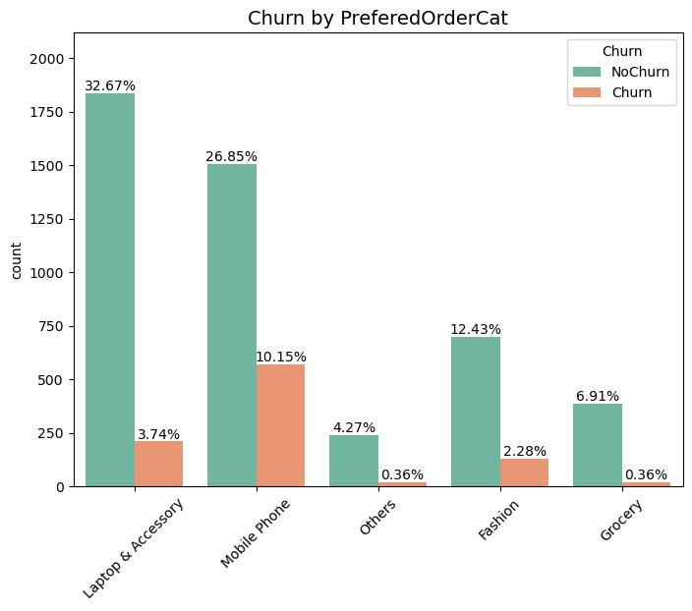
How Does Customer Churn Vary Across Different Order Categories?
The most popular order category is Laptop & Accessories with the lowest churn rate followed by mobile phones with highest churn rate

Slide 16
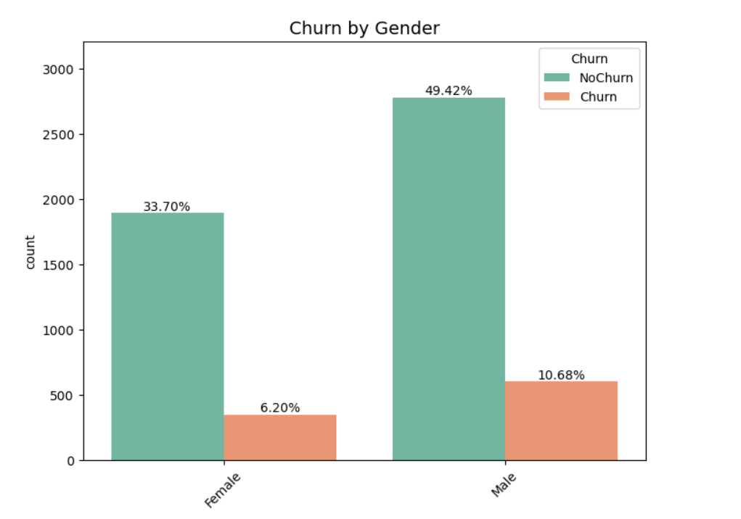
What are the number of male and female customers in the non-churn and churner customer profiles?
The company has a male-dominated customer base however gender has minimal relative influence on the churn rate.

Slide 17
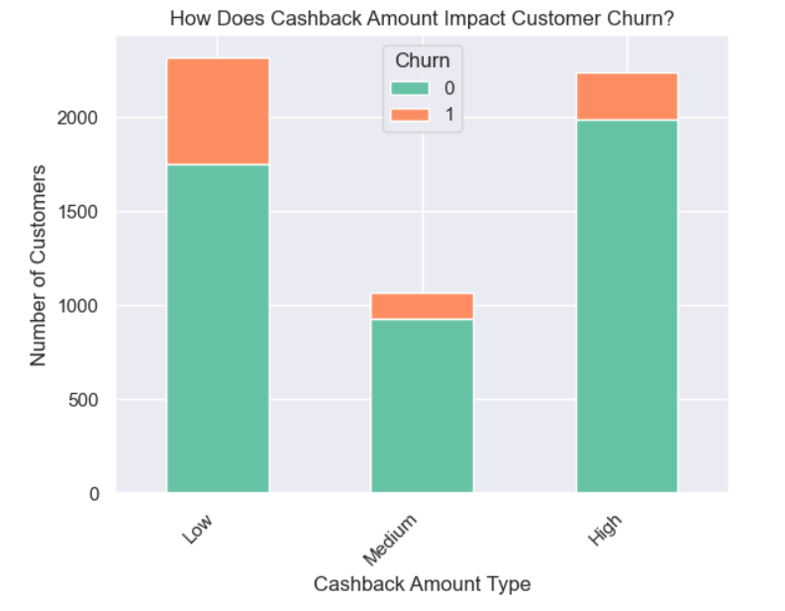
How the distribution of cashback amounts differ between customers who churn and those who do not?
Customers who received a medium to high Cashback amount tend to churn lesser.
The one who received Cashback of lesser amount than 154 (Low) has noted to have higher churn rate.

Slide 18
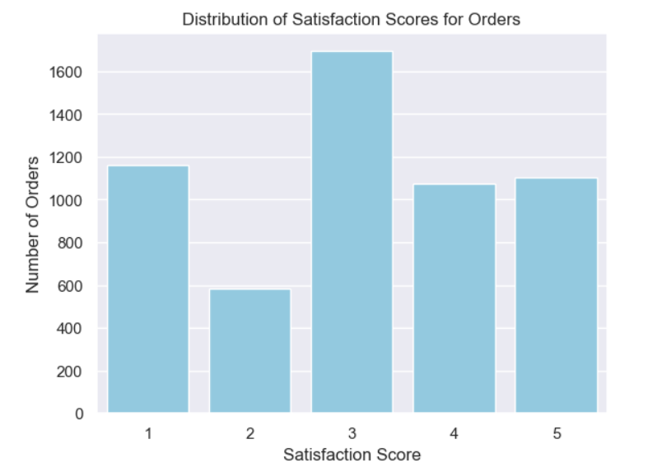
What is the distribution of satisfaction score for order?
Most of the orders placed on the e-commerce site have an average satisfaction score of 3.

Slide 19
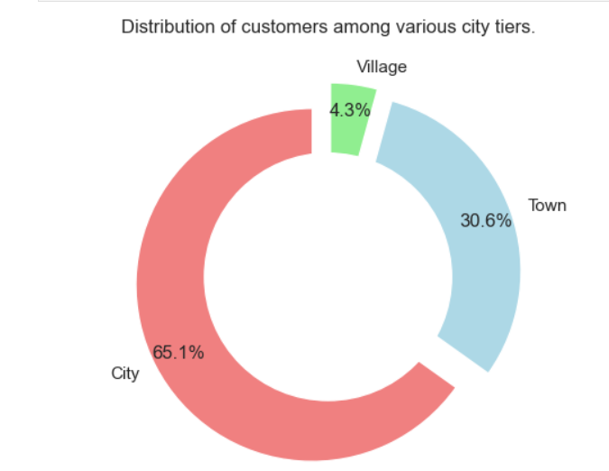
What is the Distribution of customers among various city tiers?
City Tier has been classified into 3 categories:
1.'City'
2. 'Village' and
3. 'Town'
The majority of customers reside in urban areas ('City'), whereas 'Town' and 'Village' have relatively smaller customer distributions, with 'Village' having the lowest share.

Slide 20
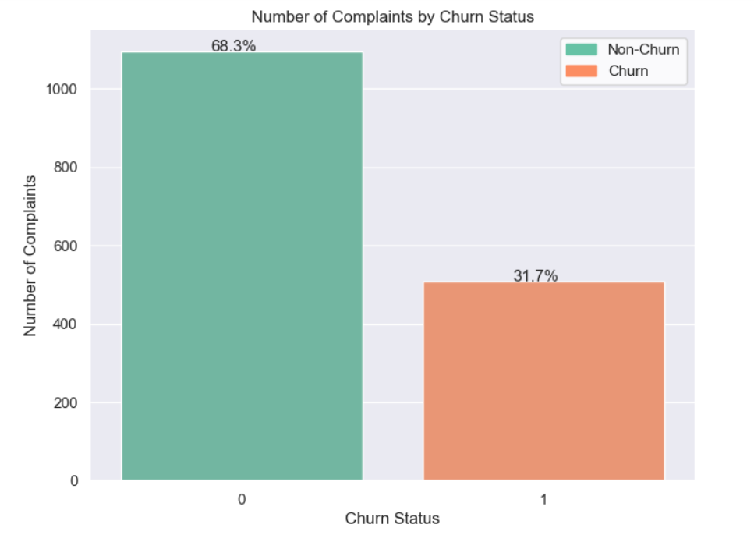
Do customers who submit complaints have a higher churn rate compared to those who do not submit complaints?
The churn rate is proportional to number of complaints.

Slide 21
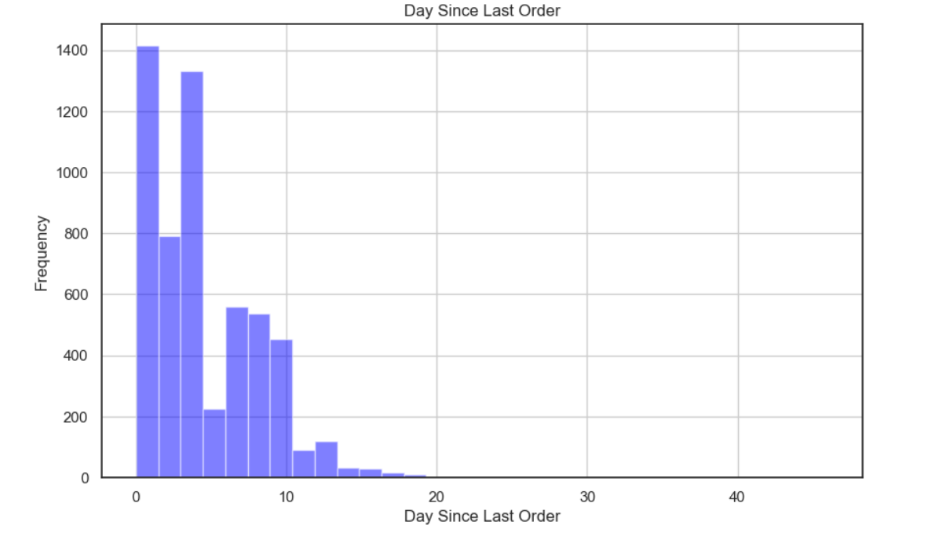
What is the Day Since the Last Order frequency of Customer?
Most of the customers place an order within three days

Slide 22
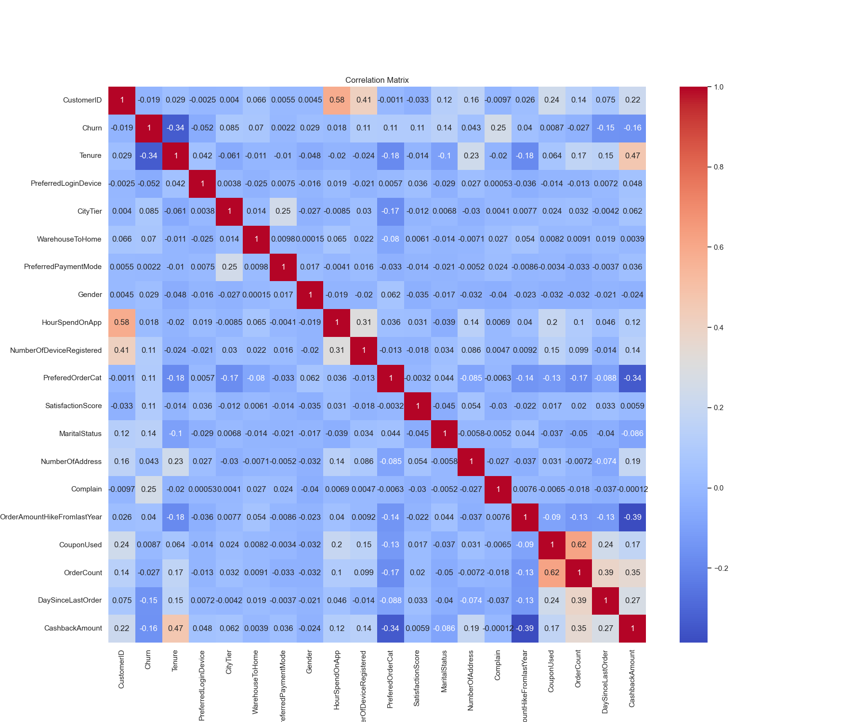
Correlation matrix
Tenure, Complaints, Cash back amount, and Number of addresses have a relatively higher correlation with customer churn.

Slide 23

Data Pre-Processing
We have encoded all the categorical data in our data set into Numerical using Label Encoder these are the columns that we are encoded
Gender
PreferedOrderCat
PreferredLoginDevice
MaritalStatus

Slide 24

Machine Learning Models
We have used two Models
Logistic Regression
Decision Tree Classification

Slide 25
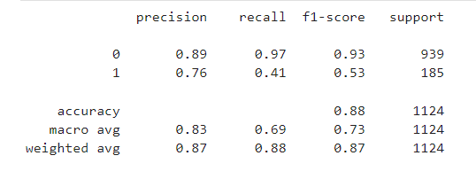
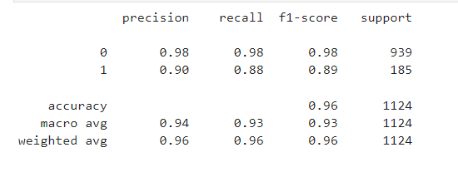
Model Evaluation
Logistic Regression:
Accuracy: 88.08%
Decision Tree Classification:
Accuracy: 96.26%

Slide 26
Conclusions
17% of the users are reported to have churned
Customers who submit complaints have a higher churn rate.
Higher cashback amounts generally reduce churn.
Married customers when compared to users who are single tend to churn less.
Highest churn is observed in customers who bought mobile phones.
Decision Tree Classification model(96.26%) when compared with Logistic Regression(88.08%) provides a better accuracy in predicting the customers who might churn.

Slide 27
Recommendations
The highest churn is observed in customers who bought mobile phones. Improving customer services, and offering better warranty plans and discounts may help minimize the churn rate.
Focusing on customer groups who are 'Single' and customizing the product range and services should improve customer retention.
Increasing the cash back amount can improve customer retention.
Modifying the satisfaction survey to better capture the customer experience and looking at the data- capturing methods would help to identify the user cohorts who need more promotions.

Slide 28

Thank you

