Slide 1
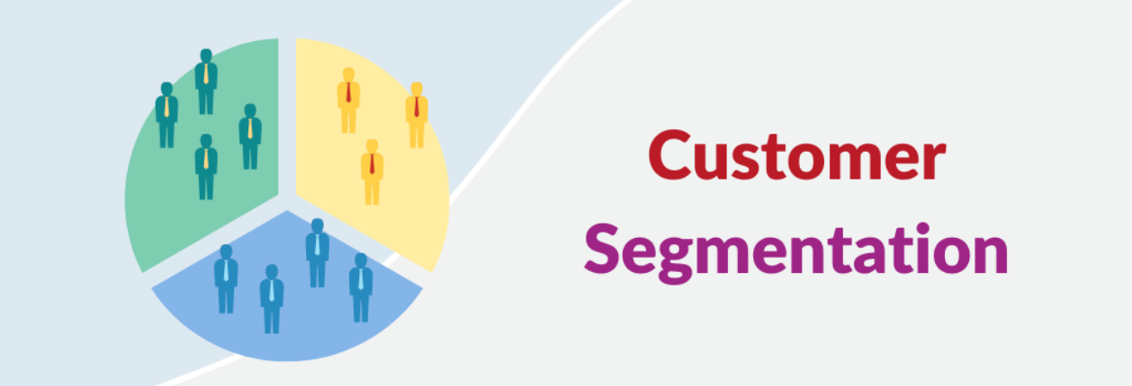
Customer Segmentation using K-Means Clustering
Presented By:
Ramandeep Kaur
Ranishree Anegundi

Slide 2
Agenda
Goal
What is K-Means Clustering
Concept of Clustering
Understanding K-Means Algorithm
K-Means Algorithm Steps
Determining Optimal number of clusters using Elbow Method
RFM Analysis technique
Project Code
Conclusion

Slide 3
Goal
By applying RFM analysis and K-means clustering to our dataset, we’d like to gain insights into customer behavior and preferences and come up with marketing strategy for each group.
Customer Segmentation using RFM Analysis and K-Means Clustering

Slide 4
What is K-Means Clustering?
The k-means clustering algorithm is an unsupervised machine learning technique used for grouping data points into specified number of clusters(k) based on features similarity. It is an iterative algorithm that aims to minimize the sum of squared distances between data points and their assigned cluster centers (centroid) until convergence.
K in K-means stands for number of clusters.
Unsupervised Machine Learning
In Unsupervised Machine Learning, we do not need to supervise the model. Such a method deals with unlabelled data. Unsupervised machine learning helps us find hidden and unknown patterns in data.

Slide 5
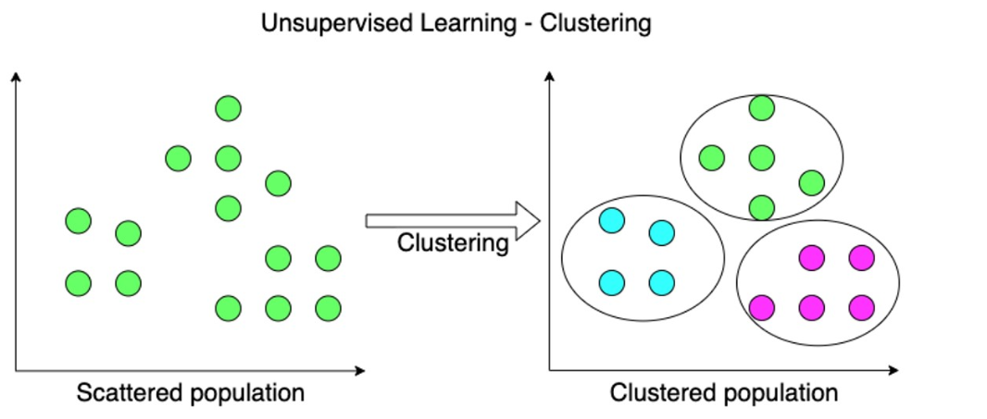
Concept of Clustering
Clustering is a technique used in data analysis to identify groups of similar data points within a dataset. The goal is to partition the data in a way that points within the same cluster are more similar to each other than to those in different clusters. These clusters can then be analyzed and used to gain insights into the data.

Slide 6
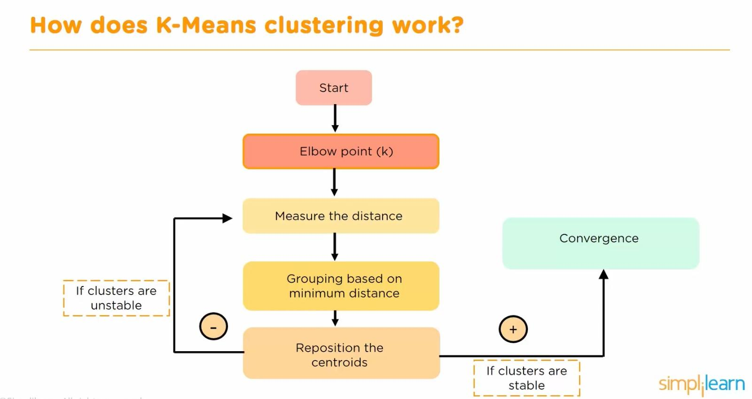
Understanding the K-Means Algorithm
To apply the k-means algorithm, we first need to define the number of clusters (k) we want to create. Each cluster will have a centroid, which represents the center point of the cluster. The algorithm iteratively assigns each data point to the cluster with the closest centroid, based on a chosen distance metric.

Slide 7
K-Means Algorithm Steps
1. Initialization: Randomly select k centroids from the dataset.
2. Assignment: Assign each data point to the cluster with the nearest centroid based on Euclidean distance metric. After this ‘Within-Clusters sum of square’ WCSS is calculated.
3. Update: Update the centroids by calculating the mean of all data points assigned to each cluster.
4. Repeat step 2 and 3 until convergence or maximum number of iterations reached: The algorithm iteratively assigns data points to clusters and updates the centroids until there is little or no change in the assignment of data points.

Slide 8
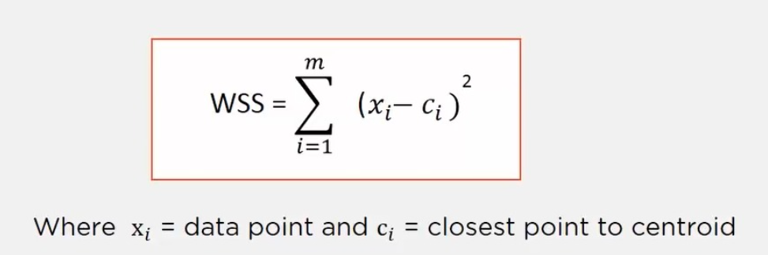
Determining the Optimal Number of Clusters
ELBOW METHOD
We will be calculating the within-cluster sum of squares (WCSS) for different numbers of clusters. WCSS measures the compactness or tightness of the clusters by calculating the sum of the squared distances between each data point and its corresponding cluster centroid. The goal is to minimize the WCSS, as smaller values indicate more compact and well-separated clusters.
After this we plot the WCSS values for every K and look for elbow point in graph. This is the point where rate of decrease in WCSS slows down. That is the optimal value of k

Slide 9
RFM Analysis
RFM Analysis is a method to quantify customer behavior. It evaluates customers based on three key dimensions:
Recency (R): How recently did a particular customer make a purchase?
Frequency (F): How often do they make purchases?
Monetary Value (M): How much money do they spend?
We’ll use the information in the dataset to compute the recency, frequency, and monetary values. Then, we’ll map these values to RFM score scale of 1 - 5. Then we will use K-Means clustering to identify customer segments with similar RFM characteristics

Slide 10
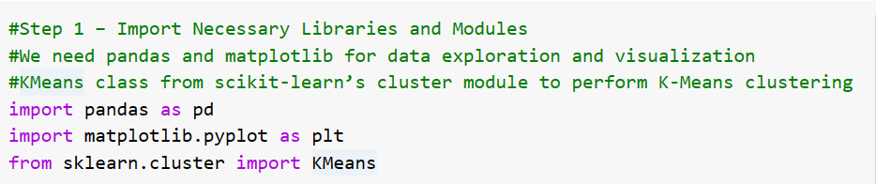
Step 1 - Importing necessary libraries

Slide 11
Step 2 - Understand the Segmentation Data
For this project, we are using Online Retail Dataset.The dataframe consists of 8 variables:
InvoiceNo: The unique identifier of each customer invoice.
StockCode: The unique identifier of each item in stock.
Description: The item purchased by the customer.
Quantity: The number of each item purchased by a customer in a single invoice.
InvoiceDate: The purchase date.
UnitPrice: Price of one unit of each item.
CustomerID: Unique identifier assigned to each user.
Country: The country from where the purchase was made.

Slide 12

Load the Dataset
Loading the dataset into pandas dataframe

Slide 13
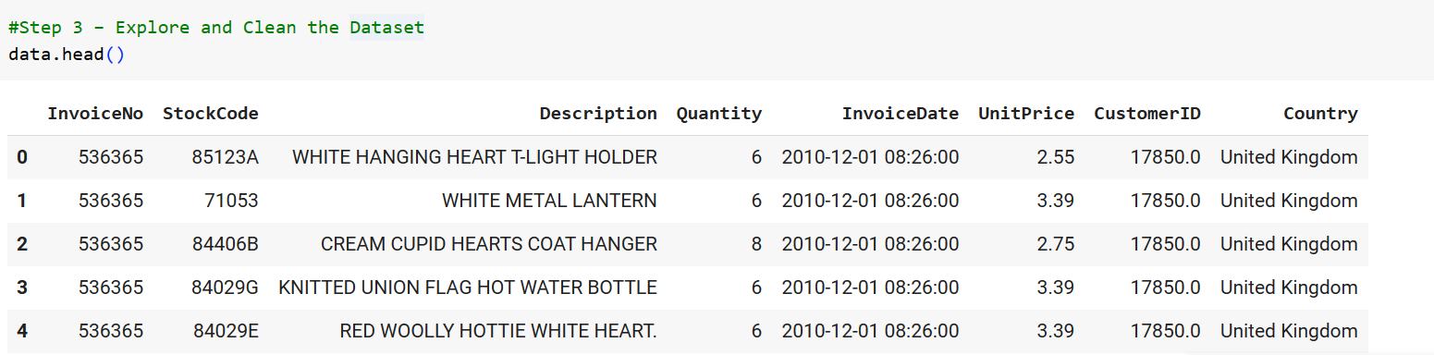
Step 3 - Explore and Clean the Dataset

Slide 14
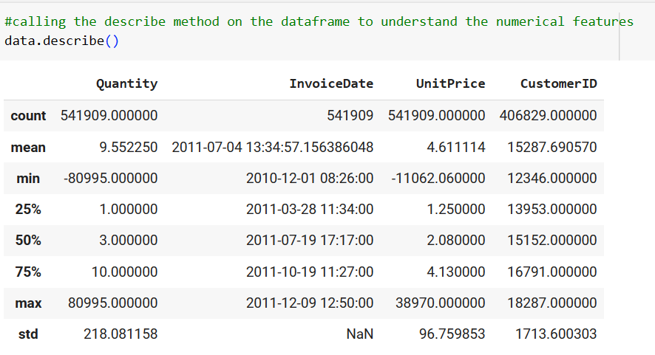
Understanding the Numerical Features
Observations: Quantity and Unit Price have negative values which we need to remove

Slide 15
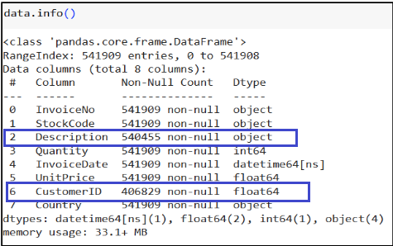
Information about Data
Observations : CustomerID column is float type object which we will convert into integer. Also CustomerID and Description column have null values which we will remove in next steps.

Slide 16
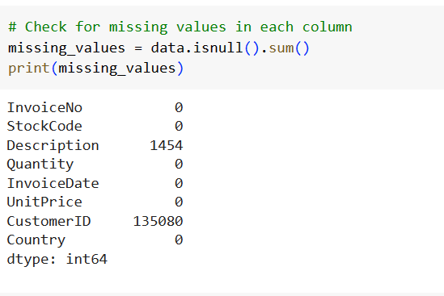
Validating Missing Values

Slide 17
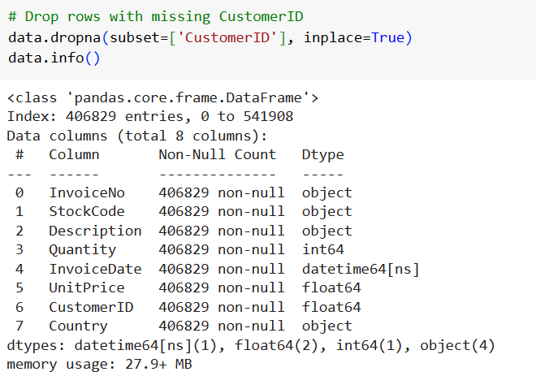
Dropping Null Values

Slide 18
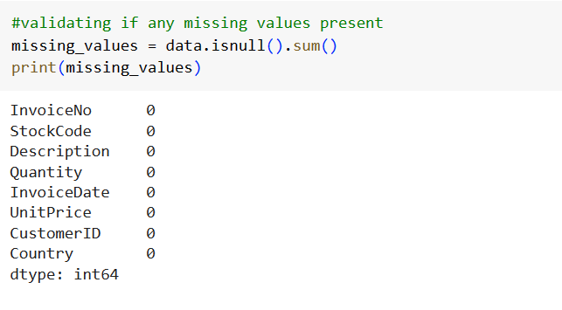
Validating Null Values are Removed

Slide 19
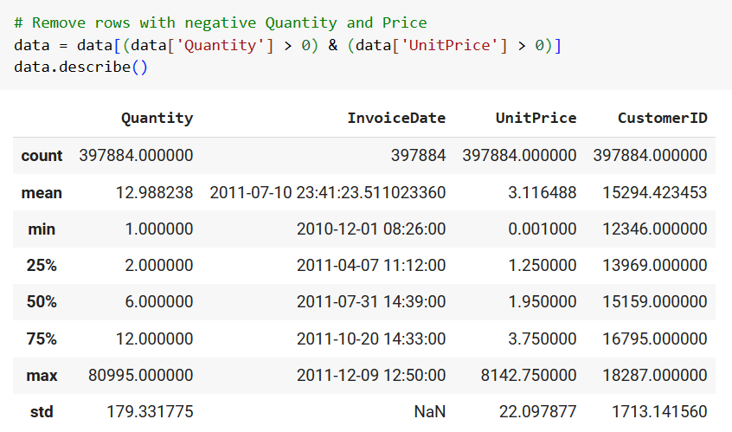
Remove Negative Values
Removing rows where ‘Quanity’ and ‘UnitPrice’ is less than 0

Slide 20
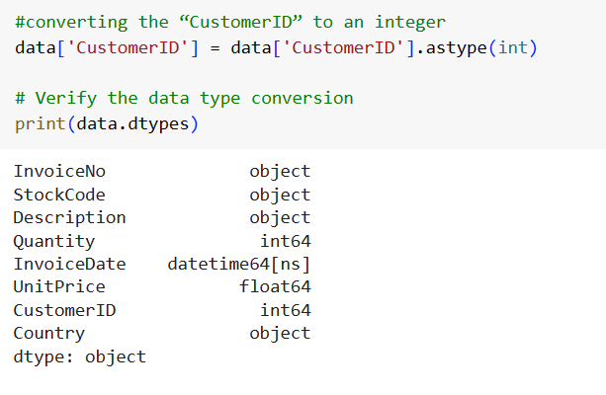
Converting CustomerID to an Integer

Slide 21
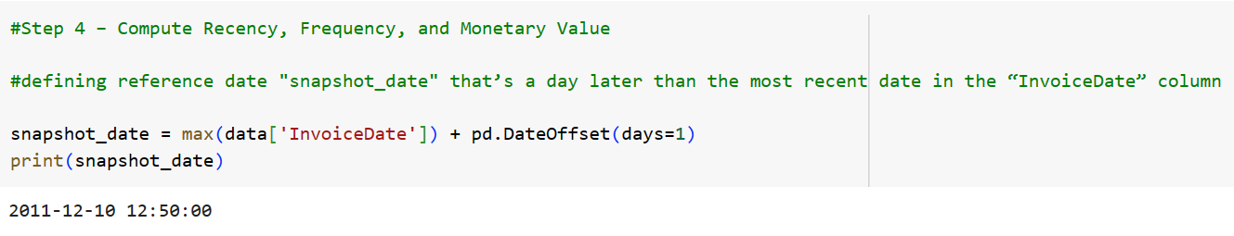
Step 4 – Compute Recency, Frequency, and Monetary Value
Defining a reference date ‘snapshot_date’ that’s a day later than the most recent date in the “InvoiceDate” column. This date will be used to compute recency for each customer.

Slide 22
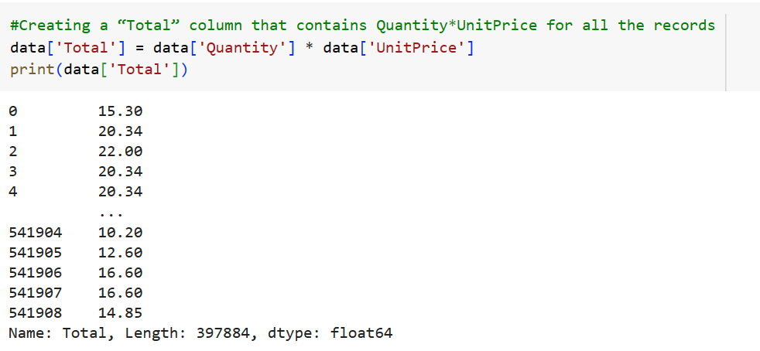
Creating a “Total” column in dataframe that contains Quantity*UnitPrice for all the records.

Slide 23
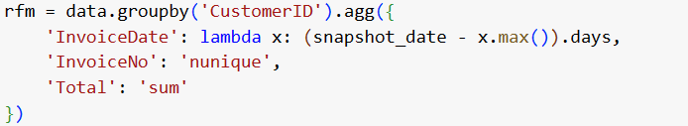
Calculating Recency, Frequency and MonetaryValue
We calculate the following—grouped by CustomerID:
Recency: The difference between the most recent purchase date and a reference date (snapshot_date). This gives the number of days since the customer's last purchase.
Frequency : The total number of unique invoices or transactions made by each customer.
Monetary value : Quantifies how much money a customer spends.
Notes:
data.groupby('CustomerID'): This groups the DataFrame data by the "CustomerID" column
.agg({}): This applies aggregation functions to the grouped data.
After executing this code, the DataFrame rfm will contain the RFM metrics (Recency, Frequency, Monetary) for each customer, with each row representing a unique customer
'InvoiceDate': This specifies the column on which the aggregation operation is being performed. In this case, it's the "InvoiceDate" column from the original DataFrame.
lambda x: defines a lambda function where x represents each group of values in the "InvoiceDate" column for each customer.
x.max() calculates the maximum date within each group.
(snapshot_date - x.max()).days calculates the recency of each customer's last transaction in terms of days.

Slide 24
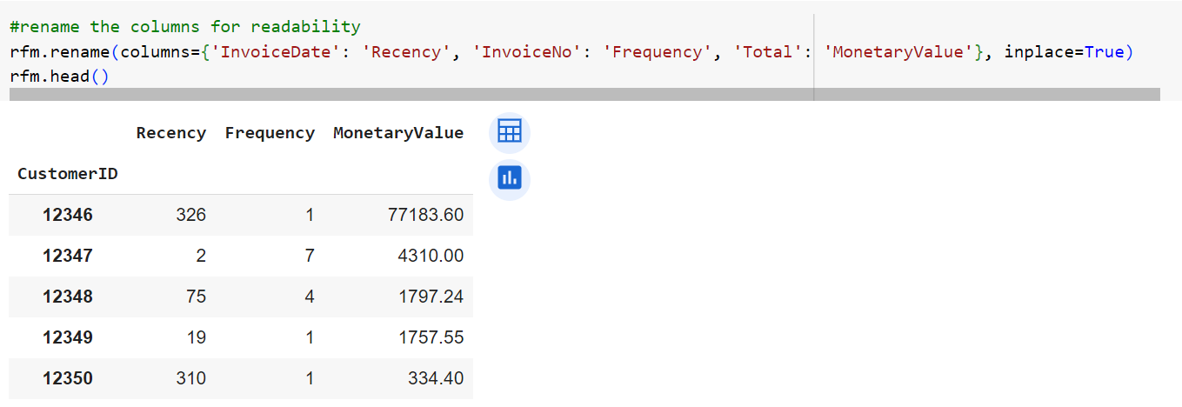
Renaming IvoiceDate to Recency, InvoiceNo to Frequency and Total to MonteryValue

Slide 25
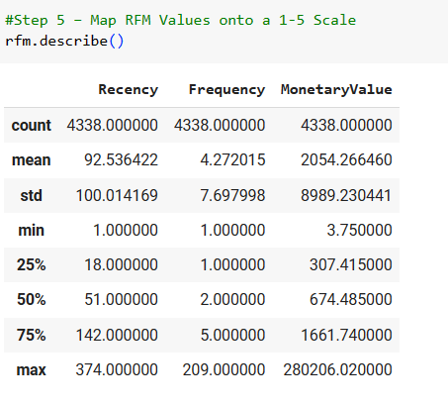
Step 5 - Map RFM Values onto a (1-5) Scale
Mapping the “Recency”, “Frequency”, and “MonetaryValue” columns to take on values in a scale of 1-5; one of {1,2,3,4,5}.
Assign the values to five different bins, and map each bin to a value. To help us fix the bin edges, let’s use the quantile values of the “Recency”, “Frequency”, and “MonetaryValue” columns:

Slide 26
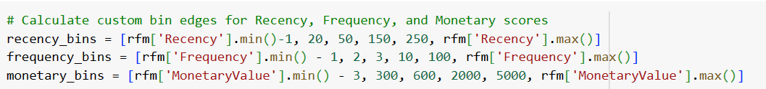
Calculating Custom bin edges
rfm['Recency'].min()-1: The minimum value of the 'Recency' column is obtained using rfm['Recency'].min(). Subtracting 1 ensures that the minimum value is included in the first bin.
20, 50, 150, 250: These are the boundary values chosen for creating bins. They represent quantiles or cutoff points for dividing the 'Recency' values into 5 bins.
rfm['Recency'].max(): The maximum value of the 'Recency' column is obtained using rfm['Recency'].max(). This value is used as the upper boundary for the last bin.
Same approach is followed to create frequency_bins and monetary_bins

Slide 27
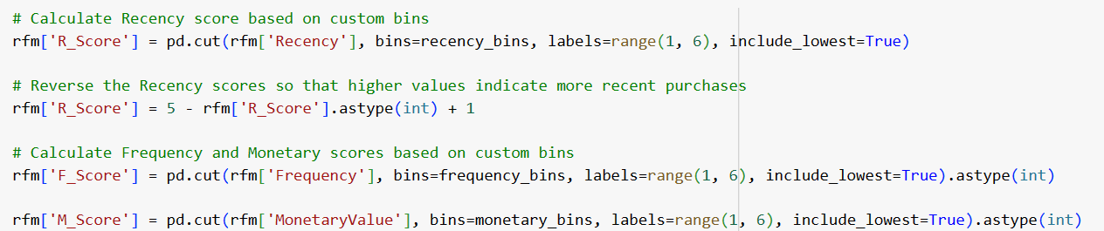
Mapping the scores to corresponding labels between 1 and 5
Notice that the R_Score, based on the bins, is 1 for recent purchases 5 for all purchases made over 250 days ago. But we’d like the most recent purchases to have an R_Score of 5 and purchases made over 250 days ago to have an R_Score of 1
To achieve the desired mapping, we do: 5 - rfm['R_Score'].astype(int) + 1.

Slide 28
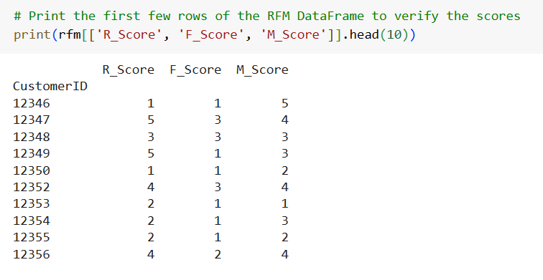
Printing RFM Dataframe to verify scores

Slide 29
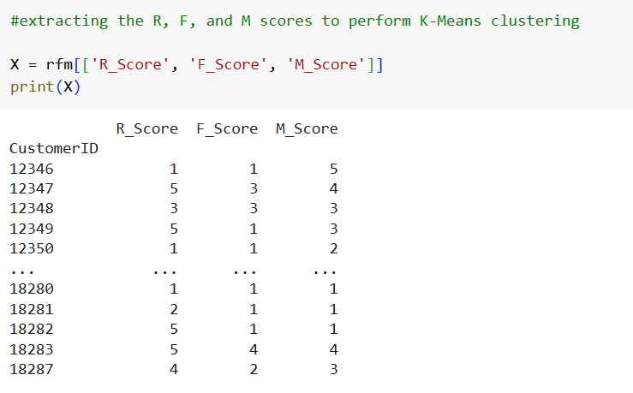
Step 6 - Perform K-Means Clustering

Slide 30
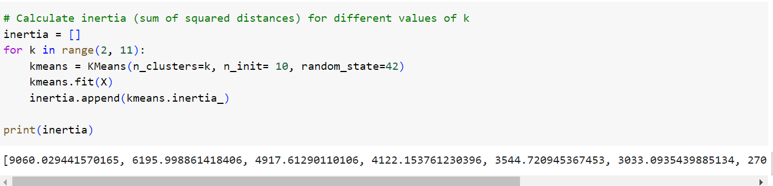
Finding the optimal number of clusters.
For this let’s run the K-Means algorithm for a range of K values and use the elbow method to pick the optimal K.
Notes:
The loop iterates over values of k from 2 to 10.
For each value of k, a new KMeans object is created with the specified number of clusters (n_clusters=k), the number of initializations (n_init=10), and a random seed (random_state=42).
The KMeans object is then fitted to the data X using the fit() method.
The fit() method computes the clustering and updates the model attributes, including inertia_
After fitting the model, the inertia_ attribute of the KMeans object contains the inertia (sum of squared distances of samples to their closest cluster center).After the clustering process is completed, the minimum WCSS value for that run is stored in the inertia_ attribute of the kmeans object
by using inertia.append(kmeans.inertia_), you are appending these minimum WCSS values to the inertia list.
By end of loop we will have 9 interia values for 9 k values which we will plot on graph
The loop continues until all values of k have been processed.

Slide 31
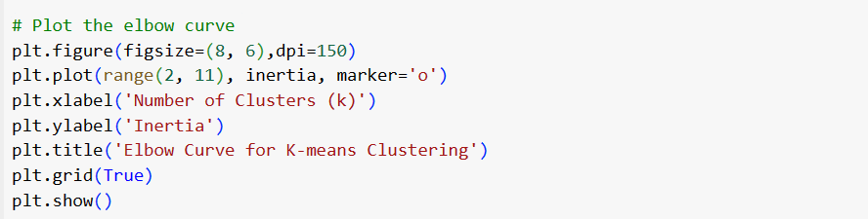
Plotting Elbow curve

Slide 32
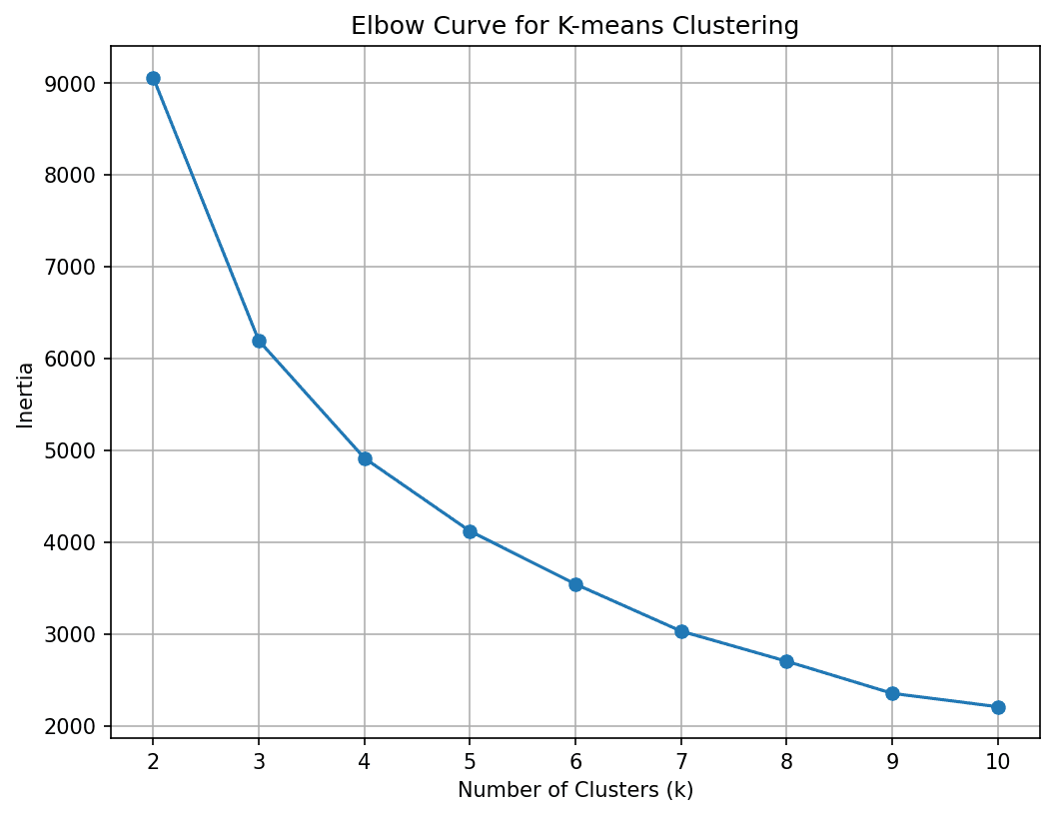
Curve elbows out at 4 clusters. We will divide the customer base into four segments.

Slide 33
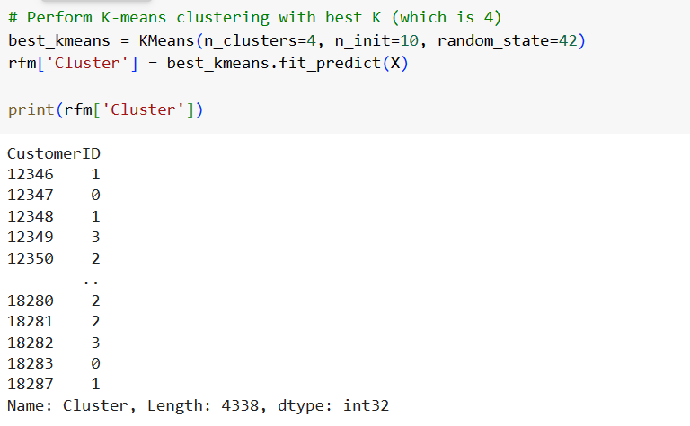
Running the K-Means algorithm
Notes:
Creating KMeans object again this time with value of k as 4
KMeans(n_clusters=4, n_init=10, random_state=42): This initializes the KMeans clustering algorithm with the specified parameters. Here, n_clusters=4 indicates that we want to cluster the data into 4 clusters. n_init=10 specifies the number of times the K-means algorithm will be run with different centroid seeds. random_state=42 sets the random seed for reproducibility.
best_kmeans.fit_predict(X): This method fits the KMeans model to the data X and returns the cluster labels assigned to each data point. These cluster labels are stored in the Cluster column of the rfm DataFrame.

Slide 34
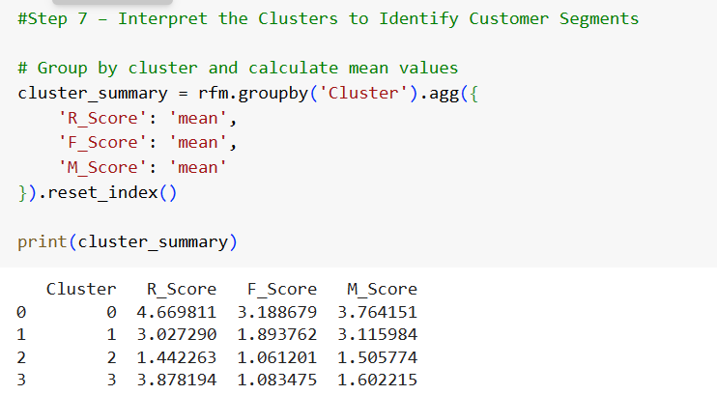
Step 7 - Interpret the Clusters to Identify Customer Segments

Slide 35
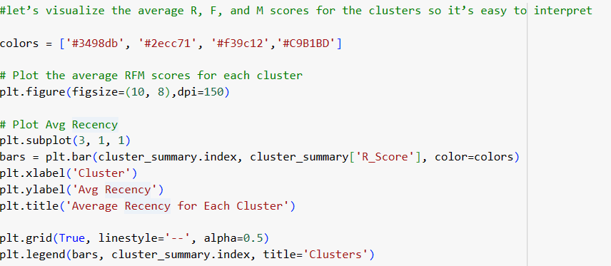
Plotting average RFM scores for clusters

Slide 36
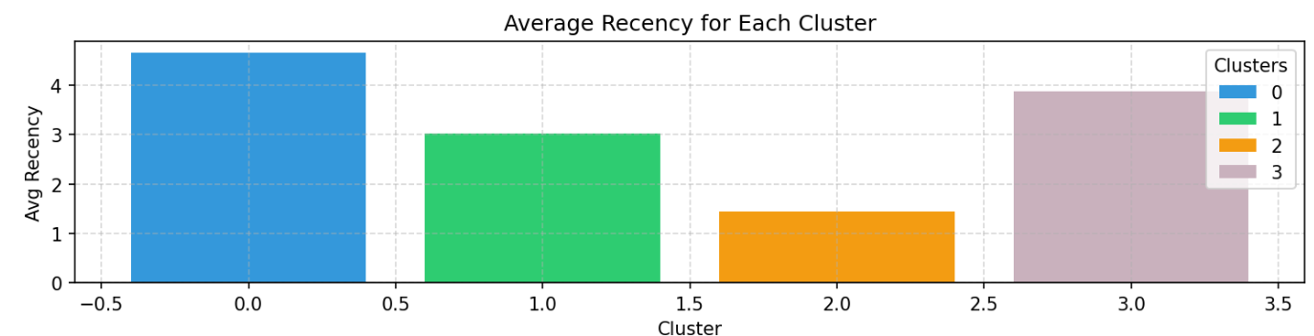

Slide 37
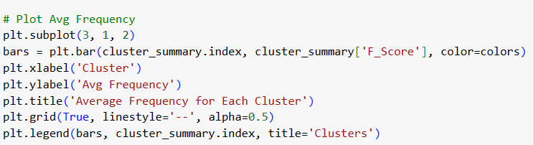
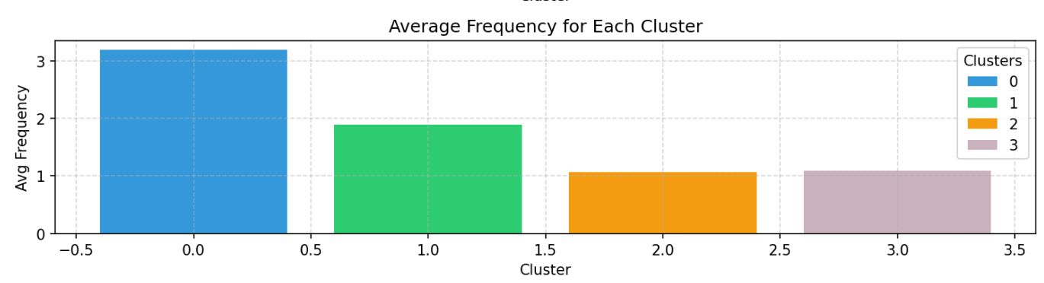

Slide 38
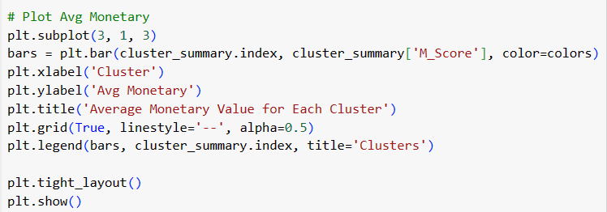
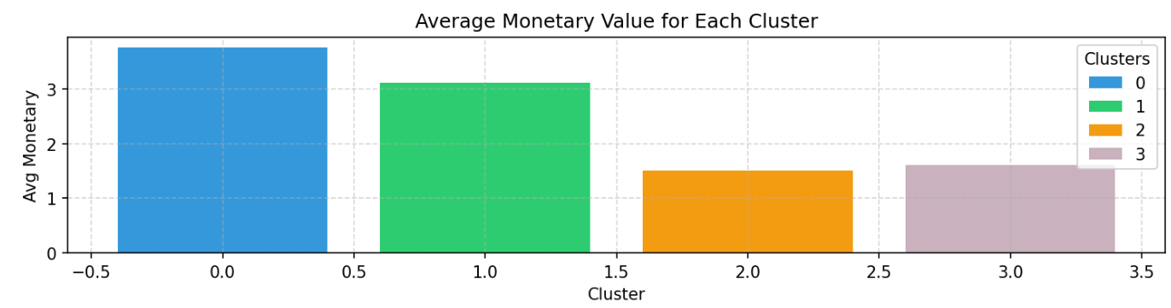

Slide 39
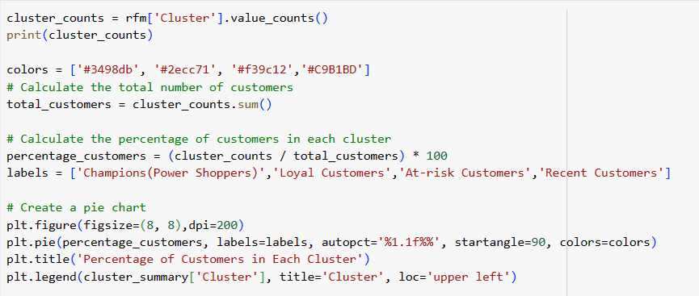
Percentage of Customers in Each Cluster
Notes:
Cluster Counts::
0 1272
3 1174
1 1026
2 866
Name: count, dtype: int64
Total Customers::
4338
Cluster Percentage::
0 29.322268
3 27.063163
1 23.651452
2 19.963117

Slide 40
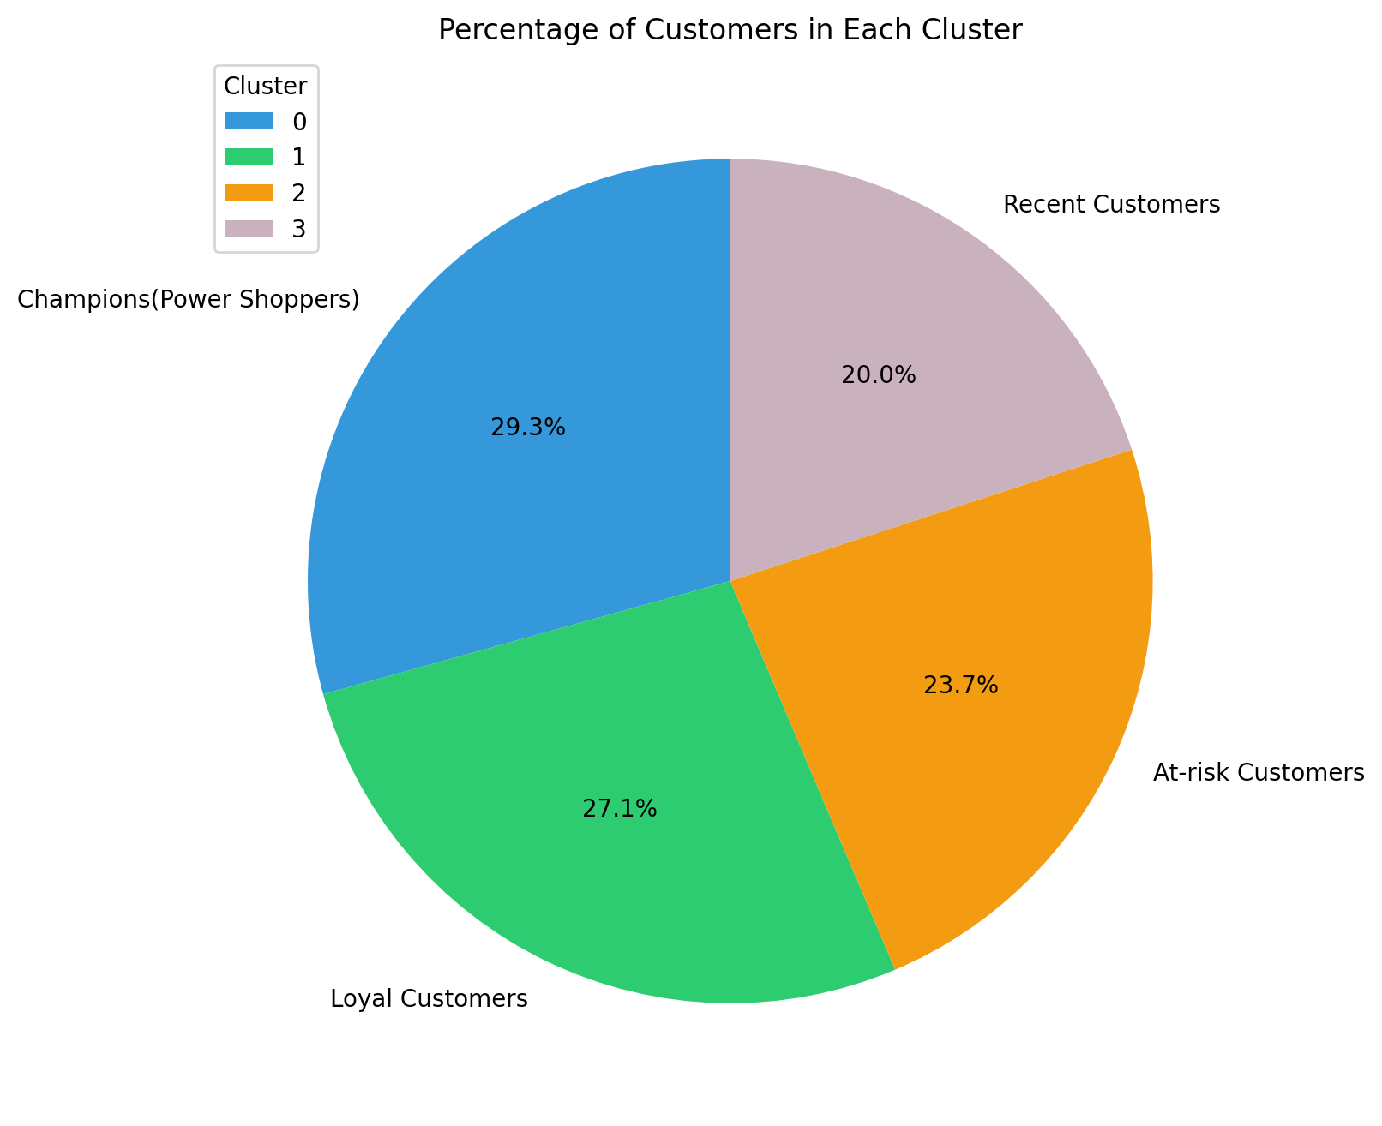

Slide 41
Conclusion
Cluster 0: Of all the four clusters, this cluster has the highest recency, frequency, and monetary values. Let’s call the customers in this cluster champions (or power shoppers).
Cluster 1: This cluster is characterized by moderate recency, frequency, and monetary values. These customers still spend more and purchase more frequently than clusters 2 and 3. Let’s call them loyal customers.
Cluster 2: Customers in this cluster tend to spend less. They don’t buy often, and haven’t made a purchase recently either. These are likely inactive or at-risk customers.
Cluster 3: This cluster is characterized by high recency and relatively lower frequency and moderate monetary values. So these are recent customers who can potentially become long-term customers.
Notes:
Cluster R_Score F_Score M_Score
0 0 4.669811 3.188679 3.764151
1 1 3.027290 1.893762 3.115984
2 2 1.442263 1.061201 1.505774
3 3 3.878194 1.083475 1.602215

Slide 42
Marketing Strategy
For Champions/Power Shoppers: Offer personalized special discounts, early access, and other premium perks to make them feel valued and appreciated.
For Loyal Customers: Appreciation campaigns, referral bonuses, and rewards for loyalty.
For At-Risk Customers: Re-engagement efforts that include running discounts or promotions to encourage buying.
For Recent Customers: Targeted campaigns educating them about the brand and discounts on subsequent purchases.

Slide 43
Questions ?

