Slide 1

PRESENTATION
REGARDING INTERNSHIP

Slide 2

INTERNSHIP DETAILS
Ranith Sarkar
Codsoft Web Development Internship (01/05/2025-31/05/2025)
Source code: github.com/RanithSarkar/Codsoft

Slide 3
Introduction
Overview of Codsoft
CodSoft is an IT services and consultancy company specializing in creating innovative solutions for businesses, with a strong focus on practical, hands-on learning through internship programs.
Role: Intern Developer
Duration of Internship: one month

Slide 4
Internship Objectives
Learn Web development
Build a deployable web app
Gain experience with real-world project flow

Slide 5
Project Overview
Task 1
a landing page
Task 2
a portfolio website
Task 3
a calculator app

Slide 6
Methodologies & Tech Stack
Languages: HTML, CSS (for styling), JavaScript (for functionality)
Tools: Git ( to push code in GitHub), GitHub (to manage code and host the website), Code Editor (VS Code for writing code)

Slide 7
TASK 1

Slide 8
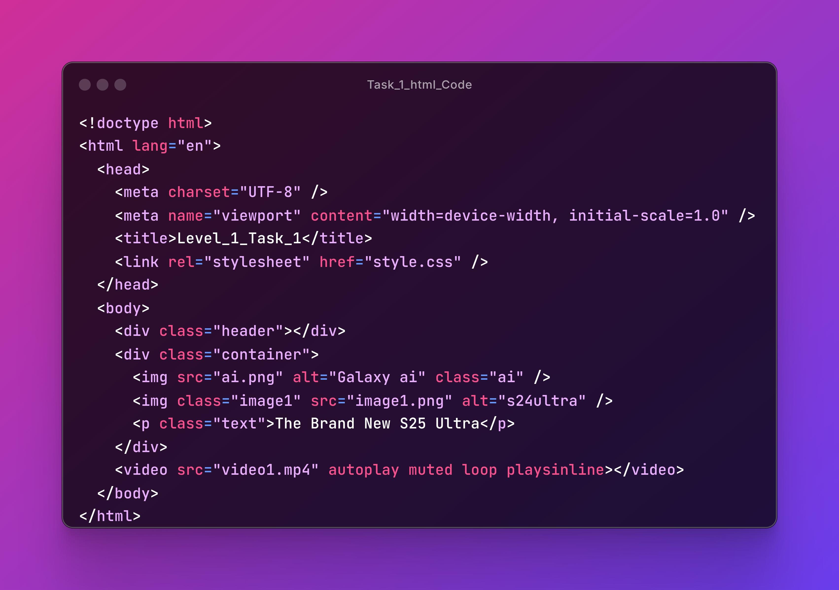

Slide 9
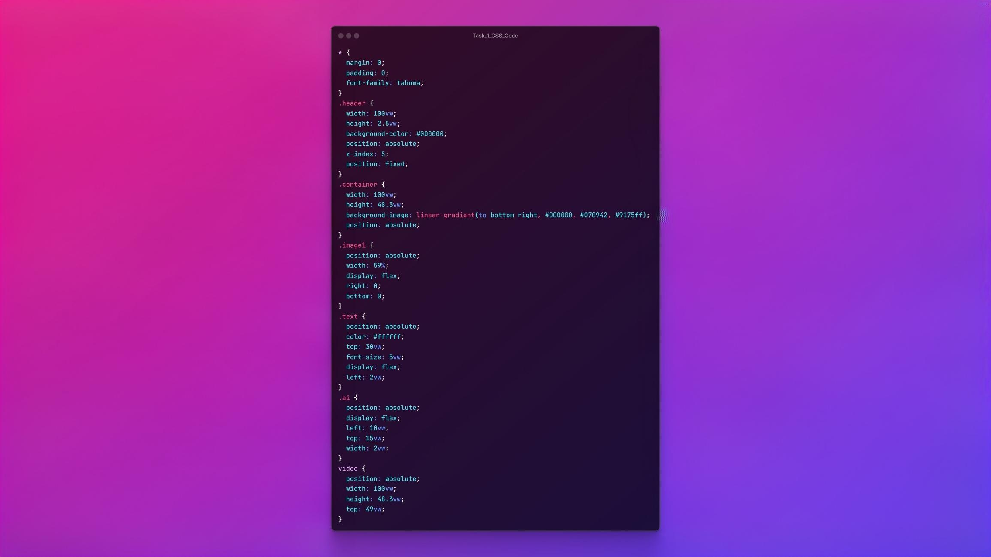

Slide 10


Slide 11
TASK 2

Slide 12
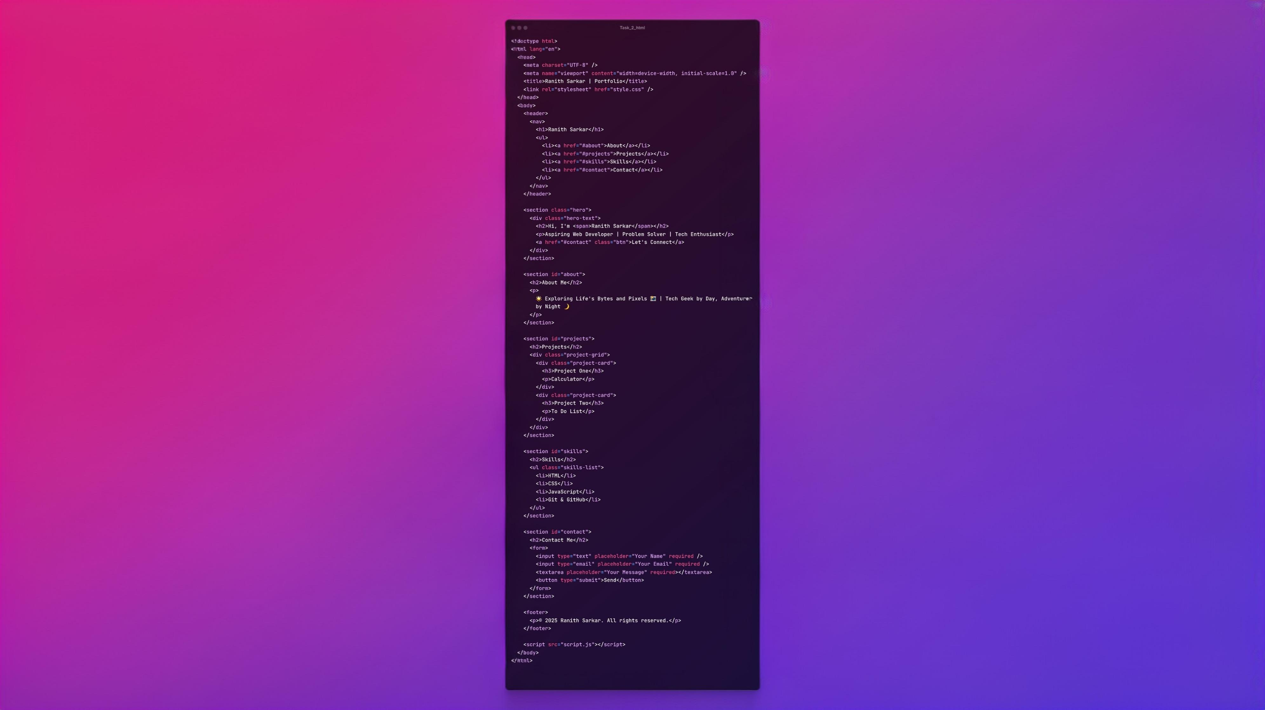

Slide 13

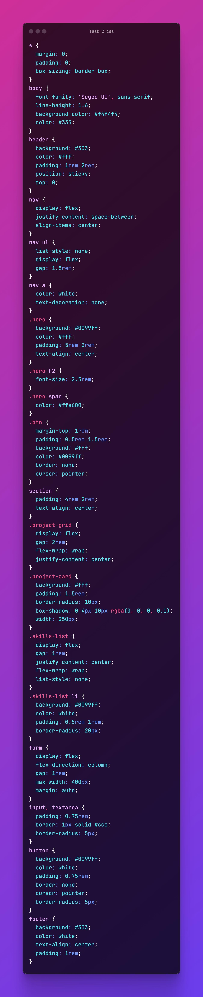

Slide 14
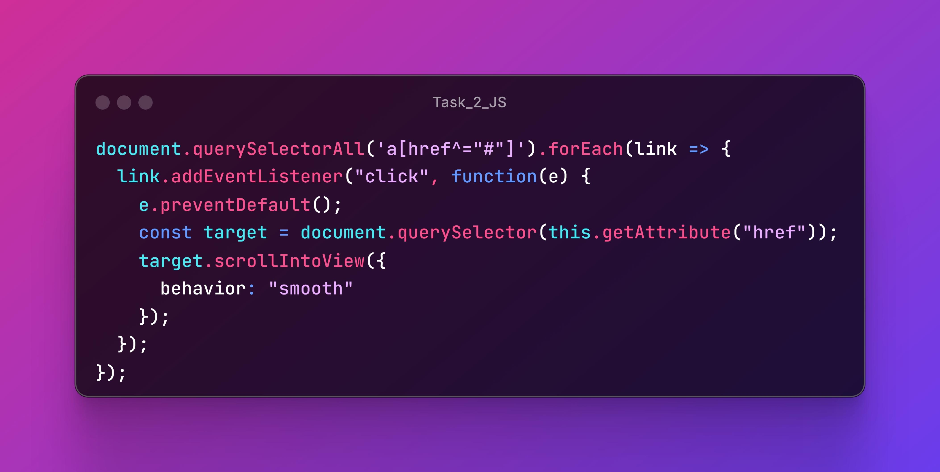

Slide 15
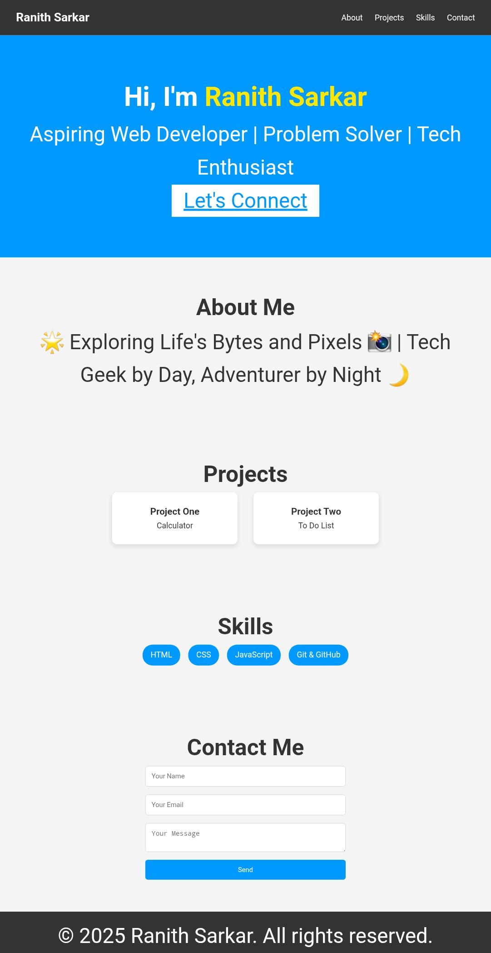

Slide 16
TASK 3

Slide 17
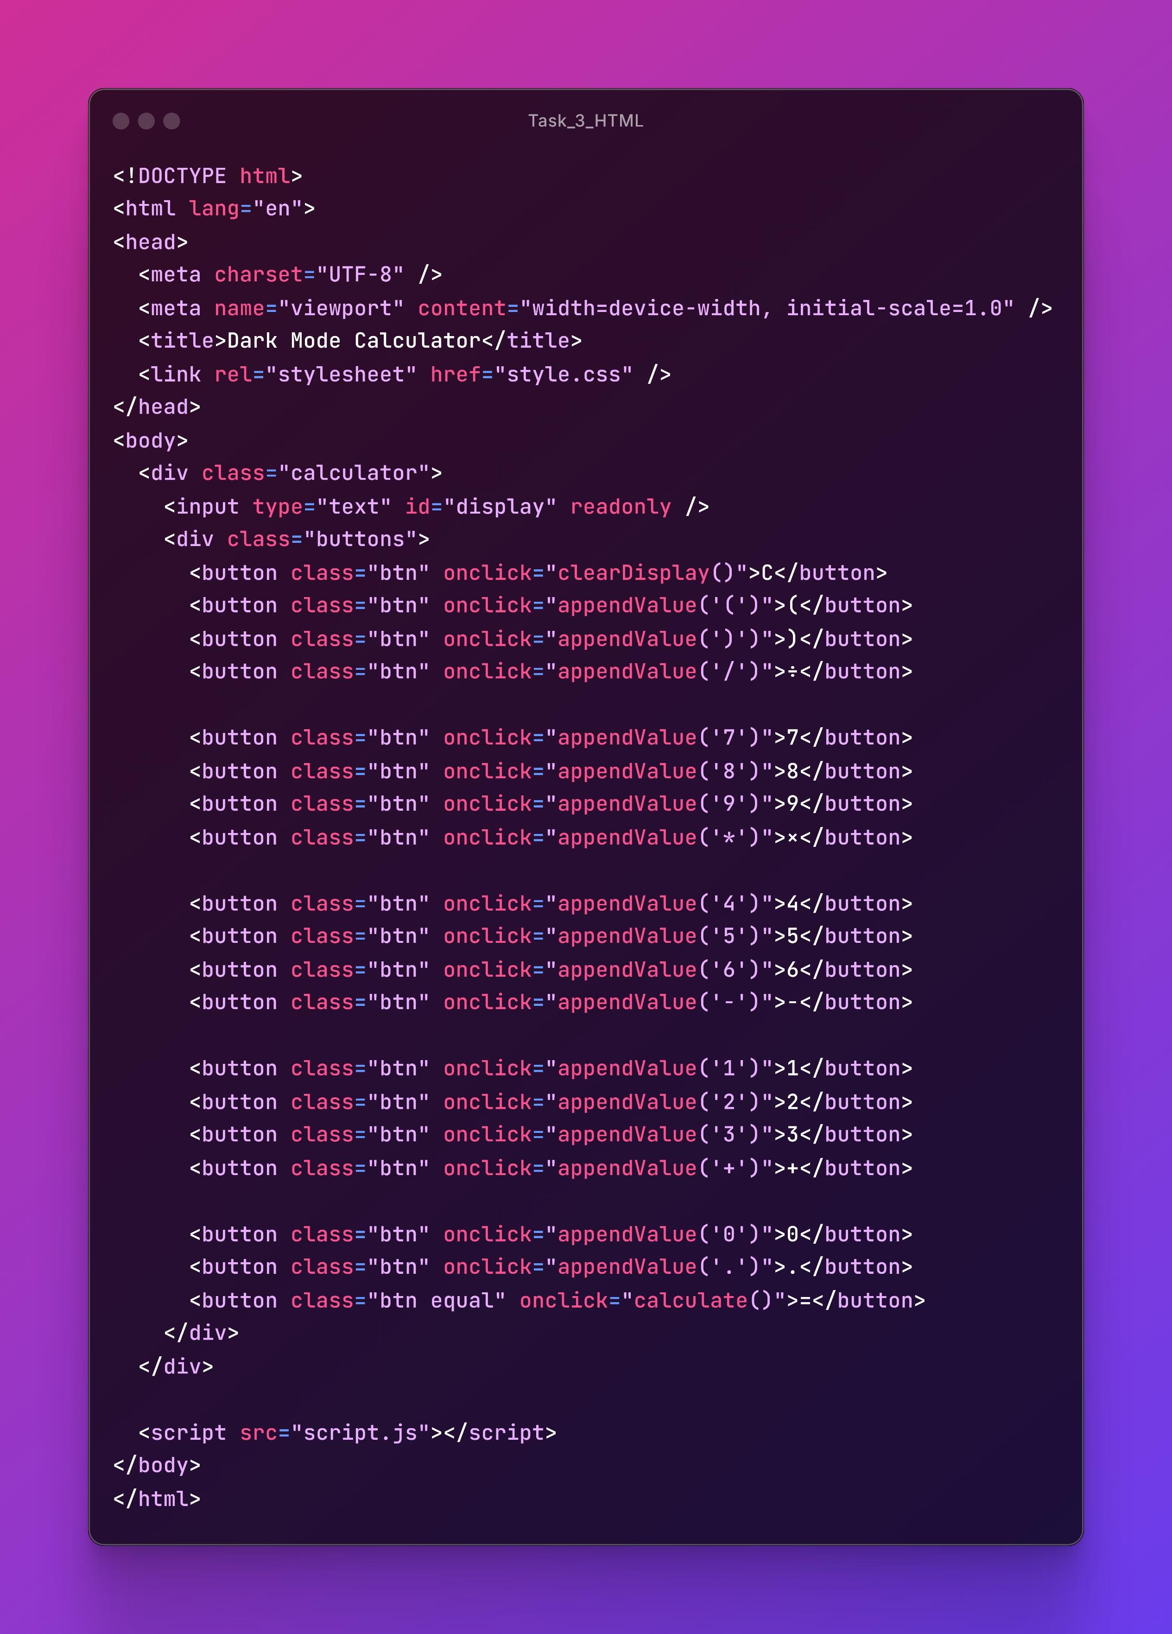

Slide 18
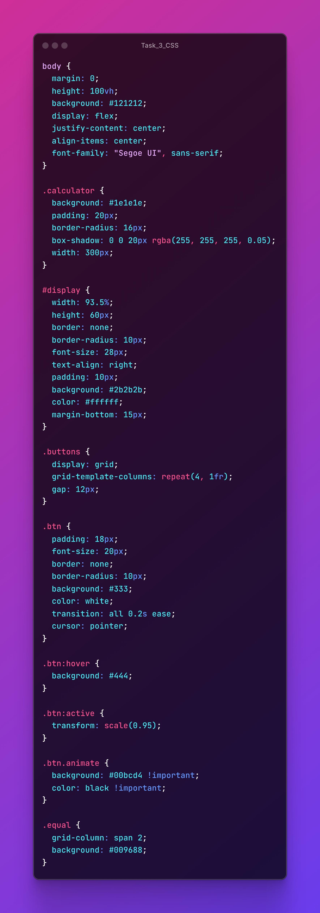

Slide 19
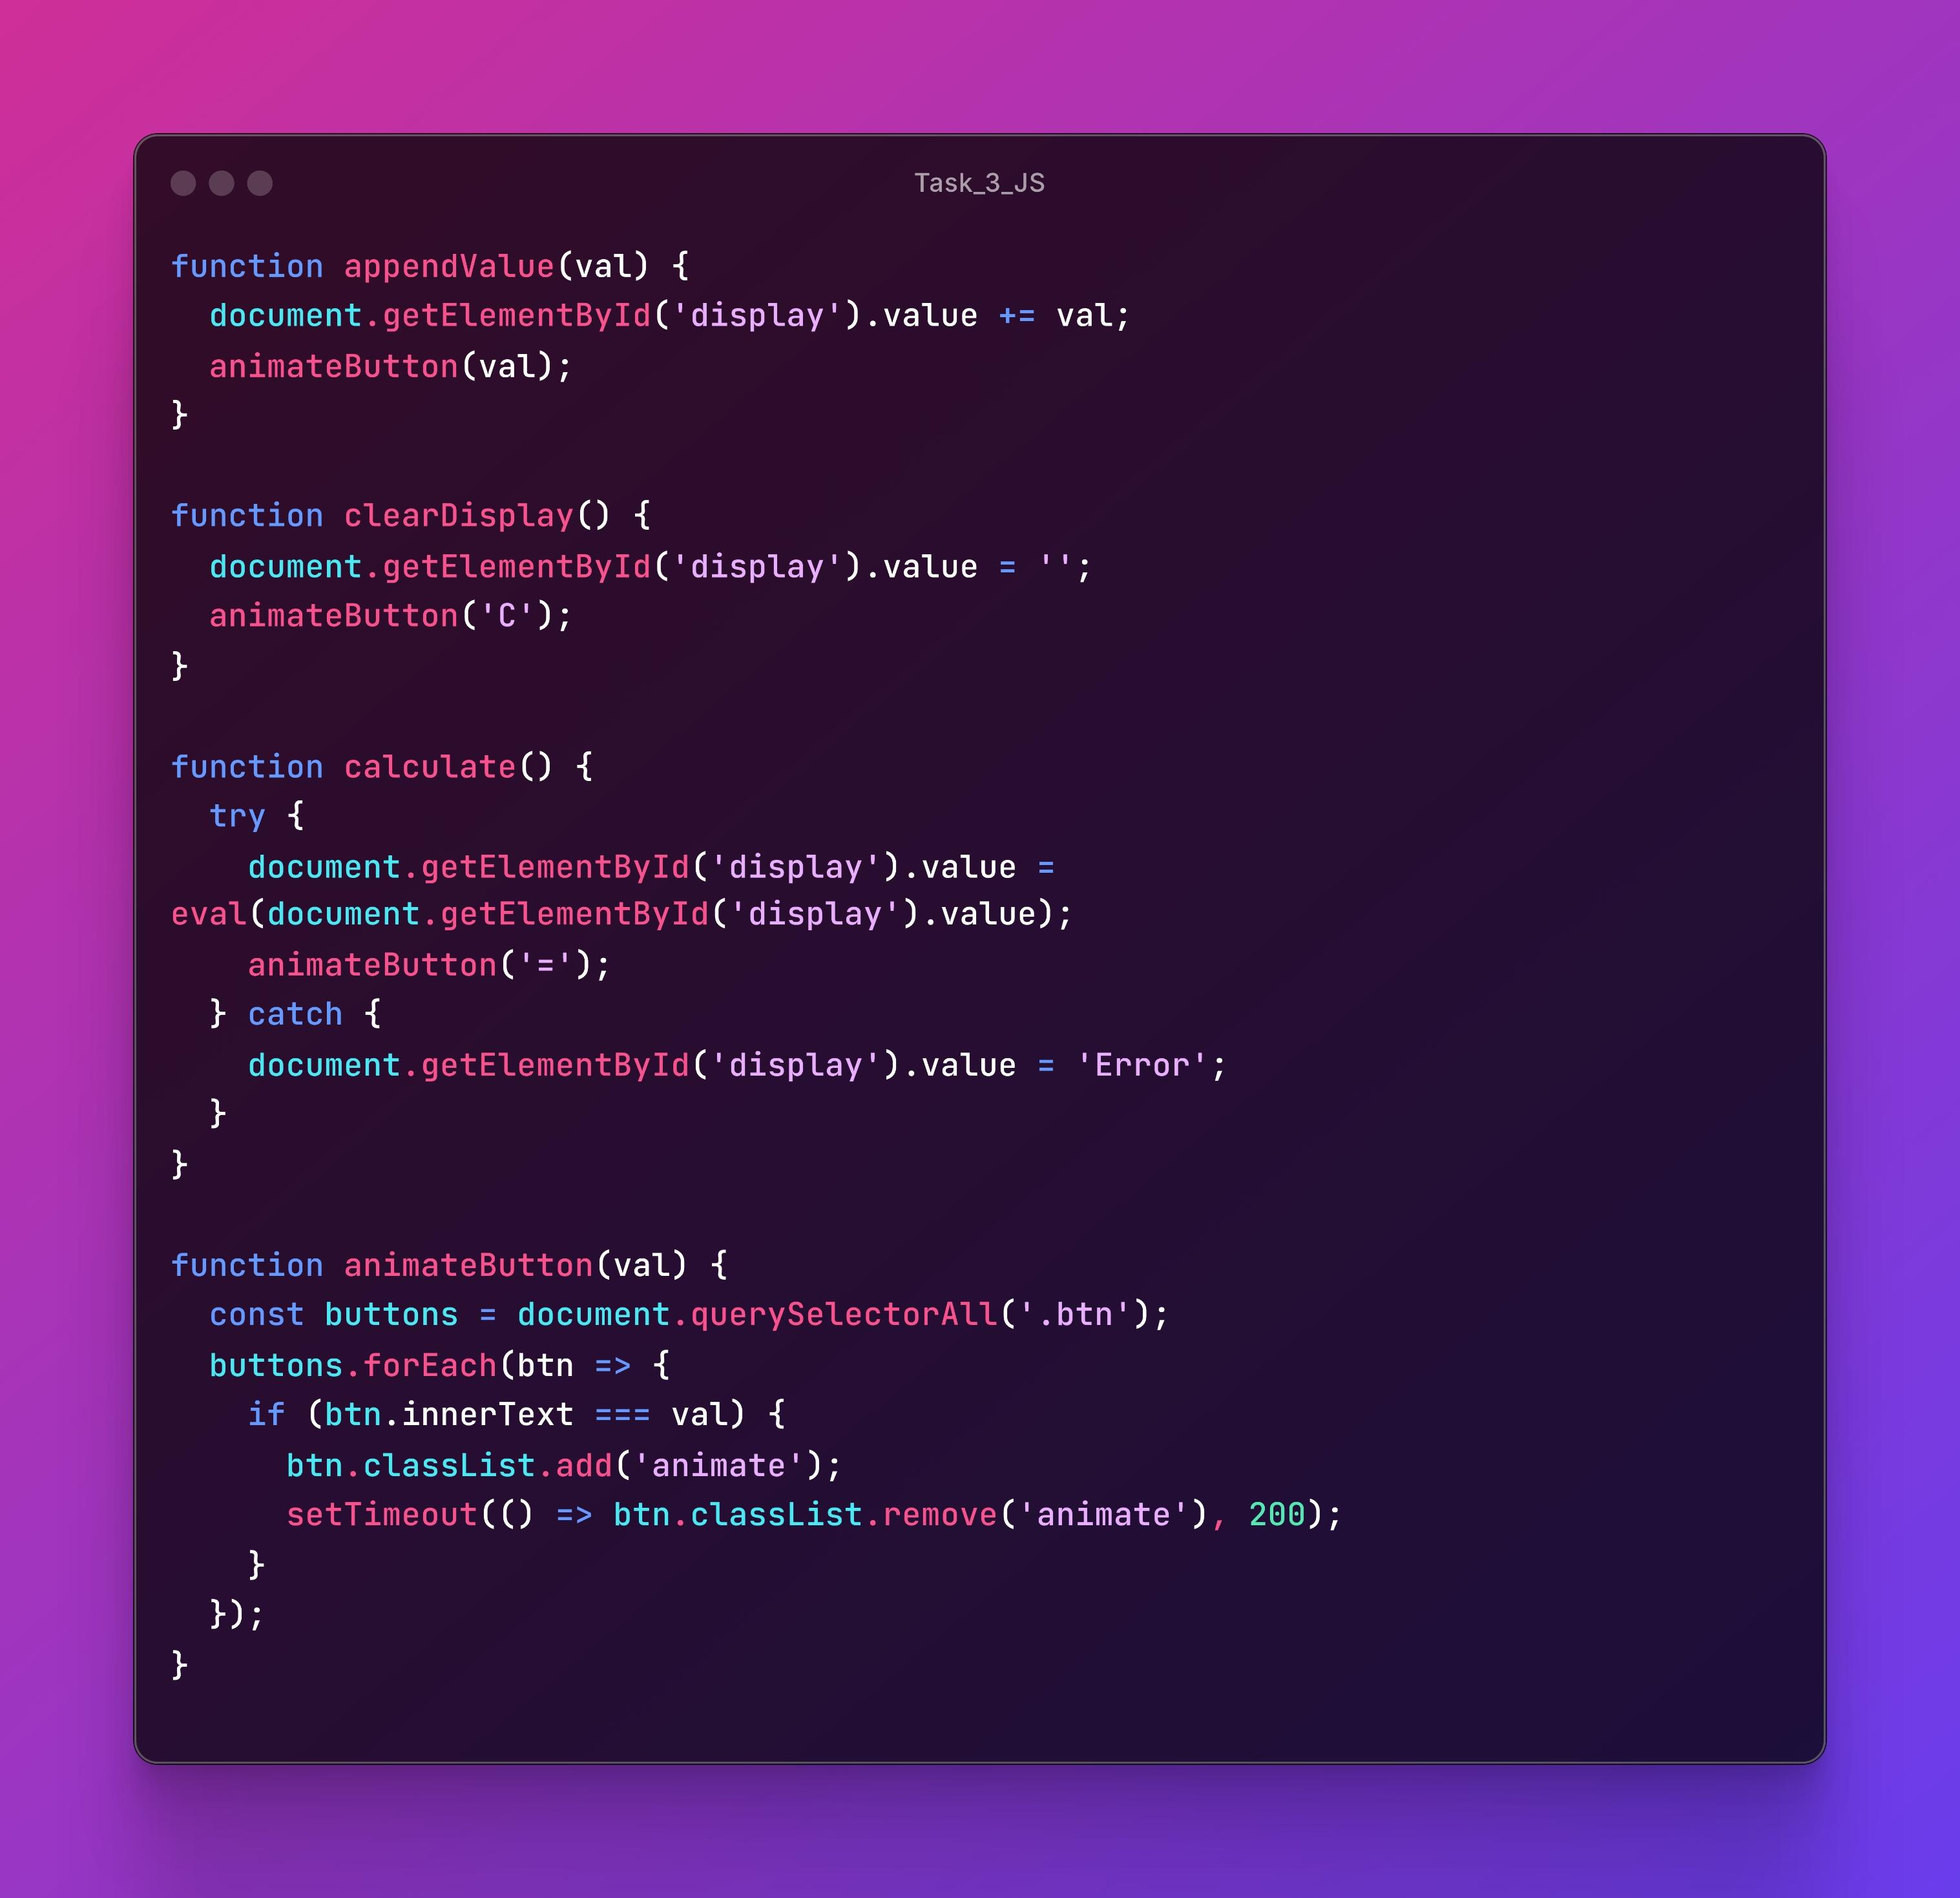

Slide 20
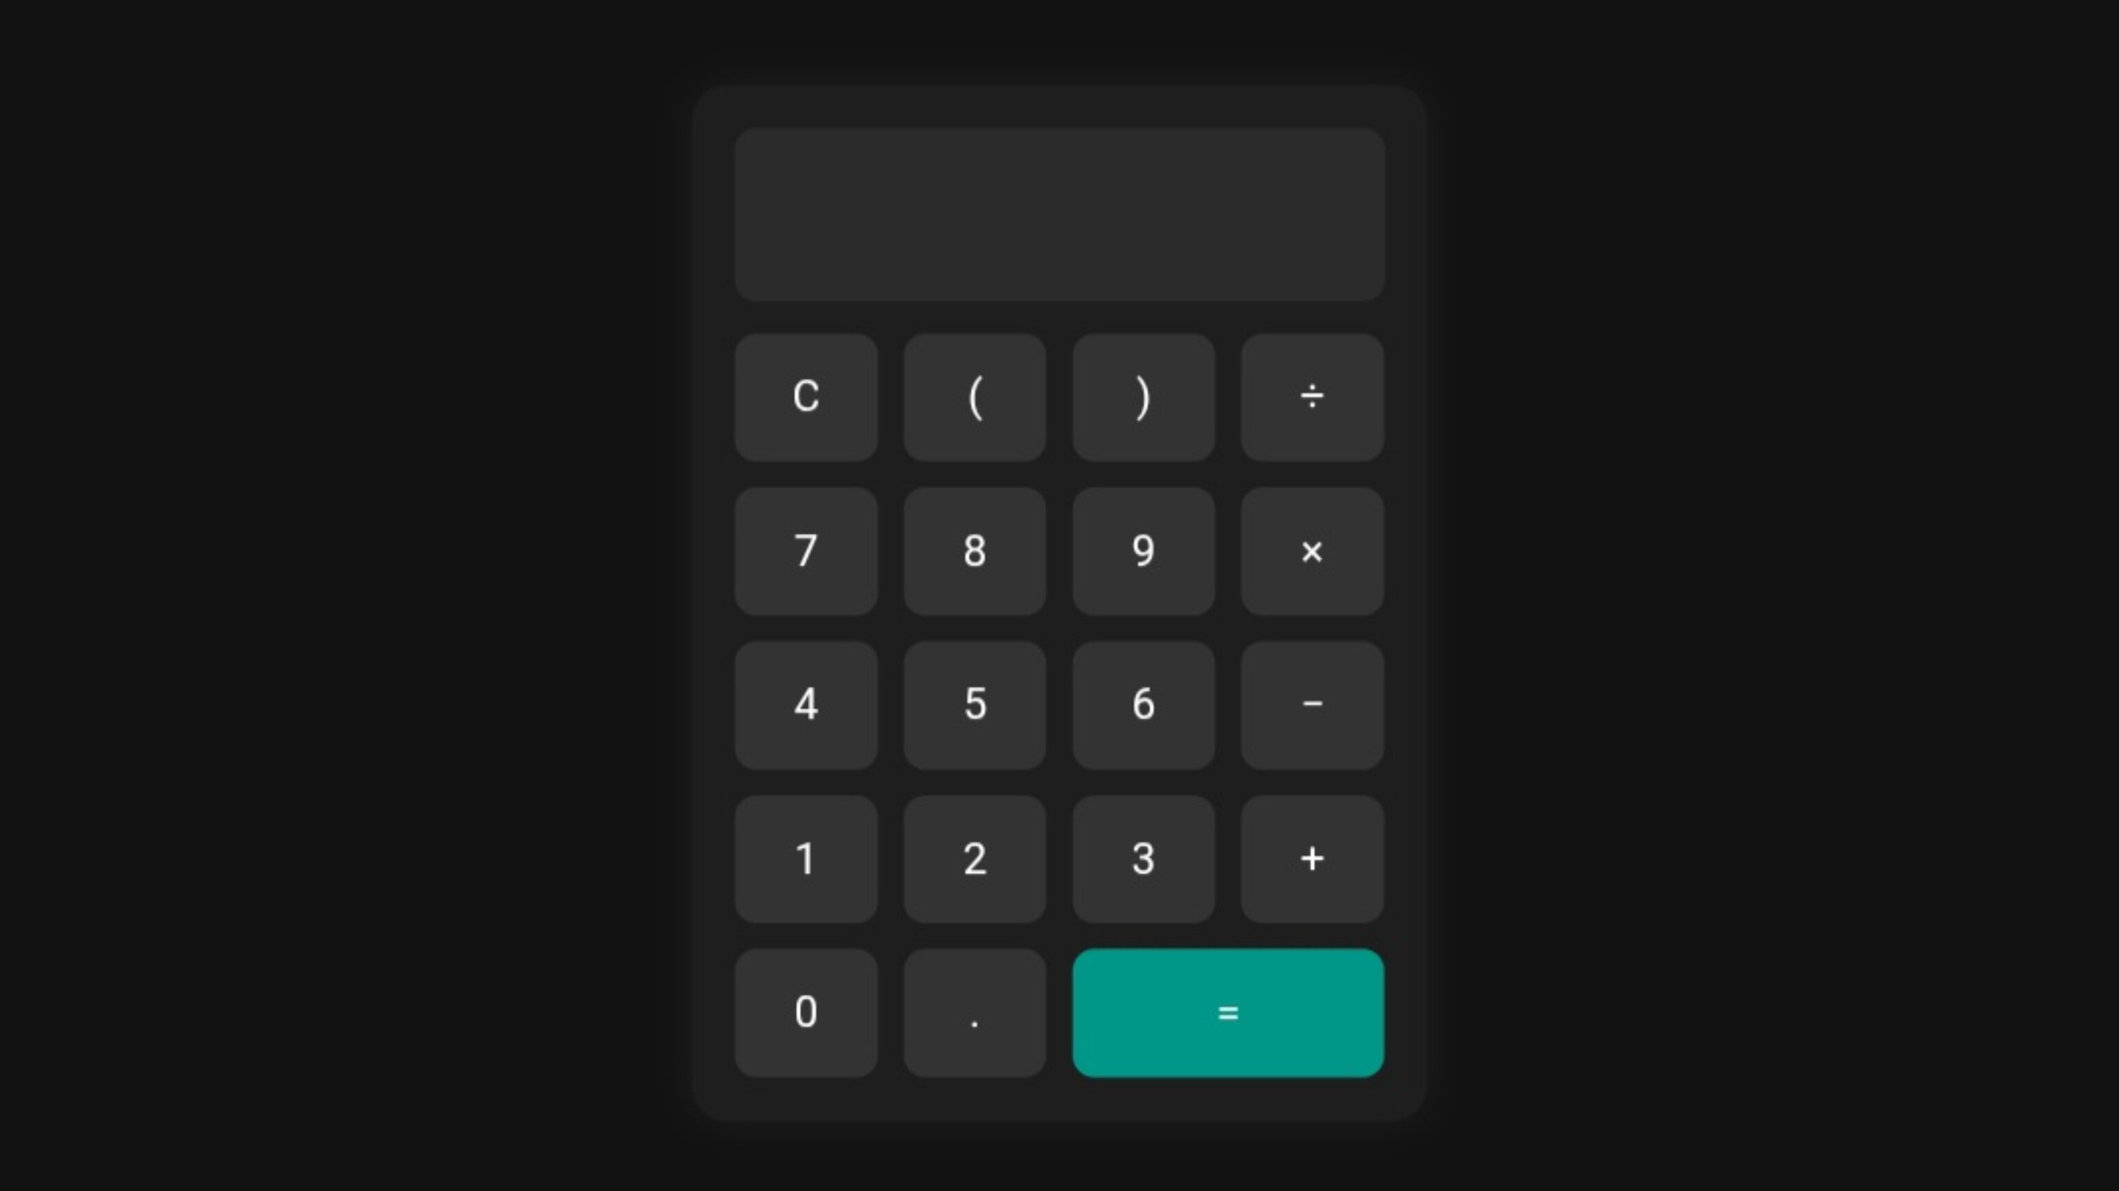

Slide 21
Challenges Encountered
Debugging and resolving errors
Ensuring responsive design
Managing code structure

Slide 22
Outcomes & Learnings
Improved coding and debugging skills
Understanding of real-world workflows
Project delivery and documentation

Slide 23
Feedback & Validation
Mentor/peer code review
Improved app performance and UI after feedback
Focus on clean UI and user experience

Slide 24
Summary & Conclusion
During my internship at Codsoft, I developed multiple frontend projects, enhanced my skills in HTML, CSS, and JavaScript, and gained real-world coding experience. This opportunity helped me understand project planning, version control, and responsive web design—laying a solid foundation for my future in tech.

Slide 25
Thank You
I sincerely thank the entire Codsoft team for their valuable support and guidance throughout my internship. Their mentorship played a crucial role in enhancing my skills and shaping my journey as a developer.

