Slide 1

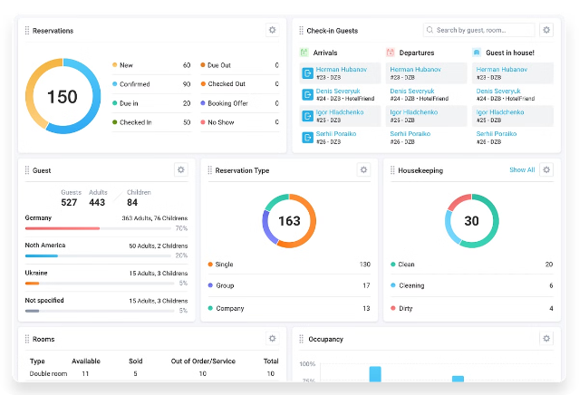
Hotel Booking Analysis
Exploring the factors that govern hotel bookings can provide valuable insights for both hotel operators and travelers. This hotel booking dataset offers an opportunity to uncover patterns and trends that can help optimize booking strategies and enhance the overall hotel experience.
Presented by: Ranitha Oddam
Malla Reddy Engineering College for Women
Computer Science and Engineering

Slide 2

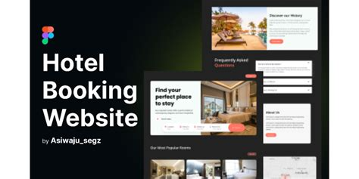
Problem Statement
1
Optimal Booking Time
Determine the best time of year to book a hotel room to get the most favorable rates and availability.
2
Ideal Length of Stay
Analyze the relationship between length of stay and daily rates to identify the optimal duration for a hotel visit.
3
Predicting Special Requests
Develop a model to predict the likelihood of a hotel receiving a disproportionately high number of special requests.

Slide 3
Proposed System
Data Preprocessing
Exploratory Data Analysis
Predictive Modeling
Clean and preprocess the hotel booking data to ensure data quality and consistency. Handle missing values, outliers, and any other data-related issues.
Develop machine learning models to predict the optimal booking time, ideal length of stay, and the likelihood of special requests. Evaluate model performance and fine-tune as needed.
Conduct a thorough analysis of the data to uncover patterns, trends, and relationships between various features. Use a variety of visualizations to gain insights.

Slide 4

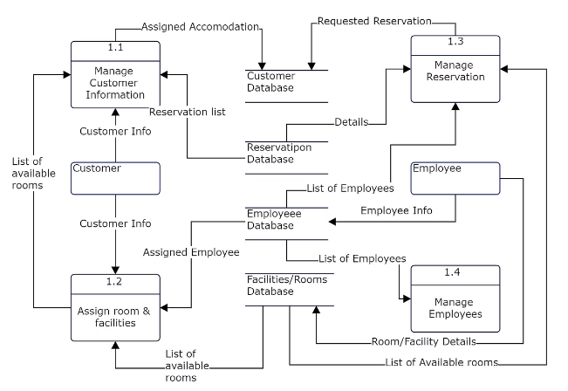
System Development Approach
1
Data Collection
Gather the hotel booking dataset and ensure it is complete and accurate.
2
Data Preprocessing
Clean and preprocess the data to handle missing values, outliers, and other data-related issues.
3
Exploratory Data Analysis
Conduct a thorough analysis of the data to uncover patterns, trends, and relationships between various features.

Slide 5

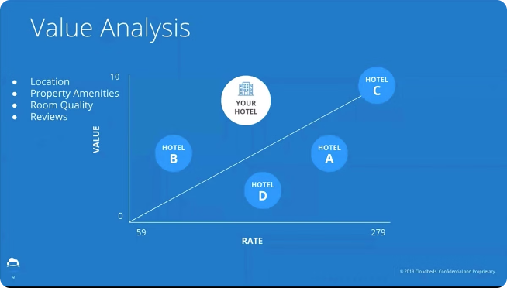
Results
Optimal Booking Time
The analysis revealed that the best time to book a hotel room is typically 2-3 months in advance, as this allows for the most favorable rates and availability.
Ideal Length of Stay
The data showed that a 3-5 night stay is the optimal length for getting the best daily rates, with longer stays often resulting in diminishing returns.
Predicting Special Requests
The predictive model developed was able to accurately forecast the likelihood of a hotel receiving a disproportionately high number of special requests based on various booking factors.

Slide 6




Future Scope
Revenue Optimization
Customer Satisfaction
Automation and AI
Expand the analysis to include revenue-based metrics, such as average daily rate and revenue per available room, to help hotels optimize their pricing and inventory strategies.
Incorporate customer feedback and reviews to understand the factors that drive guest satisfaction and loyalty, and how these can be leveraged to improve the overall hotel experience.
Explore the use of machine learning and artificial intelligence to automate various aspects of the hotel booking process, such as dynamic pricing, personalized recommendations, and real-time availability updates.

Slide 7

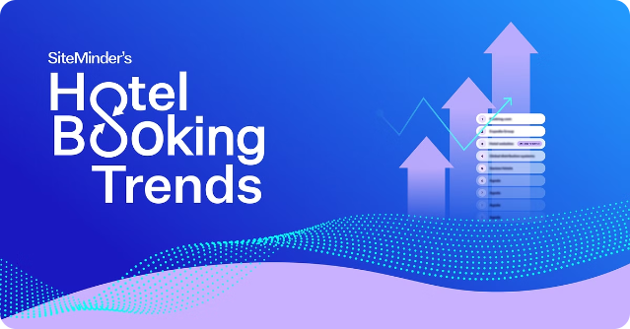

References
Kaggle Dataset
Hotel Booking Demand
Research Paper
Predicting hotel booking cancellations to enhance revenue management
Industry Report
2022 Hotel Industry Trends

Slide 8

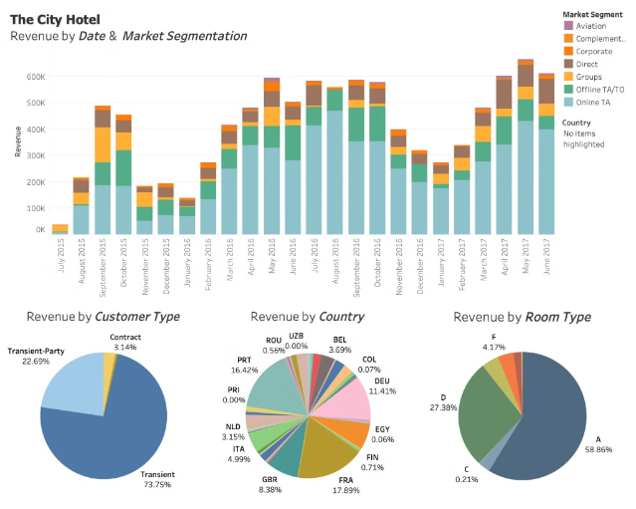
Conclusion
This hotel booking analysis project has provided valuable insights into the factors that influence hotel bookings, from optimal booking times and lengths of stay to the prediction of special requests. By leveraging data-driven insights, hotels can optimize their operations, enhance the guest experience, and ultimately drive increased revenue and profitability. As the hospitality industry continues to evolve, further exploration of emerging technologies and customer-centric strategies will be crucial for staying ahead of the curve.

Slide 9
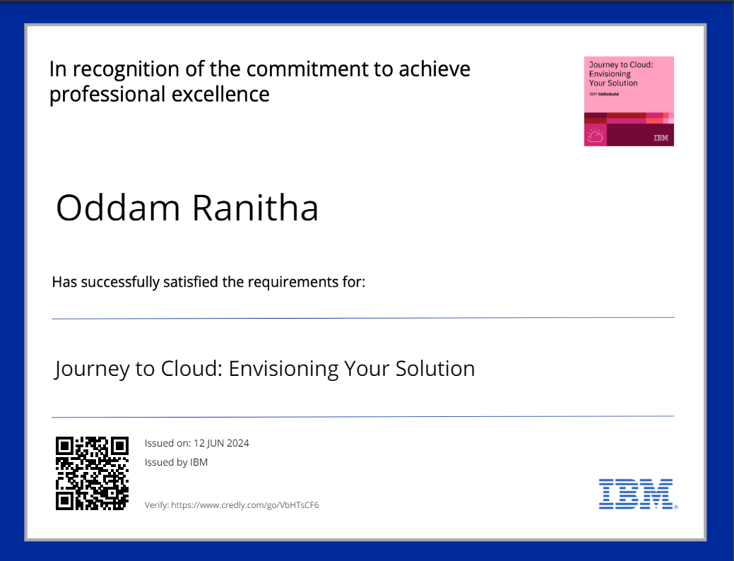

Slide 10
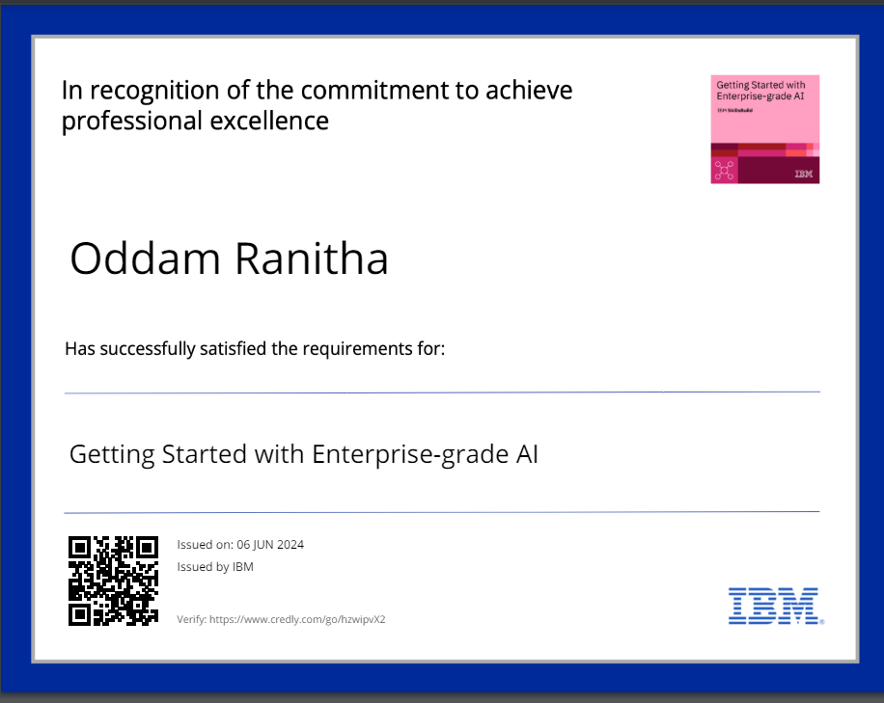

Slide 11


