Slide 1

A C P R O G R A M M I N G P R O J E C T
Library Management System
A console-based CRUD application for managing library records — adding, viewing, searching, issuing, and returning books.
Ramya N-811325104169 • Raniya A-811325104170 • Sahana D-811325104185

Slide 2


Team Members
The minds behind the project
Ramya N
Raniya A
Sahana D
Developer
811325104169
Developer
811325104170
Developer
811325104185

Slide 3

Abstract
5
The Library Management System is a console-based application developed using the C programming language to simplify the
management of library records.
Core CRUD Operations
1
Language: C
The system allows users to perform essential library operations —
adding new books, viewing all available books, searching for books by ID, issuing books, and returning books.
O(n)
Search Complexity

Slide 4


Concepts Used
C language features that power the system
Structures
Book details — ID, Title, Author, Category, Publisher, Year, Quantity, Price
Arrays
Storing multiple book records in memory
Functions
Modular operations for each library task
Loops & Conditionals
Traversing records and controlling program flow
String Handling
fgets() and strcspn() for safe text input
Input Validation
Prevents duplicate Book IDs and invalid data

Slide 5

Functions Used
Six functions drive the entire program
findId() | Searches a book using Book ID and returns its index.
addBook() | Adds a new book after validating the entered details.
viewBook() | Displays all available book records.
searchBook() | Searches and displays a book using its Book ID.
issueBook() | Issues a book by decreasing its available quantity.
returnBook() | Returns a book by increasing its available quantity.
main() drives it all — displays the menu and controls execution via a switch statement.

Slide 6





Mapping the Project to CRUD
Every library operation maps to a classic CRUD action
C
CREATE
R
READ
U
UPDATE
D
DELETE
addBook()
viewBook() / searchBook()
issueBook() / returnBook()
deleteBook()
Insert a new book record into the array
Display all records or look up one by ID
Modify quantity when a book is issued or returned
Remove a book record from the catalog

Slide 7
The Book Record
A single struct backs every CRUD operation
Every operation reads from or writes to one array of Book structures held in memory.
#define MAX 100
typedef struct { int id;
char title[100]; char author[100]; char category[50]; char publisher[100]; int year;
int quantity; float price;
} Book;
Book ID uniquely identifies each record
Fixed-size array (MAX = 100) keeps the system simple count tracks how many books are currently stored
Book books[MAX]; int count = 0;

Slide 8


CREATE — addBook()
Adding a new book to the catalog
void addBook() { Book b;
printf("Enter Book ID: "); scanf("%d", &b.id);
if (findId(b.id) != -1) { printf("Duplicate ID!\n"); return;
}
getchar(); printf("Title: ");
fgets(b.title, 100, stdin); b.title[strcspn(b.title, "\n")] = 0;
printf("Quantity: "); scanf("%d", &b.quantity); printf("Price: ");
scanf("%f", &b.price);
if (b.quantity < 0 || b.price < 0) { printf("Invalid data!\n"); return;
}
books[count++] = b; printf("Book added.\n");
Duplicate Check — findId() scans existing records to prevent ID conflicts
Input Sanitization — fgets() and strcspn() for clean string handling
Validation — ensures positive values for price and quantity
}

Slide 9
READ — viewBook()
Displaying the full library inventory
void viewBook() {
if (count == 0) {
printf("Library is empty.\n"); return;
}
for (int i = 0; i < count; i++) { printf("ID: %d\n", books[i].id); printf("Title: %s\n", books[i].title); printf("Author: %s\n", books[i].author); printf("Qty: %d | Price: %.2f\n",
books[i].quantity, books[i].price);
printf("------------------------\n");
}
}
Iterates through the global book array
Formatted output for every stored attribute
Empty-state check informs users if the library is vacant

Slide 10

READ — searchBook()
Locating one record in O(n) time
int findId(int id) {
for (int i = 0; i < count; i++) if (books[i].id == id)
return i; return -1;
}
void searchBook() { int id, idx;
printf("Enter Book ID: "); scanf("%d", &id);
idx = findId(id); if (idx == -1) {
printf("Book not found.\n"); return;
}
printf("Title: %s\n", books[idx].title); printf("Qty: %d\n", books[idx].quantity);
Leverages the findId() helper to locate specific records Instantly pulls up details using a unique Book ID
Efficient for targeted queries even as the catalog grows
}

Slide 11
UPDATE — issueBook()
Checking out a book reduces its availability
void issueBook() { int id, idx;
printf("Enter Book ID: "); scanf("%d", &id);
idx = findId(id); if (idx == -1) {
printf("Book not found.\n"); return;
}
if (books[idx].quantity <= 0) { printf("Out of stock.\n"); return;
}
books[idx].quantity--;
printf("Book issued. Remaining: %d\n", books[idx].quantity);
Validation — locates the record via findId()
Inventory calculation reduces the quantity register Quantity_new = Quantity_old − 1
}

Slide 12

UPDATE — returnBook()
Returning a book restores its availability
void returnBook() { int id, idx;
printf("Enter Book ID: "); scanf("%d", &id);
idx = findId(id); if (idx == -1) {
printf("Book not found.\n"); return;
}
books[idx].quantity++;
printf("Book returned. Available: %d\n", books[idx].quantity);
Dynamic recovery — re-indexes the returning copy via ID lookup Incrementation increases the available count
Live analytics prints the updated value back to the terminal
}

Slide 13
DELETE — deleteBook()
Completing the CRUD set by removing a record
void deleteBook() { int id, idx;
printf("Enter Book ID: "); scanf("%d", &id);
idx = findId(id); if (idx == -1) {
printf("Book not found.\n"); return;
}
for (int i = idx; i < count - 1; i++) books[i] = books[i + 1];
count--;
printf("Book deleted.\n");
Not in the original menu — added here to complete CRUD Locates the record via findId()
Shifts subsequent records left to close the gap, then shrinks count
}

Slide 14

main() — Tying It Together
A switch statement drives every CRUD action
int main() {
int choice; do {
printf("1.Add 2.View 3.Search "
"4.Issue 5.Return 6.Delete 0.Exit\n"); scanf("%d", &choice);
switch (choice) {
case 1: addBook();
case 2: viewBook();
break; break;
case 3: searchBook(); break; case 4: issueBook(); break; case 5: returnBook(); break; case 6: deleteBook(); break;
}
} while (choice != 0); return 0;
}

Slide 15
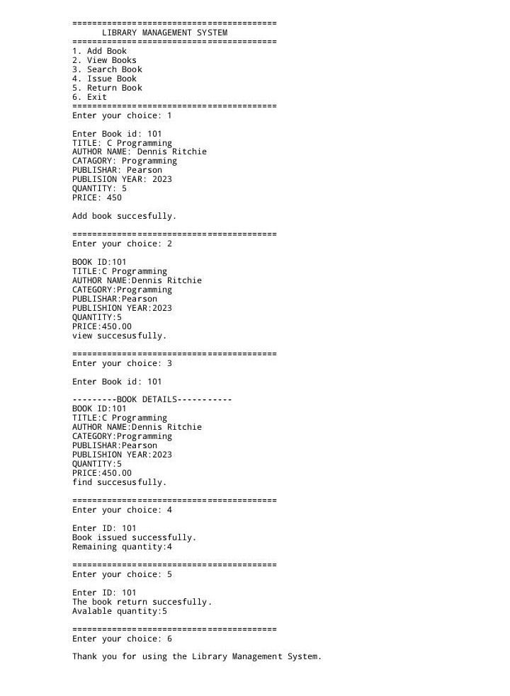

Slide 16
Thank You
Library Management System — Ramya N-811325104169 • Raniya A-811325104170 • Sahana D-811325104185

