Slide 1
Diabetes Data Analysis By:Abhishek

Slide 2
Data Pipeline
Read diabetic
data set
Create variable
Visualize
Univariate
Visualize Bivariate
Visualize
3 variate
Explore
Scatter
X=BMI
Hist of X,Y
Discover rules
Y=Glucose
Head
Tail
Describe
Correlation Matrix
Z=Outcome

Slide 3
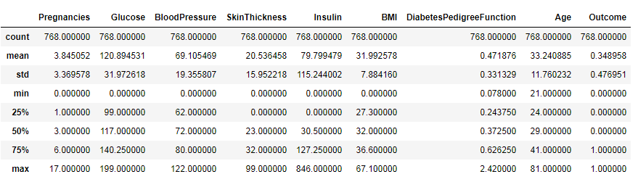
Describe

Slide 4
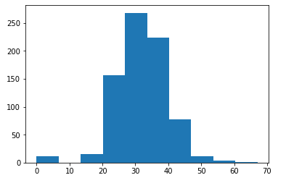
BMI Histogram

Slide 5
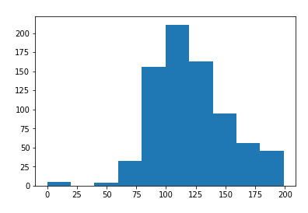
Glucose Histogram

Slide 6
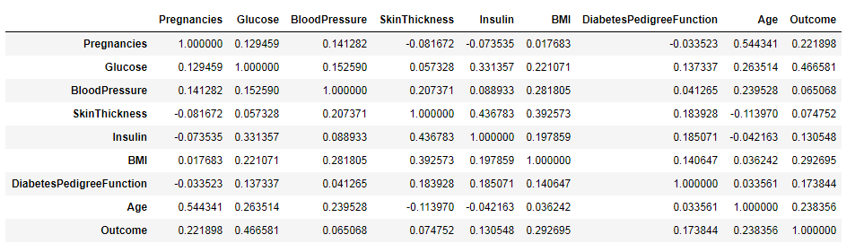
Correlation

Slide 7
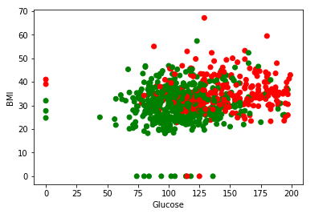
Scatter plot for X and Y variable

Slide 8
Based on the Scattered Plot
BMI>30 and BMI<50
Glucose>125 and <200 are more prone for diabetic

Slide 9
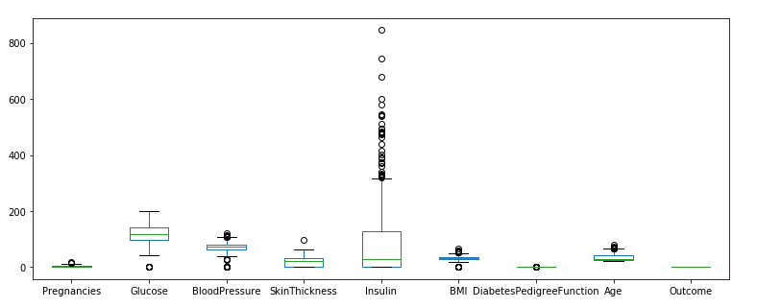
Out Layer analysis:

Slide 10
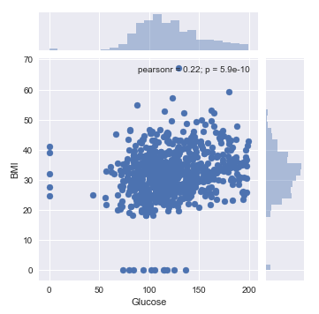
Joint Plot

Slide 11
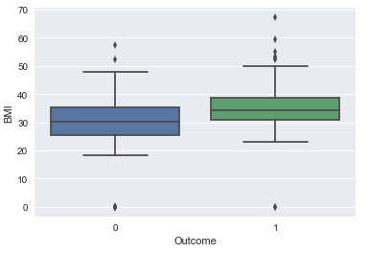
Box Plot: BMI >30 and <40 are more prone to b e diabetic.

Slide 12
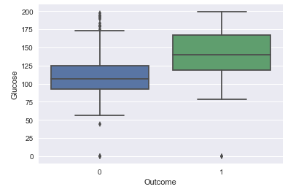
Box Plot: Glucose >120 and <170 are likely to be diabetic and it give more clarity over BMI.

Slide 13
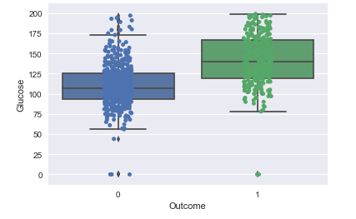
Based on the stripplot we can predict that glucose level between 120 to 160 may cause diabetes.

Slide 14
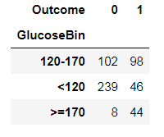
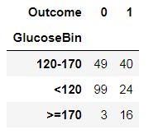
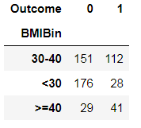
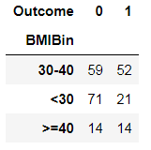
Pivot Tables – Train vs Test
Train
Test

Slide 15
https://github.com/Ranjan4mh/assigment2_module1.git

