Slide 1


VISVERSVARAYA TECHNOLOGICAl UNIVERSITY
“JNANA SANGAMA” , Belgaum, Karnataka - 590018
GOVT. S.K.S.J TECHNOLOGICAL INSTITUTE
BANGALORE - 1
Department Of Computer Science Engineering
A Computer Network Project On
“STAR, RING AND HYBRID TOPOLOGY”
using TCL Script, Network Simulator, Network Animator
In partial fulfilment Of CN Laboratory
In Computer Science & Engineering for the
Academic Year 2022-23
Submitted by:
K SRISAHITI BHAVANI ONKAR RANJAN G
1SK20CS0015 1SK20CS008 1SK20CS039
Under The Guidance Of
Mr. Shyleshchandra Gudihatti K N
Ph.D
Associate Professor
Department Of CSE

Slide 2
Star - Ring - Hybrid Topologies
Using TCL Script, Network Animator
and Network Simulator

Slide 3
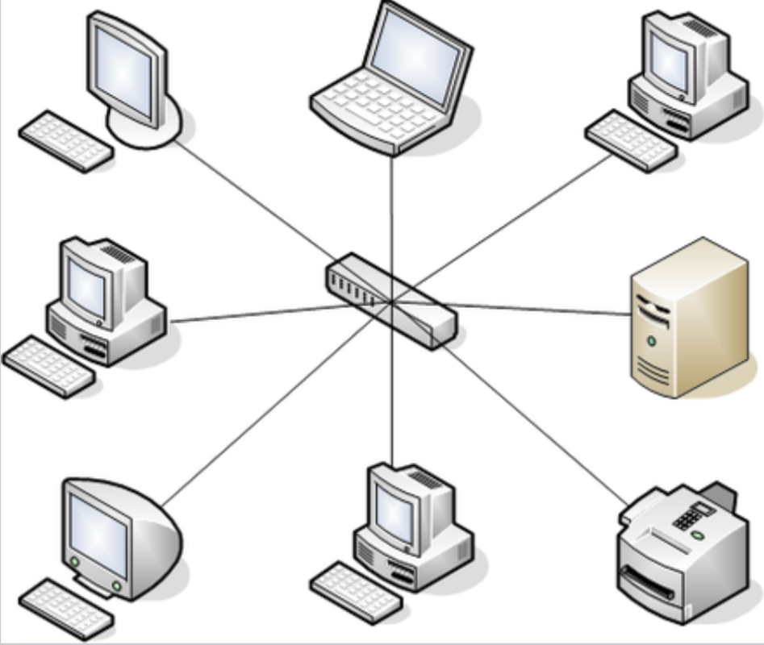
The Star Topology
A star network is an implementation of a spoke–hub distribution paradigm in computer networks.
In a star network, every host is connected to a central hub. In its simplest form, one central hub acts as a conduit to transmit messages.
The star network is one of the most common computer network topologies.
The hub and hosts, and the transmission lines between them, form a graph with the topology of a star. Data on a star network passes through the hub before continuing to its destination.
The hub manages and controls all functions of the network. It also acts as a repeater for the data flow.
The star topology reduces the impact of a transmission line failure by independently connecting each host to the hub. Each host may thus communicate with all others by transmitting to, and receiving from, the hub.
The failure of a transmission line linking any host to the hub will result in the isolation of that host from all others, but the rest of the network will be unaffected.
The star configuration is commonly used with twisted pair cable and optical fiber cable. However, it can also be used with coaxial cable as in, for example, a video router.
Advantages
If one node or its connection breaks, it does not affect the other computers nor their connections[3]
Devices can be added or removed without disturbing the network
Works well under heavy load
Appropriate for a large network
Disadvantages
Expensive due to the number and length of cables needed to wire each host to the central hub[3]
The central hub is a single point of failure for the network

Slide 4
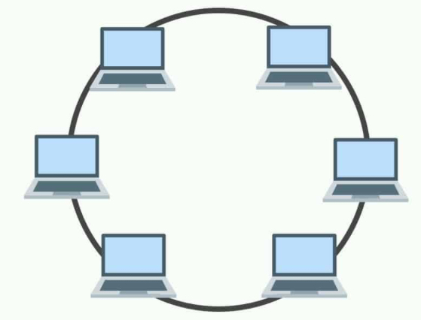
The Ring Topology
A ring network is a network topology in which each node connects to exactly two other nodes, forming a single continuous pathway for signals through each node – a ring. Data travels from node to node, with each node along the way handling every packet.
Rings can be unidirectional, with all traffic travelling either clockwise or anticlockwise around the ring, or bidirectional (as in SONET/SDH). Because a unidirectional ring topology provides only one pathway between any two nodes, unidirectional ring networks may be disrupted by the failure of a single link.
In response, some ring networks add a "counter-rotating ring" (C-Ring) to form a redundant topology: in the event of a break, data are wrapped back onto the complementary ring before reaching the end of the cable, maintaining a path to every node along the resulting C-Ring. Such "dual ring" networks include the ITU-T's PSTN telephony systems network Signalling System No. 7 (SS7), Spatial Reuse Protocol, Fiber Distributed Data Interface (FDDI), and Resilient Packet Ring
Rings can be used to carry circuits or packets or a combination of both. SDH rings carry circuits. Circuits are set up with out-of-band signalling protocols, whereas packets are usually carried via a Medium Access Control Protocol (MAC).
Advantages
Very orderly network where every device has access to the token and the opportunity to transmit
Performs better than a bus topology under heavy network load
Does not require a central node to manage the connectivity between the computers
Due to the point-to-point line configuration of devices with a device on either side (each device is connected to its immediate neighbor), it is quite easy to install and reconfigure since adding or removing a device requires moving just two connections.
Point-to-point line configuration makes it easy to identify and isolate faults.
Ring Protection reconfiguration for line faults of bidirectional rings can be very fast, as switching happens at a high level, and thus the traffic does not require individual rerouting.
Disadvantages
One malfunctioning workstation can create problems for the entire network. This can be solved by using a dual ring or a switch that closes off the break.
Moving, adding and changing the devices can affect the network
Communication delay is directly proportional to number of nodes in the network
Bandwidth is shared on all links between devices
More difficult to configure than a Star: node adjunction = Ring shutdown and reconfiguration

Slide 5
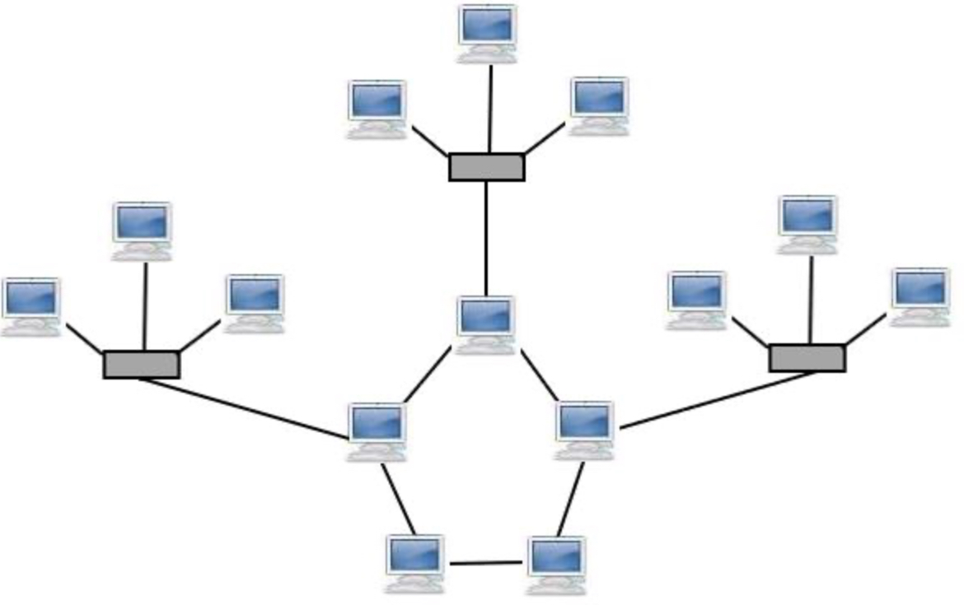
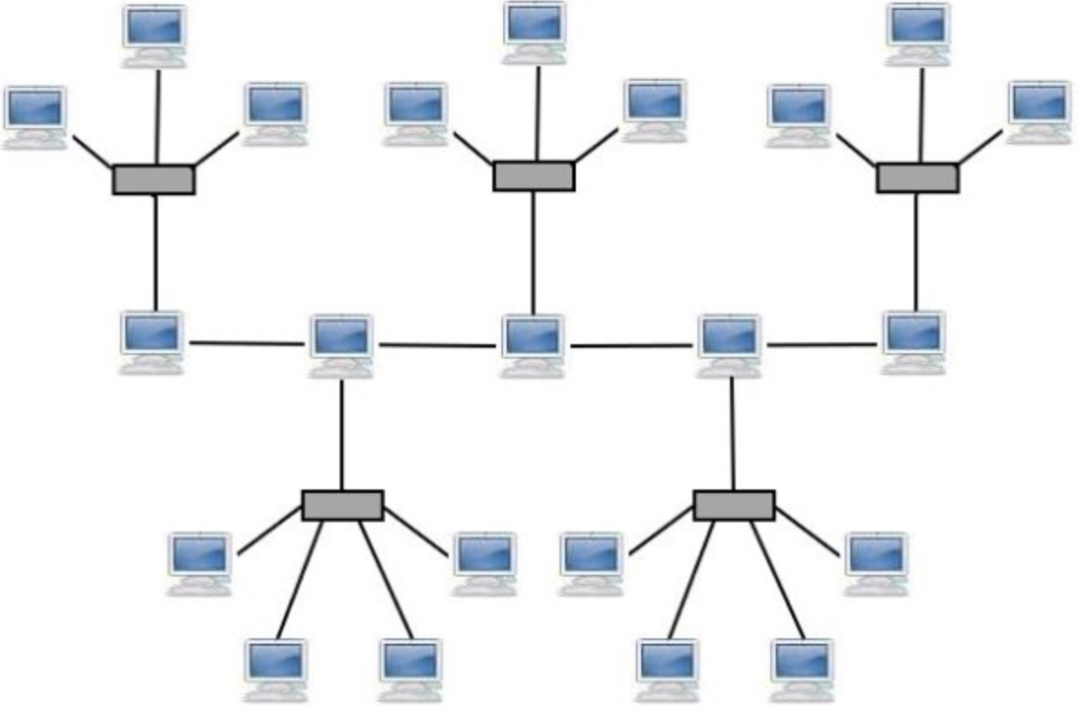
The Hybrid Topology
A hybrid topology is a type of network topology that uses two or more differing network topologies. These topologies can include a mix of bus topology, mesh topology, ring topology, star topology, and tree topology.
The choice to use a hybrid topology over a standard topology depends on the needs of a business, school, or the users. The number of computers, their location, and desired network performance are all factors in the decision.
TYPES OF HYBRID TOPOLOGIES
Star-Ring hybrid topology Star-Bus Hybrid Topology
A star-ring hybrid topology is a combination of the star topology and ring topology. A stat-bus hybrid topology is a combination of the star and bud topology.
Two or more star topologies are connected together through a ring topology. Two or more star topologies are connected through a bus topology.

Slide 6
Demonstration Of Topologies
Using TCL Script, Network Animator
and Network Simulator

Slide 7
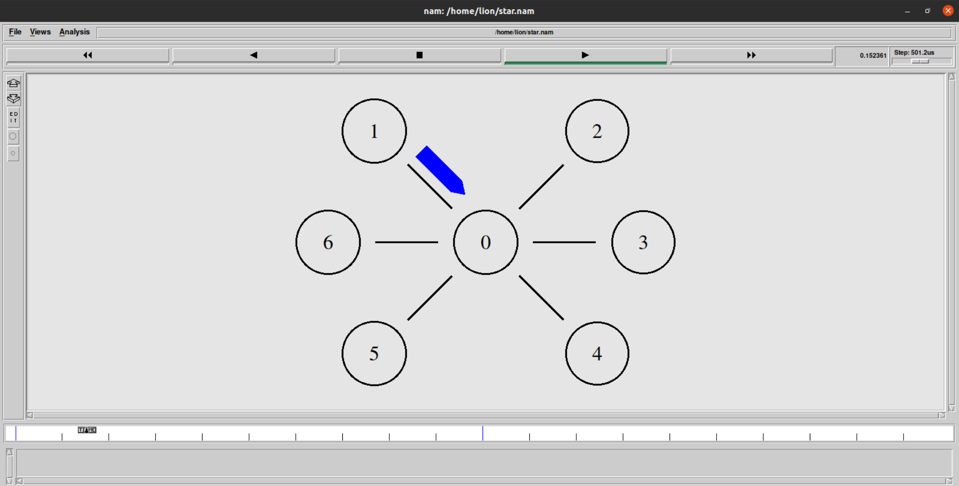
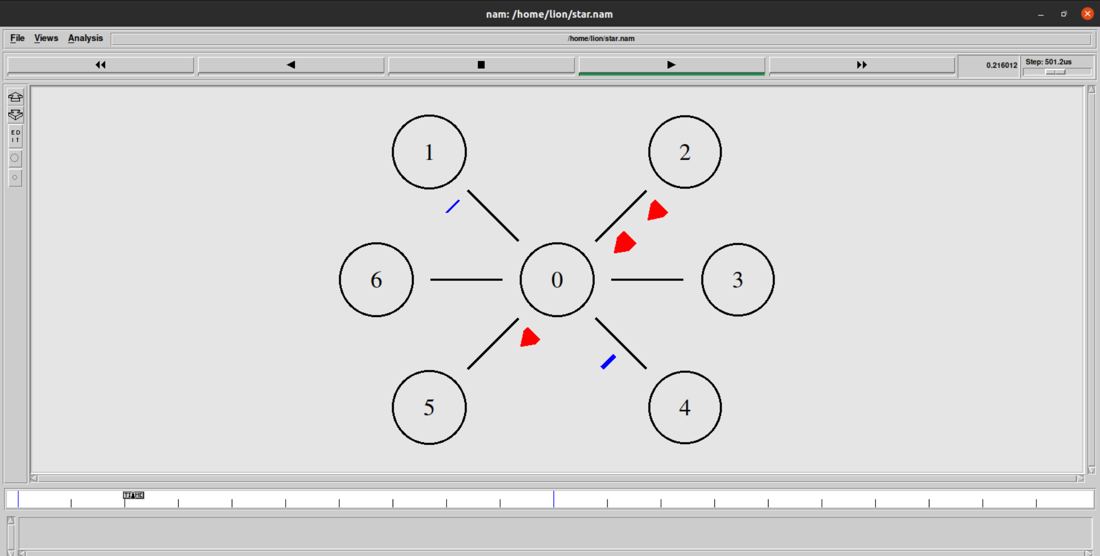
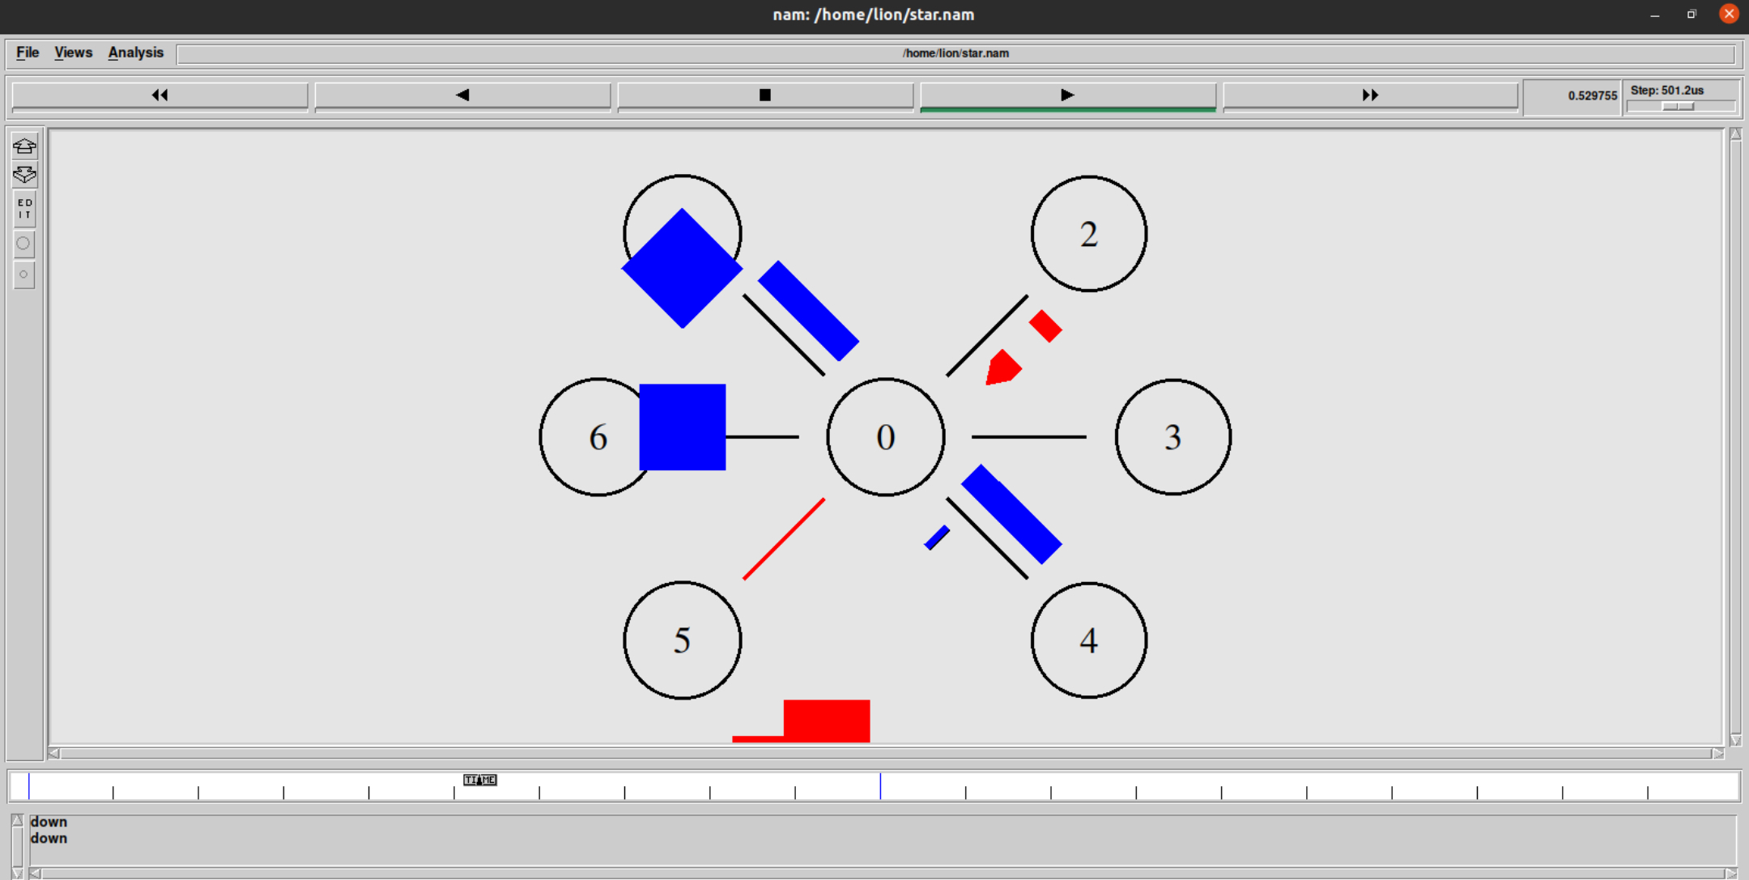
Star Topology

Slide 8
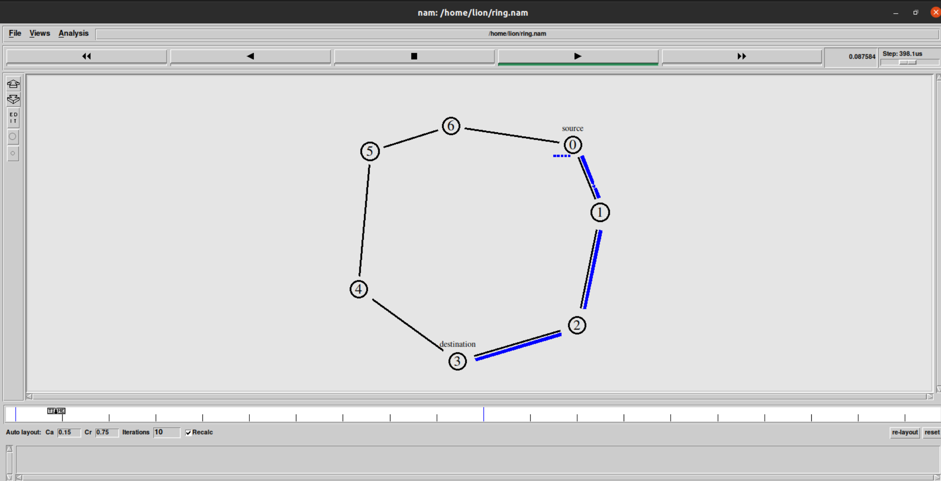
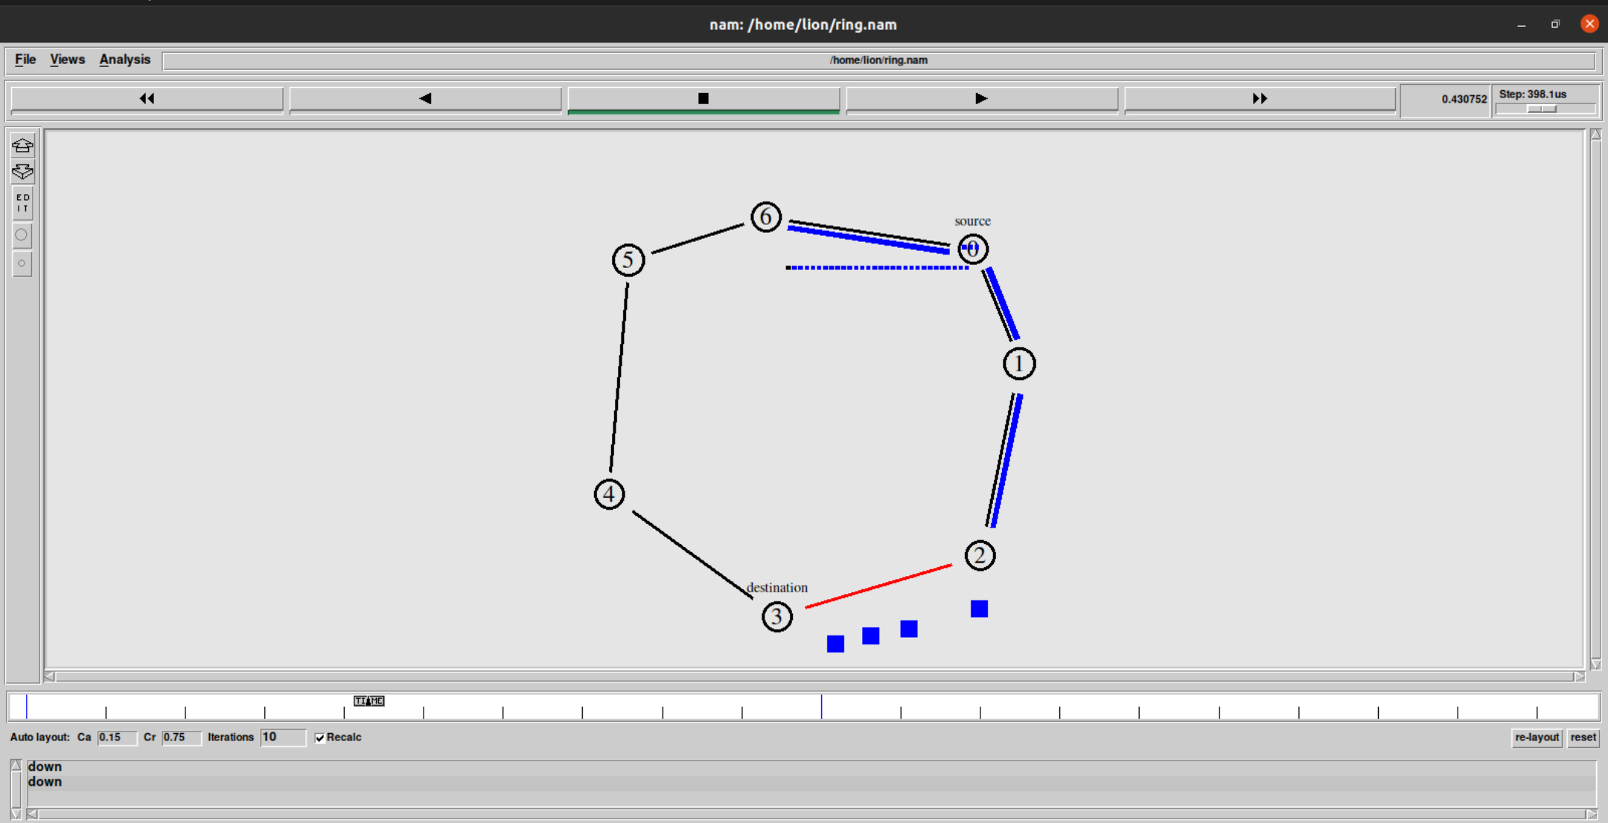
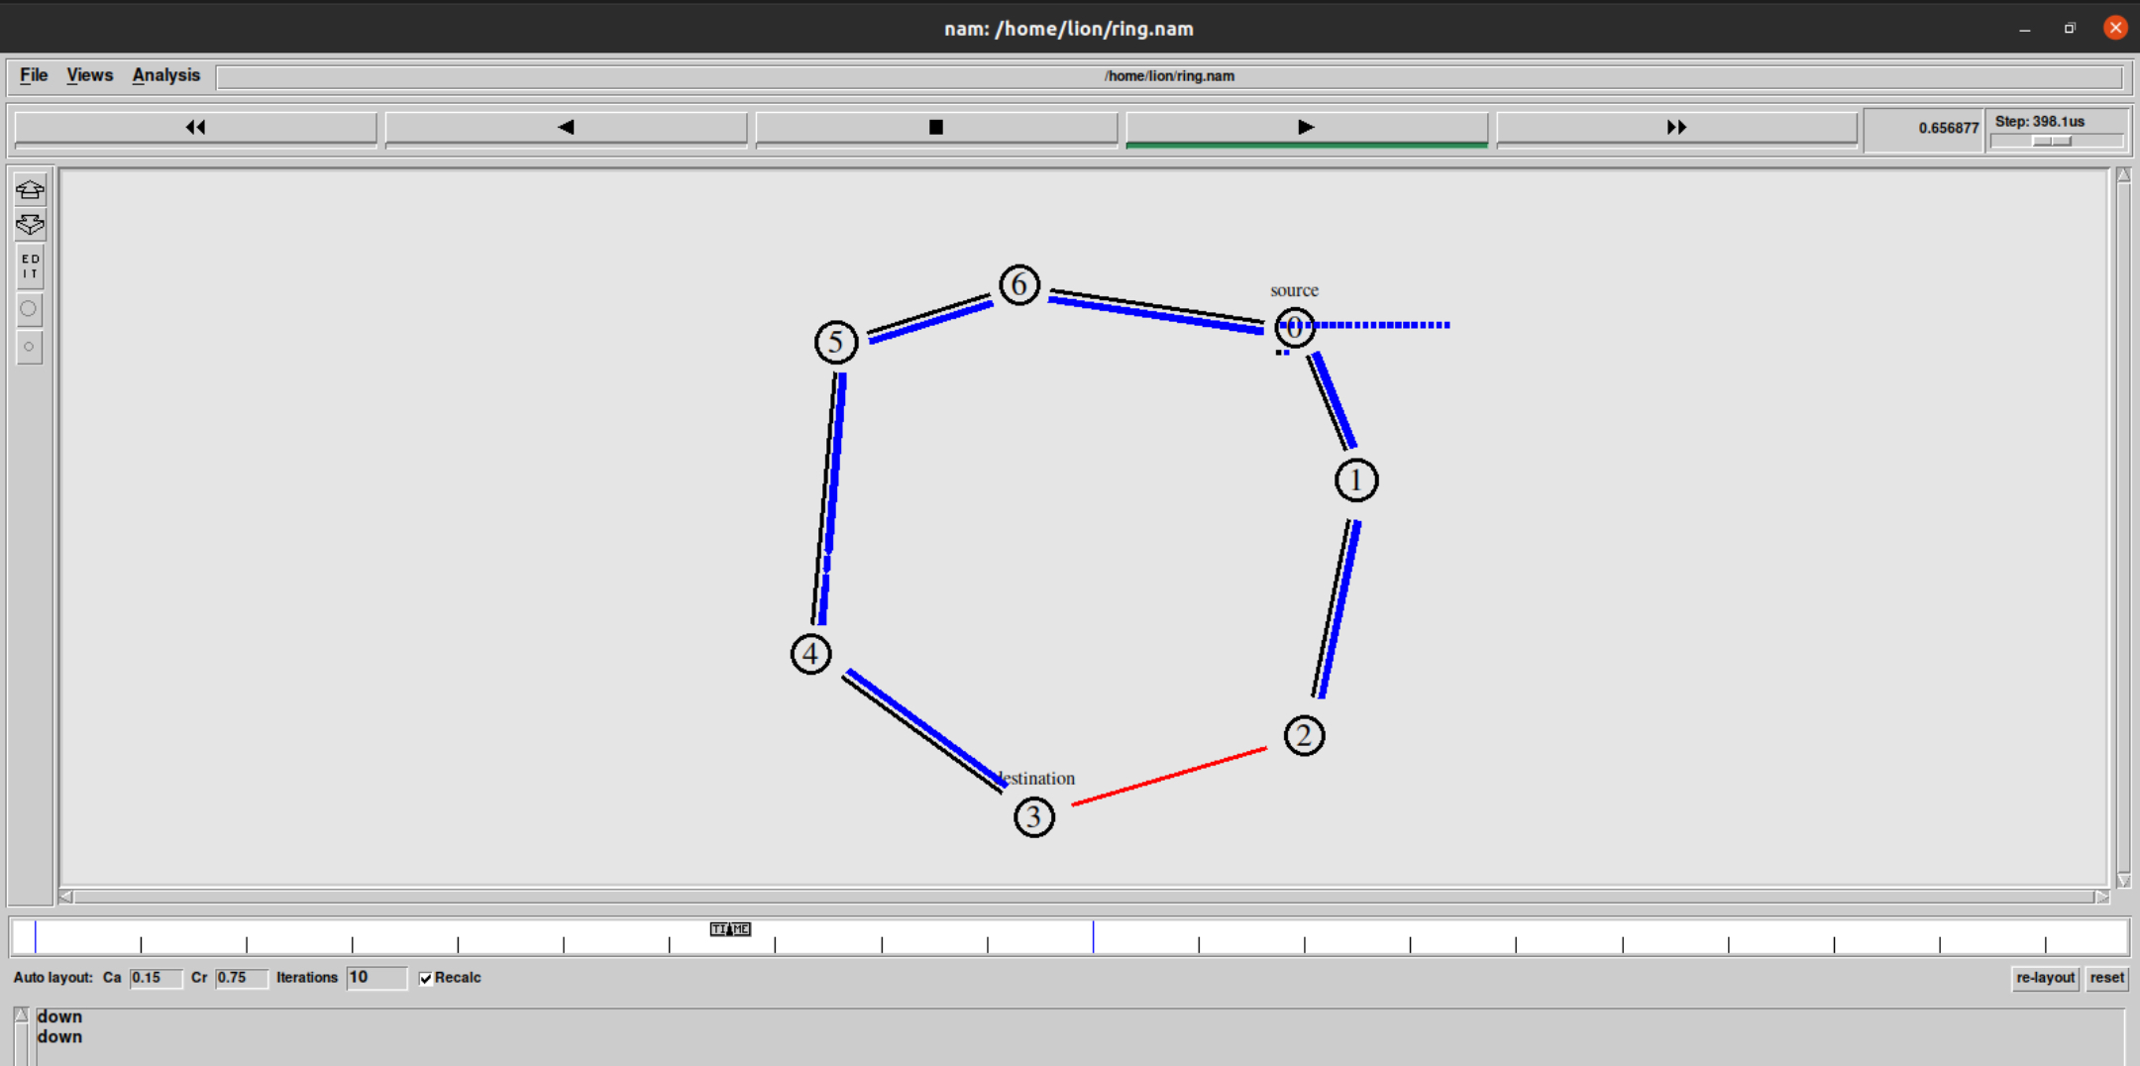
Ring Topology

Slide 9
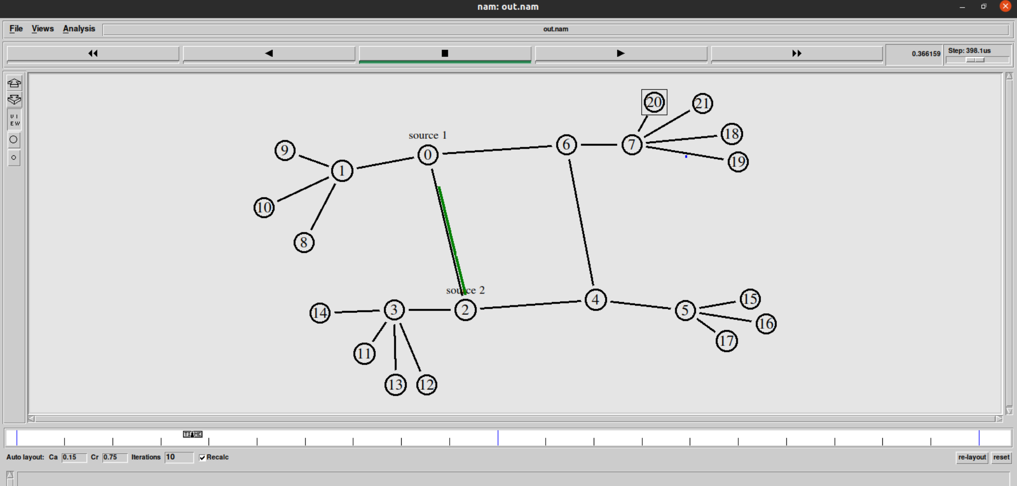
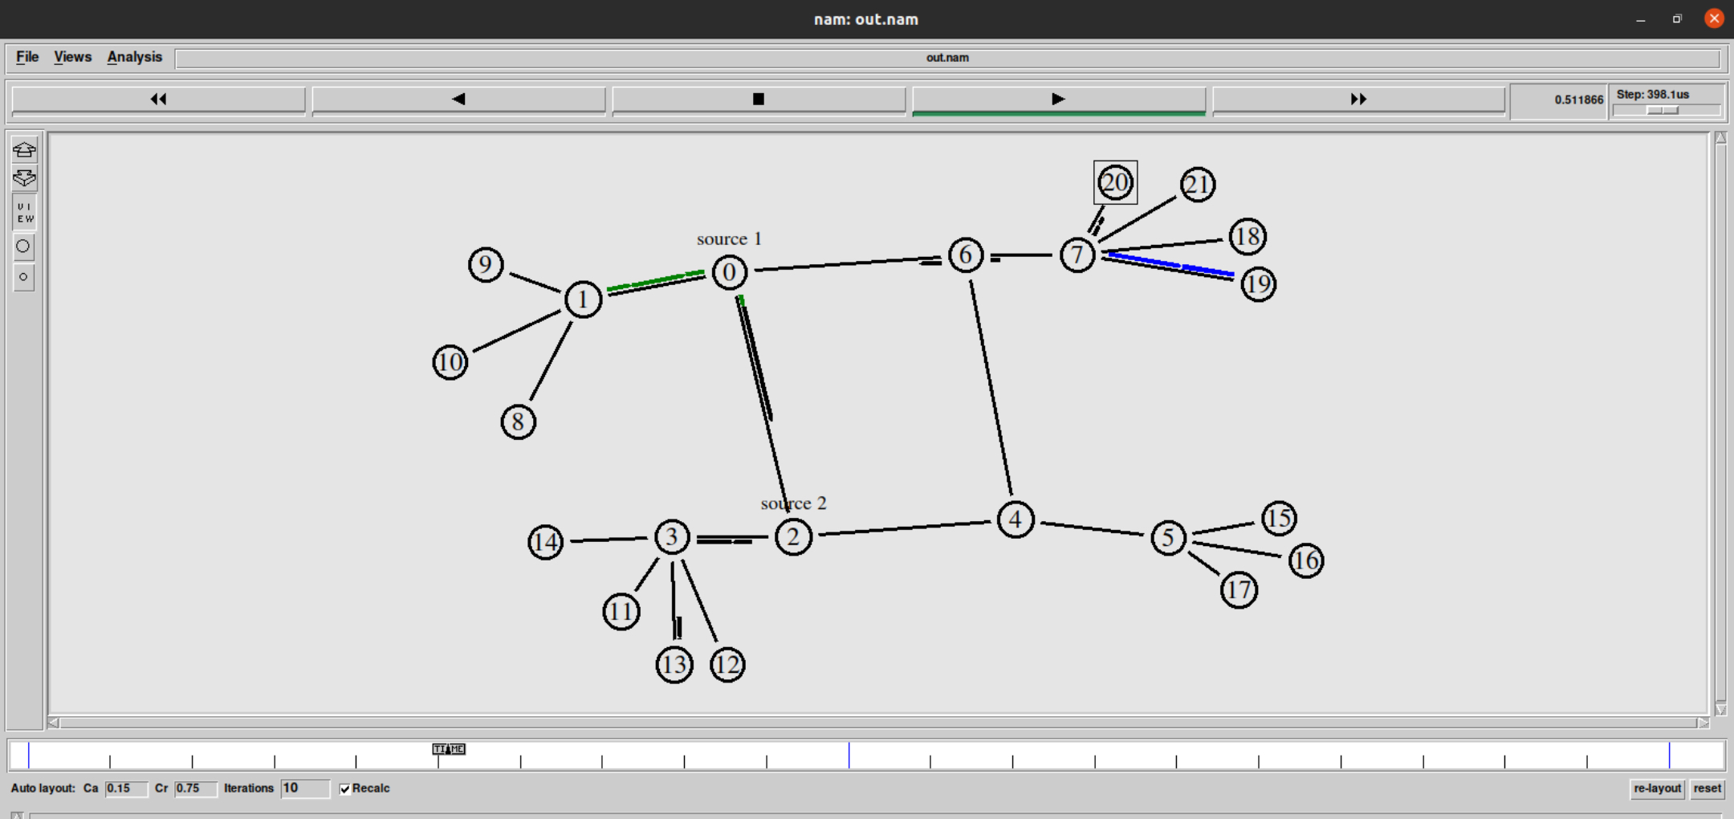
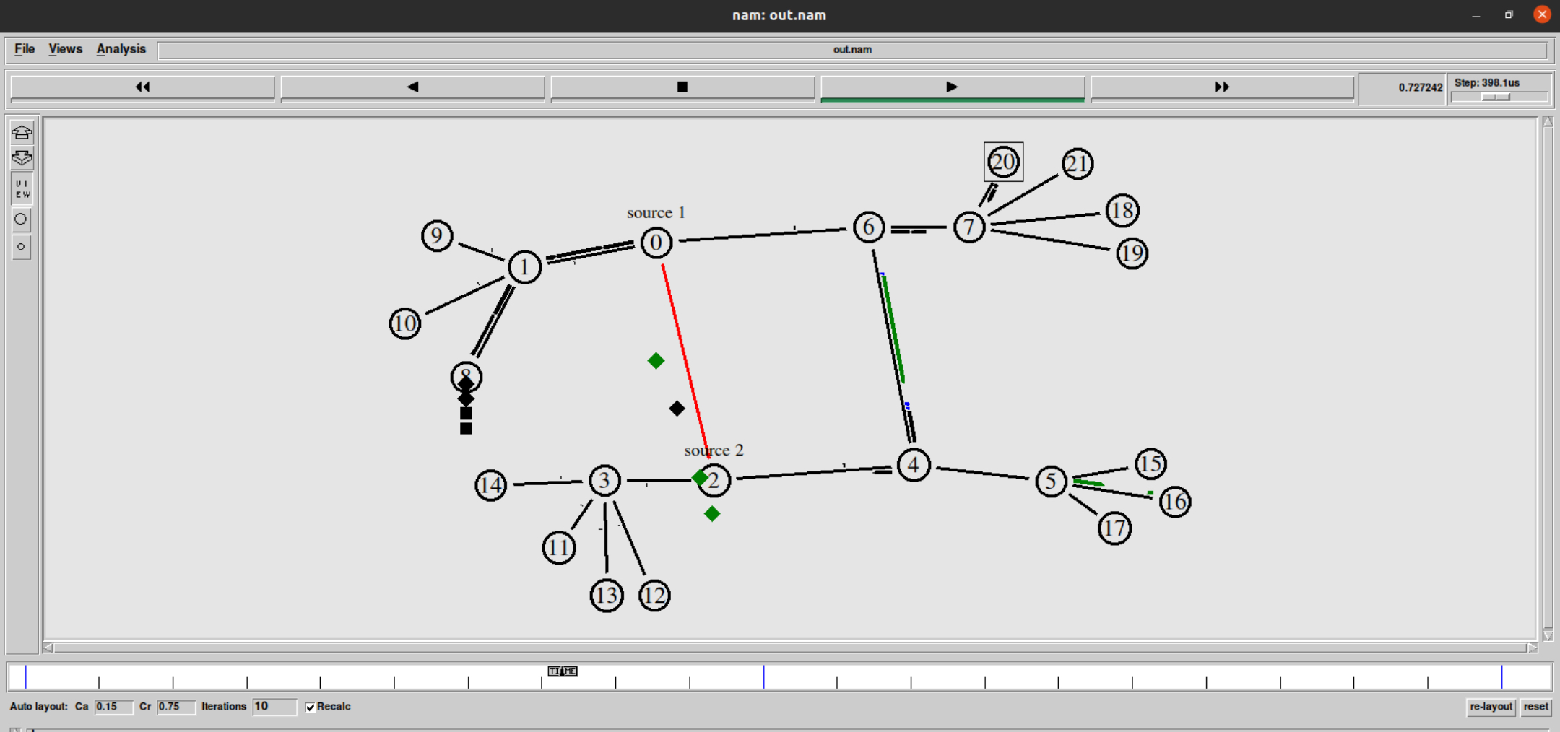
Hybrid Topology

Slide 10
Thank You

