Slide 1



SAI VIDYA INSTITUTE OF TECHNOLOGY Approved by AICTE, New Delhi, Affiliated to VTU, Recognized by Govt. of Karnataka, Accredited by NBA, New Delhi (CSE, ECE. ISE) NAAC "A" Grade
DEPARTMENT OF COMPUTER SCIENCE AND ENGINEERING BCS586: MINI PROJECT
AI-Driven Decision Support for Veterinary Management
PRESENTED BY, MAHIMA K (1VA23CS092) NIHARIKA M KODIGE (1VA23CS105) RANJANA H (1VA23CS129) SM PARKAVI (1VA23CS134)
UNDER THE SUPERVISION OF, Dr. VARUN E, Associate Professor., DEPT., OF CSE., SVIT

Slide 2
OUTLINE
Introduction
Literature Survey
Research Gap
Problem Statement
Objectives
Proposed Methodology
System Design
Outcomes
Conclusion
Paper/Patent Details
References
DEPARTMENT OF COMPUTER SCIENCE AND ENGINEERING
2

Slide 3
INTRODUCTION
Introduction – AI-Driven Veterinary Management System Rapid advancements in AI are transforming veterinary medicine, improving animal healthcare through smarter decision-making. Traditional veterinary management faces challenges in real-time data handling, animal monitoring, and personalized interventions. An AI-powered veterinary management system integrates AI/ML for predictive analysis and a chatbot assistant to ensure efficient and accurate. The project leverages AI to support clinical decisions, manage health records, and provide proactive care for livestock and pets.
DEPARTMENT OF COMPUTER SCIENCE AND ENGINEERING
3

Slide 4
LITERATURE SURVEY
S.No | Title with Authors Name, Paper Journal name and Year | Methodology/Algorithm/Technology used | Future Work
1. | AI-Powered Veterinary Chatbot for Automated Diagnosis Prashanna J, Dr. Vanita Jaitly ICICT 2025, IEEE | ML (SVM, Decision Tree) for disease detection NLP + Google API (TTS) for chatbot Data mining for learning & insights | Expand dataset for better accuracy Add multilingual support Integrate IoT pet health tracking
2. | “AI Veterinary Assistance: Enhancing Clinical Decision-Making in Animal Healthcare”Youn-Gyu Jin et al.IEEE Access, 2025 | AI Veterinary Assistance (AVA) using GPT-4o LLM. Symptom extraction via in-context learning. Disease prediction using symptom database. | Improve accuracy for varied language input. Develop specialized veterinary LLMs.
3. | Veterinary Medical Records Application using AWS Dr. Deepika Soni et al. ICMCSI 2024, IEEE | AWS 3-tier web architecture EC2, Lambda, S3, RDS, CloudFront Serverless backend with API Gateway | Add mobile app features Include IoT/microchip data Improve interface usability
DEPARTMENT OF COMPUTER SCIENCE AND ENGINEERING
4

Slide 5
LITERATURE SURVEY
S.No | Title with Authors Name, Paper Journal name and Year | Methodology/Algorithm/Technology used | Future Work
4. | “Advancements in Immunization Management for Personalized Vaccine Scheduling with IoT and Machine Learning”Dr. M. Madheswaran et al.IEEE ICCSP, 2024 | IoT devices for real-time health data. Decision Tree algorithm for vaccine scheduling. Machine learning for predictive recommendations. | • Use genetic and immune data for predictions. • Apply decentralized digital health records.
5. | “Cloud IoT Based Surveillance System for Tracking and Monitoring of Domestic Animals”Ande NagaSai Manikanta et al.IEEE ICICACS, 2024 | IoT sensors (LM35, MAX30100, GPS) with Arduino. Cloud data storage and GSM alerts. Real-time animal health tracking. | Add advanced ML for pattern analysis. Expand to multiple animal species.
6. | Web-Based Veterinary Clinic with e-Mail and SMS Notification Samuel S. Chua et al. ICBIR 2024, IEEE | Web app using PHP, MySQL, XAMPP Waterfall SDLC model Auto e-mail & SMS alerts | Enhance site security Add AI for reminders Support image attachments
DEPARTMENT OF COMPUTER SCIENCE AND ENGINEERING
5

Slide 6
RESEARCH GAP
Existing solutions often address isolated aspects such as imaging or simple record-keeping. Limited support for end-to-end decision-making in veterinary practice, particularly for multi-species, rural, and resource-limited contexts A need for integrated platforms combining health record management, AI-based symptom analysis, and actionable recommendations.
DEPARTMENT OF COMPUTER SCIENCE AND ENGINEERING
6

Slide 7
PROBLEM STATEMENT
To Design and Implement an intelligent veterinary management system that leverages Artificial Intelligence and data-driven decision-making to streamline medical record management, support accurate health monitoring, and enable timely interventions for animals.
DEPARTMENT OF COMPUTER SCIENCE AND ENGINEERING
7

Slide 8
OBJECTIVES
Digitize and centralize animal health records for easy access and update. Integrate AI to analyze symptoms and suggest possible diagnoses. Provide veterinarians with intelligent recommendations. Enable features like vaccination data, health status prediction, and automated PDF reporting.
DEPARTMENT OF COMPUTER SCIENCE AND ENGINEERING
8

Slide 9
PROPOSED METHODOLOGY
In the application, veterinary doctors serve as the main users, while the AI assistant functions as a supportive tool to assist in diagnosis. Design a structured tables for animals, and their health history to ensure easy retrieval of data. Develop core modules including: Doctor Module - for login. Animal Module - to assign unique IDs and QR codes for each animal. Health Record Module - for managing previous medical data, vaccination history and symptoms. AI and Decision Support Integration, Implement rule-based AI algorithms to analyze symptoms, suggest probable diagnoses, and survival rate. Generates a structured animal health report and allows user to download it instantly as a PDF for printing or sharing.
DEPARTMENT OF COMPUTER SCIENCE AND ENGINEERING- ARTIFICIAL INTELLIGENCE & MACHINE LEARNING
9

Slide 10
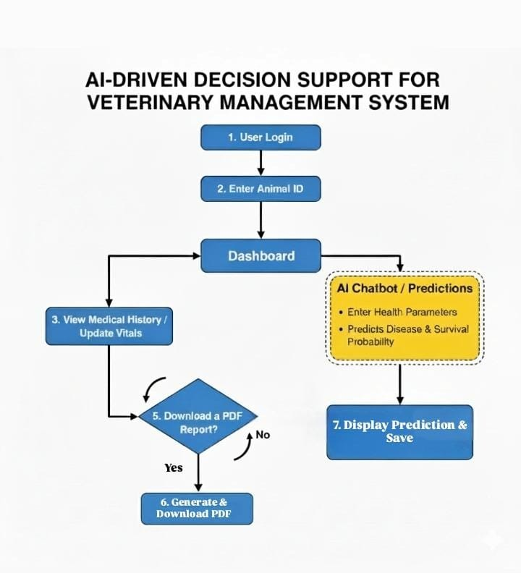
PROPOSED METHODOLOGY
Figure 1 : Methodology flow
10
DEPARTMENT OF COMPUTER SCIENCE AND ENGINEERING- ARTIFICIAL INTELLIGENCE & MACHINE LEARNING

Slide 11
), and health status.- *Decision Support:* Symptom entry, automated AI-based
Authentication and Security: Login system and password management.
Health Record Module: Tracks animal ID, species, breed, sex, vitals (BP, heart rate), and health status.
Task Automation: Vaccination data, PDF report generation, QR code scanning for access.
Decision Support(Chatbot): Doctor-friendly interface to guide symptom entry and automated AI-based diagnosis and survival rate
SYSTEM DESIGN
DEPARTMENT OF COMPUTER SCIENCE AND ENGINEERING- ARTIFICIAL INTELLIGENCE & MACHINE LEARNING
11

Slide 12
OUTCOMES
Streamlined workflow for veterinarians and animal owners; reduces administrative burden. Accurate, AI-driven diagnosis suggestions and alerts, improving early intervention rates. Enhanced record quality and accessibility—enables evidence-based and data-driven health management. Quick reporting via automated PDF, easy scanning using QR codes.
DEPARTMENT OF COMPUTER SCIENCE AND ENGINEERING
12

Slide 13
CONCLUSION
The AI-driven decision support system significantly advances veterinary management by unifying records, analysis, and recommendations in one platform Addresses critical research and operational gaps, supporting more proactive, precise, and efficient animal healthcare. Paves the way for smarter, scalable, and personalized veterinary services especially useful in rural and resource-constrained settings.
DEPARTMENT OF COMPUTER SCIENCE AND ENGINEERING
13

Slide 14
PAPER / PATENT DETAILS
The project has resulted in a draft patent application that is currently under the process of preparation and approval. The patent details have been discussed and reviewed with our project guide, and the application is being finalized for official submission to the Patent Office.
DEPARTMENT OF COMPUTER SCIENCE AND ENGINEERING
14

Slide 15
REFERENCES
[1] Prashanna J and Dr. Vanita Jaitly, “AI-Powered Veterinary Chatbot for Automated Diagnosis,” Proceedings of the International Conference on Inventive Computation Technologies (ICICT), pp. 1629–1635, Jan. 2025. [2] Y.-G. Jin, G. Wu, J.-W. Seo, S.-J. Park, S.-H. Hur, D. Aliyeva, J.-H. Park, and K.-M. Kim, “AI Veterinary Assistance: Enhancing Clinical Decision-Making in Animal Healthcare,” IEEE Access, vol. 13, pp. 119292–119299, July 2025. [3] A. N. Manikanta, A. F. Baba, D. S. Vyshnavi, D. K. Paul, and S. S. Sreedhar, “Cloud IoT Based Surveillance System for Tracking and Monitoring of Domestic Animals,” International Conference on Integrated Circuits and Communication Systems (ICICACS), pp. 1–6, December 2024. [4] Dr. Deepika Soni, Dr. Awanit Kumar, Dr. Vikas Somani, and Dr. Sheshang Degadwala, “Veterinary Medical Records Application using AWS,” 5th International Conference on Mobile Computing and Sustainable Informatics (ICMCSI), pp. 578–583, Feb. 2024.
15
DEPARTMENT OF COMPUTER SCIENCE AND ENGINEERING

Slide 16
REFERENCES
[5] Samuel S. Chua, Jolina A. Alis, and Mary Joelyn Oria, “Web-Based Veterinary Clinic with e-Mail and SMS Notification,” 9th International Conference on Business and Industrial Research (ICBIR), pp. 1160–1165, May 2024. [6] M. Madheswaran, S. Aghalya, R. Dhanalakshmi, S. Raju, G. Ramasubramanian, and P. Thirumaraiselvan, “Advancements in Immunization Management for Personalized Vaccine Scheduling with IoT and Machine Learning,” 10th International Conference on Communication and Signal Processing (ICCSP), pp. 1566–1570, April 2024.
16
DEPARTMENT OF COMPUTER SCIENCE AND ENGINEERING

Slide 17
SAI VIDYA INSTITUTE OF TECHNOLOGY Approved by AICTE, New Delhi, Affiliated to VTU, Recognized by Govt. of Karnataka, Accredited by NBA, New Delhi (CSE, ECE. ISE) NAAC "A" Grade
THANK YOU
DEPARTMENT OF COMPUTER SCIENCE AND ENGINEERING

