Slide 1

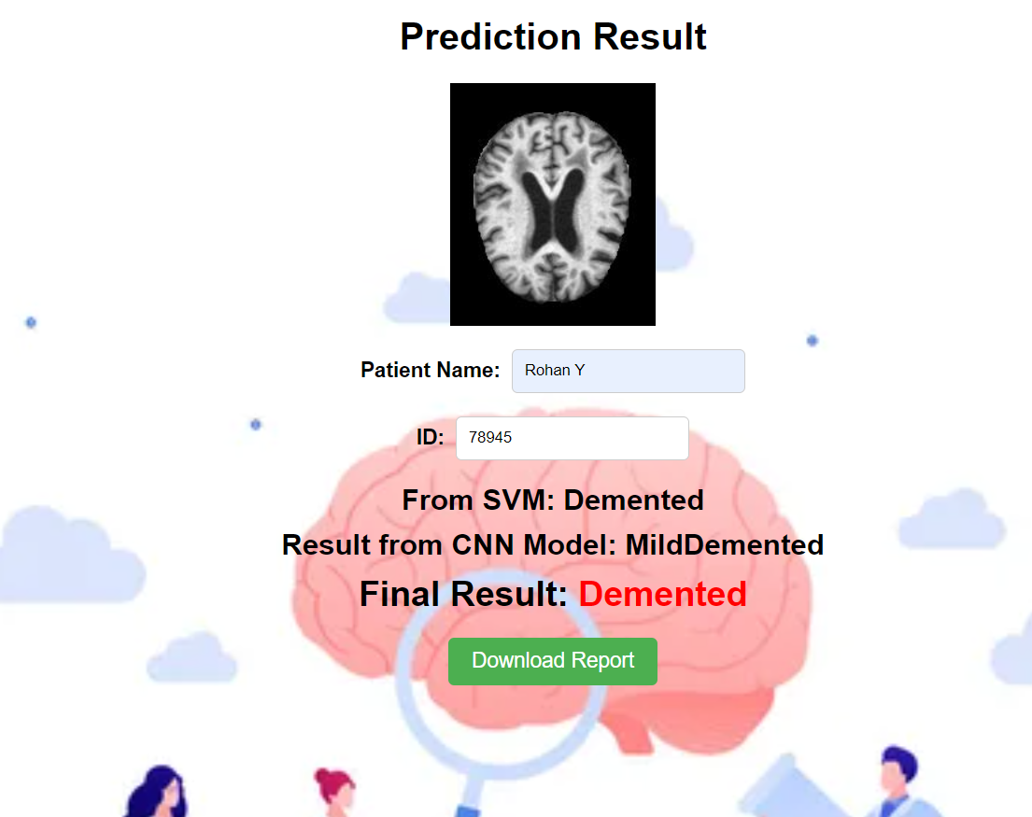
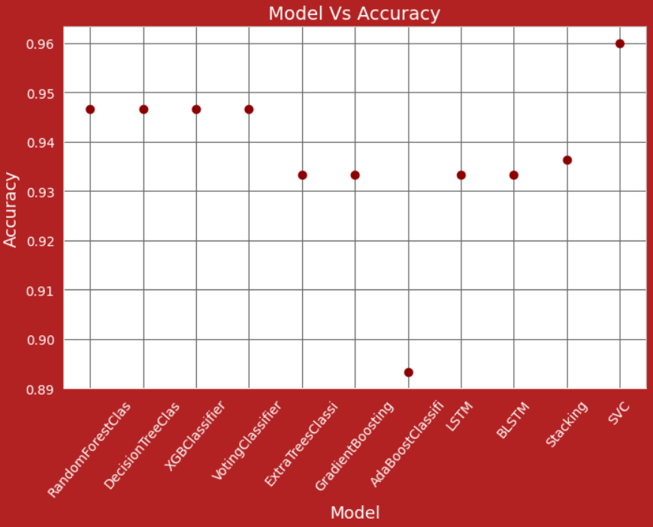
Comprehensive Dementia Detection:
MRI Insights and Patient Information
Objectives
Goals of the Project
MRI Image Analysis
Using CNN to analyse MRI scan
Patient Data Analysis
Based on reported data such as MMSE,CDR,Etiv,nWBV,ASF
1.Develop and deploy separate prediction model
2.Enhance predictive accuracy
3.Facilitate admin friendly interface
Methodology
Data Collection
Preprocessing
Model Development
Evaluation and Validation
Integration into Web Application
Results
COMBINED
ACCURACY 99.88%
CNN ACCURACY 97%
SVM ACCURACY 96%
Conclusion
In summary, this project endeavors to revolutionize early dementia detection through a fusion of cutting-edge MRI insights and patient-specific data analysis.
By integrating convolutional neural networks (CNN) for MRI analysis and classification algorithms for patient records, the initiative aims to create a unified predictive model.
TEAM MEMBERS **********
GUIDED BY: **********

