Slide 1

Batch Name: UST-GLOBAL BATCH-3
LIBRARY MANAGEMENT SYSTEM
By:
Ranjana.H.S

Slide 2
PROBLEM STATEMENT
This project is aimed at developing Library Management System (LiMS) for the college library.
Students of the college usually unable to access library because of shortage of time and hence they cannot get proper reading facility. For the purpose of management of time , there is a need of an Intranet based application.
Solution
This is an Intranet based application that can be accessed throughout the campus. This system can be used to search for books/magazines; reserve books, and issue/return books from the library. This is an integrated system that contains both the user component and the librarian component.
From this application , students can get easily access to library.

Slide 3
TECHNOLOGIES USED IN LIBRARY MANAGEMENT SYSTEM
JPA With Spring Rest
Angular 7
SOFTWARE REQUIREMENTS
Apache Tomcat Web Server
MySQL
Visual Studio Code

Slide 4
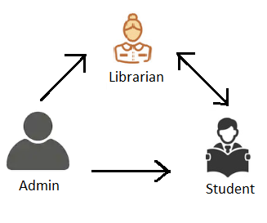
MODULES
Admin
2.Librarian
3.Student

Slide 5
DESIGN PATTERNS
DTO: It contains Bean Classes ie.POJO(Plain Old Java Object).
DAO: It is used for database interaction.
Service: It contains business logic codes.
Controller: It handles Http request and response.
Conﬁguration: It contains bean deﬁnition.

Slide 6
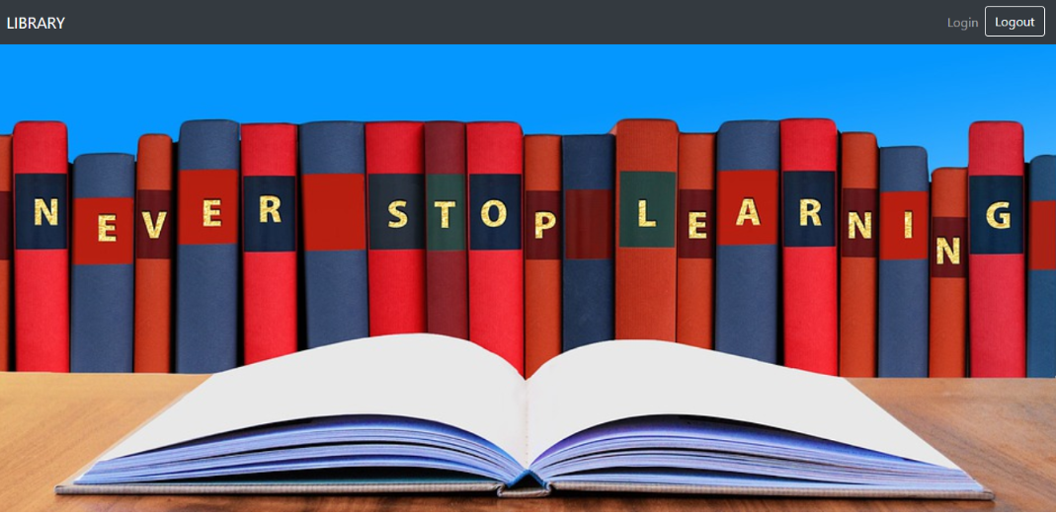
RESULTS
Home Page

Slide 7
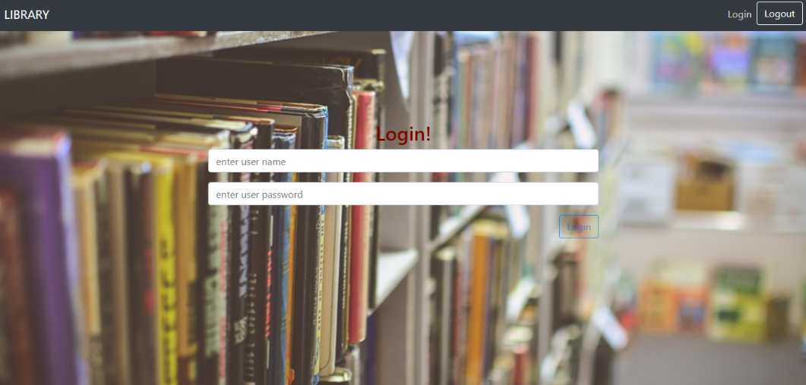
Login Page

Slide 8
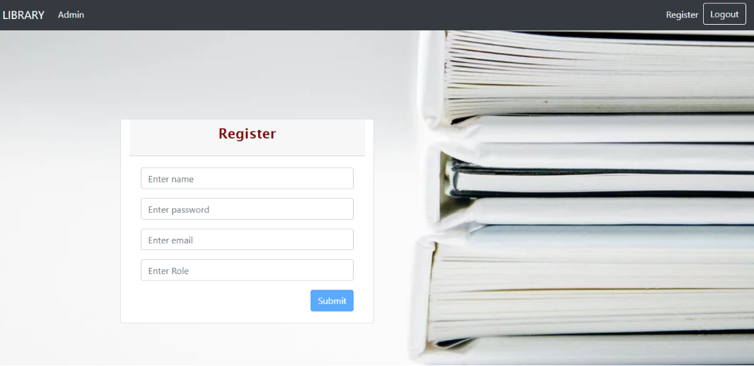
Register Page

Slide 9
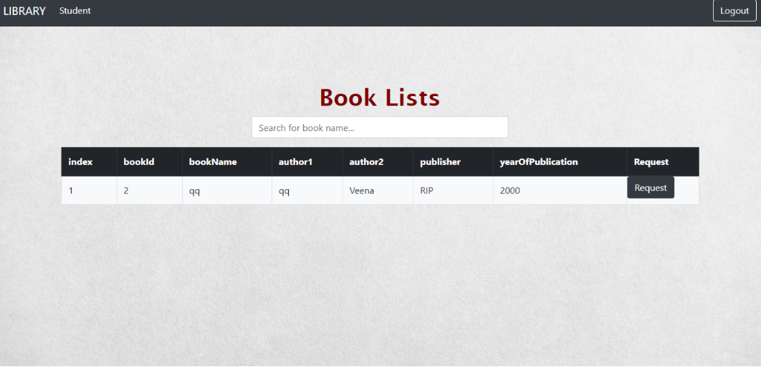
Request Book Page

Slide 10
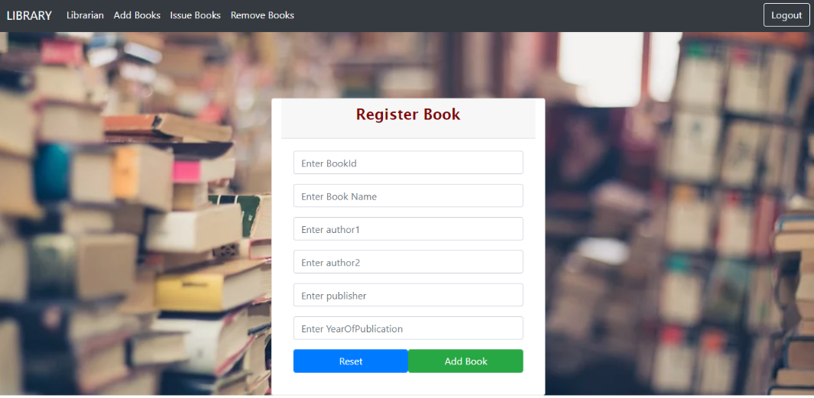
Add Book Page

Slide 11
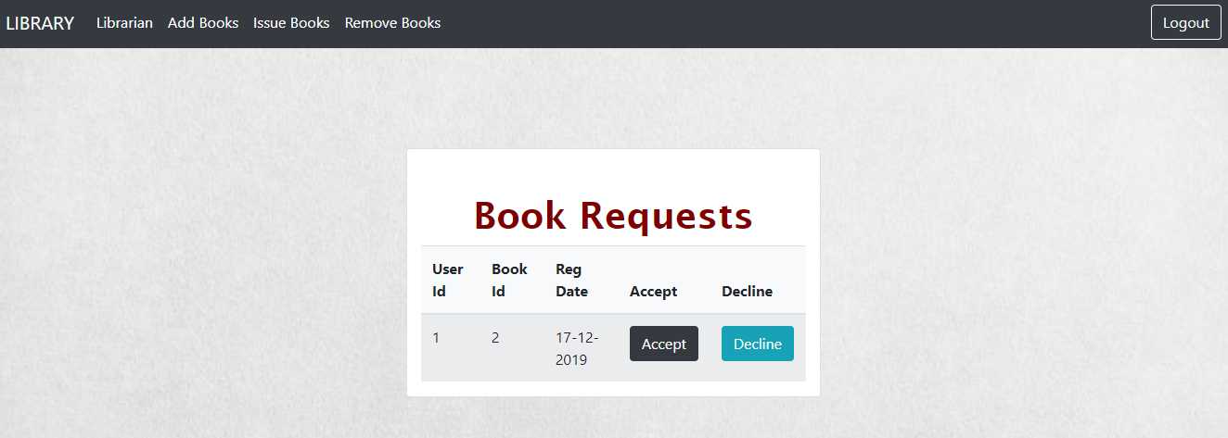
Book Request Page

Slide 12
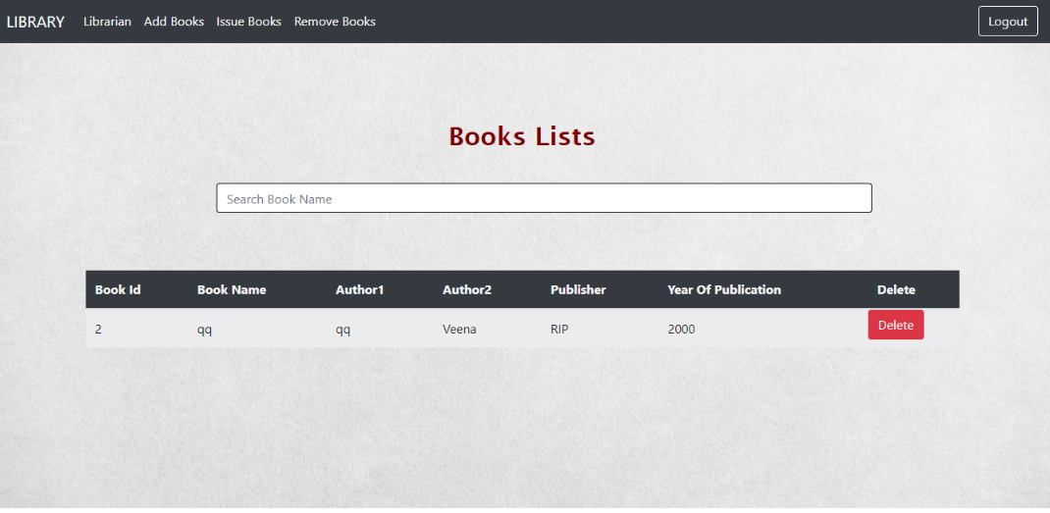
Remove Book Page

Slide 13
THANK YOU

