Slide 1
Introduction
Medicare
Doctor Appointment Management System
MERN Stack Project
MediCare is a MERN-based doctor appointment management system designed to make the process of booking and managing medical appointments simple and efficient.
The system provides separate interfaces for patients and doctors. Patients can register, securely log in, view available services, book appointments, check appointment status, and provide feedback after consultation. Doctors can manage appointments, patients, and disease information through a dedicated dashboard.
The main goal of MediCare is to reduce manual appointment management and provide a secure, organized, and user-friendly healthcare platform.
• Patient appointment booking
• Doctor administration
• Disease and feedback management
Project Presentation

Slide 2
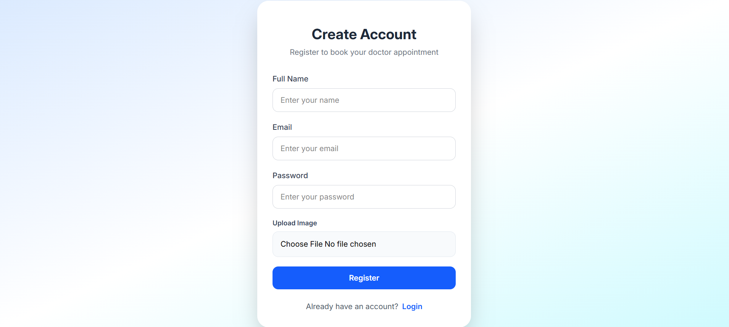
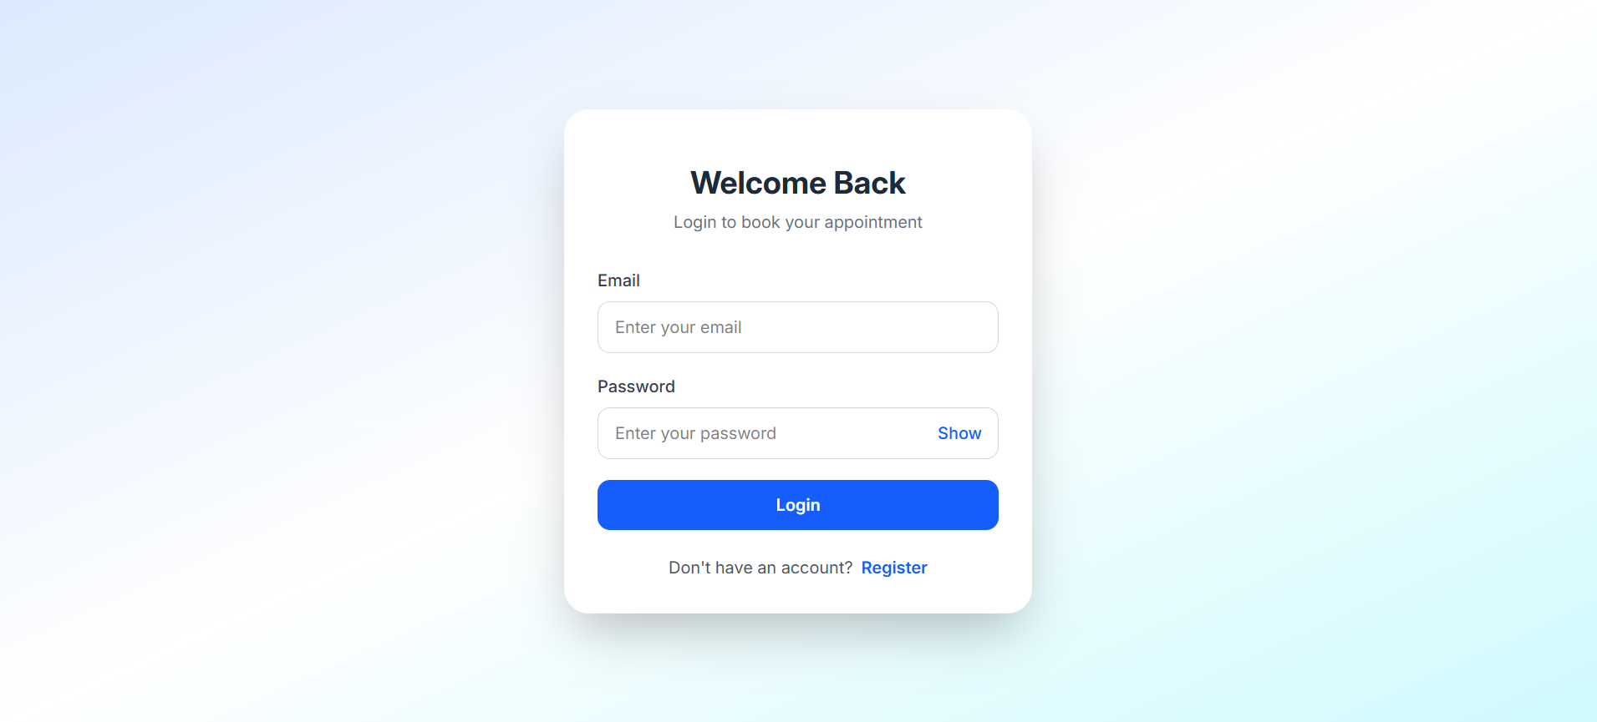
User Registration & Login
Secure entry point for patients
Patient Registration
Patient Login
MediCare • Doctor Appointment Management System

Slide 3
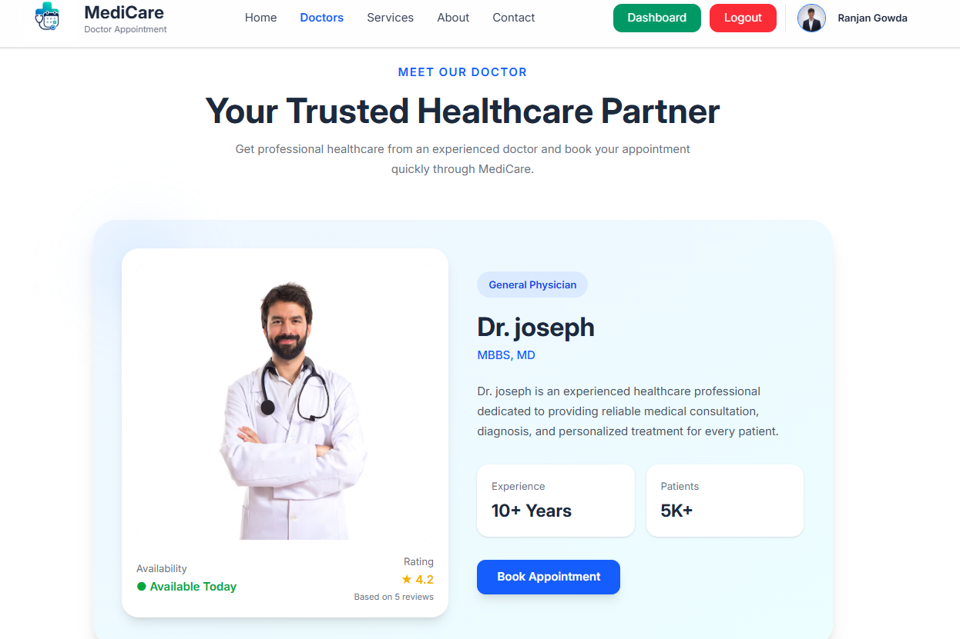
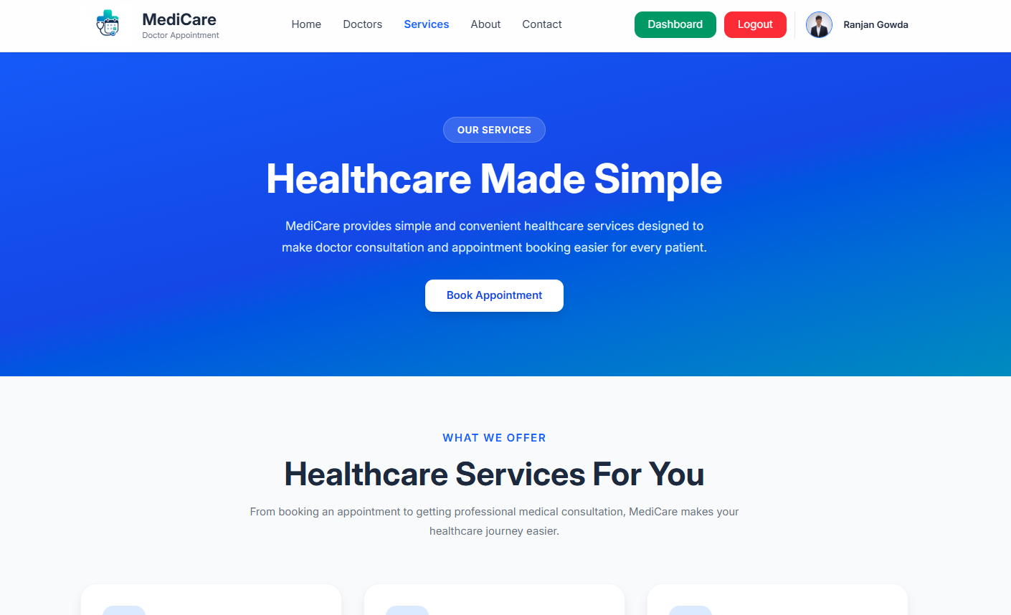
Doctors & Healthcare Services
Patients can explore the available doctor and services before booking
Doctor information and availability
Healthcare services
MediCare • Doctor Appointment Management System

Slide 4
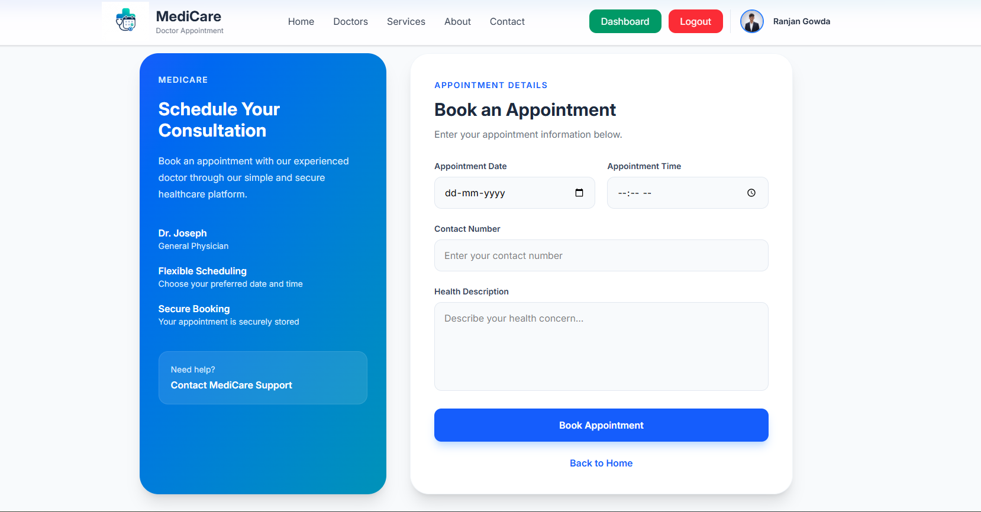
Appointment Booking
The patient selects date, time, contact number and health description
• Select an appointment date and time.
• Time slots are scheduled in 15-minute intervals.
• Enter contact details and health concern.
• The system checks the selected slot before booking.
• New appointments start with Pending status.
MediCare • Doctor Appointment Management System

Slide 5
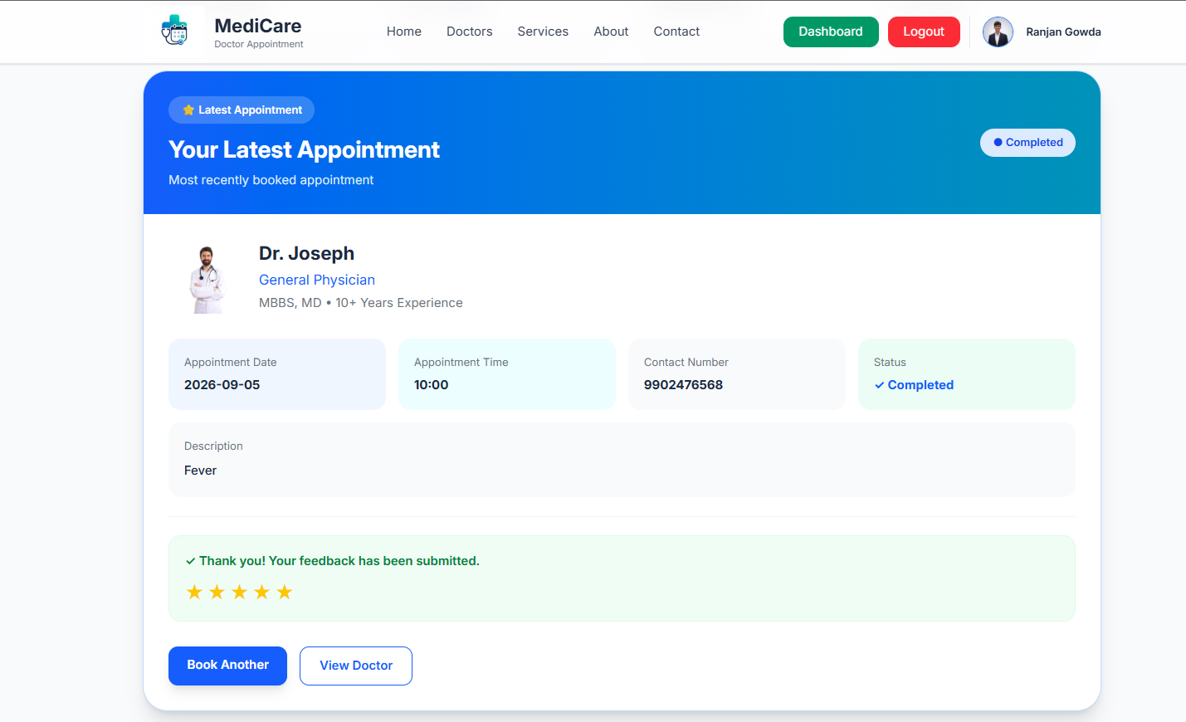
Patient Dashboard
Patients can track their latest appointment and feedback
• Displays the latest appointment details.
• Shows appointment date, time and status.
• Patients can book another appointment.
• Feedback can be submitted after completion.
• Doctor rating is displayed to the patient.
MediCare • Doctor Appointment Management System

Slide 6
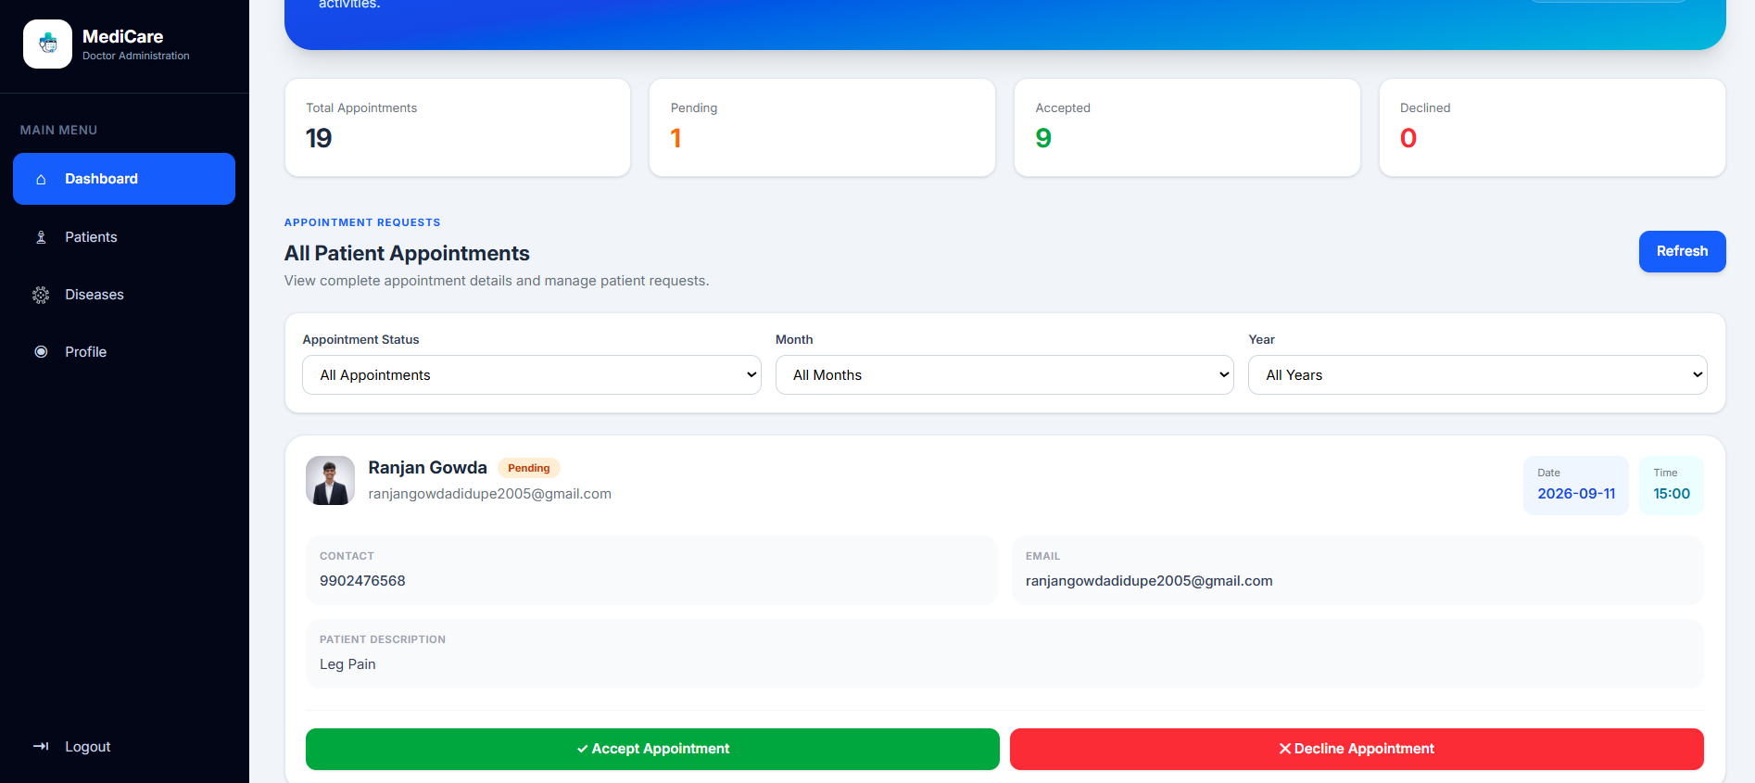
Doctor Dashboard
Central area for monitoring appointment activity
• Shows total appointment activity.
• Displays Pending, Accepted and Declined counts.
• Provides access to patient and disease modules.
• Doctor can monitor incoming appointment requests.
MediCare • Doctor Appointment Management System

Slide 7
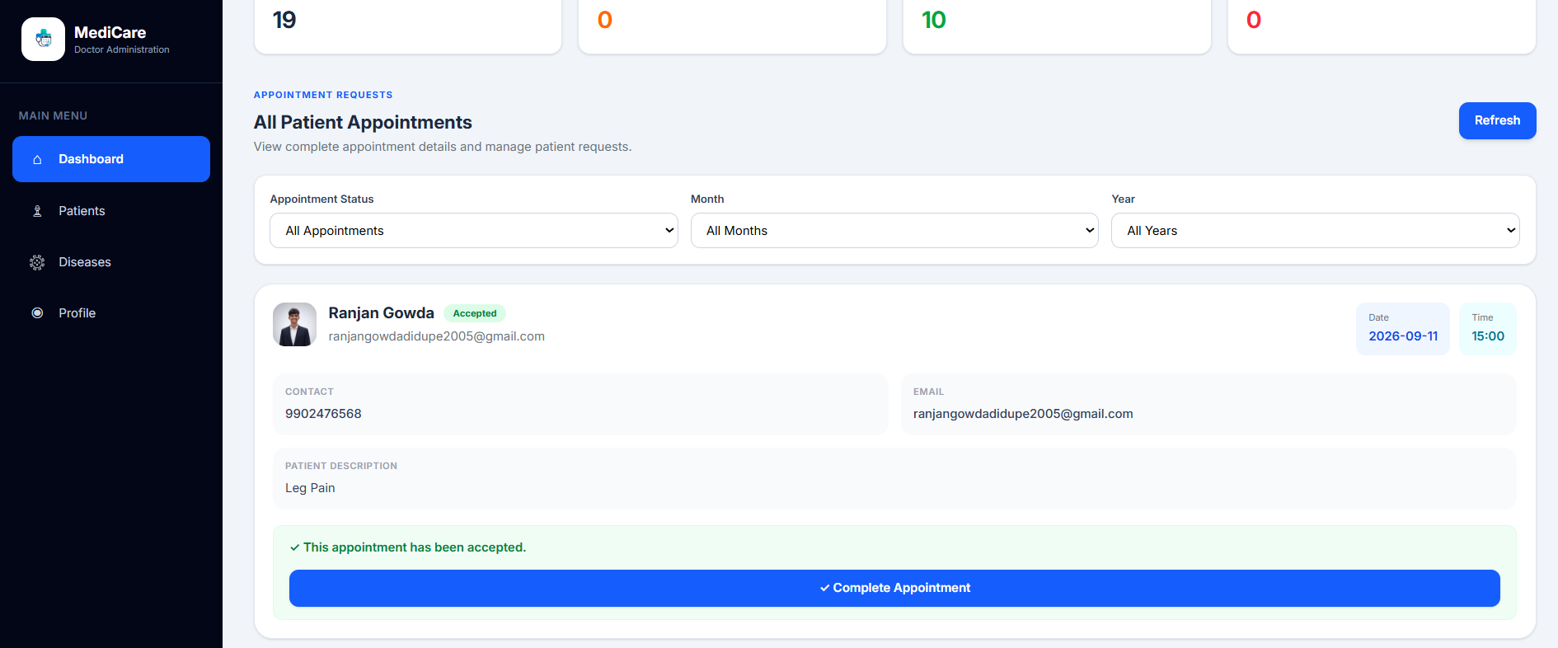
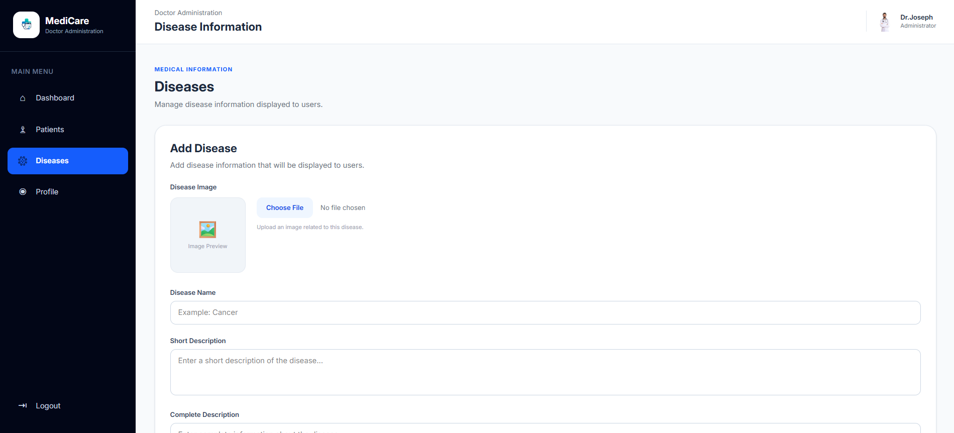
Doctor Appointment Management
Appointment requests move through controlled status stages
Pending → Accepted / Declined → Completed
Pending appointment • Accept / Decline
Accepted appointment • Complete
MediCare • Doctor Appointment Management System

Slide 8
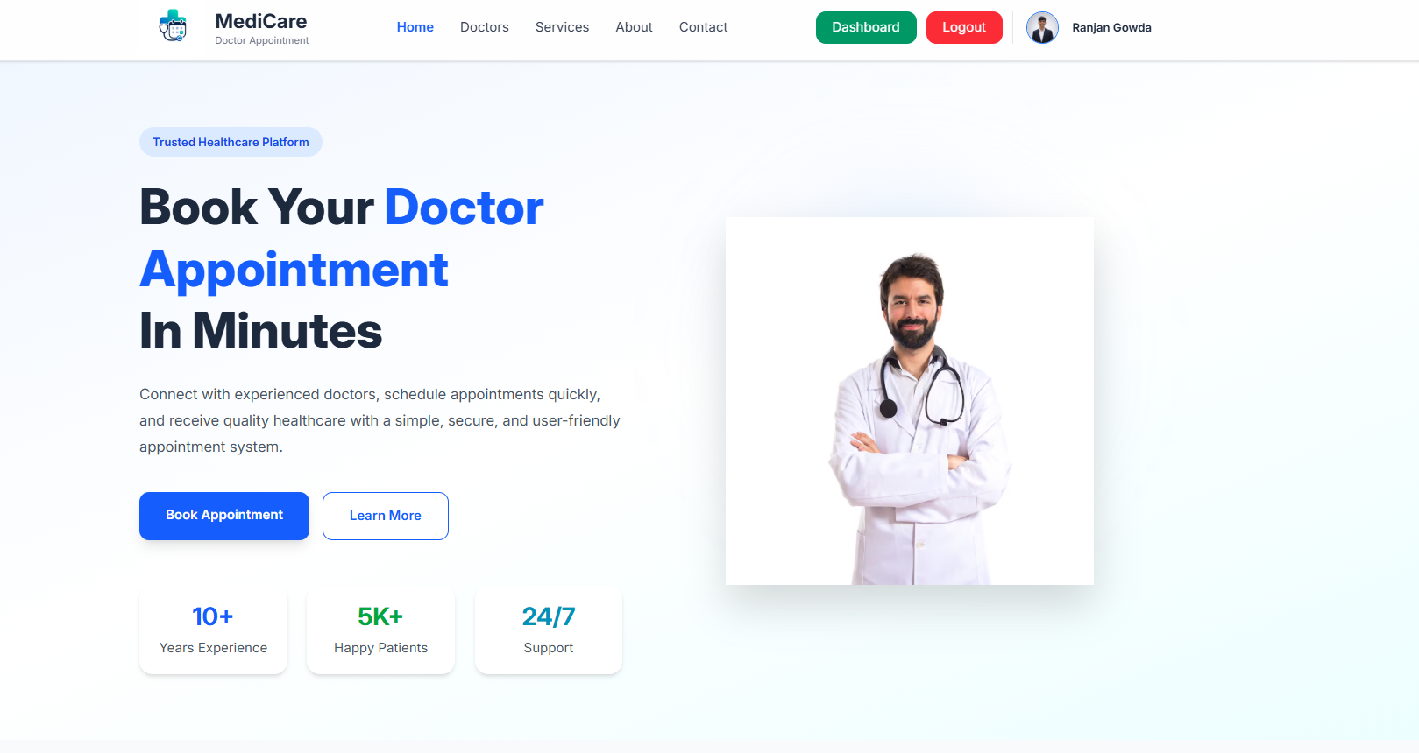
Patient Management
Doctor can review patient records generated from appointments
• Displays total and active patient counts.
• Shows patient name, email, contact and last visit.
• Appointment status is visible for each patient.
• Search helps the doctor locate patient records quickly.
MediCare • Doctor Appointment Management System

Slide 9
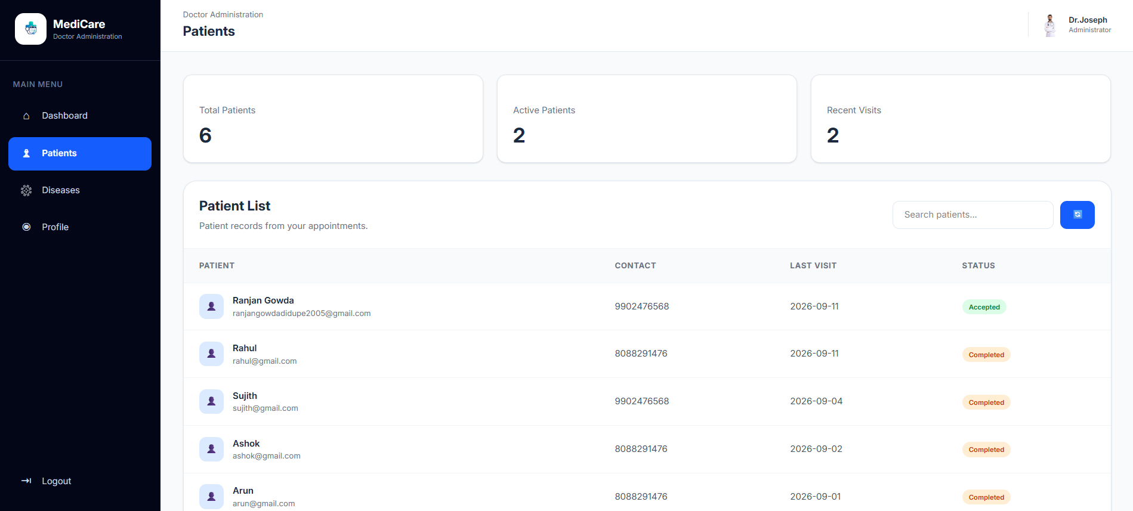
Disease Information Management
Doctor administration page for maintaining medical information
• Add disease name, descriptions and medical details.
• Upload a disease image using the application.
• Disease information is stored and displayed to users.
• The module supports Create, Read, Update and Delete operations.
MediCare • Doctor Appointment Management System

Slide 10
Technology, Architecture & Conclusion
How the MediCare application works
Frontend
React.js
React Router
Tailwind CSS
Axios
Backend
Node.js
Express.js
REST API
Middleware
Database
MongoDB
Mongoose
Security & Tools
JWT • bcrypt
Redis • Multer
localStorage • Git
React Frontend → Axios → Express API → Authentication → Controllers → Mongoose → MongoDB
Conclusion
MediCare provides a simple and secure platform for patient appointment booking and doctor-side management, including appointments, patients, diseases and feedback.
Future scope: online payments, notifications, video consultation and multiple doctors/departments.
MediCare • Doctor Appointment Management System

Slide 11
Thank You

