Slide 1

A Bayesian Convolutional Neural Network To Predict The Intensity Of Diabetic Retinopathy

Slide 2
Team Members
Vignesh Kumar Thangarajan
Sivaranjani Kumar
Pooja Patil

Slide 3
Abstract
Diabetic Retinopathy is one of the major risks of losing vision among the people who have diabetes. If found early, there is a higher chance of treating the disease otherwise it might cause irrecoverable blindness in people. Although we have many deep learning models to identify the risk of DR from eye images, we do lack the uncertainty of prediction in those models. In other words, in connectionist models, the network uses point estimates as weights and it performs well with large datasets, but they fail to express uncertainty in regions with little or no data. The proposed model will try to achieve the accuracy rate as high as the frequentist inference models. In addition to that, it handles uncertainty and avoids overfitting the data. Research has shown that it also eliminates the use of dropouts in the model.

Slide 4
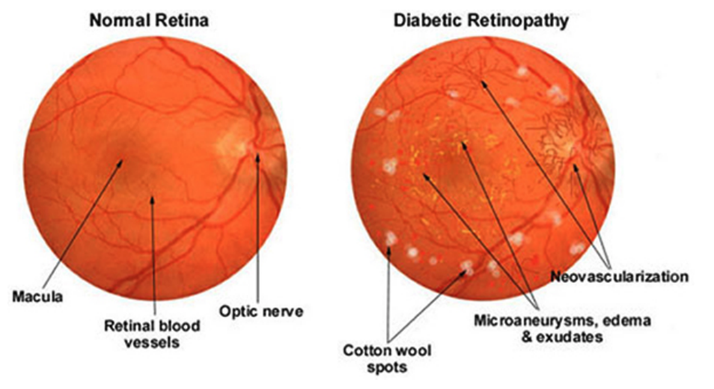
Introduction
What is Diabetic Retinopathy?
Diabetic retinopathy (DR), also known as diabetic eye disease, is a medical condition in which damage occurs to the retina due to diabetes mellitus. It occurs when the damaged blood vessels leak blood and other fluids into your retina, causing swelling and blurry vision. The blood vessels can become blocked, scar tissue can develop, and retinal detachment can eventually occur. The condition is easiest to treat in the early stages, which is why it is important to undergo routine eye exams.
Retinal (fundus) photography with manual interpretation is a widely accepted screening tool for diabetic retinopathy. Millions of people are suffering from DR around the world. Detecting DR is time consuming and the process is quite long. Instead we train our deep learning neural networks model to identify the early signs of blindess given an eye image of a person and rate it among 5 different class.

Slide 5
Approach
Transfer Learning
The Eye Image data is trained using the concept of 'Transfer Learning', to make training faster comparatively as well to improve accuracy.
Models Used
Resnet 50
VGG 16
Inception v3

Slide 6
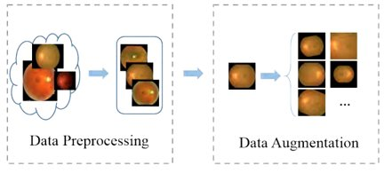
Eye Image Data Collection
We collected the data from Kaggle APTOS 2019 Blindness Detection. It is a large set of retina images taken using fundus photography under a variety of imaging conditions.
We encountered lot of noise in both images and labels.
Many images are out of focus, underexposed, or overexposed. The images were gathered from multiple clinics using a variety of cameras over an extended period, which will introduce further variation.
The size of the image data is over 10 GB.

Slide 7
Data Labels
A clinician has rated the presence of diabetic retinopathy in each image on a scale of 0 to 4, according to the following scale:
0 - No DR,
1 – Mild,
2 – Moderate,
3 – Severe,
4 - Proliferative DR

Slide 8
Technology Stack
Colab- For Development
Deployment – Webapp
Tensorboard Integration
Libraries used
Keras
OpenCV
Tensorflow_probability

Slide 9
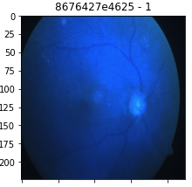
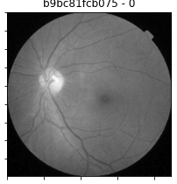
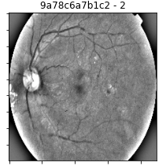
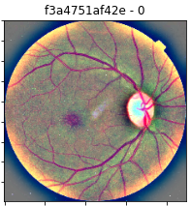
Image Transformation
The original image is improper in shape and has lot of noise. Few of them have high resolution images and some have poorly oriented images.
We used a library named OpenCv to read images and applied some transformation on top of the images. So our model will be able to learn precisely from the data and the accuracy is increased.
For our model, We have converted image from BGR2RGB and removed noise by cropping the image, then we resized every image to same pixel size (224*224*3) and at last we applied a technique called Gaussian Blur, in order to highlight the places in eye image that are affected.

Slide 10
State-of-the-art Models
A common and highly effective approach to deep learning on small image datasets is to leverage a pre-trained network. A pre-trained network is simply a saved network previously trained on a large dataset, typically on a large-scale image classification task.
ResNet50
VGG16
InceptionV3
There are two ways to leverage a pre-trained network: feature extraction and fine-tuning.

Slide 11
Key points
Data Augmentation enables us to create valid perturbations of relatively small datasets to great effect
Pre-Trained models provide an excellent starting point for acquiring completely distinct domain knowledge
Dropout helps prevent overfitting
Activation Function provides non-linear property to the NN.
Fine Tuning Model: Another widely used technique for model reuse, complementary to feature extraction, is fine-tuning. Fine-tuning consists in unfreezing a few of the top layers of a frozen model base used for feature extraction, and jointly training both the newly added part of the model (in our case, the fully-connected classifier) and these top layers. This is called "fine-tuning" because it slightly adjusts the more abstract representations of the model being reused, in order to make them more relevant for the problem at hand.

Slide 12
Model Comparison
Model | Test Accuracy | Train Accuracy
Resnet 50 | 70% | 90%
VGG 16 | 65% | 77%
Inception V3 | 64% | 89%

Slide 13
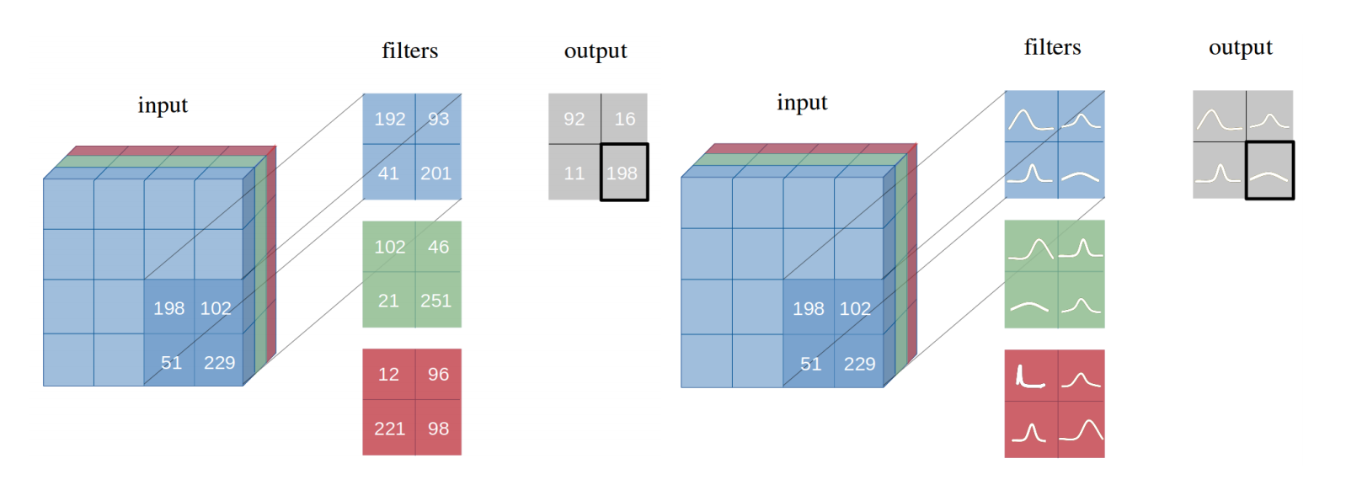
Probabilistic Machine Learning
Variational Inference : We define a function y = f(x) that estimates the given inputs {x1, . . . , xN } and their corresponding outputs {y1, . . . , yN } and produces an predictive output. Using Bayesian inference, a prior distribution is used over the space of functions p(f). This distribution represents our prior belief as to which functions are likely to have generated our data.
Uncertainties in Bayesian Learning : Uncertainties in a network is a measure of how certain the model is with its prediction. In Bayesian modelling, there are two main types of uncertainty one can model : Aleatoric uncertainty and Epistemic uncertainty.

Slide 14
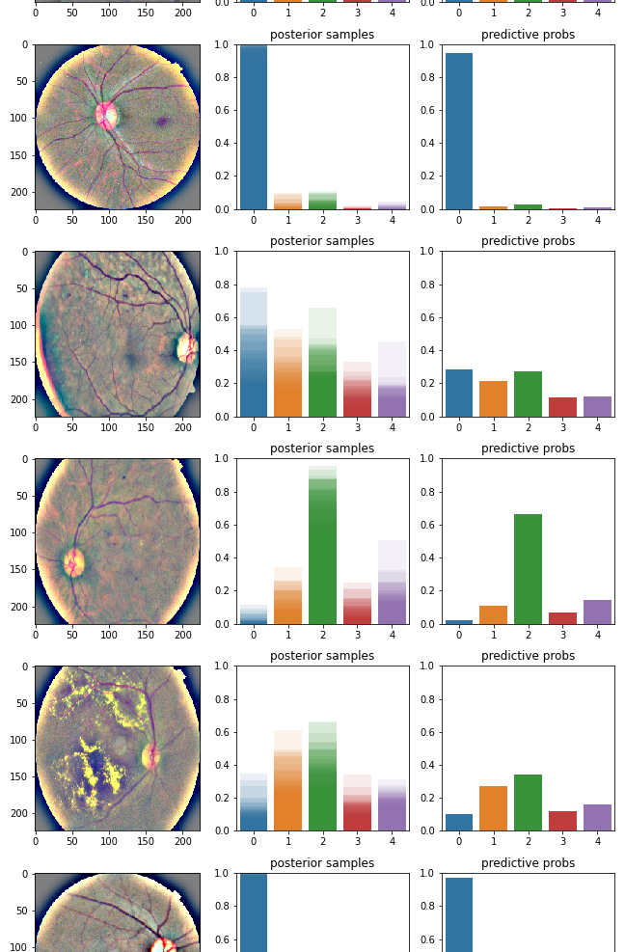
Bayesian Model
Bayesian Model
Accuracy – 70%

Slide 15
Reference
https://www.eyeops.com/contents/our-services/eye-diseases/diabetic-retinopathy
https://www.kaggle.com/c/aptos2019-blindness-detection/data
https://ieeexplore.ieee.org/stamp/stamp.jsp?tp=&arnumber=8581492
https://docs.opencv.org/2.4/modules/imgproc/doc/filtering.html#
https://arxiv.org/pdf/1901.02731.pdf

Slide 16

Thank You

