Slide 1
BOOSTING ALGORITHMS

Slide 2
ADABOOST
AdaBoost algorithm, short for Adaptive Boosting.
It is called Adaptive Boosting as the weights are re-assigned to each instance, with higher weights assigned to incorrectly classified instances.

Slide 3
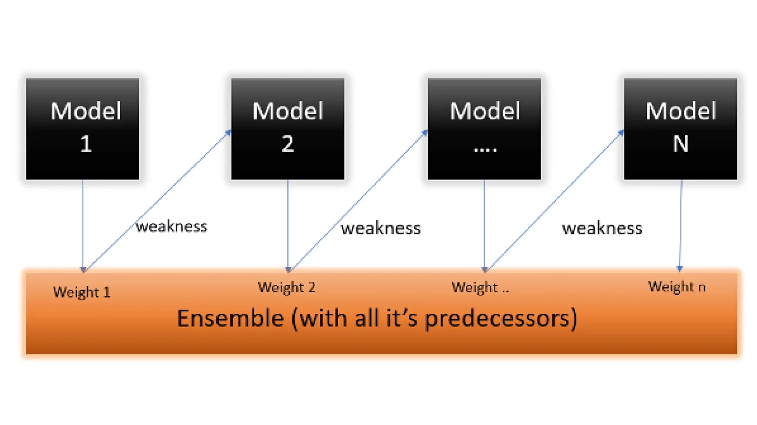

Slide 4
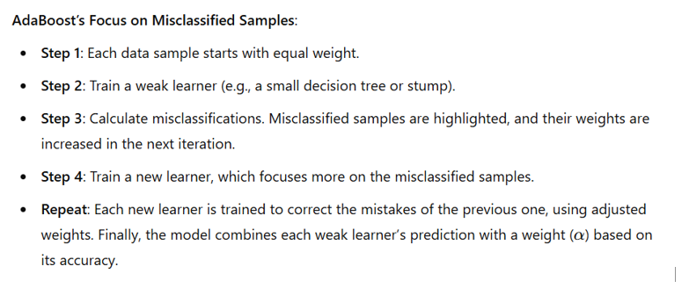
Adaboost Approach

Slide 5
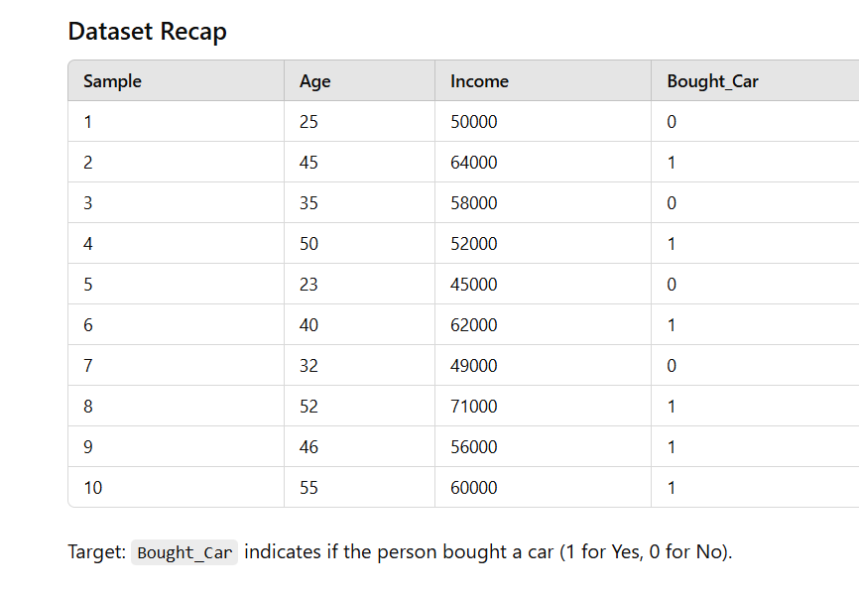

Slide 6
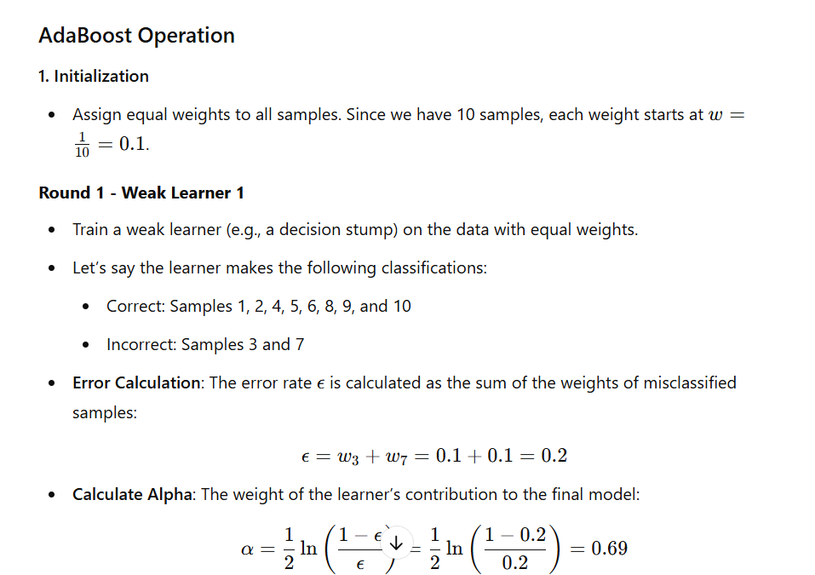

Slide 7
