Slide 1




Smart Vehicle Monitoring and Maintenance System
Team ID - CU_CP_Team_4171
Wagh Harshal Vikram
Ranjeet Bapurao Waghmode
Hrishikesh Rajendra Garje
Gavand Abhishek Rohidas
Prasad Ganesh Dongare

Slide 2

Project Objectives
Problem Statement
Project Overview – Introduction
Key objectives include
End Users
Wow Factor in Project
Modelling/Block Diagram/Flow of Project
Result/outcomes
Conclusion
Future Perspective

Slide 3
Problem Statement
Challenge:
1. Managing fleet operations, ensuring vehicle health, and predicting maintenance needs.
2. Lack of an integrated system leading to high maintenance costs, downtimes, and safety issues
Solution:
1. A unified platform to monitor, predict, and manage vehicle health and operations.
2. SAP integration for fleet management and predictive maintenance.
The increasing complexity of managing and maintaining a fleet of vehicles in various industries, along with the growing need for predictive maintenance, operational efficiency, and real-time safety monitoring, presents a significant challenge. Organizations face difficulties in tracking vehicle health, fuel consumption, maintenance schedules, and driver behavior effectively. The lack of a unified system that integrates vehicle health data and predicts failures before they happen leads to increased downtime, elevated maintenance costs, and higher safety risks.
This project aims to implement an IoT-based solution that integrates real-time vehicle monitoring, predictive maintenance, fleet management, and inventory management into a single cohesive platform, leveraging SAP technologies for streamlined operations. The system will utilize data from sensors installed in vehicles, such as temperature, fuel levels, and motion detection (via PIR sensors), to provide predictive insights and automate maintenance scheduling. Additionally, the system will monitor driver behavior, track fuel consumption, and optimize route efficiency.

Slide 4
Key objectives include:
To integrate sensor data for real-time monitoring of vehicle components (temperature, fuel levels, etc.).
Building a predictive maintenance model to foresee potential failures and schedule proactive maintenance.
Optimizing fleet management by providing insights into vehicle utilization, route efficiency, and driver behavior.
Creating a real-time dashboard that monitors vehicle status, predictive insights, and safety metrics, while also integrating features like music, navigation, and rear camera functionalities.
The system will also improve driver safety by detecting motion around the vehicle during parking using PIR sensors, providing warning alerts through lights and a buzzer, and monitoring environmental factors like gas levels and temperature. By combining predictive maintenance with real-time data and SAP technology, this system will reduce operational costs, improve safety, and enhance decision-making, providing significant value to fleet owners.

Slide 5
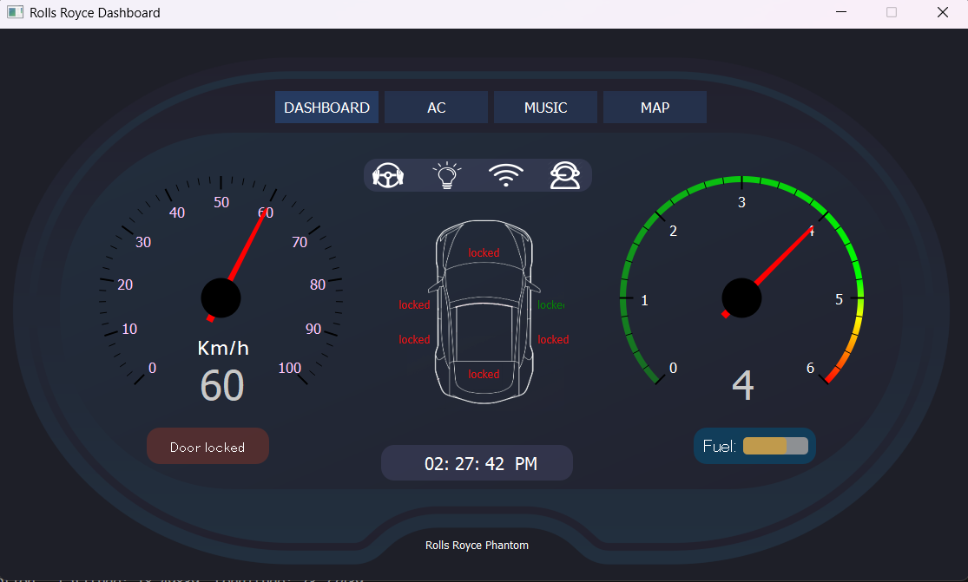
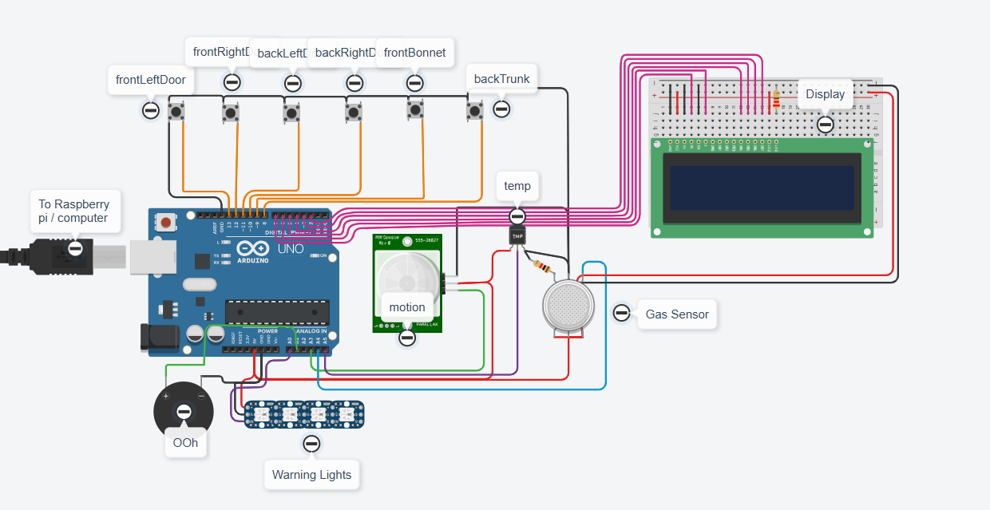
Project overview - Introduction
Addressing the complexities x fleet management, maintenance, and safety.
Leveraging IoT sensors, machine learning, and SAP technologies.
Real-time monitoring, predictive maintenance, and operational efficiency.

Slide 6
App Demonstration - Dashboard

Slide 7
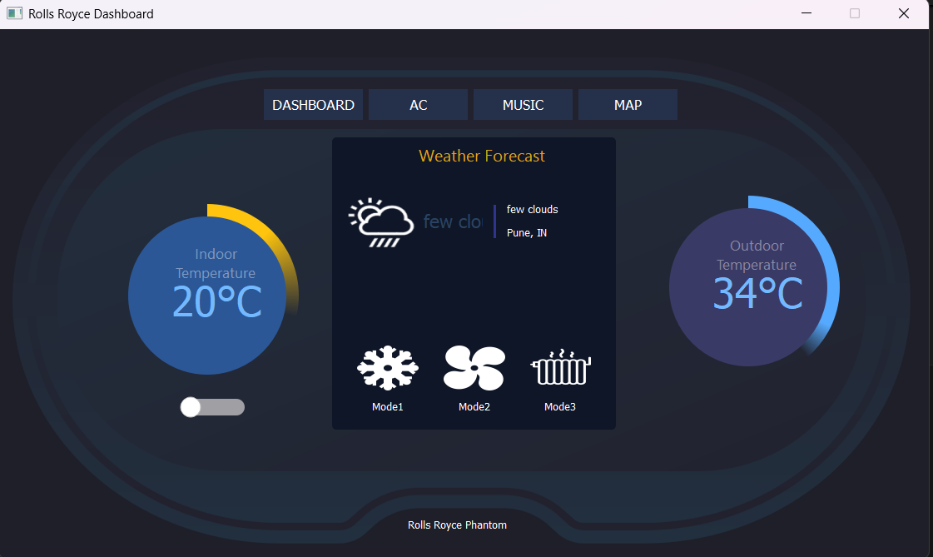
App Demonstration- AC

Slide 8
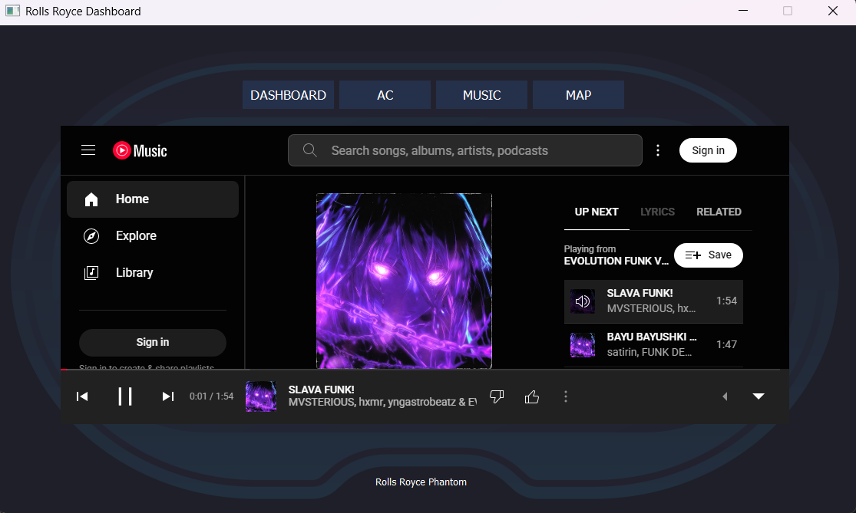
App Demonstration - Music

Slide 9
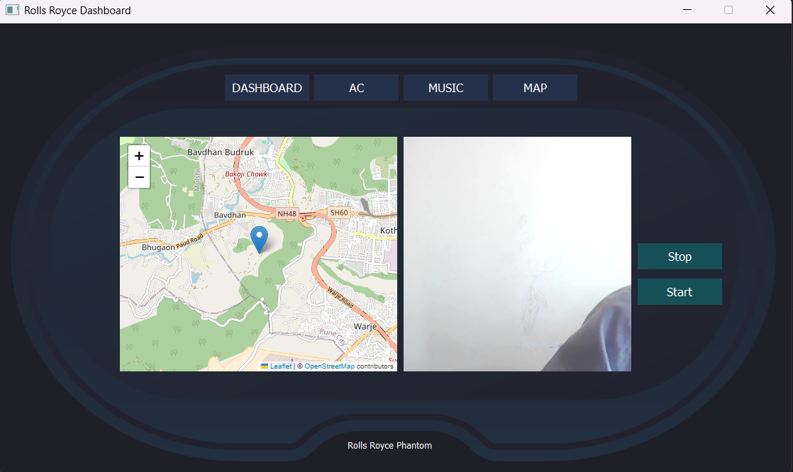
App Demonstration –Map & Rear camera

Slide 10
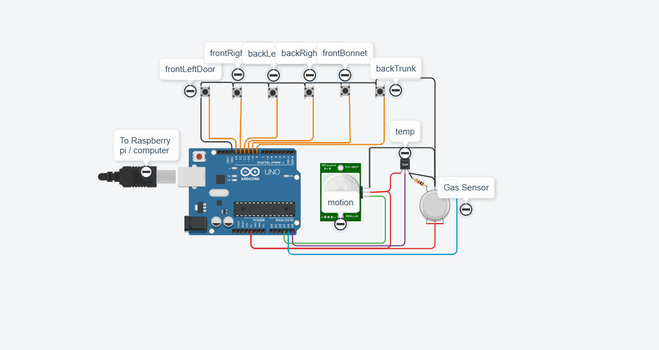
Version 1 : Prototyping and circuit diagram

Slide 11
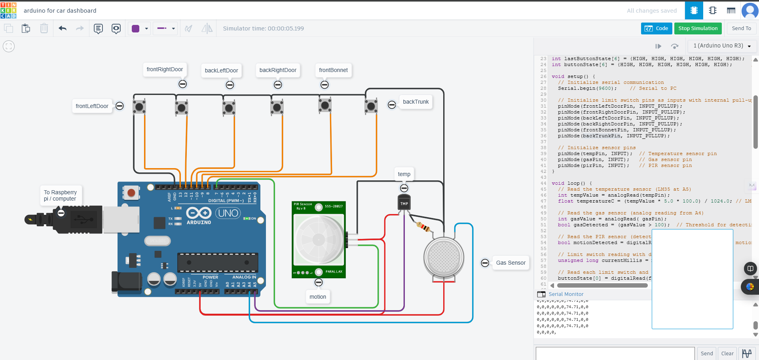
Version 2 : Prototyping and circuit diagram

Slide 12
Version 3 : Prototyping and circuit diagram

Slide 13
Thank You for Your Attention !
Notes:
13

