Slide 1


SMART INDIA HACKATHON 2025
TITLE PAGE
Problem Statement ID – SIH25061
Problem Statement Title- Digitize and Showcase Monasteries of Sikkim for Tourism and Cultural Preservation
Theme- Travel & Tourism
PS Category- Software
Team ID-
Team Name (Registered on portal)

Slide 2
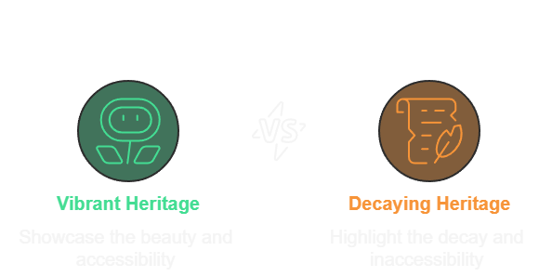
MONASTERY 360
Pixel
Nomads
Proposed Solution
Virtual Tours: Offers immersive 360° panoramic views of monastery interiors with narrated walkthroughs in multiple languages for a global audience.
Interactive Map: Provides a geo-tagged map of all monasteries, complete with travel routes, nearby attractions, and integration with local tourism services.
Digital Archives: Creates a centralized repository for preserving endangered cultural assets like scanned manuscripts, murals, and historical documents, all accessible via an AI-powered search engine.
Smart Audio Guide App: A location-based mobile app that delivers audio guides using GPS, with an essential offline mode for remote areas.
Cultural Calendar: Features a comprehensive schedule of monastery events, festivals, and rituals, offering tourists booking and participation options for direct engagement.
All-in-One Platform: It's not just a virtual tour or a map; it's a complete package that lets you explore monasteries from home, thn helps you plan and experience them in person.
Protects and Promotes: It simultaneously saves endangered historical documents digitally for future generations while making Sikkim's heritage accessible to the whole world, boosting both tourism and cultural preservation.

Slide 3
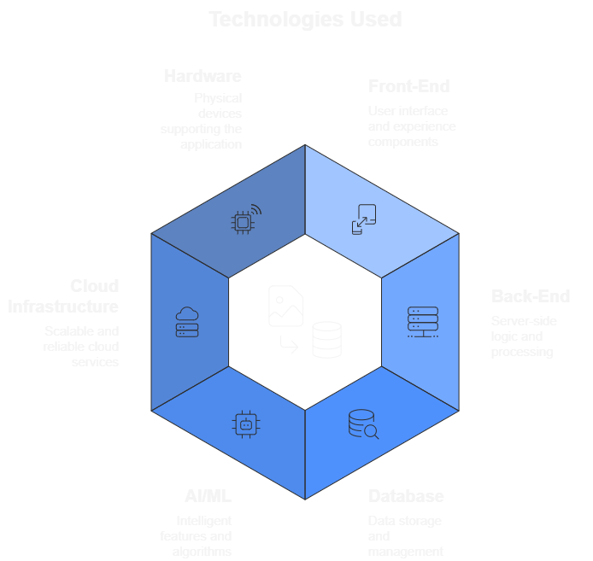
TECHNICAL APPROACH
Pixel
Nomads
The prototype will operate using the following technical approach
Front-End: React or Angular for the web and mobile apps.
Three.js for the immersive 360° virtual tours.
Back-End: Node.js or Python for server logic.
Database: A combination of a relational database (e.g.,
PostgreSQL) for structured data and a NoSQL database
(e.g., Firestore) for flexible data.
Cloud Infrastructure: Google Cloud Platform or AWS for
scalable hosting and data storage.
Hardware: GPS and Bluetooth beacons for location-based
audio guides.
APIs: Integration with Google Maps and other third-party
tourism and transport services.
AI/ML: Machine learning models (using
TensorFlow/PyTorch) for AI-powered search and
categorization of archives.

Slide 4
FEASIBILITY AND VIABILITY
Pixel
Nomads
Analysis of the feasibility of the idea.
Trust and Acceptance: The biggest challenge is getting permission from the monks and local communities. They might not want us to take pictures and scan their sacred places and old documents.
Hard-to-Reach Places: Many monasteries are high in the mountains and far away. It will be difficult and expensive to carry our equipment there to collect all the data.
Damaging Old Items: When we scan very old and fragile manuscripts or murals, there is a risk of accidentally breaking or damaging them forever.
Keeping the App Running: It will be a big challenge to find money to keep the platform.
Technical Feasibility: The project uses well-established technologies like 360° virtual reality and AI, making it technically achievable and scalable. The main challenge is the specialized skills required for development.
Economic Feasibility: While the initial investment for hardware and development is significant, the long-term potential for revenue from tourism and partnerships, along with its cultural preservation value, makes it a worthwhile investment.
Operational Feasibility: The primary challenges are logistical, including the extensive on-site data collection at remote monastery locations and the ongoing need for strong collaboration with local communities and government bodies.
Market Feasibility: There is a clear market need for a unified digital platform for Sikkim's monasteries, and the solution has a unique combination of features that gives it a significant advantage over existing, more limited offerings.
Build Trust: We will work directly with monks and local leaders from the start to make sure they are comfortable and involved in the project.
Careful Planning: Our team will plan and handle the logistics of getting our equipment to remote monasteries.
Secure Funding: We will seek government grants and partner with tourism agencies.

Slide 5
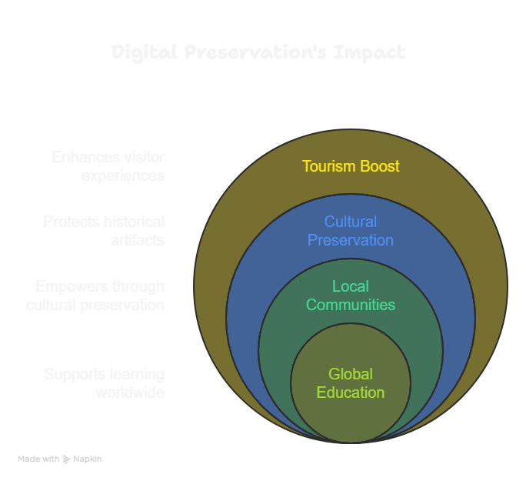
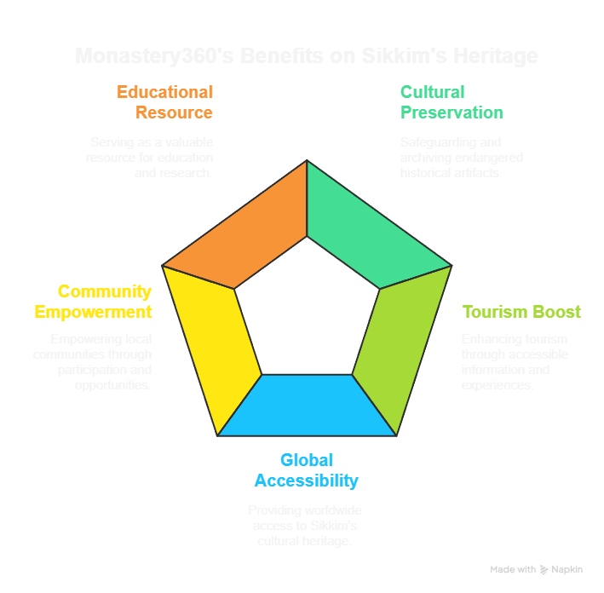
IMPACT AND BENEFITS
Pixel
Nomads

Slide 6
RESEARCH AND REFERENCES
Pixel
Nomads
https://sikkimtourism.gov.in/Public/index
https://www.rumtek.org/index.php
https://sikkimtourism.gov.in/Public/ThingsToDo/PilgrimageDetails/PL20A031?Type=Monastery&utm
https://www.aijmr.com/papers/2025/3/1128.pdf?utm

