Slide 1
Blood Bank Management System Via Cloud Computing
Submitted in the partial fulfillment for the award of the degree of
BACHELOR OF ENGINEERING
IN
COMPUTER SCIENCE WITH CLOUD COMPUTING(HONS.)
Submitted By
Ranjeet Singh -- 20BCS4012
V.Swaroopa -- 20BCS4030
Ayush Beniwal -- 20BCS4010
Kunal -- 20BCS4038
Under The Supervision of:
Geetinder Saini

Slide 2
Outline
Introduction to project
Problem Formulation
Objective of the work
Methodology used
Result and output
Conclusion
Future scope
References

Slide 3
INTRODUCTION
The project blood bank management system is known to be a pilot project that is designed for the blood bank to gather blood from various sources and distribute it to the needy people who have high requirements for it.
The software is designed to handle the daily transactions of the blood bank and search the details when required.
It also helps to register the details of donors, blood collection details as well as blood issued reports.
The software application is designed in such a manner that it can suit the needs of all the blood bank requirements in the course of future.

Slide 4
Problem Formulation
In this section, we will discuss the existing system and some of its drawbacks which force us to plan this whole idea of developing an online Blood bank management system. Let us take an example: Suppose there is some patient who needs blood urgently then how you come to know about this condition, you will not even able to reach the patient.
People will go from one blood bank to another to get the blood which is time-consuming and sometimes not able to reach at the time. In some blood banks, sometimes we get the blood but that is not sufficient so we need to search for another blood bank for more blood. If some person wants to donate the blood, he/she needs to come to the bank and need to fill the form then the first doctor will check his blood group after that he will allow donating.

Slide 5
Objective of the work
The main purpose of this project is to connect various ends of the blood donation process and automate it.
While easing the efforts taken for the blood searching/donating process the website is also is expected to make the process faster, easier, and reliable than normal traditional methods.
The website provides a very easy user interface with various features that are need of the hour. Some of which include locating blood banks near your location, sharing the obtained location with a dedicated share button, providing you with directions to the desired blood bank with an integrated google map button, a direct hyperlink to the contact details of that particular blood bank, availability along with the number of units of every blood group.
Real-time updating of units of blood available in the selected blood bank is one of the most prime features.

Slide 6
Methodology used
Blood bank Web Application
This Module Consist of element records of how utility works. The blood financial institution control machine is the web-primarily based totally on line utility with SMS in addition to Email alert characteristic diverse sharing alternatives thru social media packages and Blood financial institution locator. That applied the usage of HTML CSS PHP JavaScript and SQL for database.
In this Module the requests from receptors for the required blood organization are served.
The Blood donor can sign in at the machine and it will offer a donor identity entification at the crowning glory of registration thru Email service .if the fake request despatched to the blood financial institution the admin in addition to blood financial institution have complete rights to delete the request. In case If the request is despatched to blood financial institution for particular blood organization through consumer and his registration identity entification also generated however lamentably consumer won’t come, the machine robotically cancel his registration identity entification and replace blood financial institution facts through the usage of actual time updating The machine will tell to all of the applicable donors with the request. Blood financial institution can upload or cast off a donor from the machine. Also he can upload blood inventory to the applicable blood financial institution. Blood Bank Management machine has separate Admin panel.

Slide 7
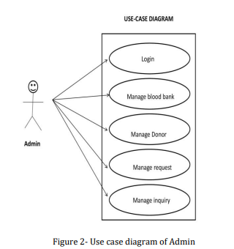

Slide 8
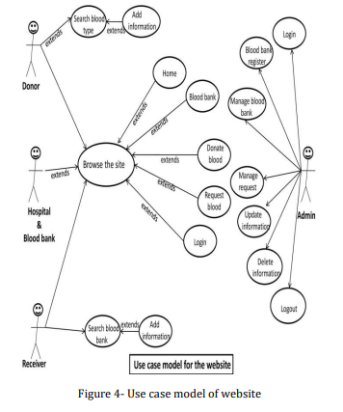

Slide 9
Database
In this system, database is used to record and manage the transactions of blood donations and blood issued.
The main purpose of this system is to keep an organize records management of blood. Information such as Donor Details, Blood Collection, Screening, Component preparation, Blood storage, Blood request, Compatibility, Blood issue, Monthly statistics records are stored using database.
It provides great help in the properly monitoring of blood available in the blood bank and for easy processing of blood request

Slide 10
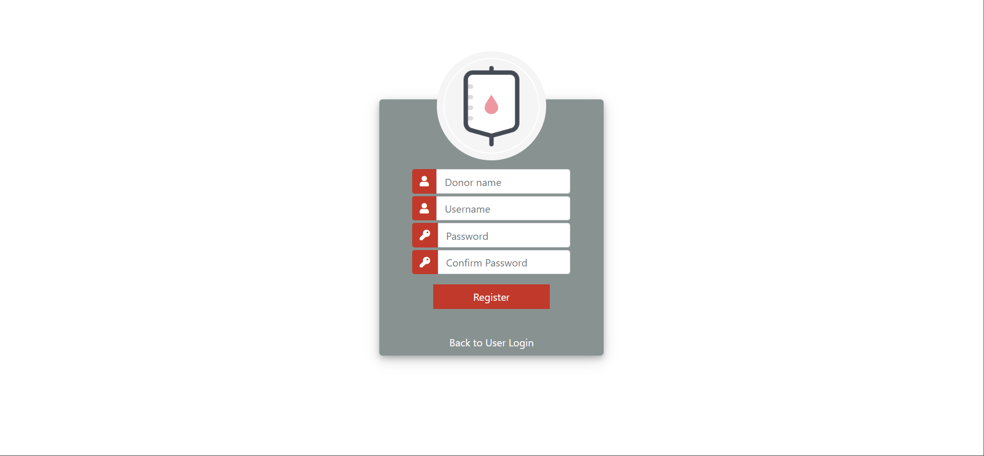
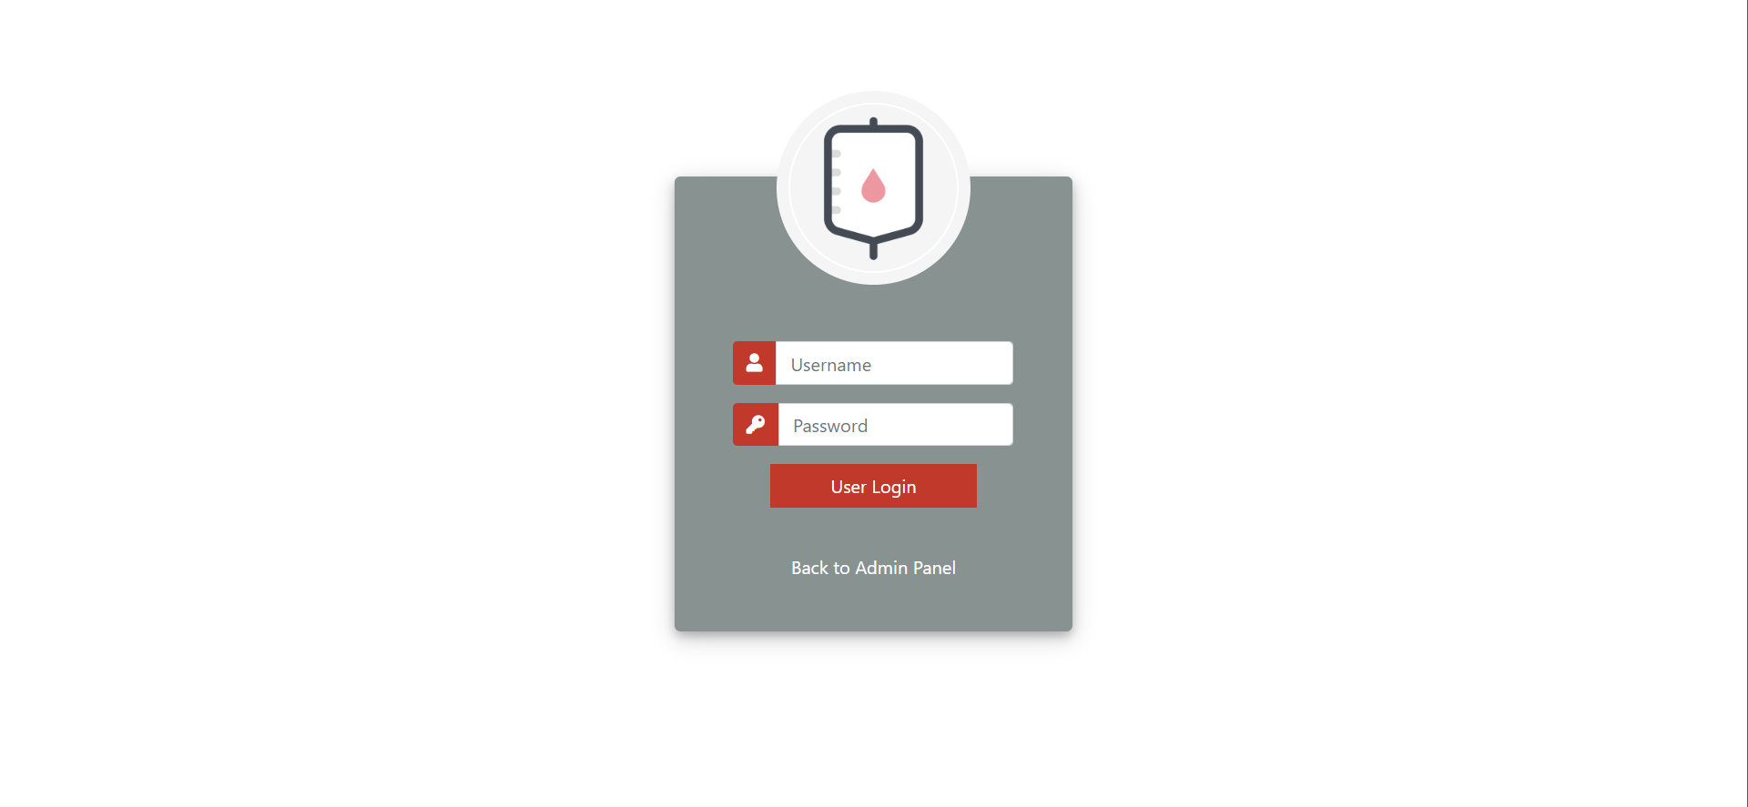
Result and output
Registration Page
User Login Page

Slide 11
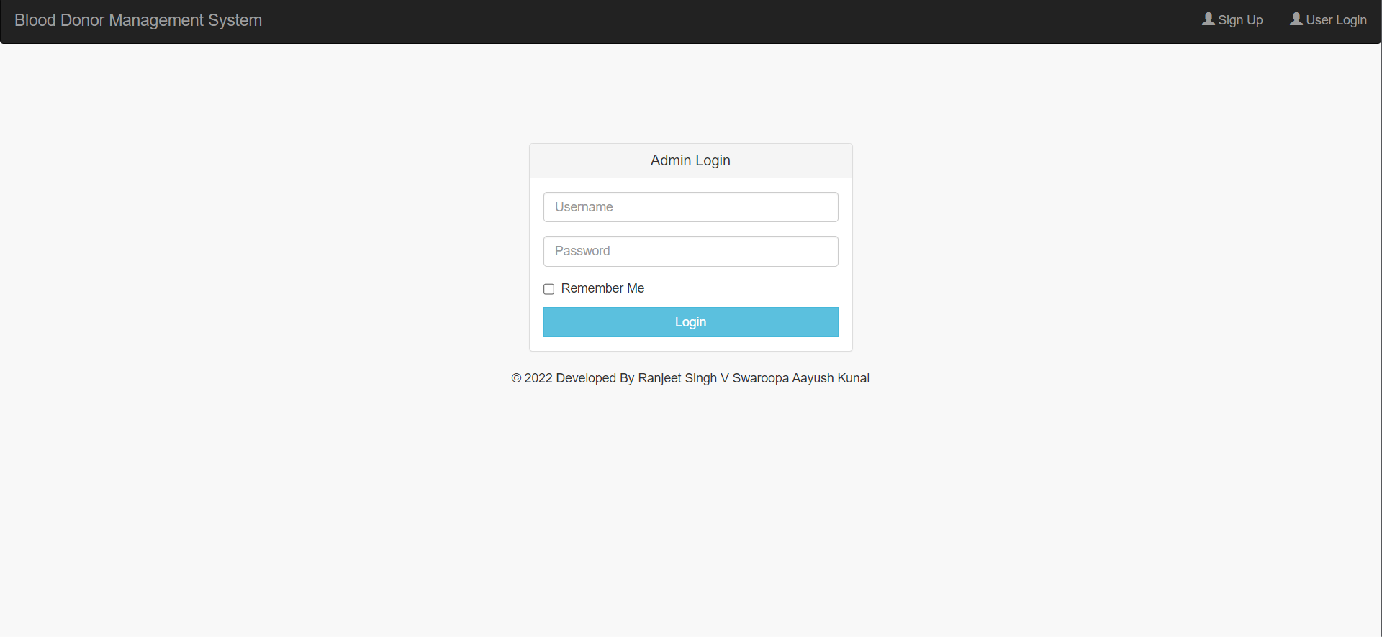
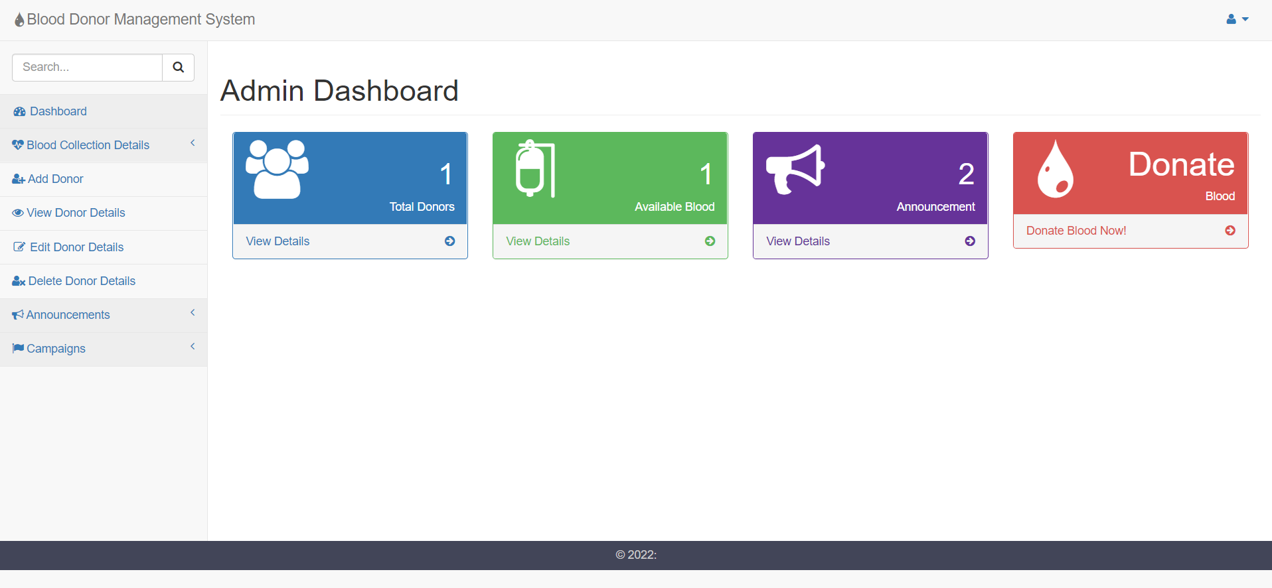
ADMIN LOGIN
Admin Dashboard

Slide 12
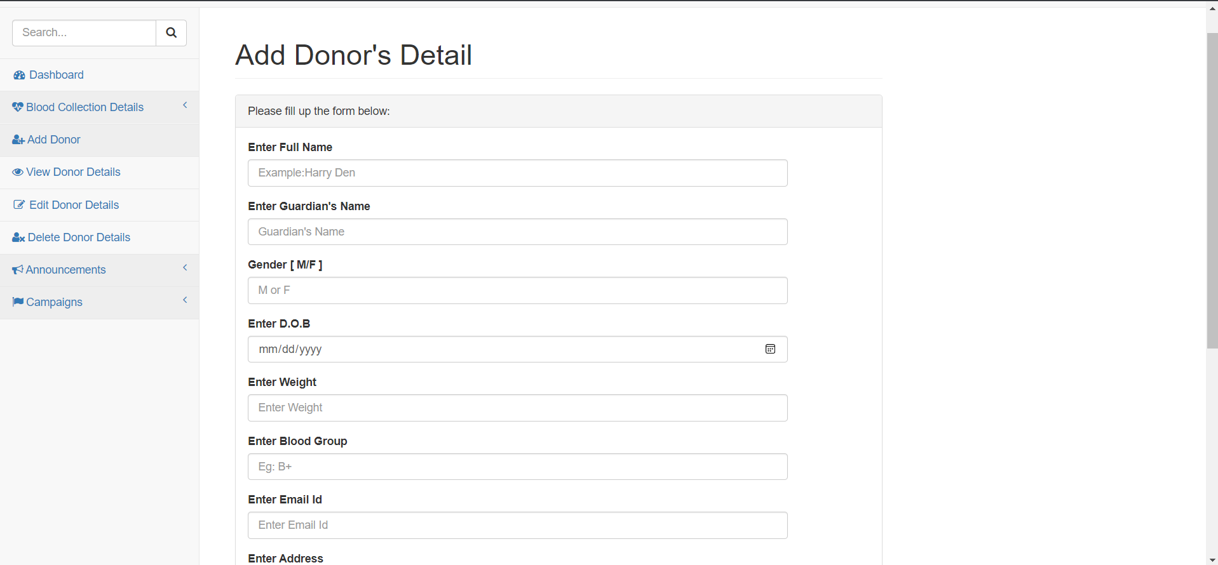
ADD DONOR DETAILS

Slide 13
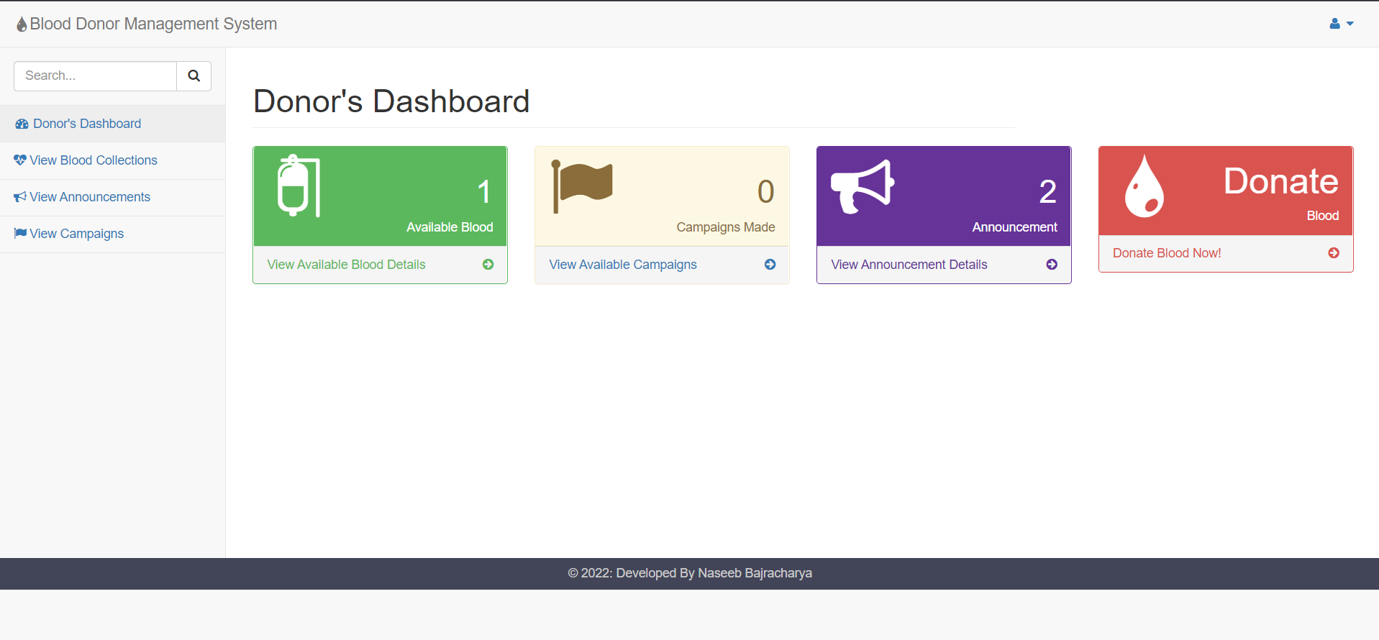
DONOR’S DASHBOARD

Slide 14
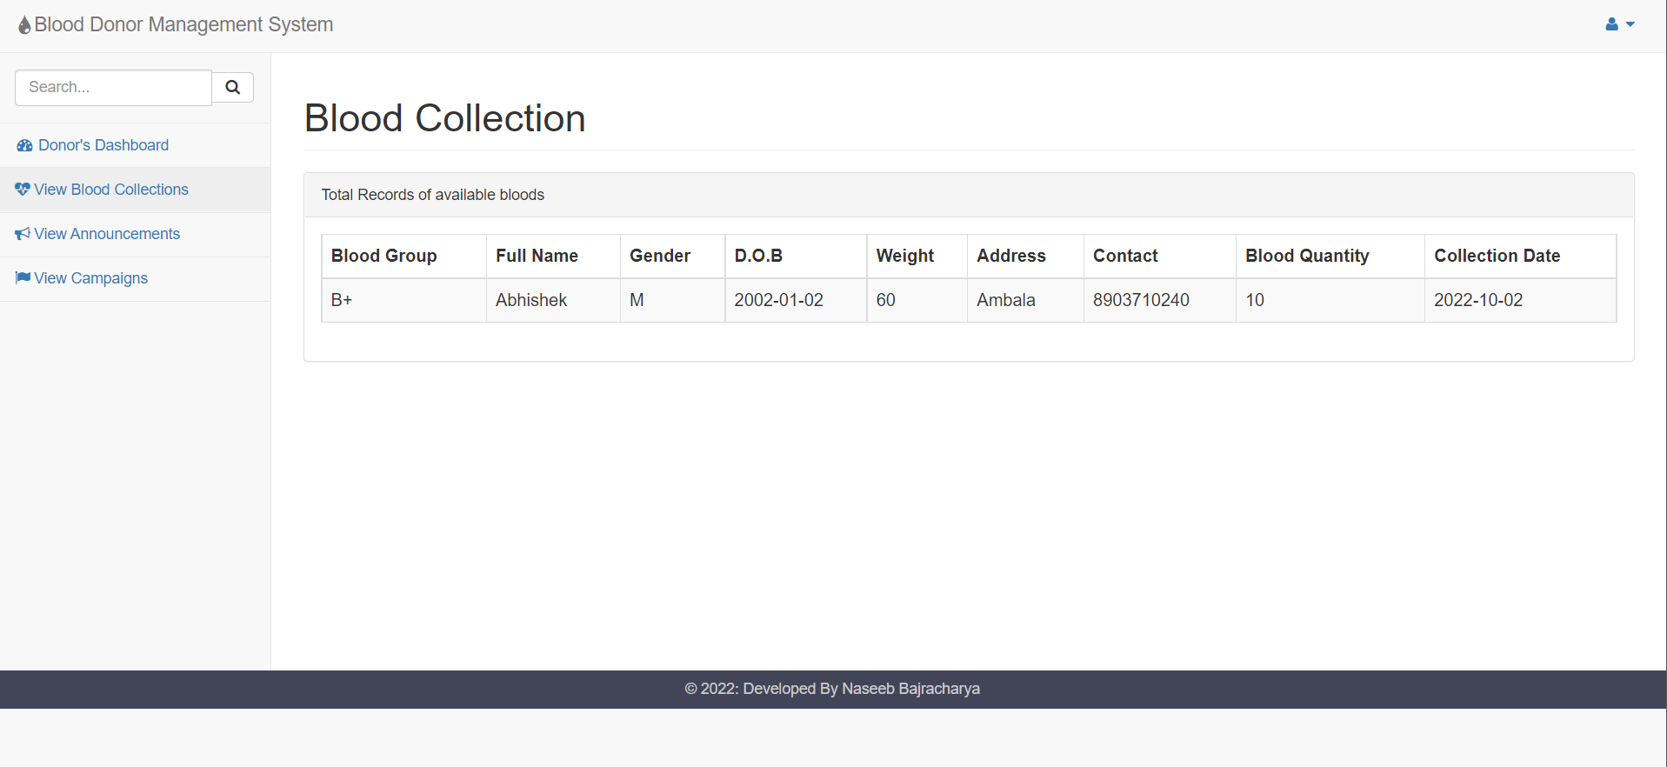
BLOOD COLLECTION

Slide 15
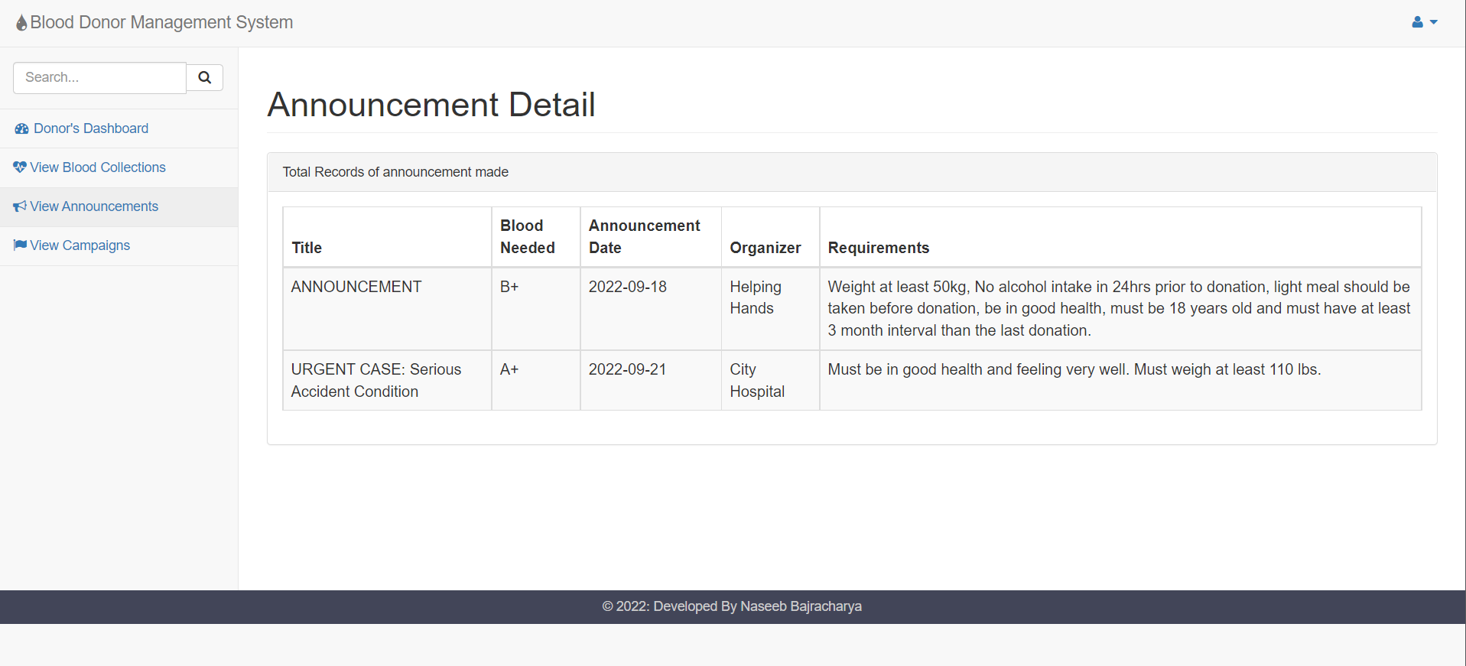
ANNOUNCEMENT DETAILS

Slide 16
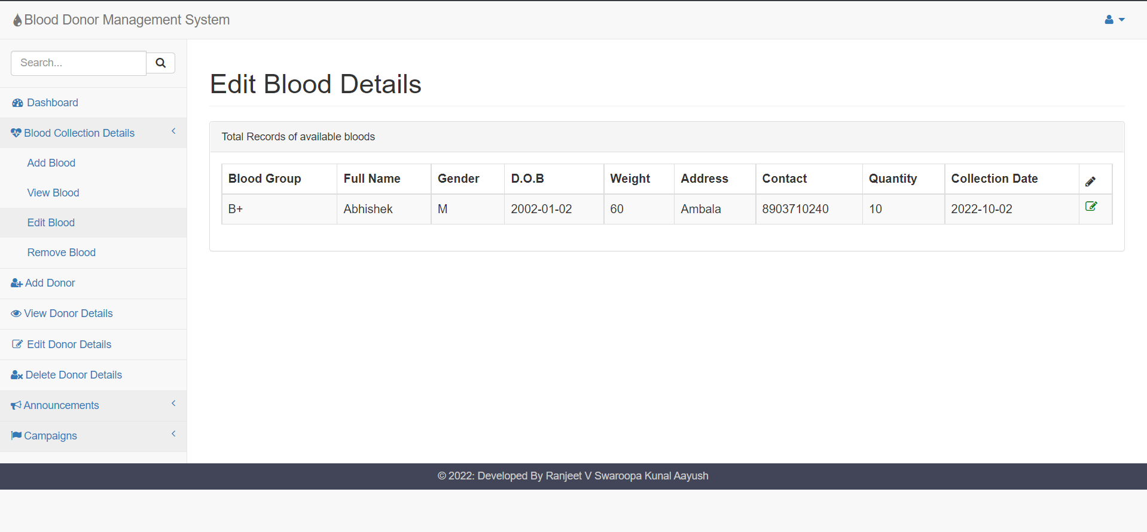
EDIT BLOOD DETAILS

Slide 17
Conclusion
Blood banking management system considered to be one of the useful source and need for saving people at emergency .
Compared to the paper work method for blood banking this online blood banking management is efficient, time saving , more productivity, more reliable and cost effective.
While making the project we tried to focus on the problems that can be solved by this project. As compared to manual system , online based banking security comparatively more secure and accurate in means of data which can further can retrieved easily.

Slide 18
Future scope
BLOOD BANK MANAGEMENT is a software application to built such a way that it should suits for all type of blood banks in future.
One important future scope is availability of location based blood bank details and extraction of location based donor's detail, which is very helpful to the acceptant people. All the time the network facilities cannot be use.
This time donor request does not reach in proper time, this can be avoid through adding some message sending procedure this will help to find proper blood donor in time. This will provide availability of blood in time.

Slide 19
References
Blood donor selection Guidelines on assessing donor suitability for blood donation. Annex 3. Geneva: World Health Organization:2012[17 August 2012]
Teena, C.A, Sankar, K. and Kannan, S. (2014). A Study on Blood Bank Management
Kumar, R., Singh, S. and Ragavi, V.A.(2017). ). Blood Bank Management System.
Vikas Kulshreshtha, Dr. Sharad Maheshwari, “Blood Bank Management Information System in India”, International Journal of Engineering Research and Applications (IJERA), Vol. I, Issue.
Alexander Horsch and Thomas Balbach," Telemedical Information Systems", IEEE Transactions On Information Technology In Biomedicine, Vol. 3, NO. 3, September 1999

