Slide 1
ENTERPRISE AI INFRASTRUCTURE • OPEN SOURCE PLATFORM
BIFROST GATEWAY
One Gateway. Every AI. Infinite Possibilities.
Unified Multi-Provider API | Intelligent Model Routing | pgvector Semantic Cache | 18ms Failover | MCP Tool Gateway
< 4ms
Internal Latency
71%
Cost Reduction
15+
Providers Connected
99.99%
Uptime SLA

Slide 2
MARKET OPPORTUNITY
The Enterprise AI Infrastructure Crisis
Why direct multi-provider API integration creates operational chaos, outages, and runaway costs.
Vendor Lock-in & Sprawl
CRITICAL FRICTION
• Teams separately integrate OpenAI, Anthropic, Gemini, DeepSeek, and Bedrock.
• Inconsistent SDKs, divergent error codes, and unique streaming transcoders.
• Engineering time wasted rewriting client code whenever new models release.
• Zero single-pane-of-glass visibility across enterprise LLM traffic.
Unreliable Upstream Outages
SLA BREACHES
• Rate limits (HTTP 429) and provider outages (503/500) crash production apps.
• Developers build brittle in-app retries that cause destructive retry storms.
• Lack of dynamic failover between cloud regions and alternative providers.
• No circuit breaker protection against runaway looping agents.
Runaway Token Spend
BUDGET WASTE
• Identical and repetitive queries repeatedly billed at full frontier prices.
• Simple classification tasks routed to expensive flagship models.
• Absence of semantic caching and per-tenant budget kill-switches.
• API keys hardcoded across microservices with zero access control.

Slide 3
PRODUCT VISION
The Bifrost Gateway Solution
One unified high-throughput infrastructure platform connecting applications with all AI providers.
Unified Drop-in OpenAI API
STANDARDIZED CONTRACT
• Developers point any OpenAI client to Bifrost by updating base_url.
• Zero code rewrite required across Python, TypeScript, Java, and Go.
• Standardized REST, SSE streaming, and multimodal payload encoding.
Intelligent Dynamic Router
SUB-3MS DECISION
• Evaluates prompt intent, context window, latency SLAs, and cost ceilings.
• Automatically routes each request to the optimal model in < 3ms.
• Weighted load balancing and tag-based policy distribution.
pgvector Semantic Caching
ZERO-COST INFERENCE
• Hybrid exact match and cosine similarity caching using PostgreSQL & Redis.
• Serves repeated or semantically equivalent queries in < 4ms at $0 cost.
• Slashes enterprise monthly token bills by 35% to 72%.
18ms Disaster Recovery Failover
100% 200 OK DELIVERY
• Integrated circuit breakers detect 429 rate limits or upstream 503 outages.
• Instantly falls back to secondary frontier models with 0 app downtime.
• Enterprise Virtual Keys with monthly spend caps and PII redaction.

Slide 4
ENGINEERING DESIGN
Complete 6-Layer System Architecture
High-throughput Go data plane separated from the administrative control plane.
Layer 01: Client & Ingress
Web/Mobile Apps, Python/TS SDKs, Autonomous Agents, Cursor, LangChain
Layer 02: Gateway Edge & Security
Go FastHTTP reverse proxy, Token-bucket rate limiting, PII/PCI redaction
Layer 03: Intelligence & Routing
pgvector semantic distance lookup, Multi-objective router, Circuit breakers
Layer 04: Provider Adapters
OpenAI, Anthropic, Gemini, DeepSeek, Groq, Bedrock, Azure, Mistral, Ollama
Layer 05: Distributed Data & Cache
PostgreSQL 16 pgvector, Redis 7 cluster for rate limits, AES-256 key vault
Layer 06: Operations & Governance
OpenTelemetry distributed W3C tracing, Prometheus /metrics, 14-screen Console

Slide 5
ECOSYSTEM COMPATIBILITY
Universal Multi-Provider Coverage
Seamlessly interconnect 15+ commercial frontier, open-weight, and on-premise inference engines.
OpenAI
GPT-4o, GPT-4o-mini, o1, o3-mini
Latency: 142ms | Pricing: $2.50 / $10.00
Anthropic Claude
Claude 3.5 Sonnet, 3.5 Haiku, Opus
Latency: 168ms | Pricing: $3.00 / $15.00
Google Gemini
Gemini 1.5 Pro (2M Context), 2.0 Flash
Latency: 118ms | Pricing: $1.25 / $5.00
DeepSeek
DeepSeek R1 (Reasoning), DeepSeek V3
Latency: 95ms | Pricing: $0.14 / $0.28
Groq LPU
Llama 3.3 70B (480 tokens/sec)
Latency: 38ms | Pricing: $0.59 / $0.79
AWS Bedrock
Claude 3.5, Titan, Command R+
Latency: 185ms | Pricing: Enterprise IAM
Azure OpenAI
GPT-4o Enterprise Private Endpoint
Latency: 154ms | Pricing: HIPAA BAA
Mistral AI
Mistral Large 2, Codestral 2501
Latency: 122ms | Pricing: EU Sovereign
Ollama Local
Llama 3.2, Qwen 2.5 (Air-Gapped)
Latency: 62ms | Pricing: $0.00 (Self-Hosted)

Slide 6
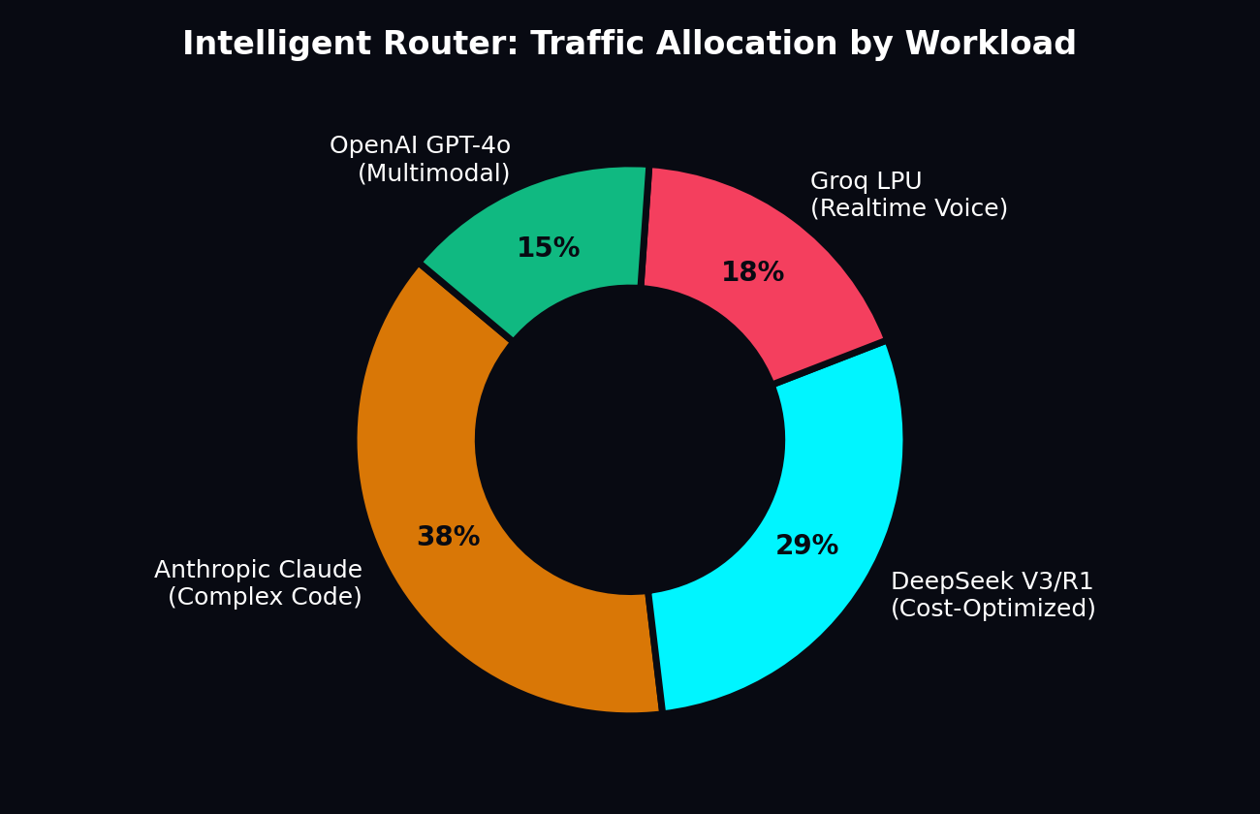
TRAFFIC OPTIMIZATION
Intelligent Model Routing Engine
Dynamic, multi-objective optimization routes requests to the ideal model in under 3 milliseconds.
Routing Policies & Strategies
POLICY RULES
• Cost-Optimized Strategy: Enforces max $0.50/1M constraint, routing routine queries to DeepSeek V3 or Gemini Flash (-78% spend).
• Sub-50ms Latency Strategy: Routes conversational voice workloads to Groq LPU (38ms P99) for immediate speech output.
• High-Context Coding Strategy: Automatically sends complex AST synthesis and refactoring to Claude 3.5 Sonnet.
• Long-Form Document Strategy: Utilizes Gemini 1.5 Pro's native 2,000,000 token context window without brittle RAG chunking.
• Weighted Enterprise Balance: Splits volume across Azure OpenAI (50%), AWS Bedrock (30%), and Google Cloud (20%).

Slide 7
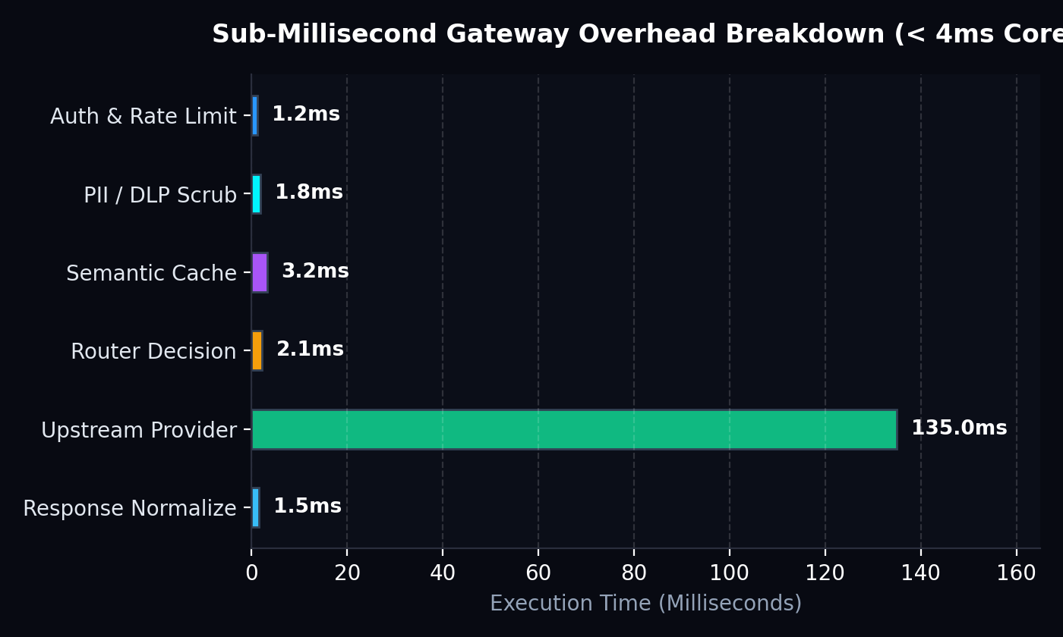
HIGH AVAILABILITY
Zero-Downtime Automatic Failover (18ms)
Circuit breakers and bounded fallback chains eliminate 99.9% of upstream AI downtime.
Disaster Recovery Invariants
CIRCUIT BREAKERS
• Upstream Outage Interception: Catches HTTP 429 (Rate Limits) and 503/500 errors before applications notice.
• 18ms Instant Fallback: Cascades to alternative provider (e.g. OpenAI -> Claude 3.5 -> Azure OpenAI) in under 20ms.
• Circuit Breaker State Machine: Trips to OPEN state after 3 consecutive failures with 30s cooldown timer.
• Bounded Retry Budget: Clamps retries to prevent catastrophic downstream retry storms.
• 100% Client Availability: Returns HTTP 200 OK without surfacing provider downtime to users.

Slide 8
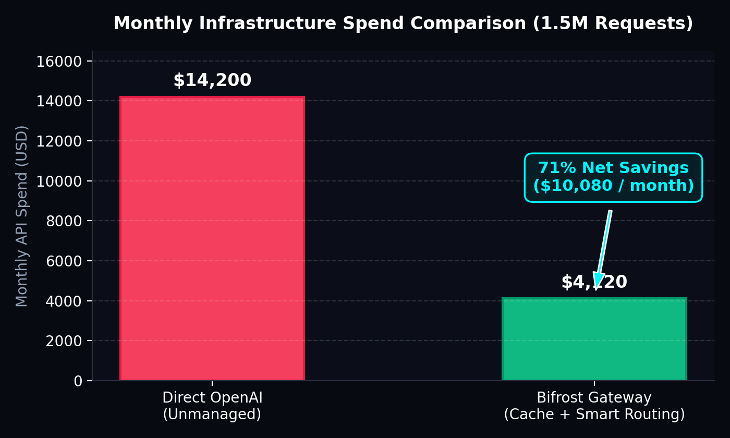
ECONOMIC EFFICIENCY
Cost Intelligence & Semantic Vector Caching
Cut enterprise AI API expenditures by 71% through intelligent memory and model tiered routing.
Semantic Cache Architecture
VECTOR MEMORY
• Cosine Distance Lookup: Embeds queries and queries pgvector IVFFlat index in under 4ms.
• Configurable Similarity Threshold: Dial between 0.80 (loose high-hit) to 0.99 (strict near-exact) precision.
• Zero-Cost Responses: 35% of repetitive queries answered with 0 upstream tokens billed.
• TTL & Invalidation: Automatic time-to-live policies and tenant-isolated namespace boundaries.
• Annualized ROI: Saves $120,000+ per year on high-volume 1.5M requests/month workloads.

Slide 9
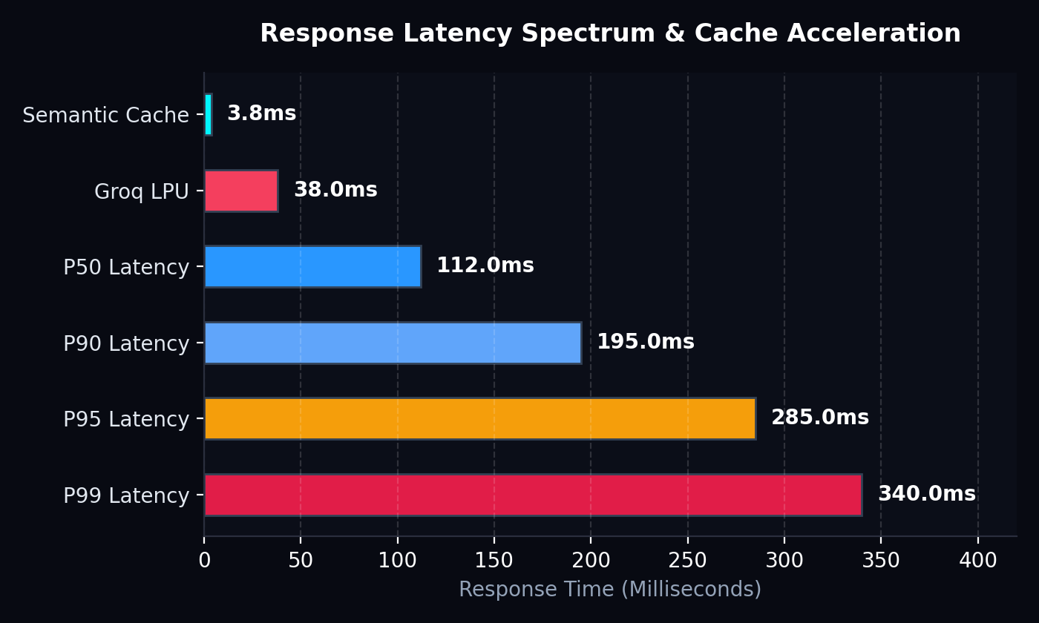
PERFORMANCE BENCHMARKS
Latency Spectrum & Real-Time Performance
Sub-4ms internal gateway overhead with hardware-accelerated LPU streaming.
Benchmark Characteristics
SPEED METRICS
• Internal Overhead: < 4ms added latency for full authentication, caching, guardrails, and routing.
• Semantic Cache Speed: 3.8ms total roundtrip response for vector cache hits.
• Groq LPU Integration: 38ms time-to-first-token with 480 tokens/sec streaming throughput.
• P95 / P99 SLA: P50 latency 112ms, P99 guaranteed under 340ms across multi-cloud regions.
• SSE Streaming Transcoder: Converts divergent upstream streams to standardized SSE in < 1.2ms.

Slide 10
DATA PROTECTION
Enterprise Security, Virtual Keys & Guardrails
Never expose root provider secrets. Issue scoped virtual keys with automated budget kill-switches.
Tenant Virtual API Keys
TOKEN SCOPING
• Issue isolated virtual keys to specific teams, microservices, or frontend clients.
• Clamp monthly budgets (e.g. $2,500/mo) with automated reject upon ceiling.
• Restrict keys to specific allowed model whitelists and RPM rate limits.
Real-time DLP & PII Redaction
PRIVACY SHIELD
• Sanitize credit card PANs, SSNs, and patient identifiers before packets leave VPC.
• Full HIPAA, GDPR, and PCI-DSS compliance conformance ready.
• Custom regex and embedding-based sensitive entity maskers.
Prompt Injection Defense
THREAT MITIGATION
• Block adversarial jailbreak attempts ('Ignore all previous instructions...').
• Detect toxic outputs and hate speech with real-time classification gates.
• Cost velocity spike breaker ($50/min cap) prevents infinite agent loops.
SOC2 Immutable Audit Trails
AUDIT COMPLIANCE
• Every request, key rotation, policy change, and PII redaction event logged.
• Full W3C trace context propagation across every microservice hop.
• Export audit records to Splunk, Datadog, or AWS S3 cold storage.

Slide 11
AUTONOMOUS AGENTS
Model Context Protocol (MCP) Tool Bridge
Governed tool execution and human-in-the-loop approval gates for agentic workflows.
Agentic Integrations
AGENT CLIENTS
• Direct bridge for LangChain, CrewAI, AutoGen, Cursor, and Claude Code.
• Agents connect to Bifrost via standardized OpenAI tool-calling semantics.
• Eliminates unmonitored raw shell or direct production database access.
• Detailed tool call latency, token usage, and error metrics recorded.
Registered MCP Tools
ENTERPRISE TOOLS
• PostgreSQL Enterprise MCP: Read-only parameterized queries with limit clamps.
• GitHub Org MCP: Secure PR creation and issue tracking with branch protection.
• Slack Alerts MCP: Incident escalation dispatch to #ai-ops channels.
• Brave Web Search MCP: Real-time web index search with content extraction.
Approval Gates & Governance
HUMAN GATES
• Granular Execution Policies: Toggle tools between 'Auto-Approved' vs 'Approval Required'.
• Human-in-the-Loop: High-risk tools (e.g. create PR, send alert) require explicit admin sign-off.
• Parameter Validation: JSON schema enforcement blocks SQL injection attempts.
• Complete Audit Playback: Replay agent execution steps for incident forensics.

Slide 12
PRODUCTION READY
Deployment, Administration & Open-Source Roadmap
Enterprise self-hosting with Docker, Kubernetes, and 14-screen admin console.
Self-Hosted Deployment Stack
TURNKEY DEPLOYMENT
• Docker Compose: Single command bootstrap with Redis and pgvector.
• Kubernetes & Helm: Multi-replica deployment, mTLS ingress, and HPA auto-scaling.
• 22MB Static Go Binary: Zero external runtime dependencies for maximum security.
14-Screen Admin Console
CONTROL PLANE
• Built-in Next.js 15 dark-mode control plane at /dashboard.
• Live waterfall trace inspector with sub-millisecond execution spans.
• Configurable semantic similarity thresholds and one-click cache purges.
Proven Economic ROI
EXECUTIVE ROI
• 71% reduction in monthly API spend ($10,080/mo saved on 1.5M requests).
• Zero vendor lock-in allows negotiating volume discounts across providers.
• SLA protection prevents catastrophic customer churn during provider outages.
Open Source & Next Steps
GET STARTED TODAY
• Released under Apache 2.0 open-source license on GitHub.
• Explore live interactive playground at http://localhost:3000/playground.
• GitHub Repository: https://github.com/Ranjeet7680/BIFROST-GATEWAY.

