Slide 1
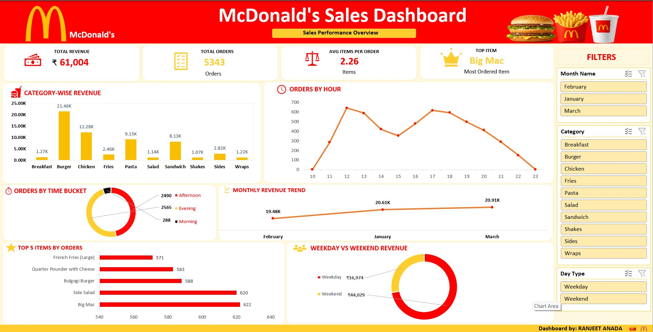
M
McDonald’s Sales Dashboard
ANALYSIS
McDonald's
Data Analysis Using Excel, Power Query & Pivot Tables
Prepared By: RANJEET ANADA

Slide 2

PROJECT OVERVIEW
M
01
02
03
Project Objective
Dashboard Purpose
Business Analysis Goals
Analyze McDonald's sales data to uncover revenue patterns, top-performing products, customer ordering behavior, and time-based trends across Feb–March.
Build an interactive Excel dashboard that enables data-driven decisions, tracks KPIs in real-time, and communicates insights visually to business stakeholders.
Identify high-revenue categories, peak ordering hours, weekday vs. weekend splits, and recommend targeted promotions to maximize revenue growth.

Slide 3




TOOLS & TECHNOLOGIES USED
M
Microsoft Excel
Power Query
Primary tool for data storage, processing, and dashboard creation with advanced formulas and conditional formatting.
Used for ETL operations — importing raw CSV data, cleaning columns, transforming data types, and merging tables.
Pivot Tables
Dashboard Design
Core analysis engine for aggregating sales by category, time, product, and weekday/weekend splits.
Custom chart configurations, slicers, KPI cards, donut charts, and interactive filters for a professional analytics feel.

Slide 4
DATASET OVERVIEW
M
DATASET COLUMNS
DATASET STATISTICS
Order ID
Unique identifier for each order
Total Records:
~12,000+ rows
Order Date
Date the order was placed
Date Range:
Jan – Mar 2024
Total Orders:
5,343
Order Time
Exact timestamp of order
Categories:
10 food categories
Item Name
Product ordered by customer
Format:
CSV / Excel .xlsx
Category
Food category (Burger, Chicken, etc.)
Quantity
Number of items ordered
DATA STRUCTURE
Unit Price (₹)
Price per item
The dataset is structured as a flat, denormalized transaction table where each row represents one item ordered. Multiple rows may share the same Order ID when a customer ordered multiple items, enabling order-level aggregation via Pivot Tables.
Total Revenue (₹)
Quantity × Unit Price
Day Type
Weekday or Weekend
Month Name
February, January, March

Slide 5

DATA CLEANING PROCESS
M
01
02
03
Null Handling
Date Formatting
Data Transformation
Identified and removed blank rows in Order ID, Item Name, and Revenue columns. Filled missing Category values using lookup from item reference table.
Standardized Order Date to DD/MM/YYYY format. Extracted Month Name and Hour using TEXT() and HOUR() functions for time-based analysis.
Converted Revenue column to numeric type. Added calculated columns: Total Revenue = Quantity × Unit Price. Validated all data types in Power Query.
04
05
06
Table Merging
Feature Engineering
Final Validation
Merged transactional data with a category reference table using Order ID as the primary key via Power Query merge (left join).
Created 'Time Bucket' column (Morning/Afternoon/Evening) based on order hour. Added 'Day Type' column (Weekday/Weekend) from Order Date.
Cross-validated total order counts and revenue figures. Verified 5,343 unique orders and ₹61,004 total revenue before building the dashboard.

Slide 6




KEY PERFORMANCE INDICATORS
M
₹61,004
5,343
2.26
Big Mac
TOTAL REVENUE
TOTAL ORDERS
AVG ITEMS / ORDER
TOP PRODUCT
Across Jan–Mar 2024
All unique orders
Items per transaction
Most ordered item — 622 orders
DASHBOARD PREVIEW

Slide 7
CATEGORY-WISE REVENUE ANALYSIS
M
KEY INSIGHTS
🏆 Burger
₹21,460 — Top revenue category (35% share)
🍗 Chicken
₹12,280 — Strong second performer
🍝 Pasta
₹9,150 — Solid mid-tier category
🥪 Sandwich
₹8,130 — Popular menu choice
📉 Breakfast
₹1,270 — Lowest — growth opportunity

Slide 8

MONTHLY REVENUE TREND
M
February
₹19,480
Starting baseline
January
₹20,610
▲ 5.8%
+5.8% from Feb
March
₹20,910
▲ 7.3%
Peak month — highest revenue
March recorded the highest revenue at ₹20,910

Slide 9

CUSTOMER ORDER ANALYSIS
M
ORDERS BY HOUR
ORDER INSIGHTS
Peak Hour
12 PM with 640+ orders — lunchtime rush
Evening Bucket
2,565 orders — busiest time of day (48%)
Afternoon Bucket
2,490 orders — strong afternoon demand
ORDERS BY TIME BUCKET
Morning Bucket
Only 288 orders — breakfast gap
Double Peak
Lunch (12 PM) and early evening (5–6 PM) show dual peaks
Night Drop
Orders drop sharply after 10 PM to near zero

Slide 10

TOP 5 PRODUCTS BY ORDERS
M
#1
Big Mac
622 orders
11.6%
#2
Side Salad
620 orders
11.6%
#3
Bulgogi Burger
588 orders
11%
#4
Quarter Pounder with Cheese
583 orders
10.9%
#5
French Fries (Large)
571 orders
10.7%
Big Mac remains McDonald's top-selling product with 622 orders

Slide 11


BUSINESS INSIGHTS
M
Weekend Sales Dominate
Burger Category Drives Revenue
₹44,029
₹21.46K
Weekend vs ₹16,974 Weekday
35% of total category revenue
Weekends account for 72% of total revenue. This significant split indicates McDonald's core customer base is leisure/weekend shoppers, not daily commuters.
Burgers are the dominant revenue driver. Chicken and Pasta are strong secondary categories, while Breakfast remains largely untapped.
Evening Orders Peak
Big Mac Strongest Performer
2,565
622
Evening = 48% of all orders
Orders — Top product overall
Evening is the busiest time bucket. Afternoon follows closely. Morning represents only 5% of orders, indicating low breakfast adoption.
Big Mac leads all items with 622 orders. Side Salad ranks 2nd, showing customers often pair burgers with healthy sides.

Slide 12

STRATEGIC RECOMMENDATIONS
M
01
02
Weekend Promotions
Breakfast Menu Expansion
Launch targeted weekend combo deals and family meal bundles. With 72% of revenue from weekends, even a 5% uplift would add ~₹2,200 revenue.
Breakfast generates only ₹1,270 — the lowest category. Introduce value breakfast sets and morning loyalty rewards to grow this untapped segment.
03
04
Evening Staffing Optimization
Combo & Upsell Deals
Evening is peak time with 2,565 orders. Schedule maximum staffing 5–9 PM to reduce wait times, boost customer satisfaction and order volume.
Big Mac + Side Salad is a natural combo (top 2 products). Bundle with Fries or Shakes to increase average items per order from 2.26 to 3+.

Slide 13

CONCLUSION & SUMMARY
M
Sales Trends
PROJECT IMPACT
Revenue grew from ₹19.48K (Feb) to ₹20.91K (March), showing a consistent upward trajectory across the quarter.
Total Revenue
₹61,004
Customer Behavior
Total Orders Analyzed
5,343
Evening and weekend customers dominate. Average order size of 2.26 items suggests high single-visit frequency with lean cart sizes.
Months Covered
3 (Jan–Mar)
Dashboard Impact
Categories Analyzed
10 food types
The Excel dashboard delivers instant visual insights across categories, hours, and products — enabling faster, data-backed operational decisions.
Top Product
Big Mac (622 orders)
Opportunity Areas
Peak Period
Evening (48% of orders)
Breakfast and weekday sales represent the biggest untapped revenue opportunities for targeted promotions and menu innovation.
Weekend Revenue Share
72% (₹44,029)
Prepared By: RANJEET ANADA

Slide 14
M
THANK YOU
for reviewing this analysis
RANJEET ANADA
Data Analyst | McDonald's Sales Dashboard Project
Excel · Power Query · Pivot Tables · Dashboard Design
McDonald's Sales Dashboard Analysis | Prepared by RANJEET ANADA | Jan–Mar 2024

