Slide 1
M
PROJECT OVERVIEW
This report presents a comprehensive Exploratory Data Analysis of McDonald's restaurant sales data. Using Microsoft Excel, Power Query, Pivot Tables, and Dashboard Visualization, the project uncovers deep insights into revenue patterns, customer behavior, and product performance.
McDonald's
TOOLS USED
DATASET
OBJECTIVES
Microsoft Excel
Power Query
Pivot Tables & Charts
Dashboard Design
order_details table
menu_items table
5,343 Total Orders
Jan–Mar 2024
Analyze Sales Performance
Identify Revenue Trends
Customer Behavior Study
Product Insights
EXPLORATORY DATA ANALYSIS REPORT
McDonald’s Sales Dashboard Analysis
KEY PERFORMANCE INDICATORS
PREPARED BY
₹61,004
5,343
2.26
Big Mac
RANJEET ANADA
TOTAL REVENUE
TOTAL ORDERS
AVG ITEMS/ORDER
TOP ITEM
Data Analyst | Excel & Power Query Project
May 2026
McDonald's Sales Analysis Dashboard | Exploratory Data Analysis Report | Ranjeet Anada | May 2026

Slide 2
EXECUTIVE SUMMARY
02
McDonald's Sales Analysis Dashboard | Jan – Mar 2024
💰 ₹61,004
🧾 5,343
⚖ 2.26
👑 Big Mac
Total Revenue
Total Orders
Avg Items/Order
Top Item
Q1 Combined
Jan–Mar
Per Transaction
622 Orders
PROJECT CONTEXT
KEY FINDINGS AT A GLANCE
This EDA report analyzes McDonald's sales data from January through March 2024, covering 5,343 transactions across multiple product categories.
The dataset integrates two tables — order_details and menu_items — enriched through Power Query with engineered features including Month Name, Day Name, Hour, Day Type, and Time Bucket.
The analysis spans 10 product categories including Burgers, Chicken, Pasta, Sandwich, and more, revealing critical patterns in consumer behavior and revenue distribution.
Key deliverables include an interactive Excel dashboard with slicers for Month, Category, and Day Type — enabling dynamic drill-down exploration of sales trends.
🍔 Burger category is the revenue leader with ₹21.46K (35% share)
🌙 Evening is peak order period — 2,565 orders (48% of daily volume)
📅 Weekends drive 72% of total revenue (₹44,029 vs ₹16,974 weekday)
🏆 Big Mac leads product performance with 622 individual orders
📈 Revenue grew steadily: Feb ₹19.48K → Jan ₹20.61K → Mar ₹20.91K
☀️ Morning segment is underdeveloped — only 288 orders (5.4%)
McDonald's Sales Analysis | Executive Summary | Prepared by: Ranjeet Anada

Slide 3
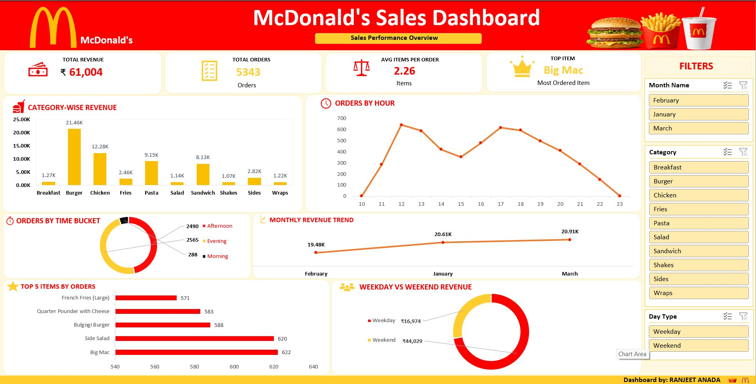
INTERACTIVE DASHBOARD OVERVIEW
03
Power Query + Pivot Charts + Dynamic Slicers | Microsoft Excel Dashboard
DASHBOARD FEATURES
📊 Category Revenue Bar Chart
Revenue breakdown across 10 product categories
📈 Monthly Revenue Trend Line
Feb to Mar growth trajectory analysis
🕐 Orders by Hour (Line Chart)
Peak hour identification for operations
🍩 Time Bucket Donut Chart
Morning / Afternoon / Evening split
🍩 Weekday vs Weekend Revenue
Revenue comparison donut visualization
📋 Top 5 Products Bar Chart
Best-performing menu items ranked
🎛 Dynamic Slicers
Month, Category, and Day Type filters
McDonald's Sales Analysis | Dashboard Overview | Prepared by: Ranjeet Anada

Slide 4
REVENUE ANALYSIS
04
Category-Wise Revenue | Monthly Trend | Weekday vs Weekend Breakdown
📊 CATEGORY-WISE REVENUE BREAKDOWN
📈 MONTHLY REVENUE TREND
🗓 WEEKDAY vs WEEKEND REVENUE
💡 REVENUE INSIGHTS
35.2% Revenue Share
7.3% Monthly Growth
72% Weekend Dominance
Low-Performers
Burgers dominate — nearly 1 in 3 rupees spent is on Burgers
Revenue grew consistently from Feb to March 2026
Weekend sales are 2.6× higher than weekday sales
Shakes (1.8%) and Salads (1.9%) signal untapped potential
McDonald's Sales Analysis | Revenue Analysis | Prepared by: Ranjeet Anada

Slide 5
CUSTOMER BEHAVIOR ANALYSIS
05
Orders by Hour | Time Bucket Analysis | Ordering Pattern Insights
🕐 ORDERS BY HOUR OF DAY
⏱ ORDERS BY TIME BUCKET
🌙 2,565
☀ 2,490
Evening Orders
Afternoon Orders
47.9% of Total
46.6% of Total
🌅 288
⏰ 12PM
💡 CUSTOMER BEHAVIOR INSIGHTS
Morning Orders
Peak Lunch Hour
Only 5.4% — Opportunity!
Highest single-hour orders
Dual Peak Pattern
Evening Dominance
Morning Gap Opportunity
Avg 2.26 Items/Order
Orders spike at 12PM (lunch rush) and 6PM (dinner rush), creating two clear daily demand peaks for workforce planning.
Evening is the single largest time window — 47.9% of orders occur after 5PM, driven likely by family dining occasions.
Only 288 morning orders (5.4%) represent a massive untapped segment — breakfast marketing could unlock significant revenue.
Low item-per-order ratio suggests combo upsell strategies could increase basket size significantly across all time buckets.
McDonald's Sales Analysis | Customer Behavior Analysis | Prepared by: Ranjeet Anada

Slide 6
PRODUCT PERFORMANCE ANALYSIS
06
Top Selling Products | Category Insights | Performance Rankings
🏆 TOP 5 PRODUCTS BY ORDER COUNT
🥇 PRODUCT LEADERBOARD
RANK
ITEM
ORDERS
🥇 #1
Big Mac
622
🥈 #2
Side Salad
620
🥉 #3
Bulgogi Burger
588
#4
Quarter Pounder w/ Cheese
583
#5
French Fries (Large)
571
📊 CATEGORY REVENUE vs PRODUCT CONCENTRATION
Burger
Chicken
Pasta
Sandwich
Others (6)
₹21.46K
₹12.28K
₹9.15K
₹8.13K
₹9.97K
35.2% share
20.1% share
15.0% share
13.3% share
16.4% share
★★★★★
★★★★☆
★★★☆☆
★★★☆☆
★★☆☆☆
McDonald's Sales Analysis | Product Performance Analysis | Prepared by: Ranjeet Anada

Slide 7
BUSINESS INSIGHTS & RECOMMENDATIONS
07
Data-Driven Strategies for Revenue Growth and Operational Excellence
💡 KEY BUSINESS INSIGHTS
🎯 STRATEGIC RECOMMENDATIONS
🍔 Burger Category is King
🌙 Evening Rush is the Goldmine
01 Launch Burger Combo Promotions
HIGH
Burgers contribute 35.2% of total revenue — nearly triple the next category. The Burger menu is the backbone of McDonald's revenue strategy.
47.9% of all orders come in the evening (5PM–11PM). Dinner and post-work occasions drive the majority of daily business volume.
Bundle Burgers with Fries and Shakes to increase average order value. Target existing Burger buyers with upgrade offers.
02 Revamp Breakfast Marketing
HIGH
Morning accounts for only 5.4% of orders. Targeted campaigns (digital, local) for breakfast combos can unlock 15–20% revenue uplift.
📅 Weekends are Revenue Multipliers
📈 Consistent Monthly Growth
Weekend revenue (₹44,029) is 2.6× higher than weekday revenue (₹16,974), accounting for 72.2% of total Q1 revenue despite being fewer days.
Revenue grew month-over-month from ₹19.48K (Feb) to ₹20.91K (Mar), showing a positive 7.3% growth trajectory over the quarter.
03 Optimize Evening Operations
MED
Staff adequately for the 5–9PM peak window. Introduce evening-exclusive deals to sustain and grow this dominant segment.
04 Launch Weekend Special Campaigns
MED
Capitalize on the 72% weekend revenue dominance with family bundles, loyalty points, and weekend-only menu items.
05 Revitalize Low-Performing Categories
LOW
Shakes (1.8%) and Salads (1.9%) are underperforming. Test product reformulations, seasonal items, or promotional bundling.
McDonald's Sales Analysis | Business Insights & Recommendations | Prepared by: Ranjeet Anada

Slide 8
DATA METHODOLOGY & FEATURE ENGINEERING
08
Power Query Data Cleaning | Feature Engineering | Table Relationships
🧹 DATA CLEANING STEPS (Power Query)
⚙ FEATURE ENGINEERING (Calculated Columns)
Removed Null Values
Fixed Date Formats
Month Name
Ex: January, February, March
01
All blank/empty rows identified and removed from both order_details and menu_items tables
02
Standardized order_date column to consistent DD/MM/YYYY date format across all records
Enables monthly revenue analysis and seasonal trend identification
Converted Data Types
Trimmed Text Spaces
Day Name
Ex: Monday, Saturday...
03
Price converted to Decimal, IDs to Integer, dates to Date type, times to Time type
04
Removed leading/trailing whitespace from item_name and category columns
Supports weekday vs weekend segmentation of customer behavior
Merged Tables
Validated Integrity
Hour
Ex: 10, 11, 12, 13...
05
Left-joined order_details with menu_items on item_id = menu_item_id for complete analysis
06
Verified all 5,343 orders matched to valid menu items with no orphan records
Enables hourly order analysis to identify peak traffic windows
Day_Type
Ex: Weekday / Weekend
Powers weekday vs weekend revenue comparison and behavioral analysis
Time_Bucket
Ex: Morning / Afternoon / Evening
Groups hours into business-relevant time buckets for operational insights
McDonald's Sales Analysis | Data Methodology | Prepared by: Ranjeet Anada

Slide 9
CONCLUSION
FINAL PERFORMANCE SUMMARY
Project
Summary
₹61,004
5,343
35.2%
TOTAL Q1 REVENUE
TOTAL ORDERS
BURGER REVENUE SHARE
This EDA report successfully uncovered actionable business insights from McDonald's Q1 2024 sales data through rigorous data cleaning, feature engineering, and visual analytics.
72%
₹20.91K
622
WEEKEND REVENUE SHARE
BEST MONTH (MARCH)
BIG MAC ORDERS (#1)
✅ ₹61,004 revenue analyzed across 5,343 orders
✅ 10 product categories benchmarked
✅ Time-based behavioral patterns identified
✅ Business recommendations generated
✅ Interactive Excel dashboard delivered
"Data transforms restaurant operations — from guessing what customers want to knowing exactly when, what, and how much they will order. This analysis equips McDonald's decision-makers with the clarity to act strategically, not reactively."
REPORT PREPARED BY
RANJEET ANADA
TOOLS USED IN THIS PROJECT
Data Analyst | Excel & Power Query Specialist
Microsoft Excel
Power Query
Pivot Tables
Pivot Charts
Dashboard Design
McDonald's Sales Analysis Dashboard | May 2026
McDonald's Sales Analysis Dashboard | EDA Report | Prepared by: Ranjeet Anada | May 2026

