Slide 1
PROJECT TITLE
USED CAR PRICE PREDICTION
BY – RANJEET JANAGOUDA

Slide 2
Problem Statement
With the covid 19 impact in the market, we have seen lot of changes in the car market. Now some cars are in demand hence making them costly and some are not in demand hence cheaper. One of our clients works with small traders, who sell used cars. With the change in market due to covid 19 impact, our client is facing problems with their previous car price valuation machine learning models. So, they are looking for new machine learning models from new data. We have to make car price valuation model. This project contains two phase-
Data Collection Phase
You have to scrape at least 5000 used cars data. You can scrape more data as well, it’s up to you. more the data better the model. In this section You need to scrape the data of used cars from websites (Olx, cardekho, Cars24 etc.) You need web scraping for this. You have to fetch data for different locations. The number of columns for data doesn’t have limit, it’s up to you and your creativity. Generally, these columns are Brand, model, variant, manufacturing year, driven kilometers, fuel, number of owners, location and at last target variable Price of the car. This data is to give you a hint about important variables in used car model. You can make changes to it, you can add or you can remove some columns, it completely depends on the website from which you are fetching the data. Try to include all types of cars in your data for example- SUV, Sedans, Coupe, minivan, Hatchback.
Model Building Phase
After collecting the data, you need to build a machine learning model. Before model building do all data pre-processing steps. Try different models with different hyper parameters and select the best model. Follow the complete life cycle of data science. Include all the steps like.
1. Data Cleaning
2. Exploratory Data Analysis
3. Data Pre-processing
4. Model Building
5. Model Evaluation
6. Selecting the best model

Slide 3
Our Exercise
Scrap the data like name of the car, year of manufacturing, price, model, fuel of the car etc. from any of the websites which deals in used cars selling. After doing all the data cleaning, EDA, data pre-processing then build a model to predict the price with different algorithms to find the best model.

Slide 4


Slide 5
Data Collection Phase
Using the selenium we can scrap the data from a used car selling website. I am scraping the data from Cars24 website for different locations like Delhi, Mumbai, Bengaluru etc. With the help of selenium we can scrap the data easily. We are scraping the information such as Name of the Car, Year of Manufacturing, Type of Car: Manual or Automatic, Fuel type of Car, Price etc. After scrapping the data successfully make a DataFrame of that & save it as csv file for future use.

Slide 6
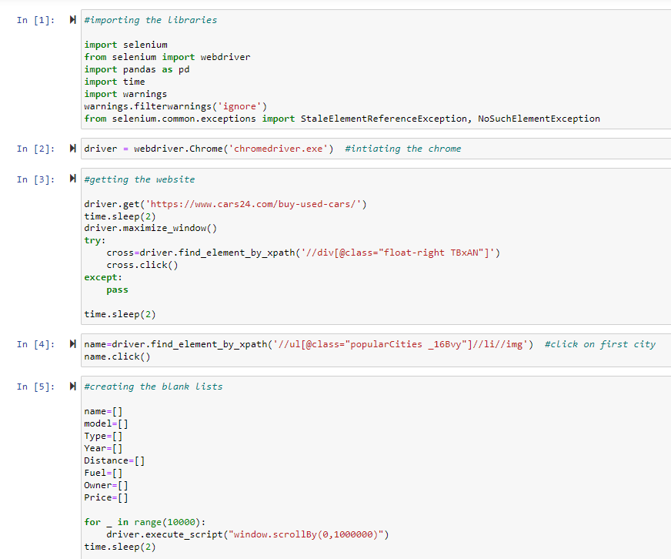
Let’s see the code for Data Scraping
Import selenium and webdriver to initiate the chrome.
Get the website using driver.get
Create blank list for the attributes you want to collect
Execute the code for scraping the data of each attribute for different locations
Make a DataFrame of extracted data and store it in a csv file

Slide 7
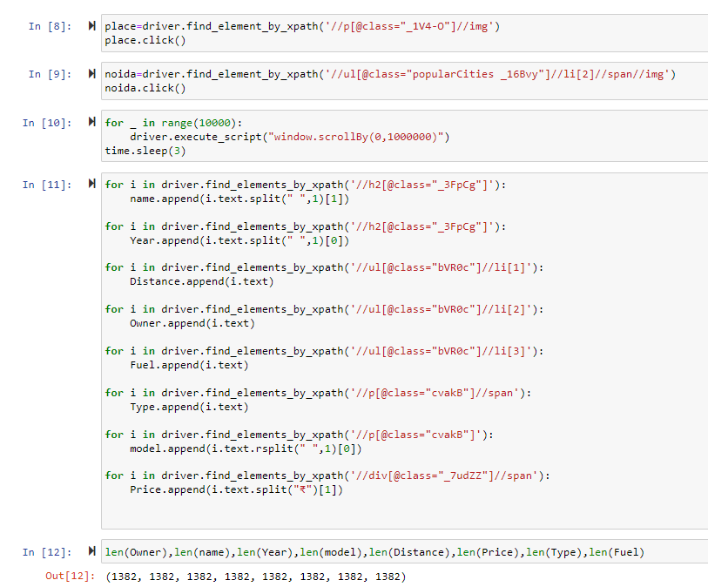
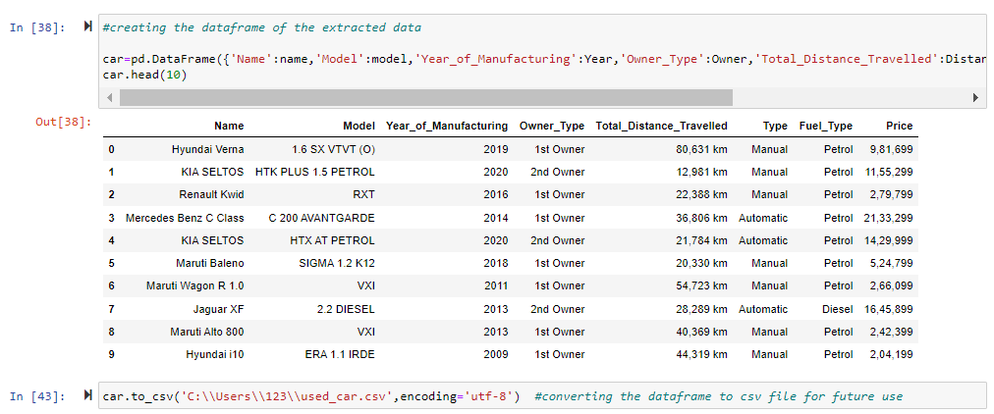
Let’s see the code for Data Scraping

Slide 8
Model Building Phase
Now, we have successfully scrap the data of around 5000 rows.
Let’s go ahead with the data cleaning and EDA process. As we have the continuous data in target we will go with the regression models to predict the price. Use the different regression model to find the best model for our prediction. Use the CV score and different hyper parameters to find the best model and check the errors in the model as well. Save the best model and check the actual & predicted values from your best model.

Slide 9
Steps Involved
Load the dataset
Distinguish the attributes
Checking the null values & handled them accordingly
Do the EDA
Check the correlation & removing the outliers
Feature Engineering – Find the best machine learning model to get the best accuracy.
Check the cross val score & perform the hypermeter tuning.
Save the model & check the predicted & actual values using the best saved model.

Slide 10
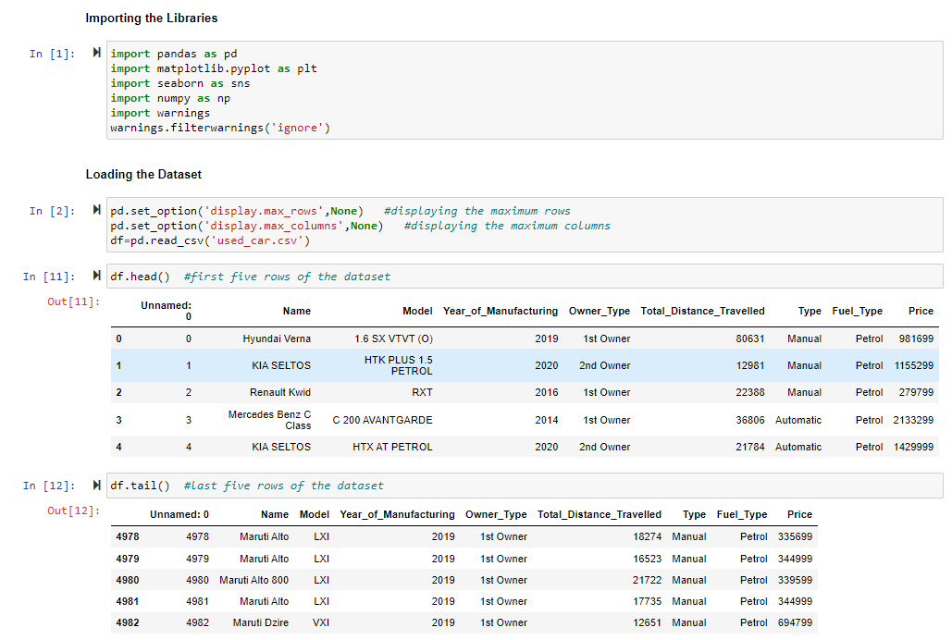
Load the dataset

Slide 11
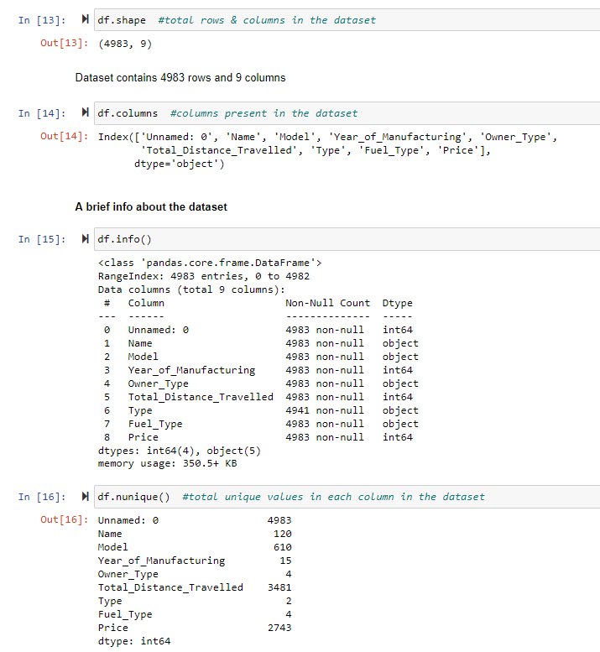
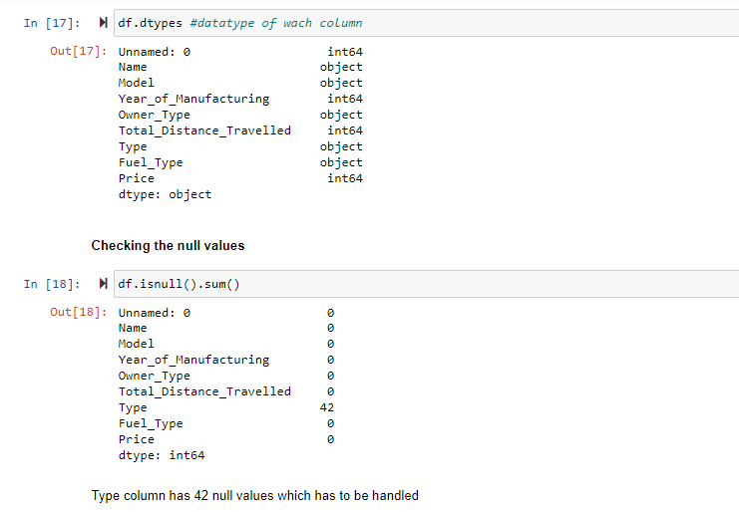
Checking the Attributes
First & last five rows the dataset
Shape of the dataset
Columns present in the dataset
Brief info about the dataset
Datatype of each column
Null values present in the dataset
Number of unique values present in each column

Slide 12
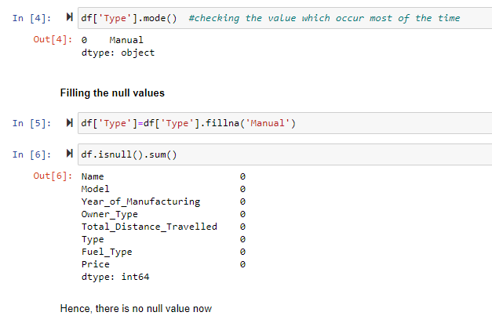
Null Values
Our dataset contain 42 null values in the type column (car is automatic or manual). As this is a categorical column which has only two values, we can find the mode of the it and fill the null values with that value.

Slide 13

Exploratory Data Analysis

Slide 14
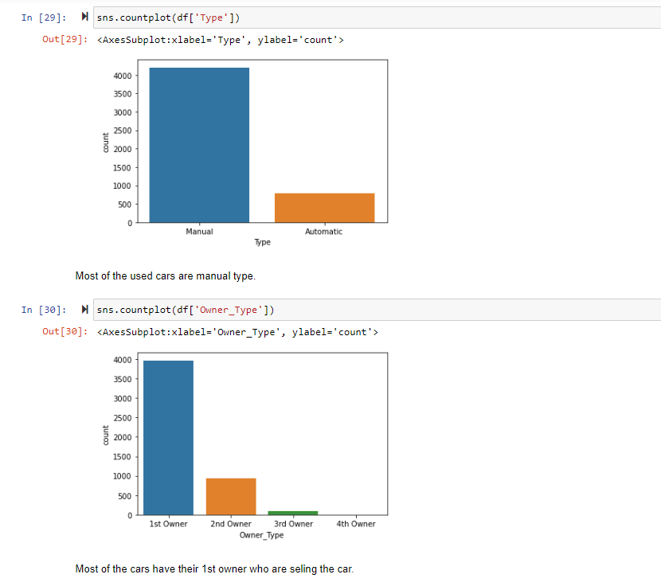
EDA
Univariate Analysis
Let’s understand the each variable one by one and try to interpret about them.
Most of the used cars are manual type.
Most of them are 1st owner who are selling their car.
Petrol based cars are on number one in the list followed by the diesel
2017 year cars have the highest number in the dataset followed by the 2018 & 2019
Density of least travelled cars is high.
Maruti swift cars number is the most followed by Maruti baleno

Slide 15
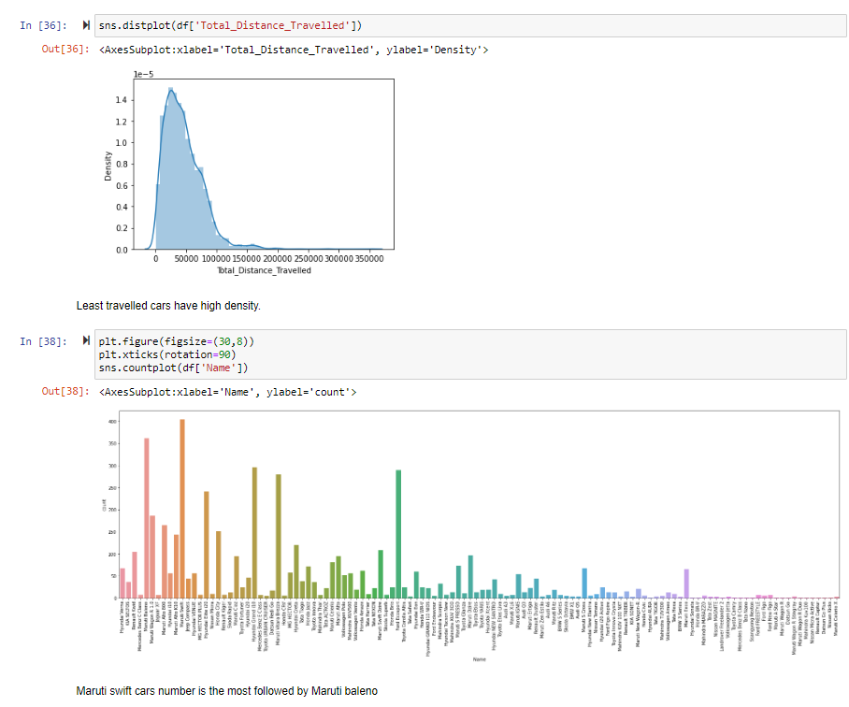
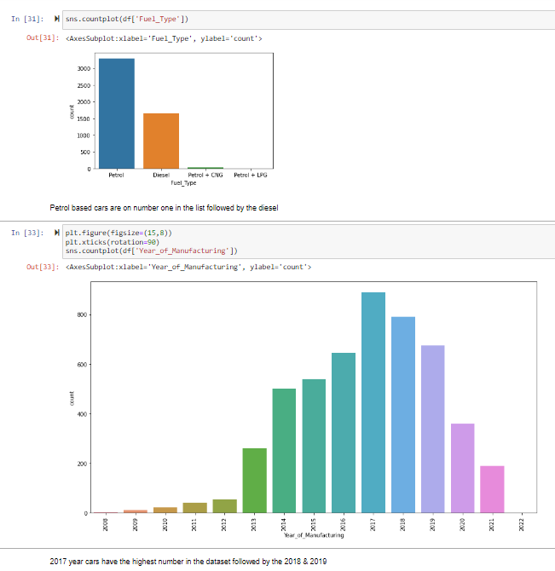

Slide 16
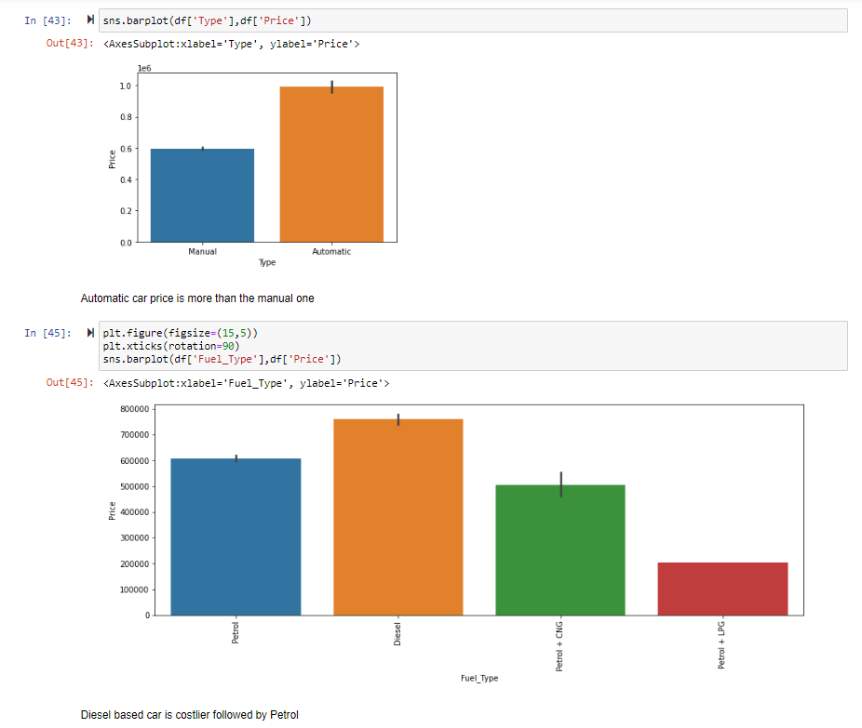
EDA
Bivariate Analysis
Let’s understand the each variable relation with the target variable and interpret how target variable vary with the inputs.
Mercedes Benz C Class price is the highest followed by Hyundai Tuscon New
Automatic car price is more than the manual one
Diesel based car is costlier followed by Petrol
1st owner based car's price is more. 2nd owner based car price is also high.
As we go for the recent manufacturing model price will be high on the other side old cars have lower rates

Slide 17
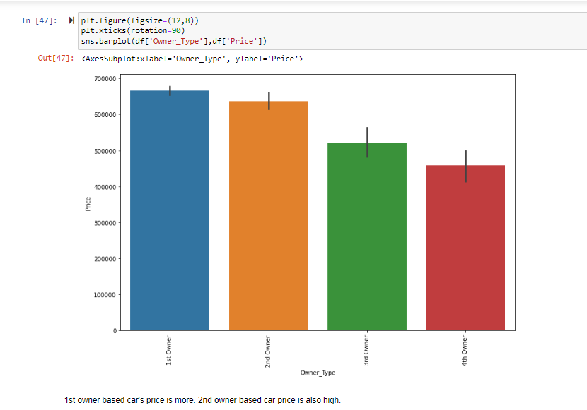
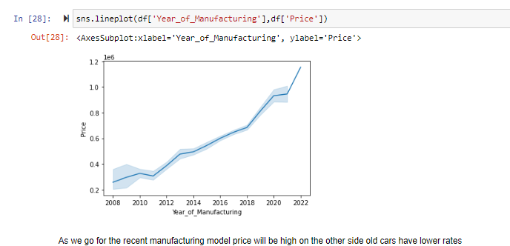
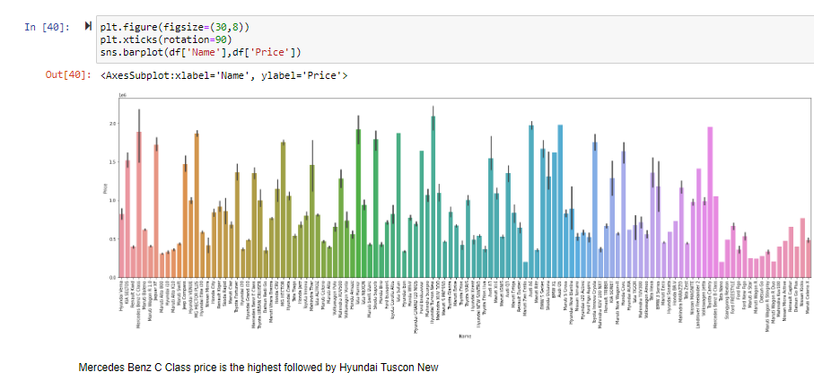

Slide 18
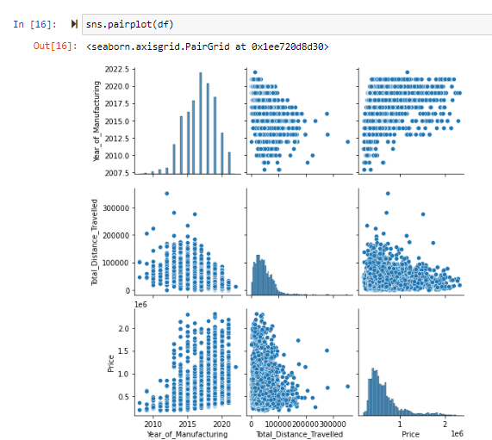
EDA
Multivariate Analysis
Using the pairplot function plot the each column relation with each other to have a better understanding.

Slide 19
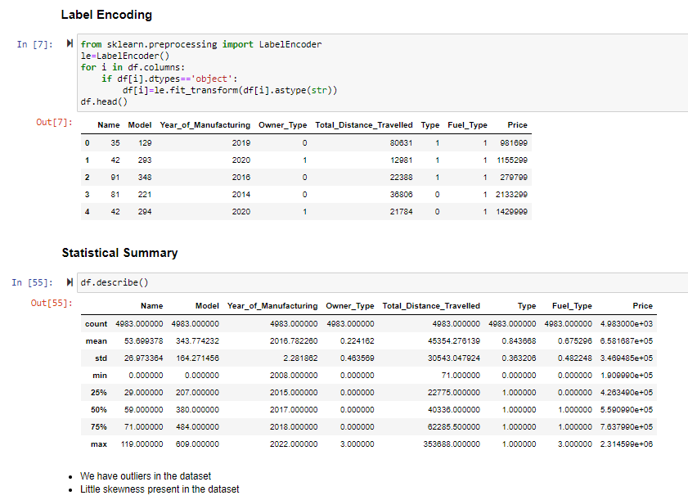
After Doing the EDA, let’s do the next step
Some of the columns have object datatype, we have to convert them in int or float using the Label Encoder
Afterwards, using the describe function we will elaborate the statistical summary of the dataset which contains the count, min, max, standard deviation, mean etc. of every column.
Find the correlation between each column
Plotting the outliers using boxplot
Checking the skewness.
As skewness in the dataset is low we can continue with it
Removing the outliers.

Slide 20
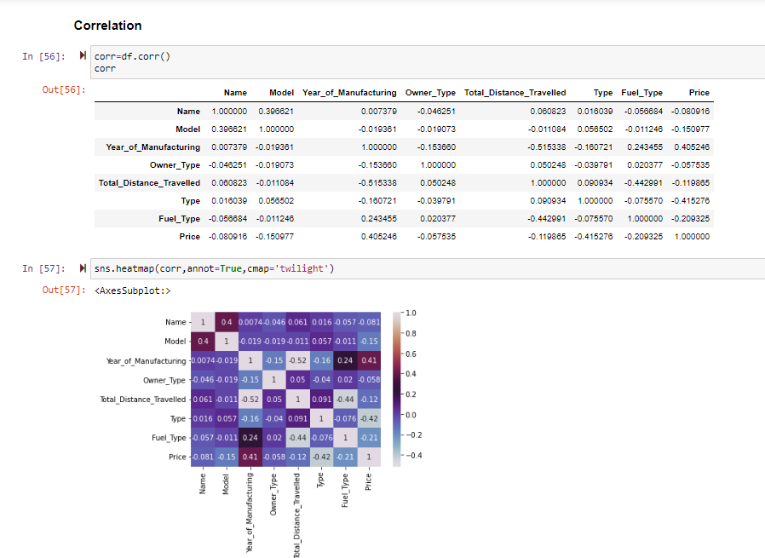
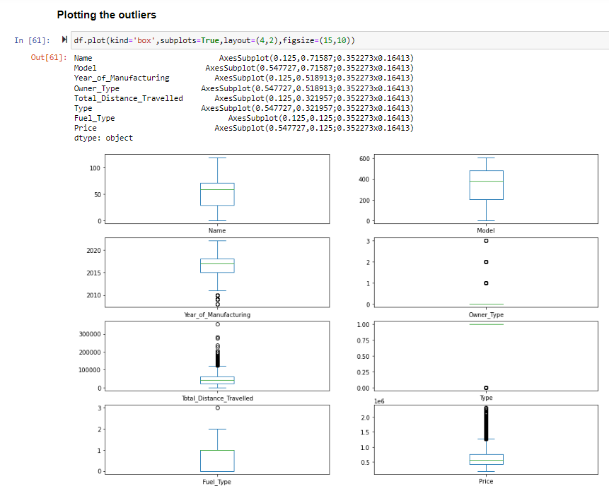
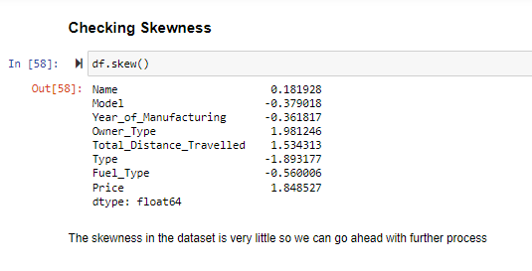

Slide 21
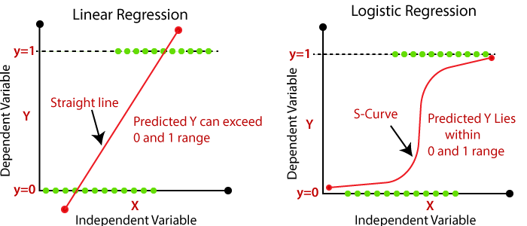
Is this a Regression problem or Classification problem?
By looking at the output i.e. ‘Price’, this is a continuous data not a categorical output so we go for the regression machine learning algorithms to predict the Price.
What does Regression mean?
In Regression, the output is continuous data. In this method, we predict the trends of training data based on the features. The result does not belong to a certain category or class, but it gives a numeric output that is a real number. For example, predicting House Prices is based on certain features like size of the house, location of the house, and no. of floors, etc.

Slide 22


Slide 23
Used Classification Algorithms
Linear Regression
from sklearn.linear_model import LinearRegression
Decision Tree Regressor
from sklearn.tree import DecisionTreeRegressor
Support Vector Regressor
from sklearn.svm import SVR
Kneighbor Regressor
from sklearn.neighbors import KNeighborsRegressor
Random Forest Regressor
from sklearn.ensemble import RandomForestRegressor
MODEL | ACCURACY
Linear Regression | 0.4459634857166468
Decision Tree Regressor | 0.8856552523096618
Support Vector Regressor | -0.08005490482792754
Kneighbor Regressor | 0.04292499937121386
Random Forest Regressor | 0.8815066126350098

Slide 24
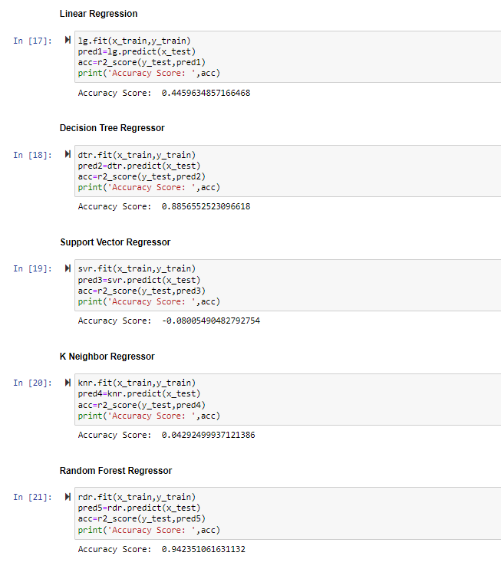

Slide 25
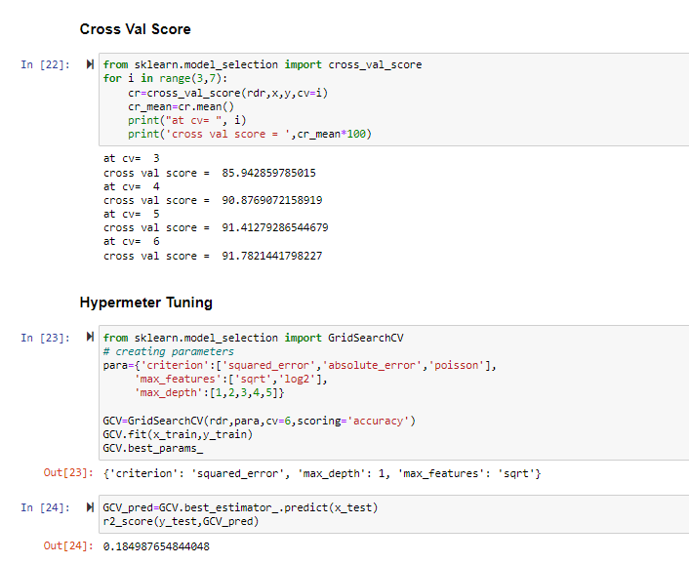
Cross Val Score & Hypermeter Tuning
Finding the cv at which the model runs the best.
Finding the parameters of the model whose accuracy we found the best at which it runs the best using the hypermeter tuning.
We found Random Forest accuracy the highest but by using the hyper parameters we get know that this model is not consistent or its accuracy is low in reality. So we will move ahead with the next model that is Decision Tree Model.

Slide 26
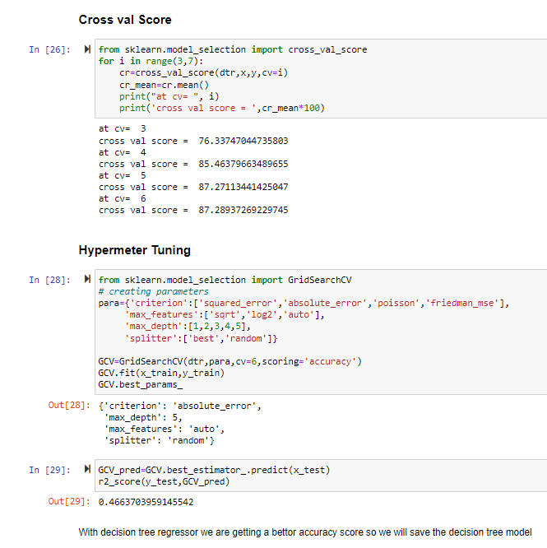
Cross Val Score & Hypermeter Tuning
Now for Decision tree model we get a better accuracy so we will save this model for future predictions.

Slide 27
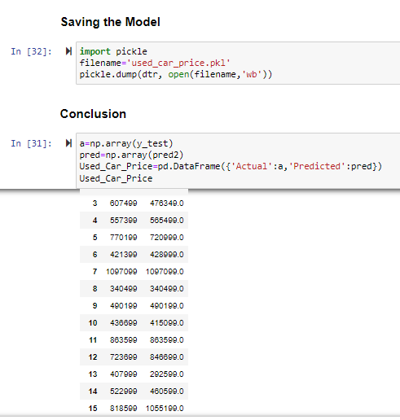
Saving the Model
After doing all the EDA process and find our best regression algorithm we will save that model for future predictions using the pickle algorithm.
We will conclude after comparing the actual & predicted values.

Slide 28


