Slide 1
Introduction to AI
Our first step into Artificial Intelligence + Python
Notes:
Welcome everyone. Aaj hum AI ki journey start kar rahe hain. Pehle introduce karo apna naam aur experience, phir students se unka naam aur 'AI ke baare mein kya pata hai' pucho.

Slide 2
1. Introduction of AI
AI = machines that can think, learn and make decisions like humans
You already use AI daily: YouTube suggestions, Google Maps, face unlock, ChatGPT
Goal: solve problems that normally need human intelligence
Notes:
Simple definition do: machine ko insaan jaisa sochna/seekhna sikhana. Students se pucho: 'Aap din mein kaha AI use karte ho?' (YouTube recommendations, Google Maps, ChatGPT, face unlock).

Slide 3
AI, ML, DL and Generative AI
Artificial Intelligence
Artificial Intelligence
AI is the broad field of creating machines that can perform tasks requiring human-like intelligence.
Machine Learning
Machine Learning
ML is a subset of AI where machines learn from data to make predictions or decisions.
Deep Learning
Deep Learning
DL is a specialized part of ML that uses neural networks with many layers, e.g. image and speech recognition.
Generative AI
Generative AI
Gen AI refers to models that create new, original content such as images, text, or music.
Notes:
Ye nested circles dikhate hain ki sab AI ka hi hissa hain: AI sabse bada, uske andar ML, ML ke andar DL, aur DL ke andar Generative AI.

Slide 4
ML Model vs LLM
Earlier: ML Model
Today: LLM (Large Language Model)
Built for ONE single problem
Small, simple predictions (price, pass or fail)
New task = train a new model
Very BIG model trained on huge data
ONE model, MANY tasks
Chat, write, translate, code, summarize
Can solve complex tasks
Real examples
Real examples
Gmail spam filter | Weather forecasting
Bank fraud detection | House price prediction
YouTube / Netflix recommendations
ChatGPT | Claude | Gemini | GitHub Copilot
The AI you see today works with an LLM behind the scenes
Notes:
Samjhao: pehle ML model sirf ek kaam ke liye banta tha, jaise house price predict karna ya spam email pehchanna. Har naye kaam ke liye naya model. Aaj jo AI tools aap dekhte ho (ChatGPT, Gemini, Claude), unke peeche LLM hota hai - ek bada model jo chat, likhna, translate, code, summary jaise bahut saare complex kaam kar leta hai.

Slide 5
2. What we will cover in this journey
1
Introduction of AI
2
Introduction to Python & Programming Language
3
Variables & Data Types
4
If - Else
5
Loops
6
Functions
Notes:
Roadmap dikhao taaki students ko pata ho aage kya aane wala hai. Bolo: 'Hum step-by-step chalenge, basics strong honge to AI easy lagega.'

Slide 6
3. Let's start with...
To build AI, we first need to talk to computers = programming
Our starting point: Python
Notes:
Yahan se class ka hands-on part start hota hai. Zor do: AI sikhne ke liye pehle programming aani chahiye, aur uske liye hum Python se start karenge.

Slide 7
4. What is Python & Programming Language?
Programming language = a way to give instructions to a computer
Python is simple, readable and powerful
Our first program
print("Hello, AI!")
# Output:
Hello, AI!
Notes:
Programming language = computer se baat karne ki bhasha. Example do: jaise hum Hindi/English bolte hain, computer Python samajhta hai. Live demo: print('Hello AI').

Slide 8
5a. Variables & Data Types
Variable = a named box that stores a value
int → whole numbers, float → decimals
str → text, bool → True / False
age = 20 # int
height = 5.8 # float
name = "Ravi" # str
is_student = True # bool
print(type(age))
Notes:
Variable = dabba jisme value store hoti hai. Har dabbe ka naam hota hai. Data types: jaise dabbe mein kya rakha hai - number, text, ya True/False. type() se check karwao.

Slide 9
5b. Variable Naming Rules
Start with a letter or underscore ( _ ), never a number
Only letters, digits and underscore allowed
No spaces or special symbols ( - @ $ )
Case-sensitive: age and Age are different
Cannot use Python keywords (if, for, class)
Tip: use clear names like student_name
Valid names
age = 20
student_name = "Ravi"
_count = 5
marks2 = 90
Invalid names
2marks = 90 # starts with 2
student name # has space
my-age = 20 # has hyphen
class = 5 # keyword
Notes:
Variable ka naam kuch rules follow karta hai. Ek ek rule ke saath right side ka example dikhao. Invalid examples live run karke error dikha sakte ho. Case-sensitive par zor do: age aur Age alag variables hain.

Slide 10
5c. String Indexing & Slicing
word = "PYTHON"
Forward
index
0
1
2
3
4
5
P
Y
T
H
O
N
Backward
index
-6
-5
-4
-3
-2
-1
Single item: [index]
Multiple items (slicing): [start:end]
word[0] # 'P'
word[2] # 'T'
word[5] # 'N'
word[-1] # 'N'
word[-3] # 'H'
word[-6] # 'P'
word[0:3]
'PYT'
word[2:5]
'THO'
word[-3:]
'HON'
Highlighted: word[2:5] gives 'THO' (index 2, 3, 4). The end index 5 is NOT included.
Notes:
Word 'PYTHON' ek variable (word) mein store hai. Har character ka ek index hota hai. Forward index 0 se start (P=0, Y=1...), backward index -1 se start (N=-1, O=-2...). Ek item ke liye word[index]. Ek se zyada characters ek saath chahiye to slicing: word[start:end]. Dhyan do: end index include NAHI hota. word[2:5] = index 2, 3, 4 = 'THO' (highlighted boxes). word[-3:] = last 3 characters. Shortcut: word[:3] start se 3 characters, word[3:] index 3 se end tak.

Slide 11
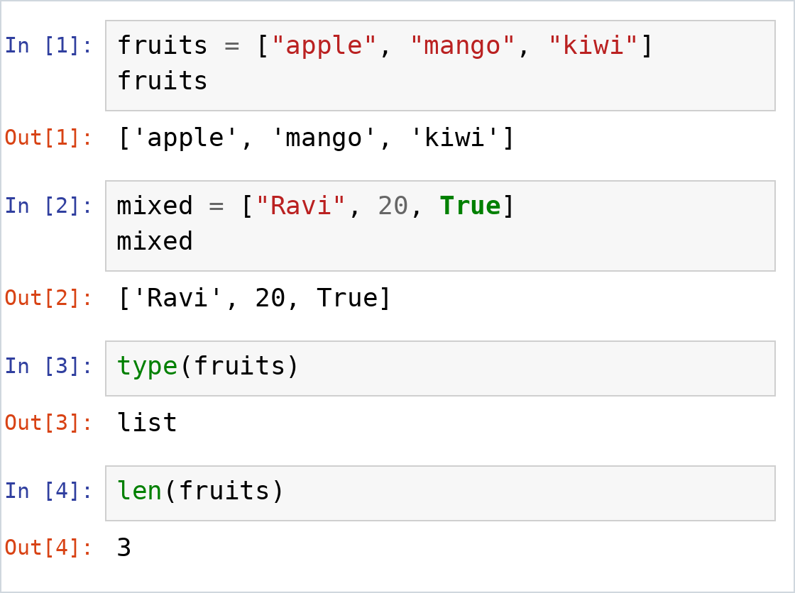
5d. Lists
List = ordered collection of items
Written inside square brackets [ ]
Items separated by commas
Can hold different data types
Changeable: add, remove, edit items
Notes:
List = ek variable mein bahut saari values. Square brackets [ ] mein likhte hain, commas se alag. Alag-alag data types mix ho sakte hain. List changeable hoti hai (items add, remove, edit kar sakte hain), string nahi hoti. Right side ka image notebook ka real output hai.

Slide 12
5e. List Functions (Methods)
Each example starts with:
nums = [30, 10, 20]
Function | What it does | Example | Result
append(x) | Add item at the end | nums.append(40) | [30, 10, 20, 40]
insert(i, x) | Add item at position i | nums.insert(1, 99) | [30, 99, 10, 20]
remove(x) | Remove item by value | nums.remove(10) | [30, 20]
pop() | Remove the last item | nums.pop() | [30, 10]
sort() | Arrange in ascending order | nums.sort() | [10, 20, 30]
reverse() | Reverse the order | nums.reverse() | [20, 10, 30]
len() | Count the items | len(nums) | 3
Notes:
Ye list ke sabse common functions hain. Table mein har function ka kaam, example aur result hai. Har example nums = [30, 10, 20] se start hota hai (independent). Ek ek function notebook mein live chalake dikhao. Dhyan do: append, insert, remove, pop, sort, reverse list ko khud change karte hain.

Slide 13
5f. List Indexing & Slicing
fruits = ["apple", "mango", "kiwi", "grape", "lemon", "melon"]
Forward
index
0
1
2
3
4
5
"apple"
"mango"
"kiwi"
"grape"
"lemon"
"melon"
Backward
index
-6
-5
-4
-3
-2
-1
Single item: [index]
Multiple items (slicing): [start:end]
fruits[0] # apple
fruits[2] # kiwi
fruits[5] # melon
fruits[-1] # melon
fruits[-3] # grape
fruits[-6] # apple
fruits[0:3]
['apple', 'mango', 'kiwi']
fruits[1:4]
['mango', 'kiwi', 'grape']
fruits[-3:]
['grape', 'lemon', 'melon']
Highlighted: fruits[1:4] gives mango, kiwi, grape (index 1, 2, 3). The end index 4 is NOT included.
Notes:
Bilkul string jaisa, bas ab har box ek poora item hai. fruits mein 6 items hain: forward index 0 se 5, backward -1 se -6. Ek item ke liye fruits[index]. Ek se zyada items ke liye slicing: fruits[start:end], end include nahi hota. fruits[1:4] = index 1, 2, 3 = mango, kiwi, grape (highlighted boxes). Slicing ka result hamesha ek nayi list hoti hai. Pucho: fruits[6] likhein to kya hoga? (IndexError: list index out of range).

Slide 14
5g. If - Else (Decisions)
Computer makes decisions using conditions
If condition is True → run this block
Else → run the other block
Indentation (spaces) matters in Python!
marks = 65
if marks >= 40:
print("Pass")
else:
print("Fail")
Notes:
Real life example: 'Agar baarish ho rahi hai to chhatri lo, nahi to mat lo.' Computer bhi aise decision leta hai. Indentation (spaces) ka importance batao.

Slide 15
5h. Loops (Repeat Tasks)
Loop = repeat a task many times without rewriting code
for loop → when we know how many times
while loop → repeat until a condition becomes False
for i in range(1, 6):
print(i)
count = 1
while count <= 3:
print("Hi")
count += 1
Notes:
Loop = same kaam baar baar karna bina baar baar likhe. Example: 1 se 5 tak print karna. range(1,6) mein 6 include nahi hota - ye zaroor batao.

Slide 16
5i. Functions (Reusable Code)
Function = a reusable block of code with a name
Write once, use many times
Takes input (parameters), gives output (return)
def add(a, b):
return a + b
result = add(5, 3)
print(result) # 8
Notes:
Function = ek machine jaisa: input do, output lo. Ek baar banao, baar baar use karo. def, parameter, return samjhao.

Slide 17
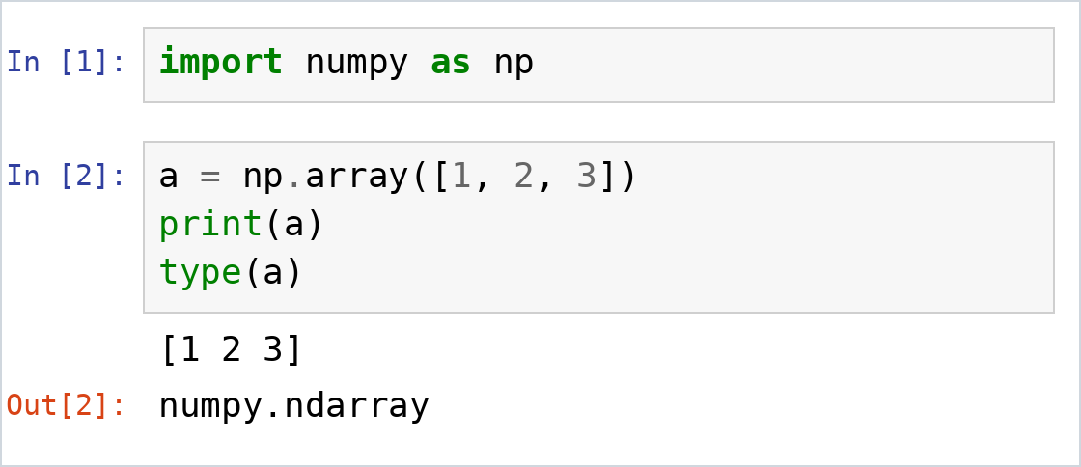
6a. Introduction to NumPy
NumPy = Numerical Python
Library for fast number and array work
Base of many AI/ML libraries
Import it as np
Notes:
NumPy = Numerical Python. Bolo: Python list se bahut fast, aur AI/ML ki almost saari libraries iske upar bani hain. 'import numpy as np' - np ek short naam (alias) hai. Image Jupyter notebook ka real output hai.

Slide 18
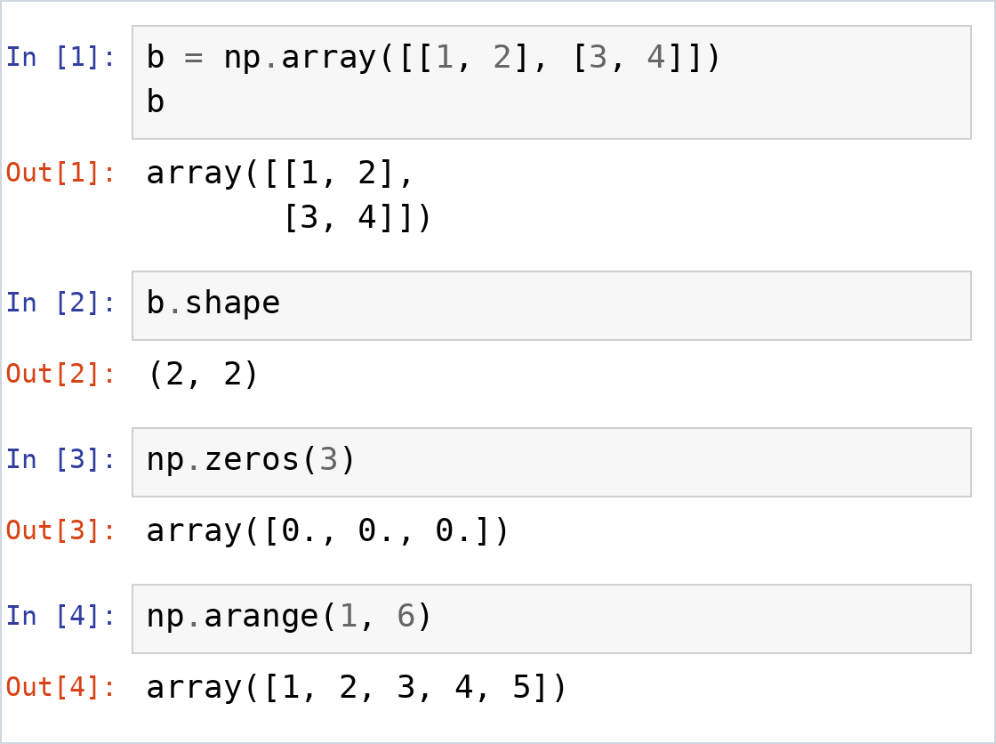
6b. NumPy Arrays
Array = values of the same type
1D = like a list
2D = rows and columns (table)
shape tells the size
Ready-made: zeros, ones, arange
Notes:
Array = same type ki values ka collection. 1D list jaisa, 2D table jaisa (rows aur columns). shape se pata chalta hai kitni rows aur columns hain.

Slide 19
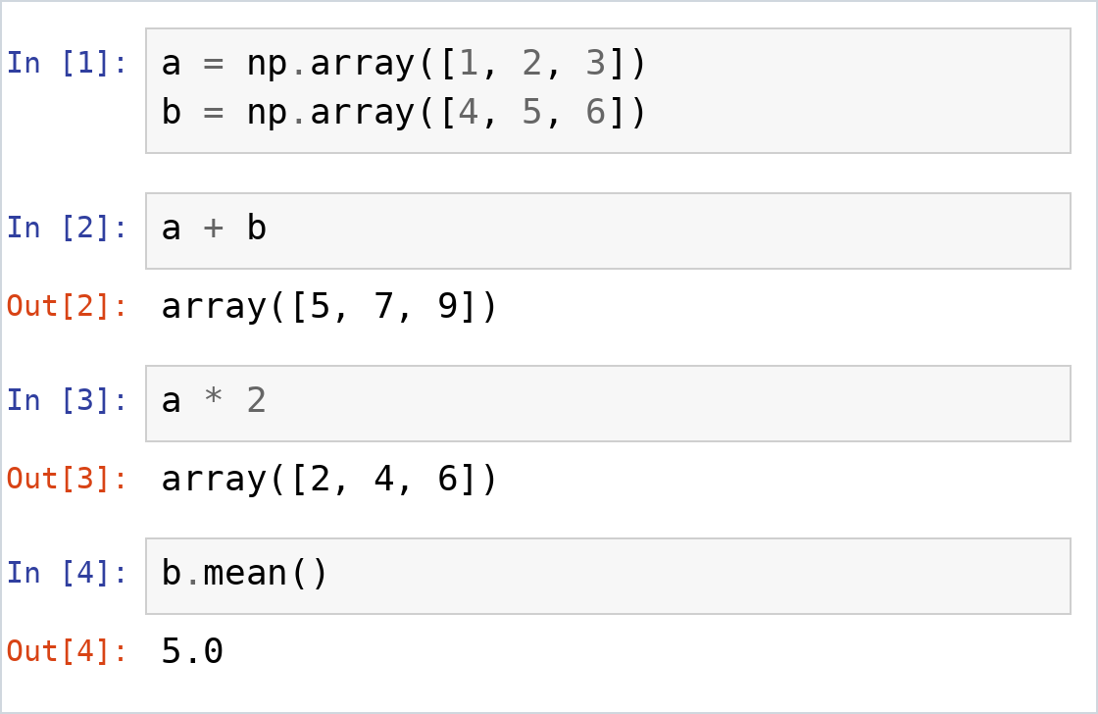
6c. Array Operations
Operations work on every element at once
No loop needed
Built-in stats: sum, mean, max, min
Notes:
Yahan magic dikhao: a + b se har element ek saath add hota hai, loop ki zarurat nahi. Isko vectorization kehte hain. Phir sum, mean, max jaise built-in functions dikhao.

Slide 20
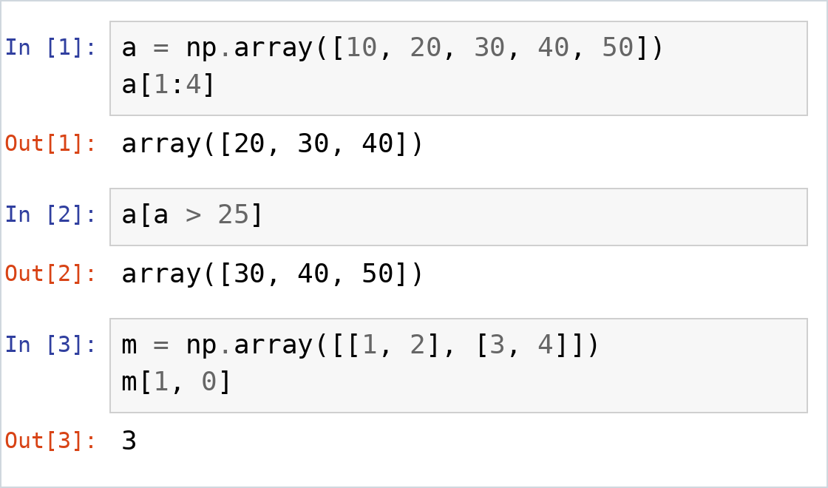
6d. Indexing & Slicing
Index starts at 0
Slice: a[start:end] (end not included)
2D: m[row, col]
Filter: a[a > 25]
Notes:
Index 0 se start hota hai. Slice mein end wali value include nahi hoti (a[1:4] = index 1,2,3). 2D mein m[row, col]. Boolean filter bahut useful hai, ML mein roz use hota hai.

Slide 21
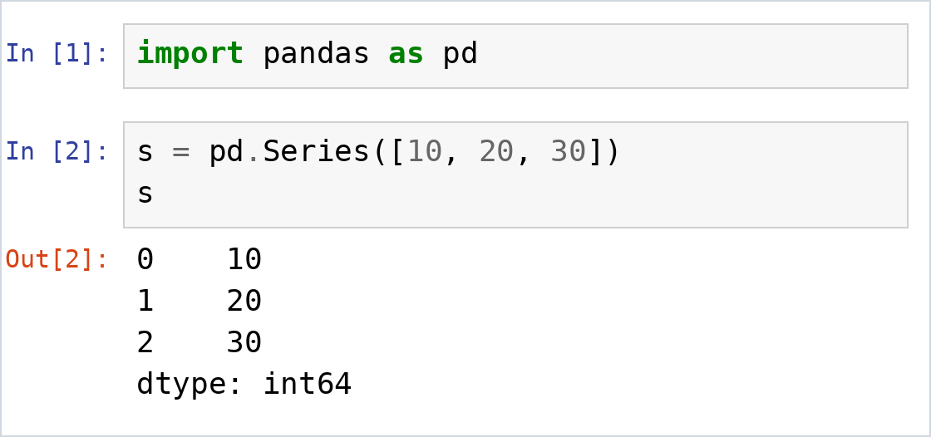
7a. Introduction to Pandas
Pandas = library for table data
Think of it as Excel inside Python
Series = one column
DataFrame = full table
Import it as pd
Notes:
Pandas = tables (rows aur columns) ke saath kaam karne ki library. Excel jaisa socho, lekin Python mein. Series = ek column, DataFrame = poori table.

Slide 22
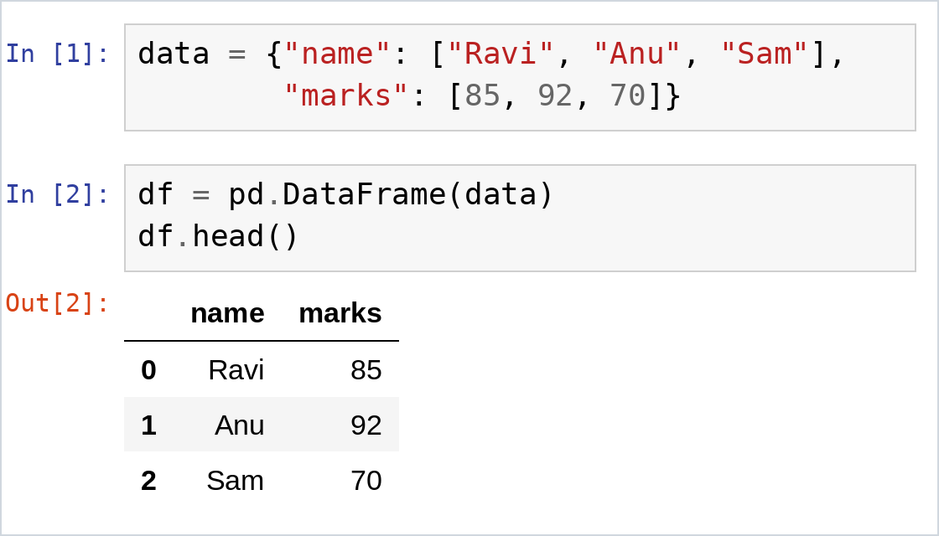
7b. Creating a DataFrame
Create from a dictionary
Keys become column names
Read a file: pd.read_csv()
head() shows the first 5 rows
Notes:
Dictionary se DataFrame banao: key = column ka naam, value list = column ka data. Table jaisa output dikhao, ye bilkul notebook jaisa dikhta hai. Real life mein data CSV se aata hai: pd.read_csv('file.csv'). head() pehli 5 rows dikhata hai.

Slide 23
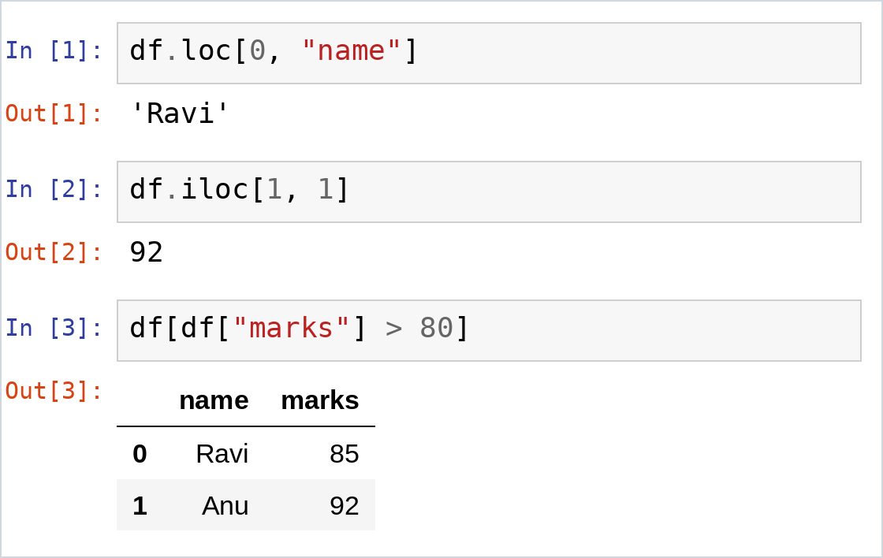
7c. Selecting Data
One column: df["name"]
loc = select by label
iloc = select by position
Filter rows with a condition
Notes:
loc = label se, iloc = position se. Condition se rows filter karna sabse useful hai: df[df['marks'] > 80] sirf Ravi aur Anu dega. Ek column lene ke liye df['name'] bhi dikhao.

Slide 24
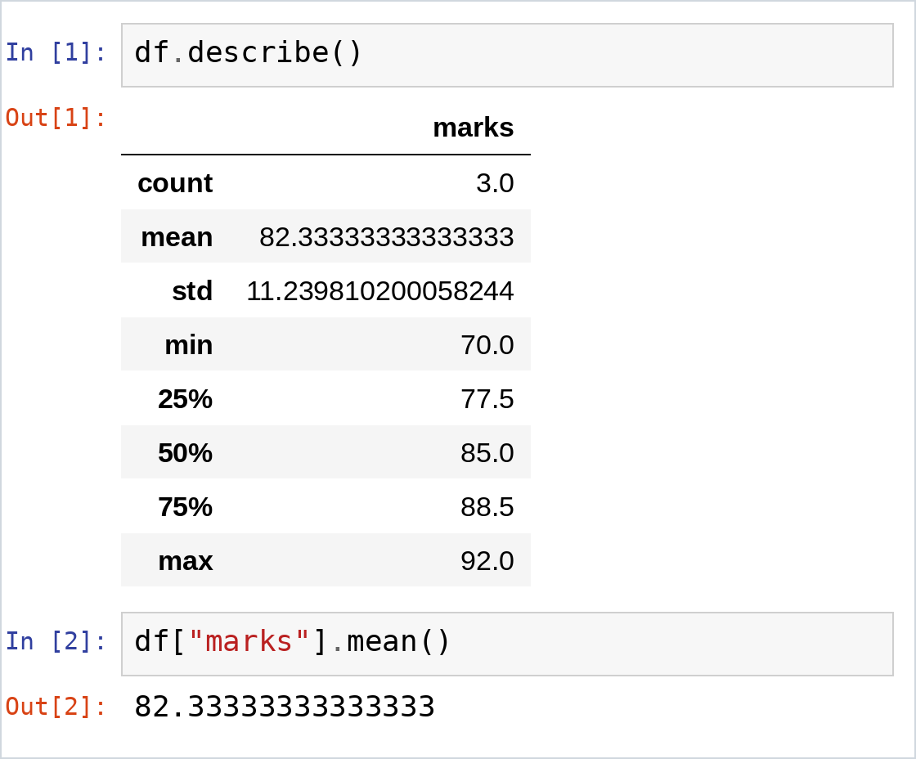
7d. Basic Data Analysis
describe() = quick statistics
mean(), max() on a column
info() = structure of data
sort_values() to order rows
isnull().sum() = missing values
Notes:
Naya dataset aaye to pehle info() aur describe() chalao. describe() count, mean, min, max sab ek saath deta hai. Phir sort_values aur missing values (isnull().sum()) check karo. Data cleaning ML ka bada hissa hota hai.

Slide 25
8a. What is NumPy?
NumPy = Numerical Python
Library for fast number and array work
Main object: ndarray (N-dimensional array)
Used in AI, ML and data science
Foundation for Pandas and scikit-learn
Install and import
pip install numpy
import numpy as np
1D array (one row of values)
1
2
3
4
5
2D array (rows and columns)
1
2
3
4
5
6
7
8
and more dimensions: 3D, 4D ...
Notes:
NumPy = Numerical Python. Ye Python ki library hai jo numbers aur arrays ke saath bahut fast kaam karti hai. Iska main object ndarray hai (N-dimensional array): 1D, 2D ya usse zyada dimensions. Pandas aur scikit-learn jaisi libraries NumPy arrays par based hain, isliye AI/ML seekhne se pehle NumPy zaroori hai. Pehle install karo, phir import numpy as np.

Slide 26
8b. Why NumPy instead of a Python List?
Feature | Python List | NumPy Array
Speed | Slower | Much faster
Memory | Uses more memory | Uses less memory
Math on all items | Needs a loop | Direct: arr * 2
Data type | Mixed types allowed | One type only
Built-in functions | Few | Many (sum, mean, max ...)
Python list
NumPy array
lst = [1, 2, 3]
lst * 2
[1, 2, 3, 1, 2, 3]
arr = np.array([1, 2, 3])
arr * 2
array([2, 4, 6])
NumPy multiplies every item. A list just repeats itself.
Notes:
Pehle table samjhao: NumPy fast hai (C mein likha hai), memory kam leta hai, aur poore array par ek saath math karta hai. Phir neeche ka demo: list ko 2 se multiply karo to wo repeat hoti hai ([1,2,3,1,2,3]), NumPy array mein har item 2 se multiply hota hai ([2,4,6]). Bonus: notebook mein %timeit se speed ka difference live dikha sakte ho (bade array par).

Slide 27
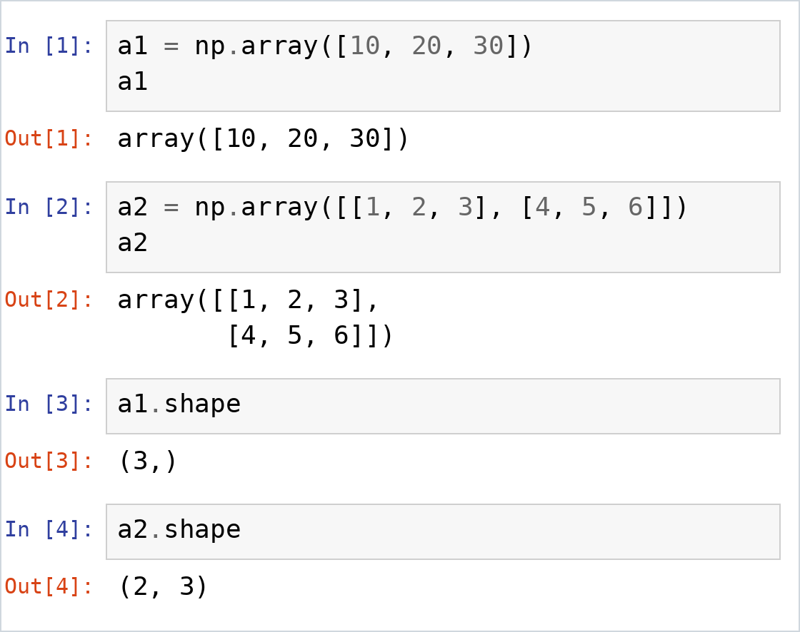
8c. Creating NumPy Arrays (1D and 2D)
np.array() turns a list into an array
1D = a simple list of numbers
2D = list of lists (rows and columns)
shape = (rows, columns)
All items share one data type
Notes:
np.array() list ko NumPy array mein convert karta hai. Ek list dene par 1D array banta hai (ek row). List of lists dene par 2D array banta hai (rows aur columns). shape batata hai size: (3,) matlab 1D mein 3 items; (2, 3) matlab 2 rows aur 3 columns. Image notebook ka real output hai.

Slide 28
8d. NumPy 1D Array: Indexing & Slicing
arr = np.array([10, 20, 30, 40, 50])
Forward
index
0
1
2
3
4
10
20
30
40
50
Backward
index
-5
-4
-3
-2
-1
Single item: [index]
Multiple items (slicing): [start:end]
arr[0] # 10
arr[2] # 30
arr[4] # 50
arr[-1] # 50
arr[-3] # 30
arr[-5] # 10
arr[0:3]
array([10, 20, 30])
arr[1:4]
array([20, 30, 40])
arr[-2:]
array([40, 50])
Highlighted: arr[1:4] gives array([20, 30, 40]) (index 1, 2, 3). The end index 4 is NOT included.
Notes:
1D array bilkul list/string jaisa hai. Forward index 0 se start (10 = index 0), backward -1 se start (50 = -1). Ek item ke liye arr[index]. Ek se zyada items ke liye arr[start:end], end include nahi hota. arr[1:4] = index 1, 2, 3 = [20 30 40] (highlighted boxes). Result bhi NumPy array hota hai.

Slide 29
8e. NumPy 2D Array: Access by Row & Column
m = np.array([[1, 2, 3], [4, 5, 6], [7, 8, 9]])
One item
One full row
One full column
m[1, 2]
m[0]
m[:, 1]
0
1
2
0
1
2
0
1
2
0
1
2
3
0
1
2
3
0
1
2
3
1
4
5
6
1
4
5
6
1
4
5
6
2
7
8
9
2
7
8
9
2
7
8
9
Result: 6
Result: [1 2 3]
Result: [2 5 8]
m[row, column]: first number = ROW, second number = COLUMN ( : means all )
Notes:
2D array table jaisa hai: rows (aadi lines) aur columns (khadi lines). Ek hi rule yaad rakhna: m[row, column] - pehla number ROW, dusra number COLUMN. Teen cases dikhao: (1) m[1, 2] = row 1, column 2 = 6 (ek item). (2) m[0] = poori pehli row = [1 2 3]. (3) m[:, 1] = ':' matlab saari rows, column 1 = [2 5 8] (poora column). Highlighted cells dekhkar students ko turant samajh aata hai. Row index orange, column index green.

Slide 30
8f. Common NumPy Functions
Each example uses:
arr = np.array([10, 20, 30, 40])
Function | What it does | Example | Result
sum() | Total of all items | arr.sum() | 100
mean() | Average value | arr.mean() | 25.0
max() | Largest value | arr.max() | 40
min() | Smallest value | arr.min() | 10
arange() | Numbers in a range | np.arange(1, 6) | [1 2 3 4 5]
zeros() | Array filled with 0 | np.zeros(3) | [0. 0. 0.]
reshape() | Change the shape | arr.reshape(2, 2) | [[10 20] [30 40]]
Notes:
Ye NumPy ke sabse common functions hain. sum, mean, max, min array ke statistics dete hain. arange 1 se 5 tak numbers banata hai (end include nahi). zeros 0 se bhara array banata hai. reshape 1D array ko 2D mein badalta hai. Har example arr = [10, 20, 30, 40] se start hota hai. Sabko notebook mein live chalao.

