Slide 1
ATM INTERFACE
TEAM REDS

Slide 2
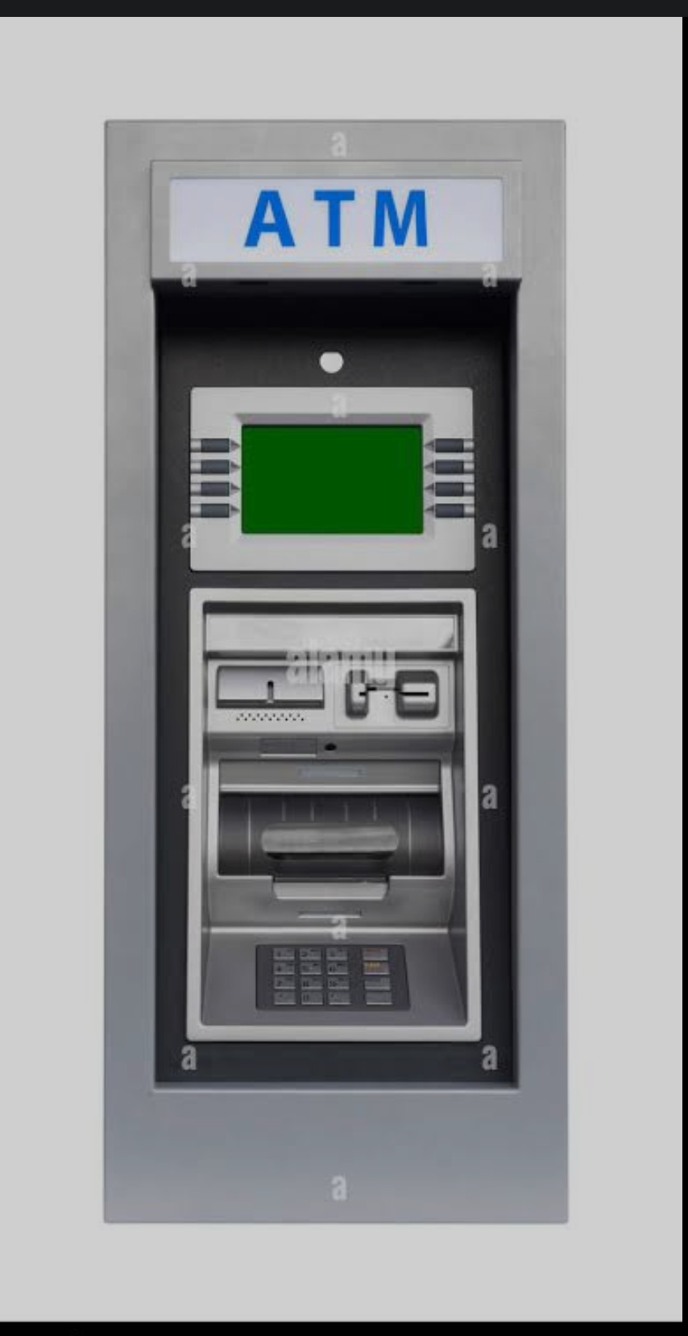
Introduction for ATM
Java, we can create an ATM program for representing ATM transection. In the ATM program, the user has to select an option from the options displayed on the screen. The options are related to withdraw the money, deposit the money, check the balance, and exit.

Slide 3
CODE
import java.awt.*;import java.awt.event.*;
import javax.swing.*;
import java.sql.*;
import java.util.*;
public class Deposit extends JFrame implements ActionListener{
JTextField t1,t2;
JButton b1,b2,b3;
JLabel l1,l2,l3;
Deposit()

Slide 4
setFont(new Font("System", Font.BOLD, 22));
Font f = getFont();
FontMetrics fm = getFontMetrics(f);
int x = fm.stringWidth("DEPOSIT");
int y = fm.stringWidth(" ");
int z = getWidth() - (6*x);
int w = z/y;
String pad ="";
pad = String.format("%"+w+"s", pad);
setTitle(pad+"DEPOSIT PAGE");
l1 = new JLabel("ENTER AMOUNT YOU WANT");
l1.setFont(new Font("System", Font.BOLD, 35));
l2 = new JLabel("TO DEPOSIT");
l2.setFont(new Font("System", Font.BOLD, 35));

Slide 5
l3 = new JLabel("Enter Pin");
l3.setFont(new Font("System", Font.BOLD, 14));
t1 = new JTextField();
t1.setFont(new Font("Raleway", Font.BOLD, 22));
t2 = new JTextField();
t2.setFont(new Font("Raleway", Font.BOLD, 14));
b1 = new JButton("DEPOSIT");
b1.setFont(new Font("System", Font.BOLD, 18));
b1.setBackground(Color.BLACK);
b1.setForeground(Color.WHITE);
b2 = new JButton("BACK");
b2.setFont(new Font("System", Font.BOLD, 18));
b2.setBackground(Color.BLACK);
b2.setForeground(Color.WHITE);

Slide 6
b3 = new JButton("EXIT");
b3.setFont(new Font("System", Font.BOLD, 18));
b3.setBackground(Color.BLACK);
b3.setForeground(Color.WHITE);
setLayout(null);
l3.setBounds(620,10,80,30);
add(l3);
t2.setBounds(700,10,40,30);
add(t2);
l1.setBounds(150,150,800,60);
add(l1);
l2.setBounds(290,210,800,60);
add(l2);
t1.setBounds(250,300,300,50);
add(t1);

Slide 7
public void actionPerformed(ActionEvent ae){
try{
String a = t1.getText();
String b = t2.getText();
public static void main(String[] args){
new Deposit().setVisible(true); }
}

Slide 8
SINCERE THANKS TO
ANJU MAM
DIVIYA MAM
DIVIYA

Slide 9
TEAM MEMBERS
RANJITH.K
SARATHY.A
ESSAKIRAJA.R
DINESHKUMAR.K

