Slide 1
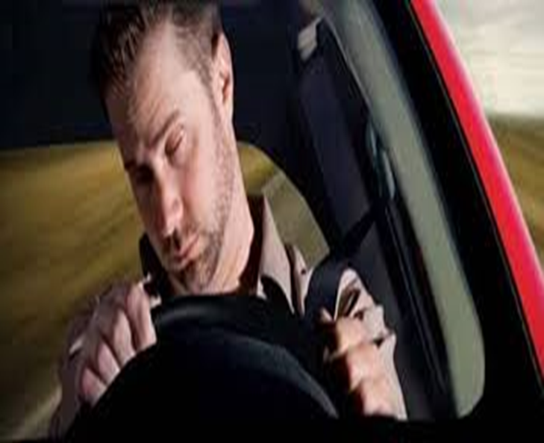
Driver
Drowsiness
Detection using
OpenCV and Python

Slide 2
Nowadays the driver safety in the car is one of the most wanted system to avoid accidents. Our objective of the project is to ensure the safety system so we are creating a system that can detect real time driver drowsiness and alert the driver.
Objective

Slide 3
Driver drowsiness detection is a car safety technology which prevents accidents when the driver is getting drowsy. Various studies have suggested that around 20% of all road accidents are fatigue related, up to 50% on certain roads. Driver fatigue is a significant factor in a large number of vehicle accidents. Recent statistics estimate that annually 1,200 deaths and 76,000 injuries can be attributed to fatigue related crashes. The development of technologies for detecting or preventing drowsiness at the wheel is a major challenge in the field of accident avoidance systems.
Introduction

Slide 4
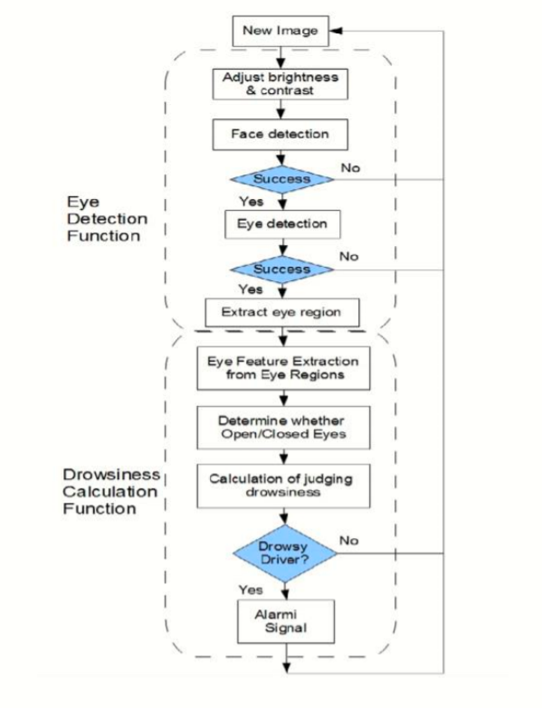
Methodology

Slide 5
Step 1 – Take image as input from a camera.
Step 2 – Detect the face in the image and create a Region of Interest (ROI).
Step 3 – Detect the eyes from ROI and feed it to the classifier.
Step 4 – Classifier will categorize whether eyes are open or closed.
Step 5 – Calculate score to check whether the person is drowsy.
Step 6 – To alert the driver

Slide 6
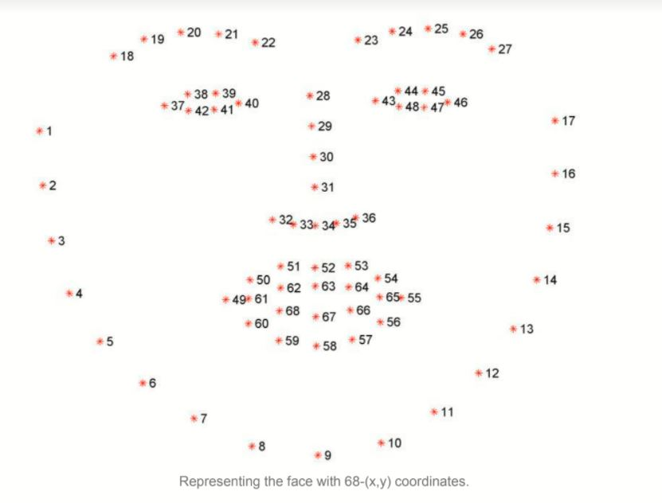
68 Landmark

Slide 7
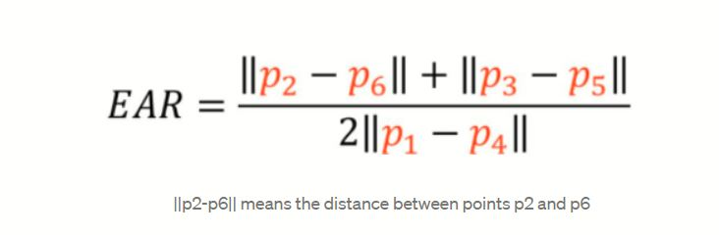
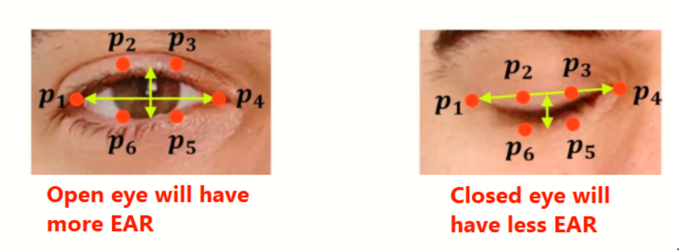
Eye Aspect Ratio(EAR)

Slide 8
Scipy
Imutils
argparse
Numpy
Pyglet
opencv
dlib
time
playsound
SOFTWARE REQUIREMENS

Slide 9
The detected abnormal behavior is corrected through alarms in real time.
Component establishes interface with other drivers very easily.
Life of the driver can be saved by alerting him using the alarm system.
Traffic management can be maintained by reducing accidents.
ADVANTAGES

Slide 10
DISADVANTAGES
Dependency on proper ambient light.
An optimum range is required.
Problem with multiple faces.
Poor detection of a person’s eyes with spectacles.

Slide 11
This system can be used in factories to alert the workers.
If found drowsy, the alarm system gets activated and the driver is alerted.
This system can also be used for railway.
APPLICATIONS

Slide 12
We have installed all the modules which are required for the project.
Scipy
Imutils
argparse
Numpy
Pyglet
opencv
dlib
time
playsound
Work Progress

Slide 13
Project Under Supervision of
Mr. Gaurav Aggarwal
Efforts by
Sonu Kumar- 180410101045
Ranjit Kumar- 180410101038

Slide 14


