Slide 1
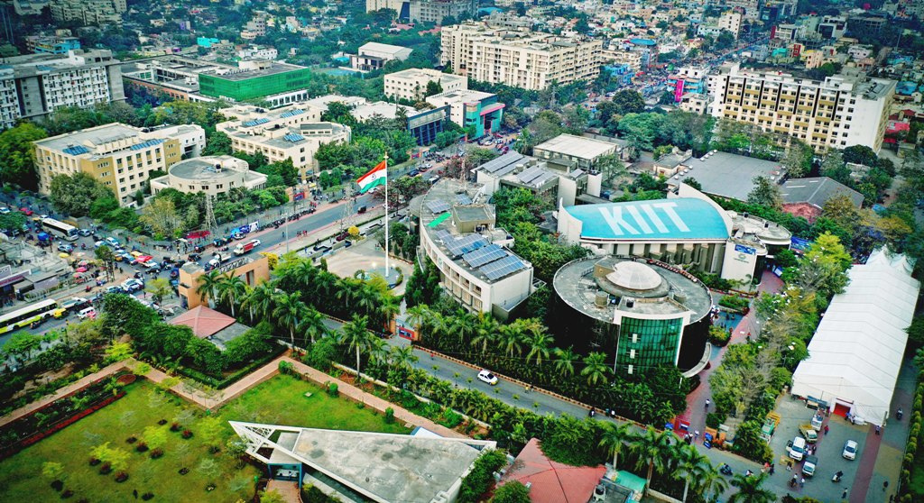




IEEE 7ᵗʰ International Conference On Computational Intelligence and Networks, CINE 2026
March 12ᵗʰ - 14ᵗʰ 2026
KIIT Deemed to be University, Odisha, India
PAPER ID:-185
ResMamba: A Hybrid Residual-State Framework for Deepfake Detection
Presented by-
PREETI BAJAJ, KIIT UNIVERSITY
Authors:
Pratyusa Mukherjee, Ram Prakash Jha, Ranjit Singh & Pritam Mandal
CINE2026

Slide 2
Introduction
Deepfake technology enables the creation of highly realistic yet entirely fabricated visual content, posing severe threats to media integrity, public trust, and digital security.
Traditional detection methods rely on handcrafted features and shallow pipelines, often failing to generalize across diverse and evolving forgery techniques.
To address this, we propose a hybrid architecture combining a ResNet-18 convolutional backbone for robust spatial feature extraction with a Mamba State Space Model (SSM) for capturing long-range sequential dependencies within feature embeddings .
Trained and evaluated on the large-scale GRAVEX-200K dataset and External, our model delivers accurate and scalable deepfake detection across varied manipulation domains.
CINE2026
185, ResMamba

Slide 3
Innovation in the Study
This study proposes a hybrid ResNet-18 + Mamba SSM architecture that fuses spatial feature extraction with state-space sequence modeling, achieving superior deepfake detection over traditional CNN-based approaches.
As a structured sequence modeling technique, Mamba SSM captures long-range dependencies in feature embeddings while remaining computationally efficient and improving detection accuracy.
In deepfake detection, the proposed model ensures robust generalization across diverse forgery techniques by training and evaluating on the large-scale GRAVEX-200K dataset, making detection more accurate, scalable, and trustworthy.
CINE2026
185, ResMamba

Slide 4
Related work
Author & Year | Model / Approach | Identified Limitations (Research Gap) | Identified Limitations (Research Gap)
Kapoor et al. (2025) [1] | ResNet-50 & VGG-16 | Strong spatial feature extraction using residual learning and deep CNNs | Limited global dependency modeling, no long-range sequence understanding, high computational cost, weak temporal representation
Ghita et al. (2024) [2] | Vision Transformer (ViT) | Captures global relationships using self-attention | Requires massive training datasets, computationally expensive, unstable with limited data, heavy parameter tuning
Deng et al. (2022) [3] | EfficientNet-B3 (Face-Edge Focused) | Extremely high AUC on boundary artifact detection | Over-dependence on edge artifacts; performance drops when manipulations are subtle or compression artifacts vary
Saeed et al. (2025) [4] | Facial Enhancement Analysis (FabSoften, GFPGAN) | Demonstrated vulnerability of detection models against photorealistic augmentation | Shows existing CNN-based models lack robustness against enhancement-based attacks
Rogovoi et al. (2024) [5] | ResNet + Frequency & Color Reduction | Improved robustness under blur and noise conditions | Still primarily spatial-based; lacks effective long-range sequence modeling and adaptive feature integration
CINE2026
185, ResMamba

Slide 5
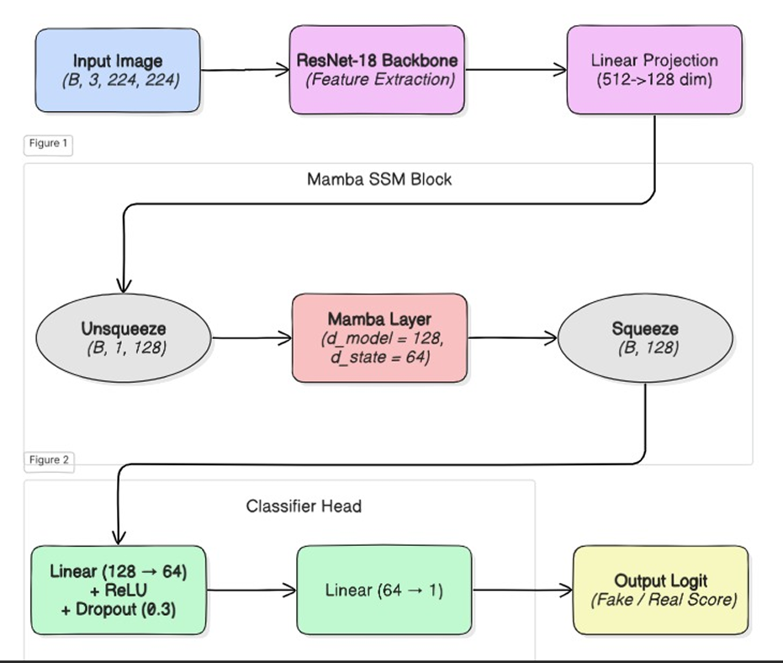
Proposed Architecture
CINE2026
185, ResMamba

Slide 6
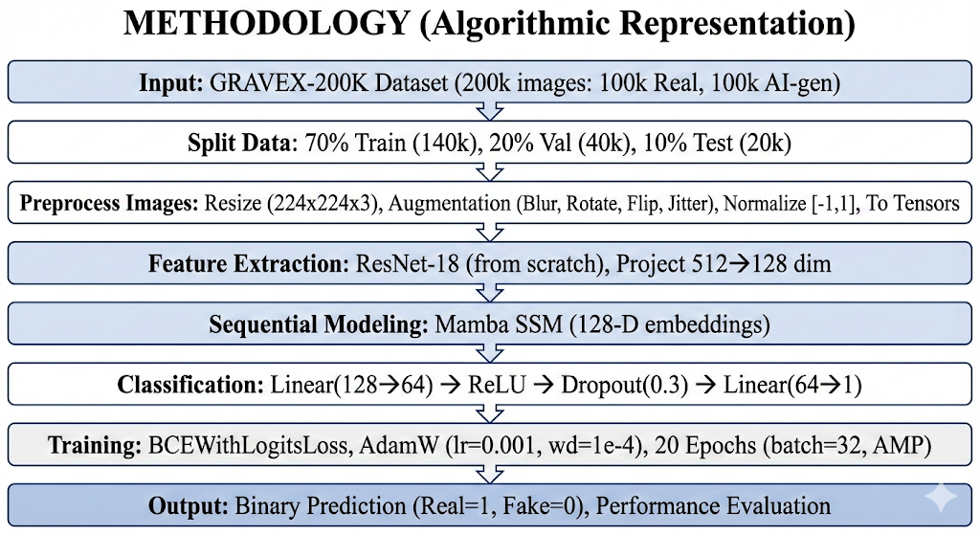
Proposed Methodology
CINE2026
185, ResMamba

Slide 7
Results
Metric | External Test Data (140k) | 200k Test Data
Accuracy | 97.70% | 92.01%
Precision | 96.41% | 88.36%
Recall / Sensitivity | 99.09% | 96.77%
F1-Score | 97.73% | 92.37%
Dataset | True Label | Predicted Fake (Class 0) | Predicted Real (Class 1)
External Test (140k) | Fake (Class 0) | 9,631 | 369
 | Real (Class 1) | 91 | 9,909
200k Test Data | Fake (Class 0) | 8,725 | 1,275
 | Real (Class 1) | 323 | 9,677
CINE2026
185, ResMamba

Slide 8
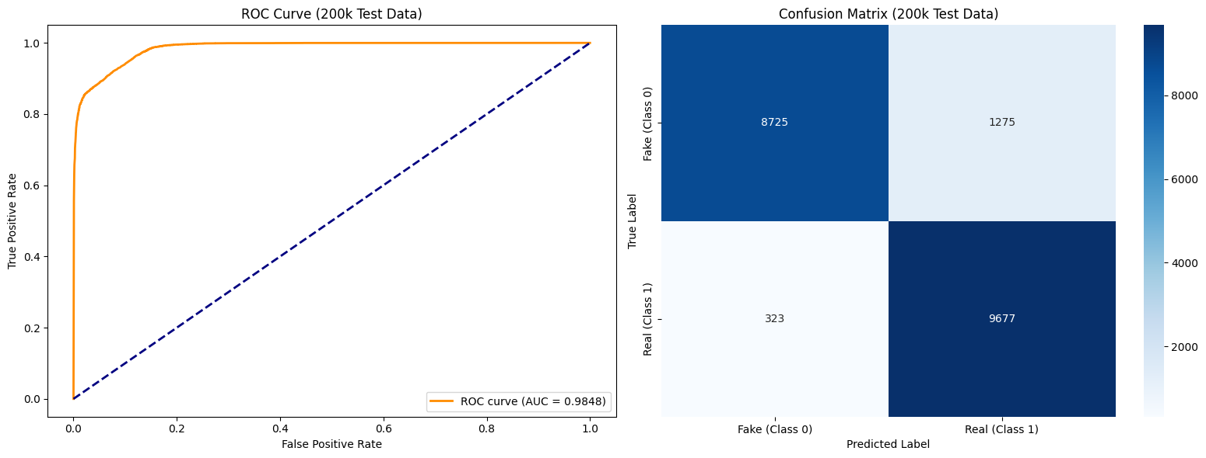
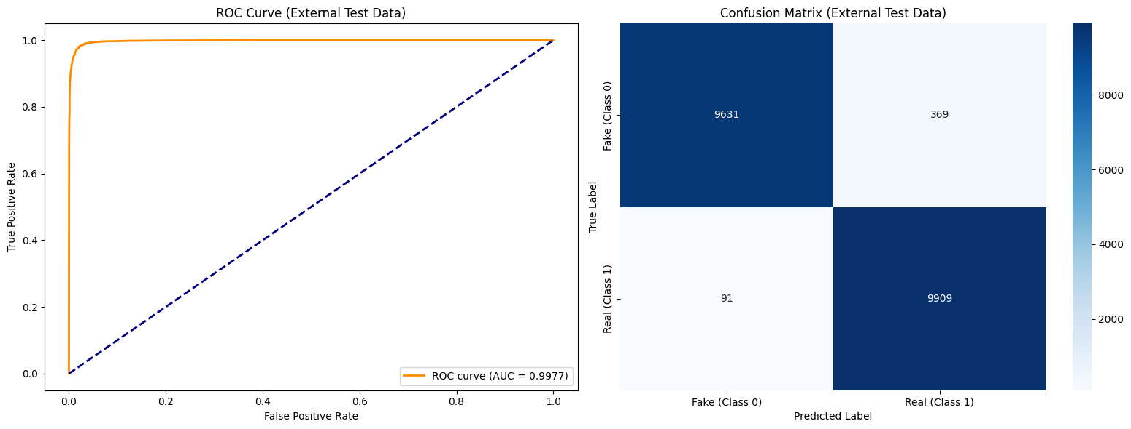
Results
CINE2026
185, ResMamba

Slide 9
Conclusion
The hybrid ResNet-18 and Mamba SSM architecture demonstrates reliable deepfake detection, outperforming conventional CNN and Transformer-based models on GRAVEX-200K and other datasets in terms of accuracy, generalization, and consistency. With a time complexity of approximately O(n·d), the model remains computationally and memory efficient while achieving competitive performance comparable to VGG-style CNNs. Mixed-precision training and regularization further reduce training cost and improve convergence. Future work will extend the ResMamba framework to video-level analysis and evaluate robustness against adversarial enhancements such as GFPGAN.
CINE2026
185, ResMamba

Slide 10
Reference
[1] K. Kapoor, S. P. Singh, G. Aggarwal, and M. Sharma, ”Deepfake Detection Using CNN-Based Architecture,” in Proc. 2025 International Conference on Engineering, Technology & Management (ICETM), May 2025, pp. 1–6, IEEE.
[2] B. Ghita, I. Kuzminykh, A. Usama, T. Bakhshi, and J. Marchang, ”Deepfake Image Detection Using Vision Transformer Models,” in Proc. 2024 IEEE International Black Sea Conference on Communications and Networking (BlackSeaCom), June 2024, pp. 332–335, IEEE.
[3] Z. Deng, B. Zhang, S. He, and Y. Wang, ”Deepfake Detection Method Based on Face Edge Bands,” in Proc. 2022 9th International Conference on Digital Home (ICDH), Oct. 2022, pp. 251–256, IEEE.
CINE2026
185, ResMamba

Slide 11
Reference
[4] M. S. Saeed, I. U. Haq, and K. Malik, ”Realism to Deception: Investi gating Deepfake Detectors Against Face Enhancement,” arXiv e-prints, arXiv:2509, 2025.
[5] V. Rogovoi, V. M. Korzhuk, and O. A. Kokorina, ”Development of a Deepfake Detection Method: Application of Frequency Analysis and Re duction of the Image Color Space to Improve Classification Accuracy,” in Proc. 2024 V Int. Conf. on Neural Networks and Neurotechnologies (NeuroNT), June 2024, pp. 36–39, IEEE.
CINE2026
185, ResMamba

Slide 12
Thank You
CINE2026
185, ResMamba

