Slide 1
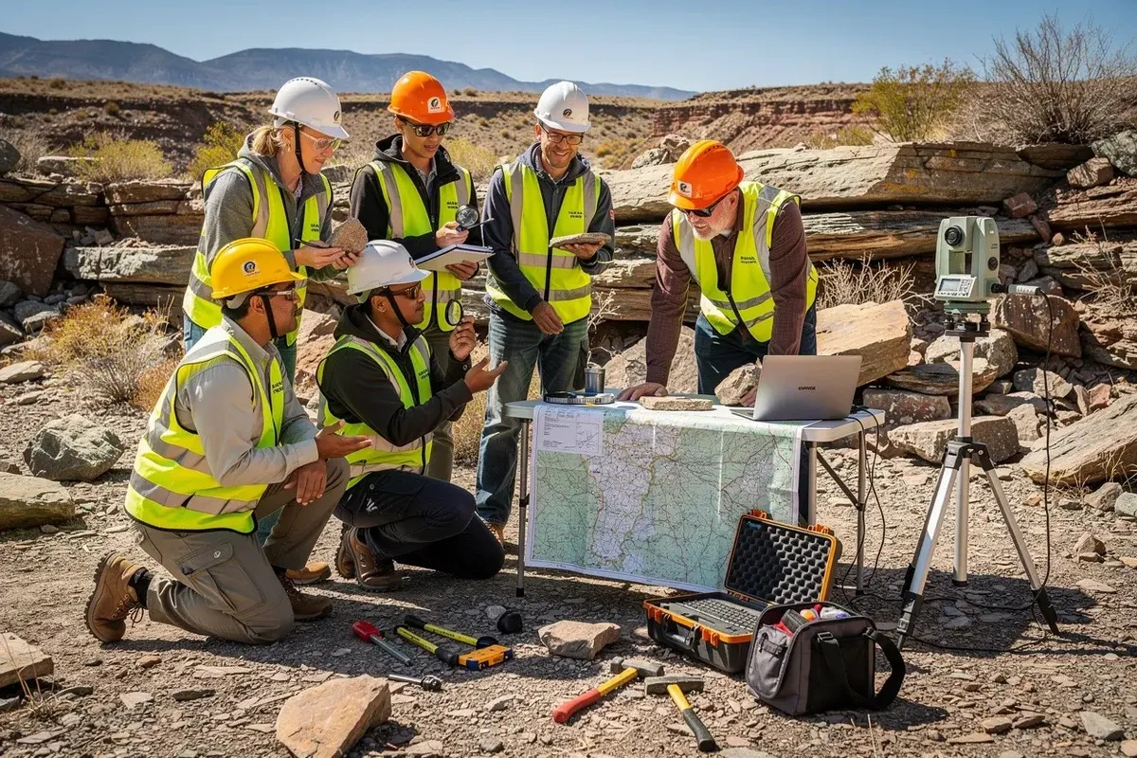

GitHub for Geological Research
Git & GitHub Fundamentals – Final Session
Applying Version Control in Geological Research
FINAL SESSION
GEOLOGY + COLLABORATION
Today we connect GitHub concepts with a real-world geology project.
1/15
Notes:
Welcome students to the final session. Explain that Day 1 and Day 2 gave them Git and GitHub mechanics; today shows why those skills matter for geology and research work. Emphasize the main message: GitHub is a collaboration and project management tool, not only a programming platform.

Slide 2
What We Learned So Far
GitHub for Geological Research
Git
GitHub
Team Workflow
①
②
③
Version Control
Tracking Changes
Commits
Repository
Remote Collaboration
Sharing Projects
Branches
Merge
Pull Requests
2/15
Notes:
Briefly recap the previous two days. Day 1 focused on individual version control and the GitHub remote workflow. Day 2 focused on collaboration with branches, merge, and pull requests. Tell students that these concepts are now ready to be applied to a geological research project.

Slide 3
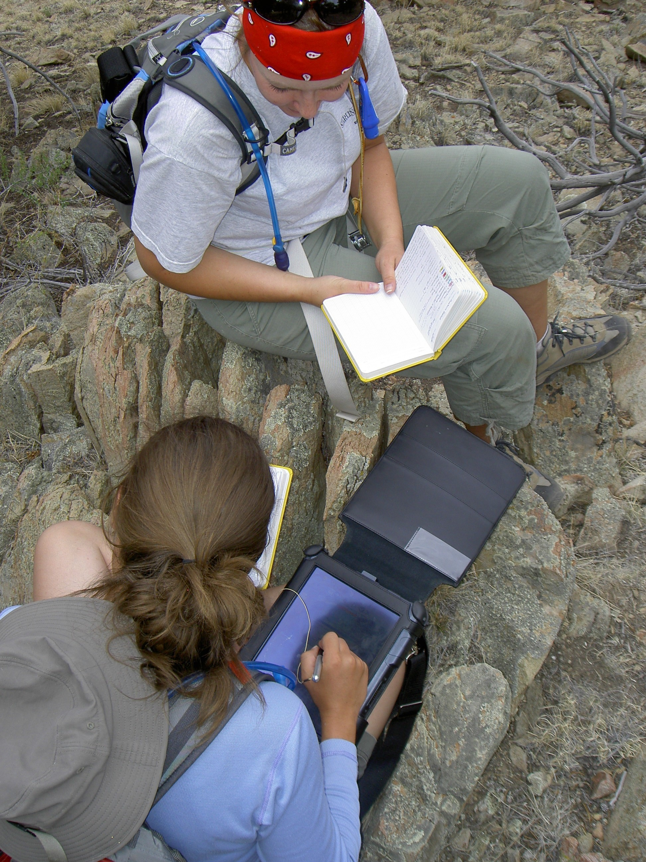
The Big Question
GitHub for Geological Research
“Why should a Geology student learn GitHub?”
GitHub is not only for programmers. Researchers, scientists, GIS professionals, and engineers use similar workflows.
3/15
Notes:
Ask the question directly and pause. Explain that many students associate GitHub with programming, but the deeper idea is managing changes, evidence, files, feedback, and teamwork. Those needs exist in geology, GIS, lab work, and research writing.

Slide 4
Where Can Geologists Use GitHub?
GitHub for Geological Research
🪨
Geological Research Projects
📍
Field Survey Data
🗺️
GIS Mapping Projects
🧪
Laboratory Data
📄
Research Reports
📝
Scientific Documentation
👥
Team Collaboration
4/15
Notes:
Walk through the examples. Connect each one to a real student task: collecting field observations, managing rock sample data, storing maps, writing reports, and working with classmates. Stress that GitHub can be used even when the project contains no complex code.

Slide 5
Real-World Example
GitHub for Geological Research
Project: Geological-Survey-2026
A team of geology students collects rock samples from different locations and creates a research report.
Plan survey
Collect samples
Record data
Analyze
Write report
5/15
Notes:
Introduce the sample project that will be used for the rest of the session. Make it concrete: different students go to different field sites, record observations, collect measurements, and later combine everything into a single report.

Slide 6
Project Repository Structure
GitHub for Geological Research
Each folder has a purpose.
Geological-Survey-2026
├── README.md
•
README: project overview
├── data/
•
data: scientific datasets
│ └── rock_samples.csv
├── scripts/
•
scripts: optional analysis tools
│ └── analyze.py
•
reports: research writing
├── reports/
•
images: field photos and figures
│ └── report.md
└── images/
6/15
Notes:
Explain that a repository is like a well-organized research folder with history. The README introduces the project, data stores measurements, scripts may contain analysis, reports hold writing, and images hold field photos or figures. Students should understand structure before tools.

Slide 7
Managing Geological Data
GitHub for Geological Research
Sample_ID
Location
Rock_Type
Hardness
Density
RS-001
Dhangadhi
Sandstone
5
2.35
CSV
=
structured
evidence
RS-002
Kailali
Limestone
3
2.71
RS-003
Godawari
Granite
6
2.62
CSV files are common in scientific datasets.
•
Rock samples
•
Earthquake records
•
Soil analysis
•
Environmental data
7/15
Notes:
Show that data does not have to be complicated. Many research datasets start as CSV files. GitHub can track changes to CSV data, who updated the file, and when. Mention that clean column names and consistent formats make research easier to review later.

Slide 8
Documentation Matters
GitHub for Geological Research
README.md and Markdown reports explain the research story.
•
Project objective
# Geological Survey 2026
## Objective
Map and describe rock samples from selected field sites.
## Methodology
- Field observation
- Sample labeling
- CSV data recording
## Findings
Granite samples show higher hardness than limestone.
•
Methodology
•
Findings
•
Conclusion
8/15
Notes:
Explain that documentation is what makes a project understandable to other people. README files and Markdown reports are simple text documents that describe the objective, methods, findings, and conclusion. Good documentation is part of professional scientific work.

Slide 9
Data Analysis Example
GitHub for Geological Research
Python can support research by analyzing larger datasets.
📊
🐍
📈
📄
→
→
→
CSV Data
Python Script
Graph
Research Report
Focus: research workflow, not deep Python teaching.
9/15
Notes:
Clarify that this session is not a Python class. The point is to show the research workflow: data goes into a script, the script produces a graph or result, and that result goes into a report. GitHub tracks the data, script, figures, and report together.

Slide 10
Collaboration Workflow
GitHub for Geological Research
Student A
Field Data Collection
Student B
Data Cleaning
Student C
Analysis
Student D
Report Writing
Branches → Commits → Pull Requests → Merge
10/15
Notes:
Connect roles in a geology project to GitHub workflow. Each student can work on a branch, commit their contribution, open a pull request for review, and merge the final approved work. This reduces confusion and keeps the group project organized.

Slide 11
Connecting Git Concepts With Geology Projects
GitHub for Geological Research
Git Concept
Meaning in a Geology Project
Repository
Project storage
Commit
Record changes
Branch
Work separately
Merge
Combine contributions
Pull Request
Review work
Push
Upload changes
11/15
Notes:
Use the table to translate Git terminology into research language. A repository stores the research project. A commit records changes. A branch lets one student work without disturbing the main project. A pull request allows review before merging.

Slide 12
Live Demonstration
GitHub for Geological Research
1
Create repository
2
Add geological dataset
3
Commit changes
Push to GitHub
Local Project
↓
Git Commit
↓
GitHub Repository
4
5
Update report
6
View history
12/15
Notes:
Use this slide as the checklist for the live demo. Keep the demo slow and simple. Use a small CSV file and README update. Show commit history so students see that GitHub records project evolution, not just final files.

Slide 13
Why GitHub Skills Matter
GitHub for Geological Research
🗂️
Organized projects
🕒
Version history
👥
Team collaboration
🔁
Research reproducibility
💼
Professional portfolio
📚
Better documentation
These are professional research habits.
13/15
Notes:
Summarize the benefits in a practical way. GitHub helps students organize work, recover earlier versions, collaborate fairly, and show a professional portfolio. For research, version history and documentation support reproducibility.

Slide 14
Final Assignment
GitHub for Geological Research
Repository: Geological-Survey-2026
✓
README.md
Geological-Survey-2026
├── README.md
✓
Geological CSV data
├── data/rock_samples.csv
✓
Report
├── reports/report.md
└── images/
✓
Images
✓
Meaningful commits
Push to GitHub
14/15
Notes:
Give students the final assignment clearly. They should create a repository, add a README, a small geological CSV dataset, a short report, and images if available. Ask them to make meaningful commits rather than one final upload.

Slide 15
Final Message
GitHub for Geological Research
“GitHub is not about becoming a software developer.
It is about learning how professionals organize, collaborate, and share their work.”
Thank You
Questions?
15/15
Notes:
Close the workshop by repeating the main message. GitHub is a professional workflow tool. Encourage students to use it in research reports, field survey projects, GIS work, and team assignments. Invite questions and then proceed to the final activity or submission instructions.

