Slide 1
COURIER SERVICE MANAGEMENT
Date of presentation: 30th Sep ,2021
E - Diploma in Advanced Computing (E-DAC),
May 2021 Batch
institute OF ADVANCED COMPUTING AND
SOFTWARE DEVELOPMENT,PUNE.

Slide 2
Project Team
Group No – 100
Project Guide – Mr. Akshay Parab.
Faculty Guide – Mrs. Monica Jadhav.
Project Members –
Savita Gujare.
Ranjit Gaikwad.

Slide 3
Content
Introduction
Project Flow
Details About Project
Conclusion

Slide 4
Introduction
This Courier Service Management Project will have different modules. The login section will have login facility for the admin and for the user who will operate this system.
While taking orders from its customers, it will take all the details
of its customers who is placing the orders and all the details for the recipient such as its address, name, mobile number.

Slide 5
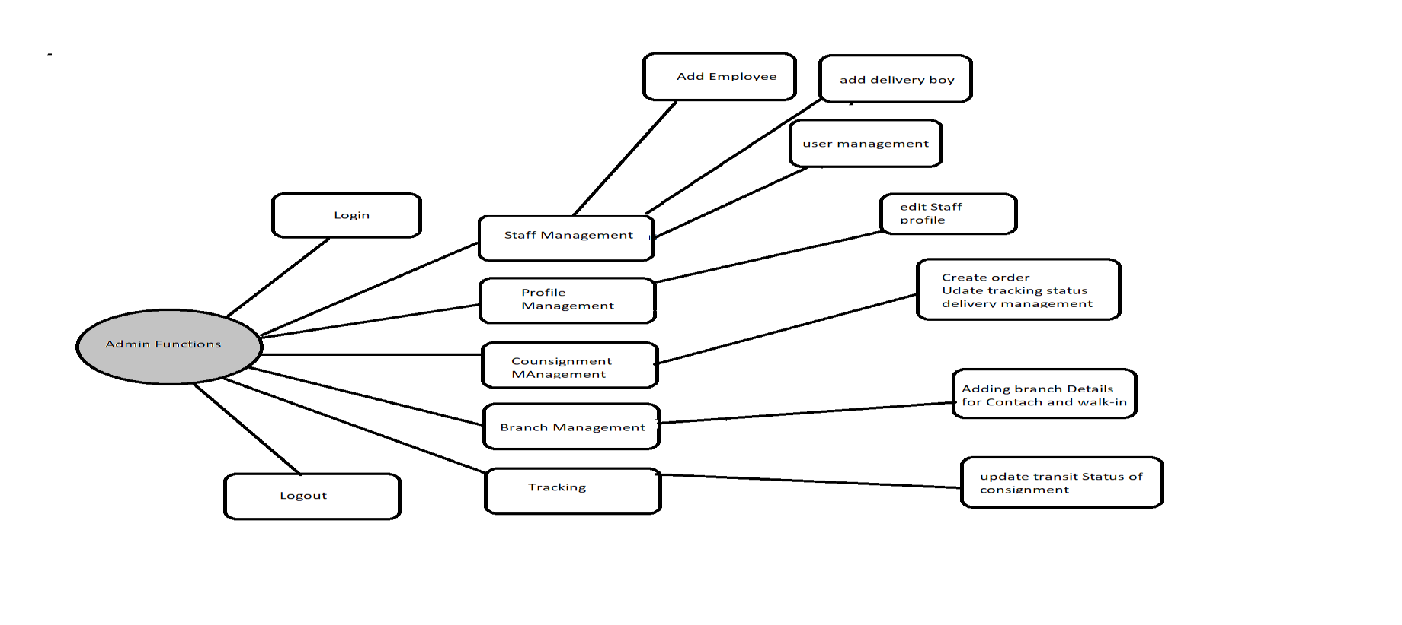
Project Flow

Slide 6
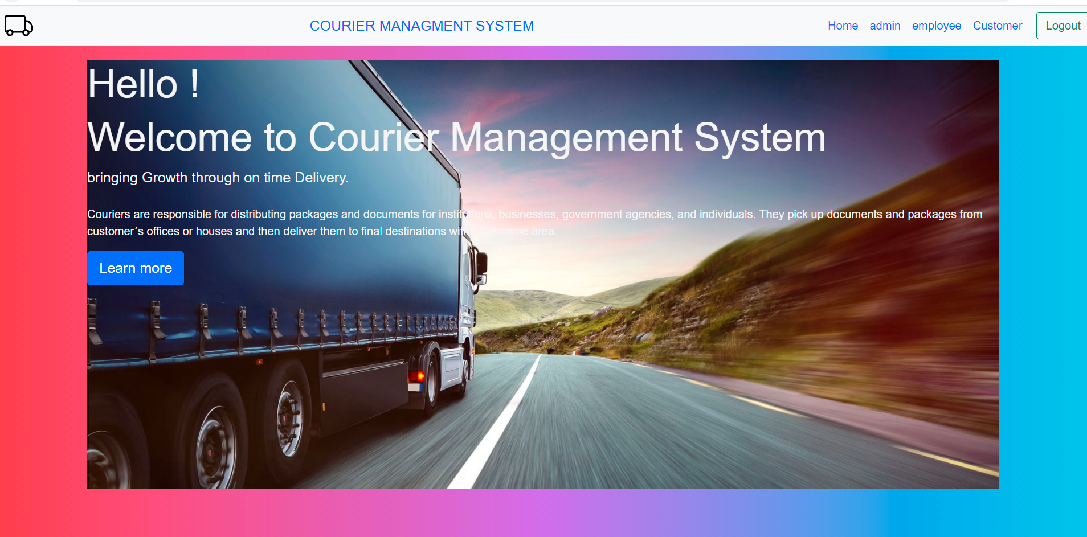
A).User:HomePage

Slide 7
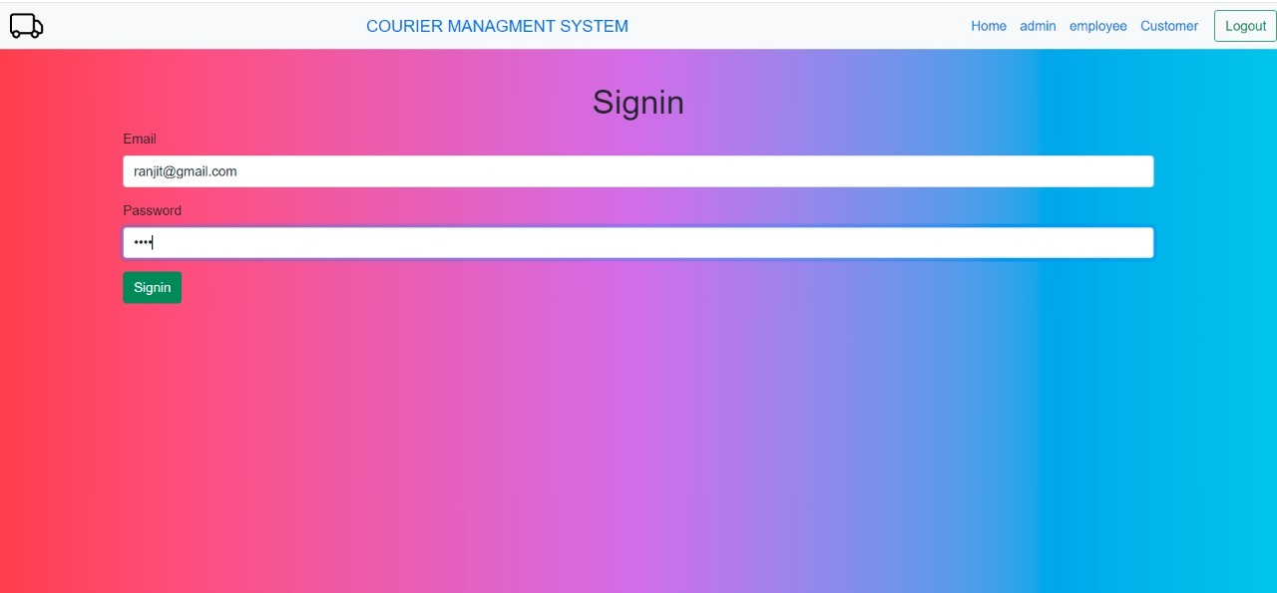
Login

Slide 8
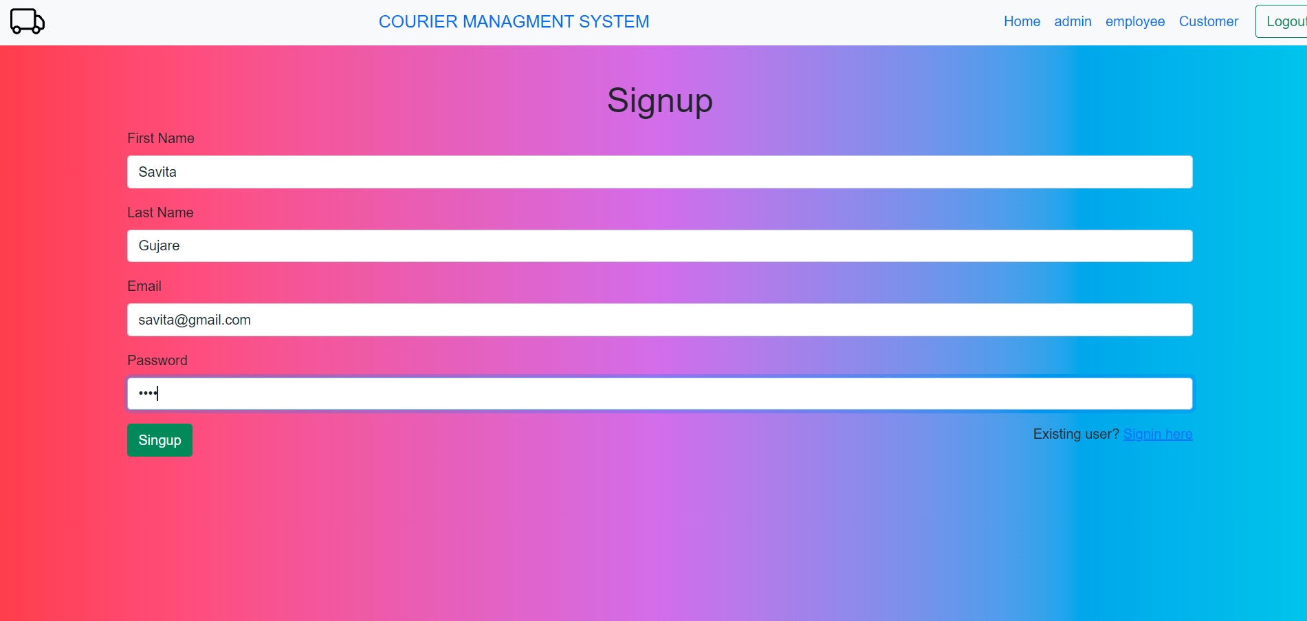
SignUp

Slide 9
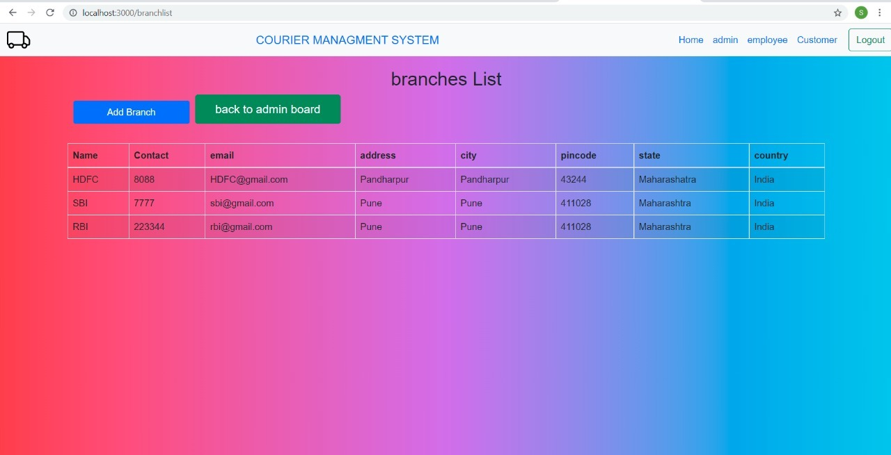
Branches:-

Slide 10
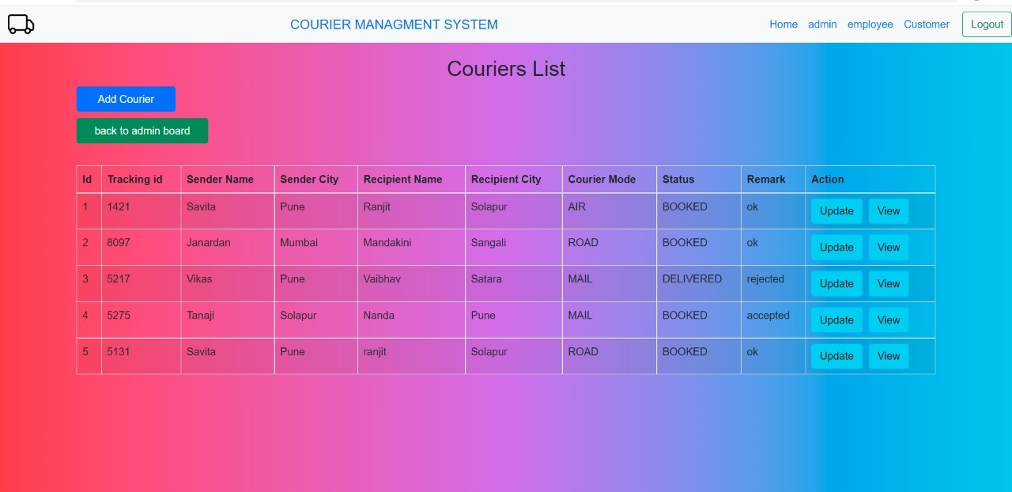
Courier Details:

Slide 11
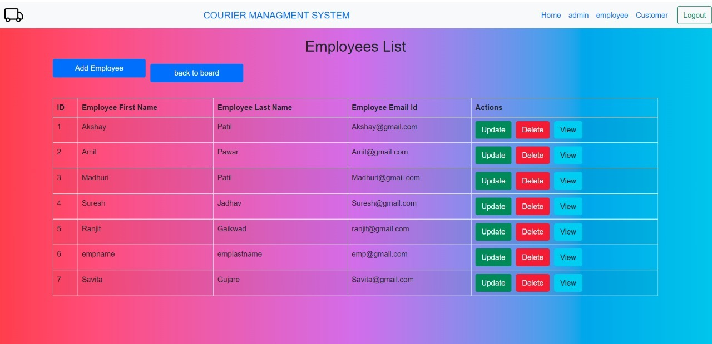
Employees List:

Slide 12
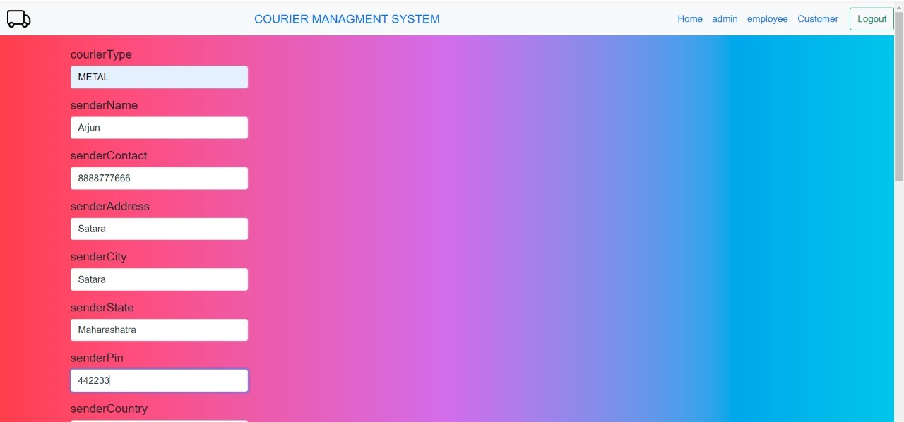
Add Courier Details:

Slide 13
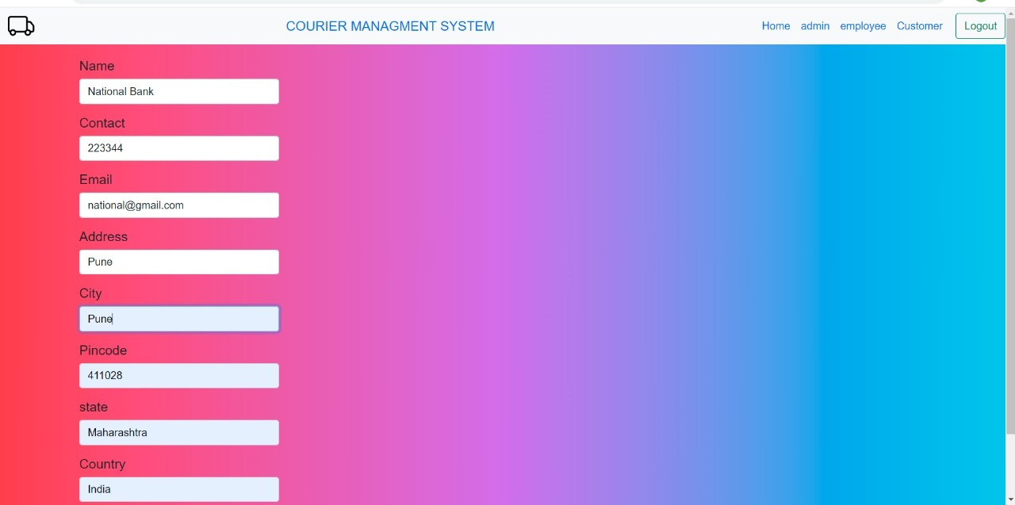
Add Branch:

Slide 14
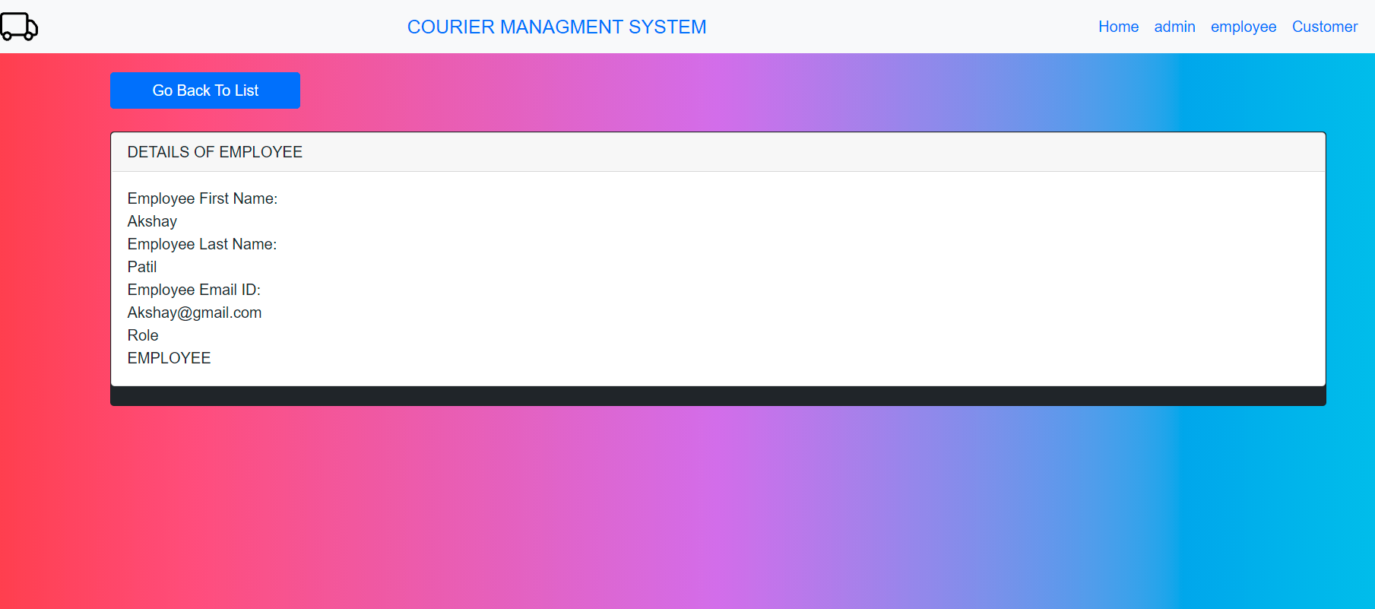
View Employee Details:

Slide 15
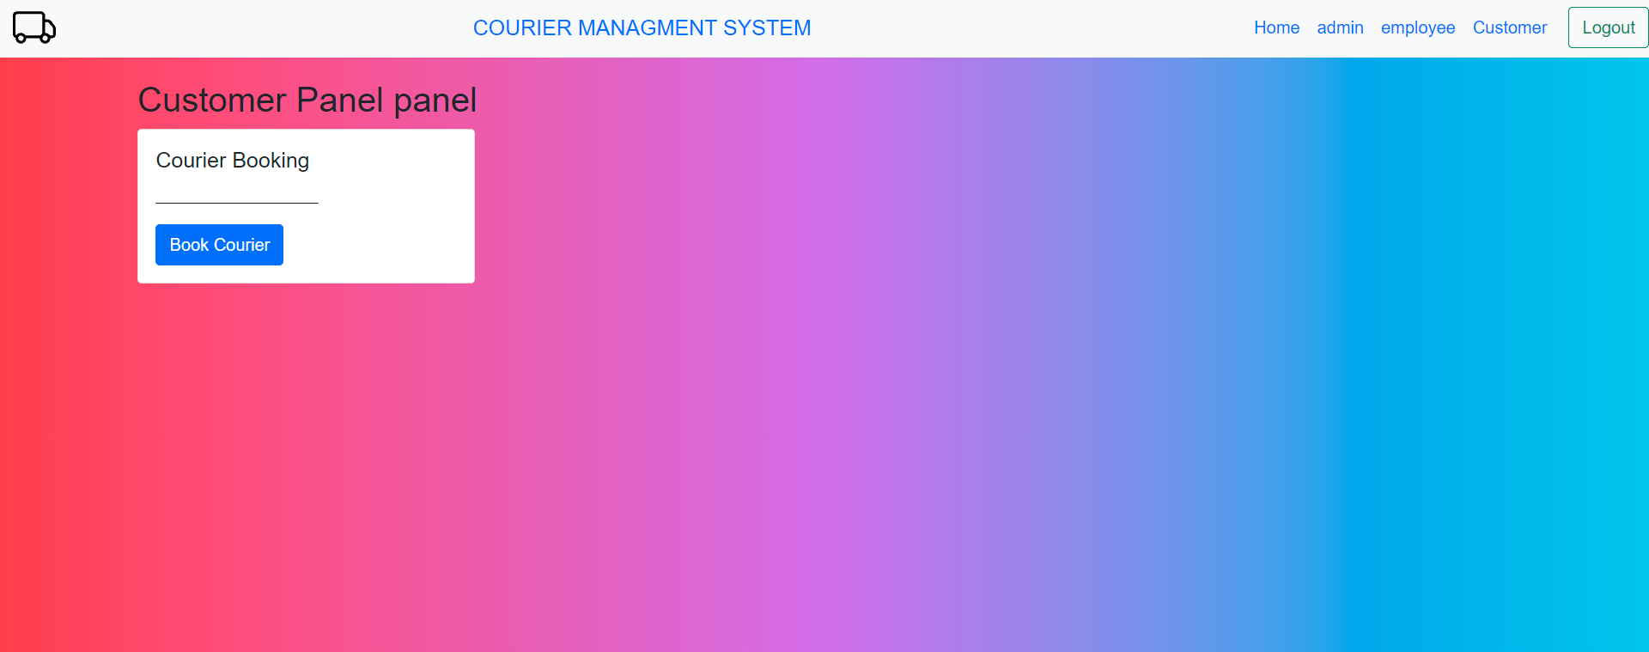
Customer Courier Booking:

Slide 16
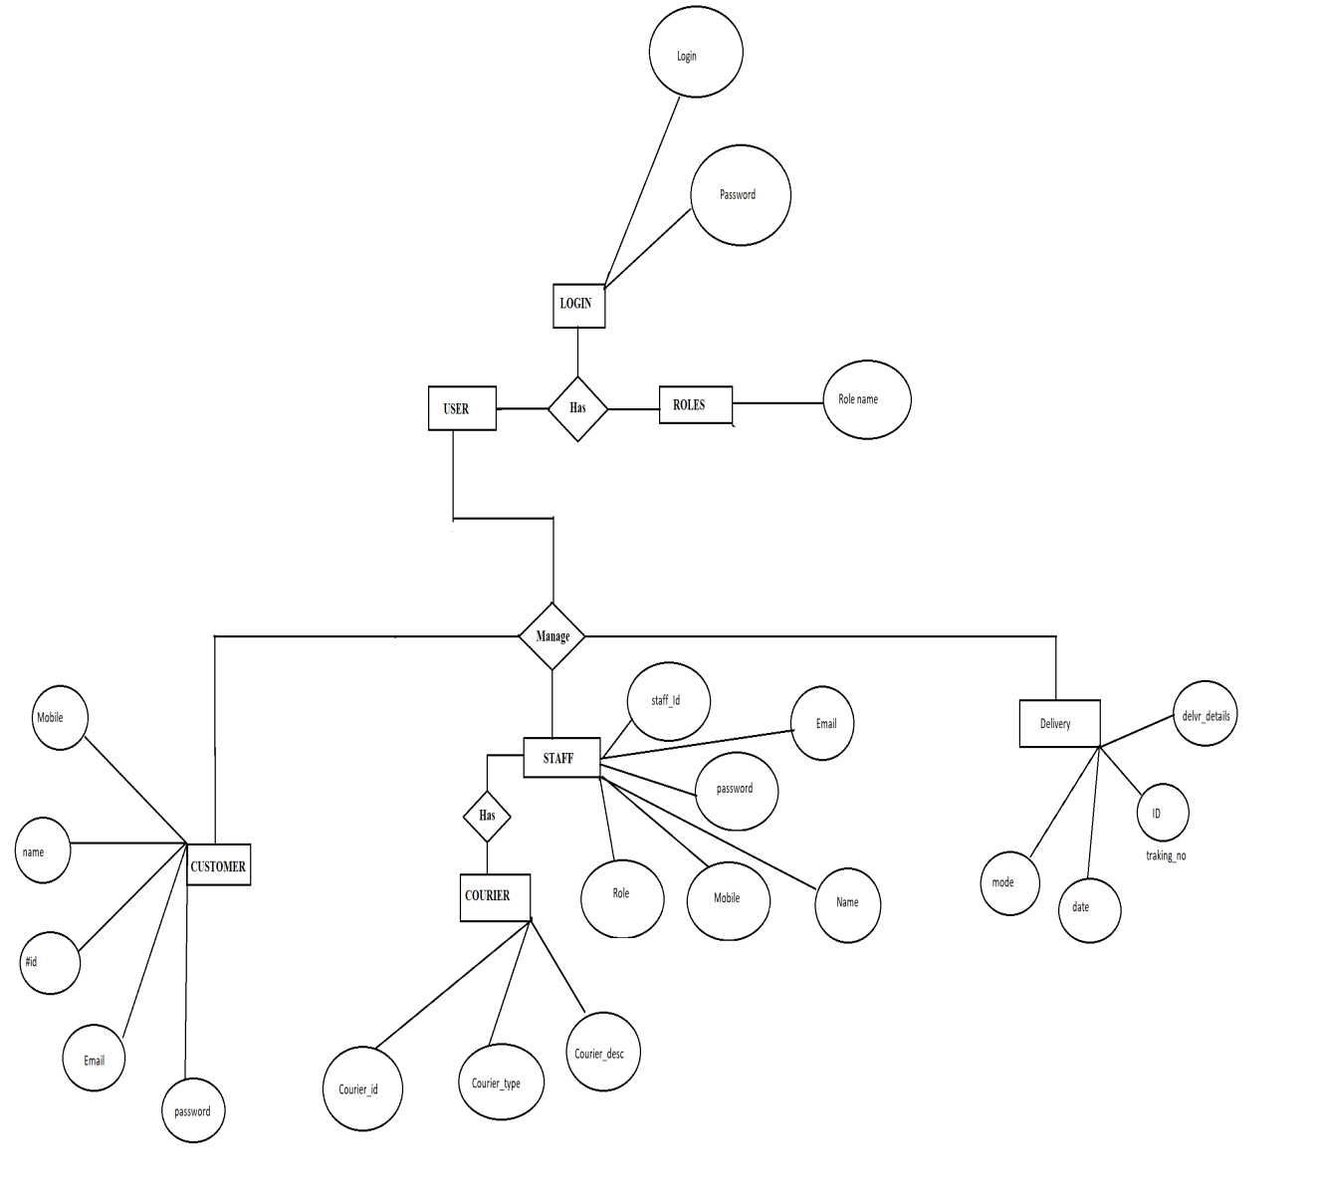
c).Admin:Login

Slide 17
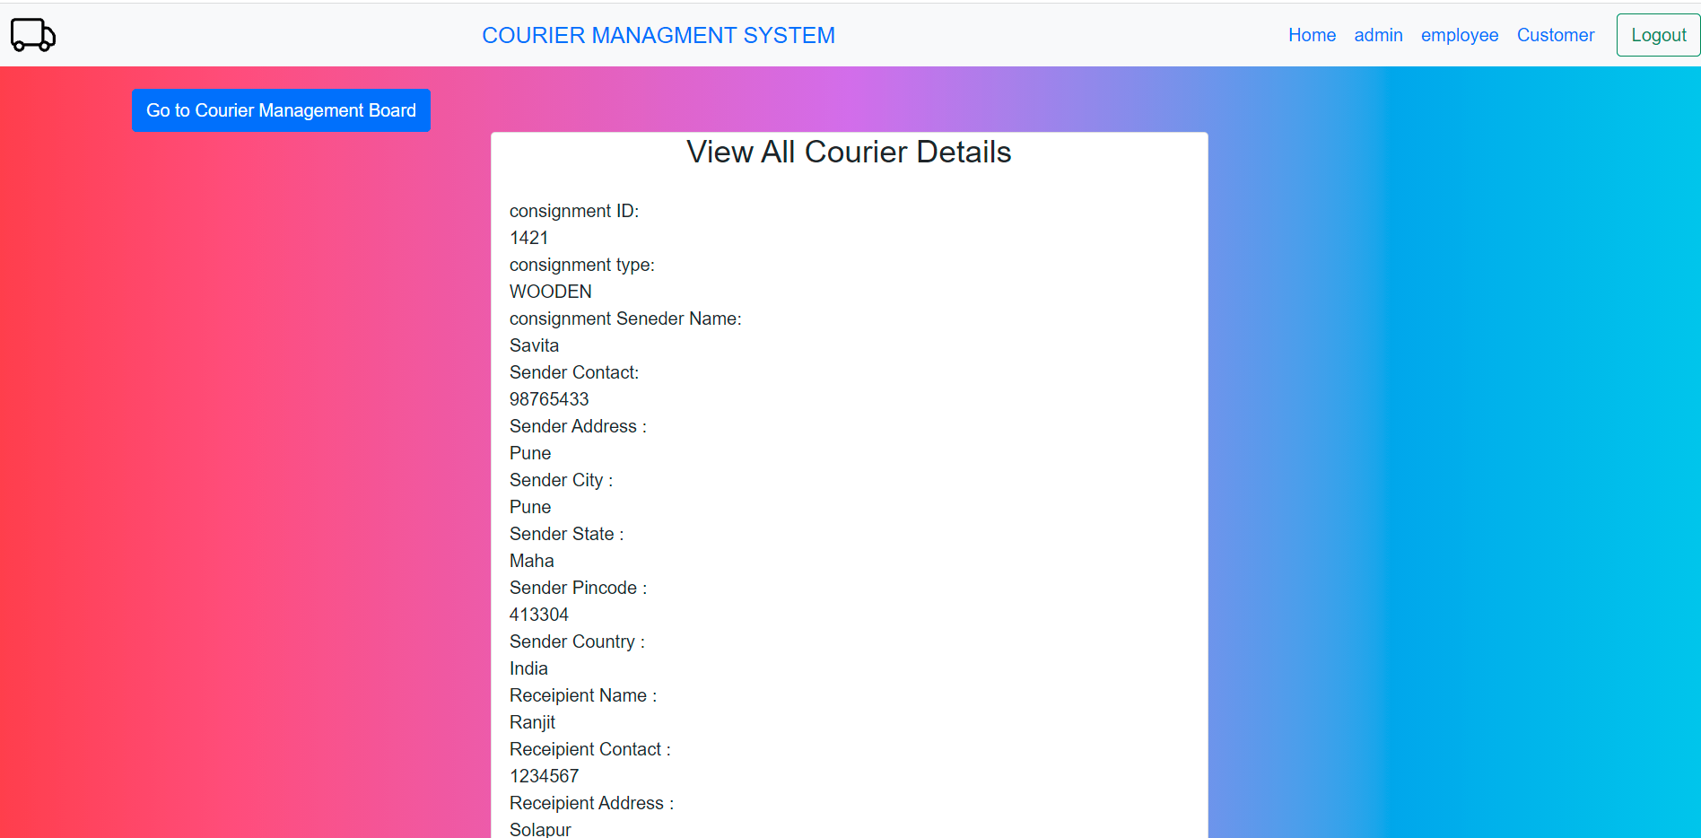
B).Admin:View Courier Details

Slide 18
Thank You

