Slide 2
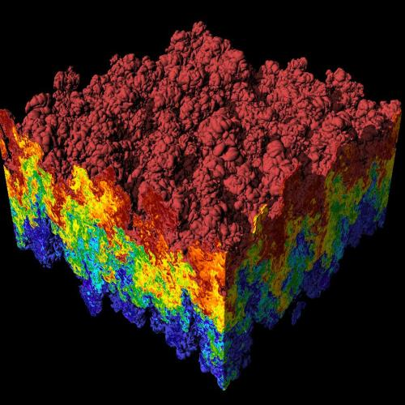
Introduction to Data Wrangling

Slide 3
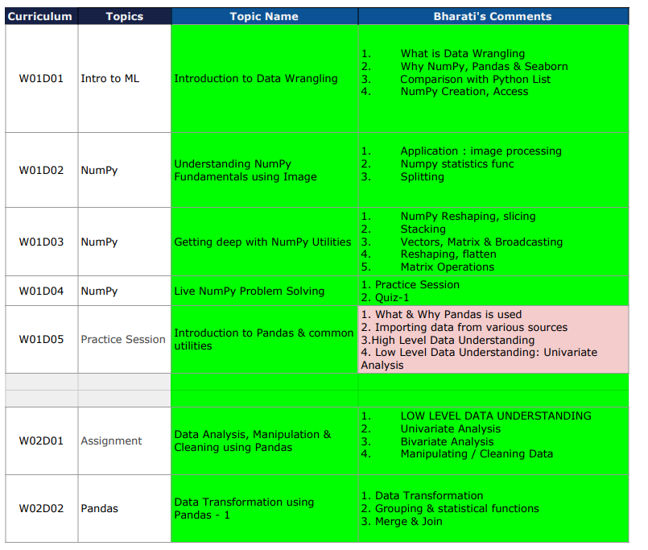
What will we cover

Slide 4
What is Data Analysis
Data analysis is a process of inspecting, cleansing, transforming, and modeling data with the goal of discovering useful information, informing conclusions, and supporting decision-making.

Slide 5
Why python for data analysis ?

Slide 6
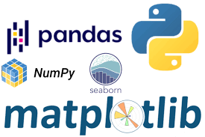
Simple and intuitive to learn
Open Source
powerful libraries with community support

Slide 7
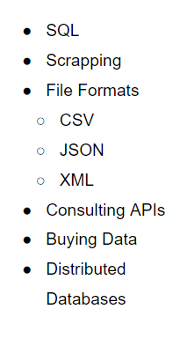
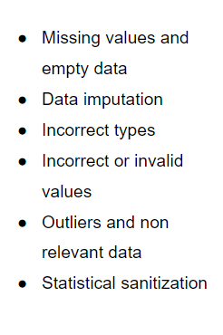
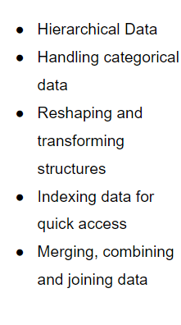
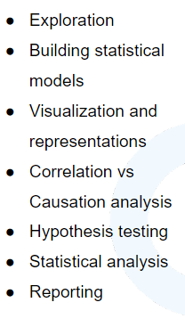
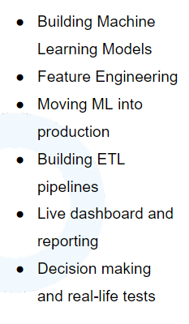
Data Extraction
Data Cleaning
Action
Data Wrangling
Analysis

Slide 8
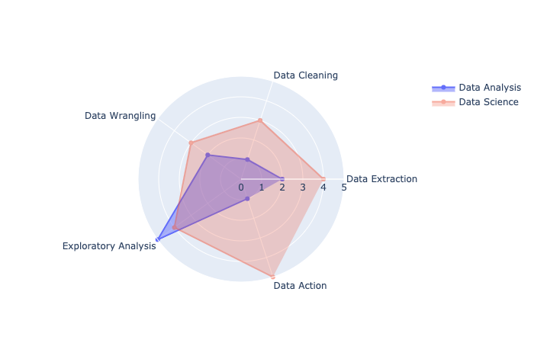
Data Analysis v/s Data Science

Slide 9
Libraries:
pandas: The cornerstone of our Data Analysis job with Python
matplotlib: The foundational library for visualizations. Other libraries we’ll use will be built on top of matplotlib.
numpy: The numeric library that serves as the foundation of all calculations in Python.
seaborn: A statistical visualization tool built on top of matplotlib.
statsmodels: A library with many advanced statistical functions.
scipy: Advanced scientific computing, including functions for optimization, linear algebra, image processing and much more.
scikit-learn: The most popular machine learning library for Python (not deep learning)

Slide 10

Numpy
The fundamental package for scientific computing with Python
https://numpy.org/

Slide 11
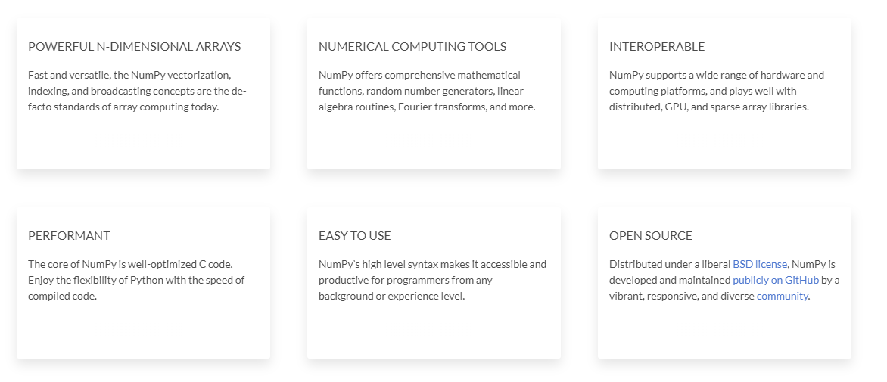
Sample Data

Slide 12
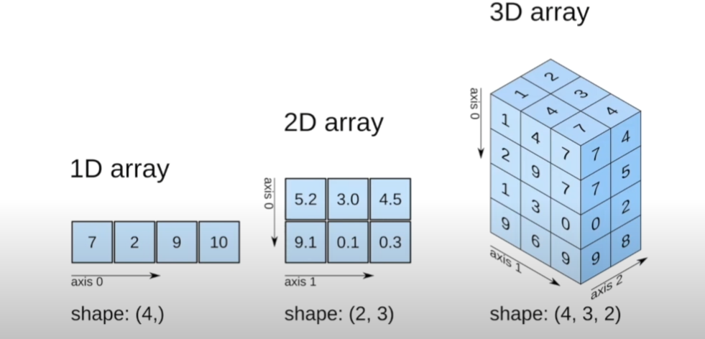

Slide 13
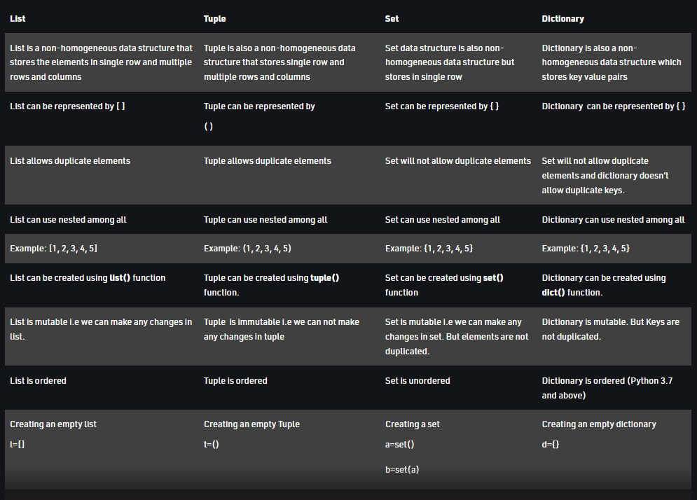
Notes:
Tuples are stored in a single block of memory. Tuples are immutable so, It doesn't require extra space to store new objects. Lists are allocated in two blocks: the fixed one with all the Python object information and a variable-sized block for the data. It is the reason creating a tuple is faster than List

Slide 14
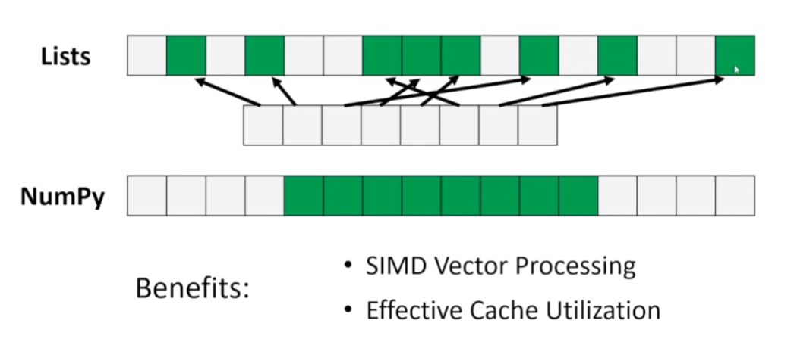
Advantages of using Numpy array vs lists
Consumes less memory.
Fast as compared to the python List.
Convenient to use.

