Slide 1
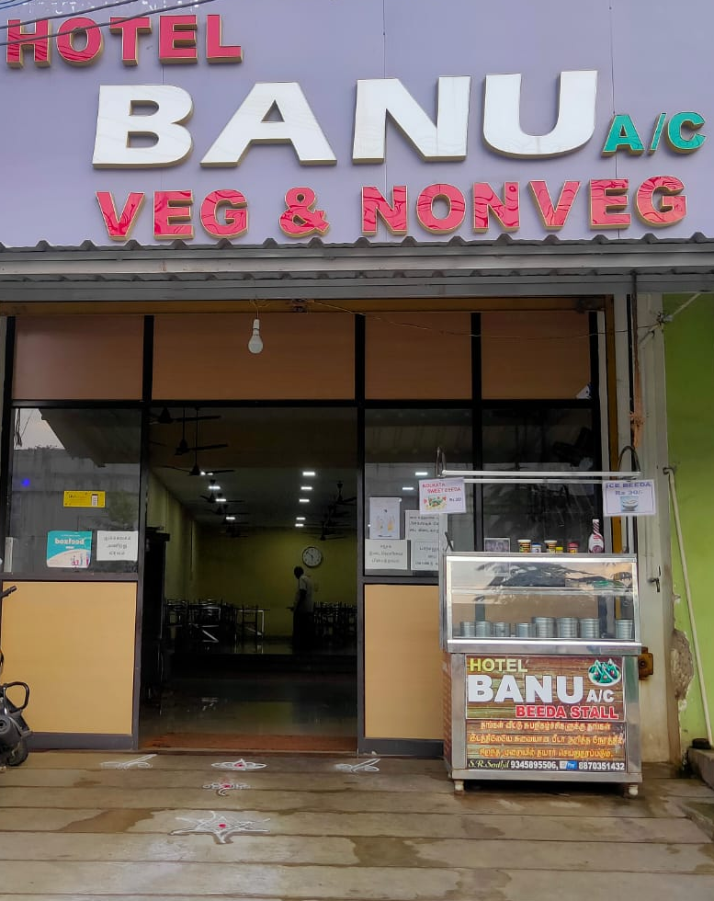
BUSSINESS DATA MANAGEMENT - CAPSTONE PROJECT
APK BANU HOTEL, Aruppukottai, Tamil Nadu.
BACKGROUND:
Hotel is present in a locality where competition is bit high, but has a different concept in terms of items served.
Hotel mainly covers family customers which has an A/C room in addition of normal rooms.
DATA COLLECTED:
I collected my data through a phone call, where the data was not in a format to draw inferences about the business.
Data provided to me was of September 2020, a month with some restriction due to covid crisis.
Data has a total of 8 columns [ BU, SKU, Item, Date, Day, SP, Sales, Revenue ].

Slide 2
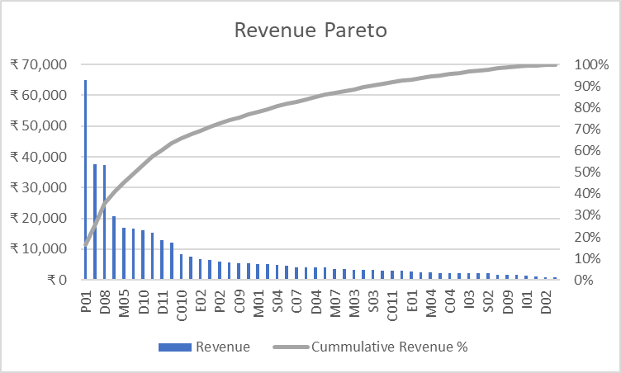
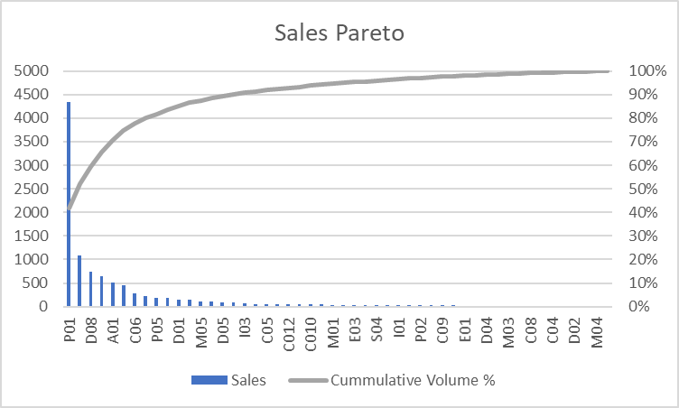
ANALYSIS:
Revenue pareto analysis-
42% of items are giving a 80% of total revenue.
Pareto Principle is NOT OBEYED.
Sales pareto analysis-
16% of items are giving 80% of total volume.
Pareto Principle is OBEYED.
RECOMMENDATIONS:
Can increase the selling price of SKUs which has high sales.

Slide 3
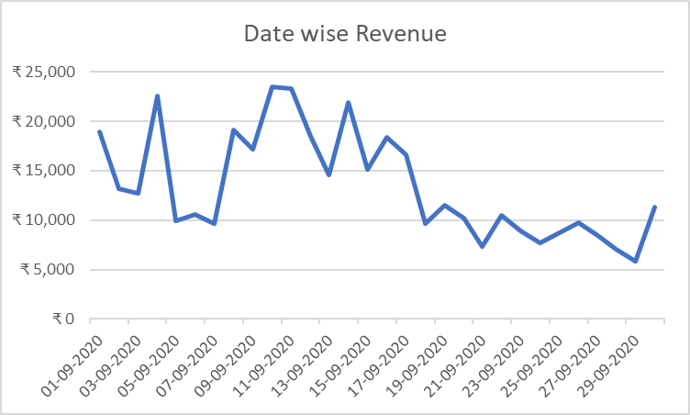
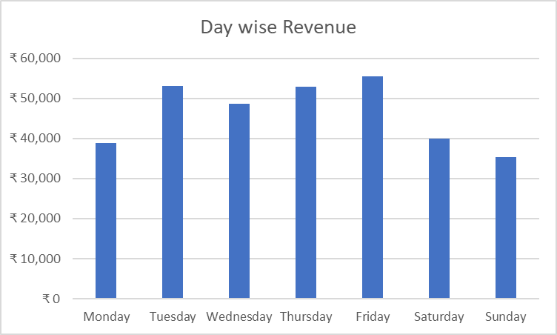
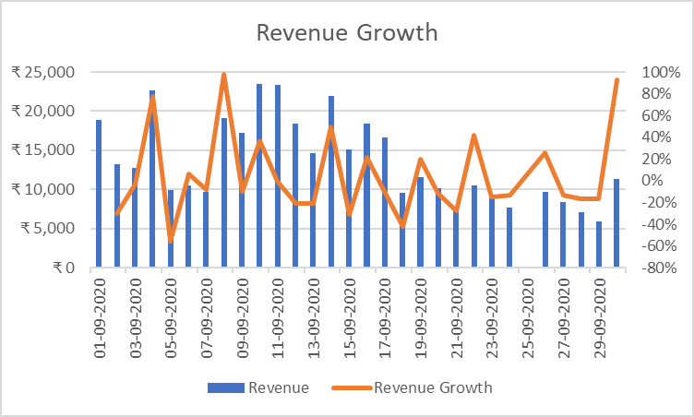
ANALYSIS:
Date wise revenue : Revenue started decreasing at mid September 2020 because of covid restrictions.
Day wise revenue : Revenue in weekends are less than revenue at weekdays.
RECOMMENDATIONS:
Food parcels could be provided with some sort of discounts and special offers.

Slide 4
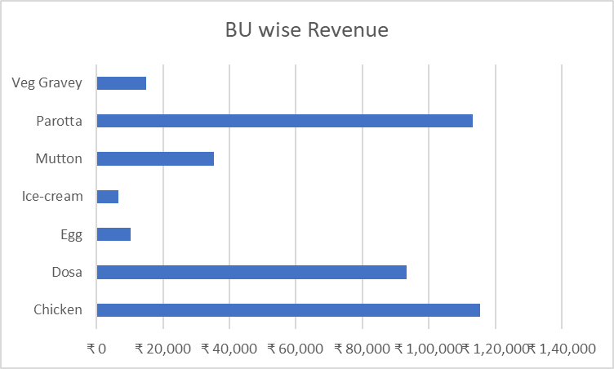
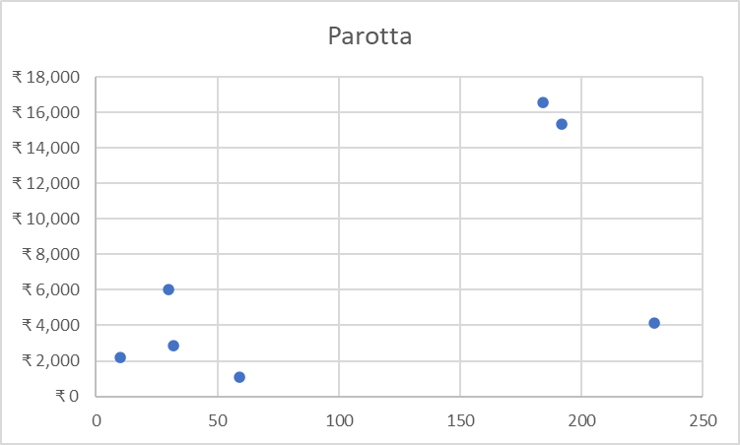
ANALYSIS:
With a total of 7-BUs distributed into 50-SKUs Revenue of each BU is plotted in a bar graph.
Among these 7-BUs only 3-BUs contribute more in terms of revenue [ with varying number of SKUs ].
However, BU-Parotta with only 8-SKUs contributes a lot in revenue.
So, I took BU-Parotta and used scatter plot to analyze its volume and revenue.
After removing an outlier we could see that only 2-SKUs have high revenue with high volume.
RECOMMENDATIONS:
Should ensure that the customers know what are all the dishes made using parotta are available in the hotel. So, customers can try new dishes, Which increases both sales and revenue.

Slide 5
Feedback :

