Slide 1
A case study on Software Testing Methods and Tools
Member names:
Đinh Bảo Duy - ITITIU19107
Trần Văn Tiến - ITITIU19218
Tống Quốc Thắng - ITITIU19209
Nguyễn Văn Đạt -ITITIU19100

Slide 2
Research Methodology:
-This thesis addresses the above mentioned research objectives and questions by performing an interpretive case study
-Qualitative methods are selected to conduct this study, because they provide much richer data for analysis and concept formation.
-Two different roles (outside observer, involved researcher) adopted by researchers during case studies. For this research a role of “involved researcher” was taken, as it allows to gain deeper insight of the research subject

Slide 3
Research Methodology:
The overall strategy for this research study was:
1) To identify the scope of research by performing systematic literature review.
2) Collecting data via systematic literature review and semi-standardized interviews.
3) Analysis of the collected data based on grounded theory
-> During the analysis phase open coding was performed on the data collected from interviews and literature review. The inductive approach was followed to categorize different sources and patterns emerging from the data.

Slide 4
Research Methodology:
The interviews were designed as a semi-standardized interviews, because it will help in keeping the focus of interview towards the main theme of interview and still provide the flexibility to adapt the interview to the situations where there is a possibility to gain new insights.
The interview respondents were assured about their confidentiality.
The questions were framed in such a way that while conducting the interview it was possible to shift between questions belonging to different themes seamlessly.

Slide 5
Research Methodology:
Purposive sampling technique was employed for selecting interview samples and persons involved in software testing activities were contacted to participate in the interviews.
During the interview sessions notes were taken, and all the interviews were recorded (interviewee’s permission was taken before recording the interview session), and later the interview recording was transcribed according to systemic filling systems.
The analysis of the interview data was done in the following way:
1) Referring the interview notes and transcripts;
2) Identification of certain keywords which were frequently appearing;
3) Dividing the interview responses in terms of categories;
4) Observing patterns.

Slide 6
Software testing methodology:
This section presents the extent of adoption of software testing practices in the various projects that were involved in this case study and also discusses the possible factors affecting the adoption of these factor practices.

Slide 7
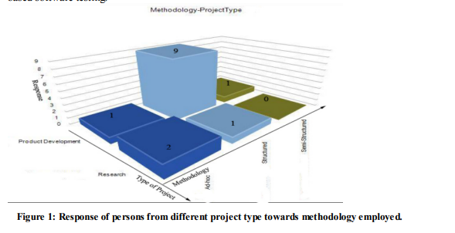
Methods and practices
The graph shown in figure 1 represents the response of the interview respondents, type of project vs. software testing approach.
x- Axis of the graph represents methodologies employed .
z-axis represents the type of projects.
y-axis shows the number of responses.
This section presents the interview response for the questions concerned with software testing methods and practices.

Slide 8
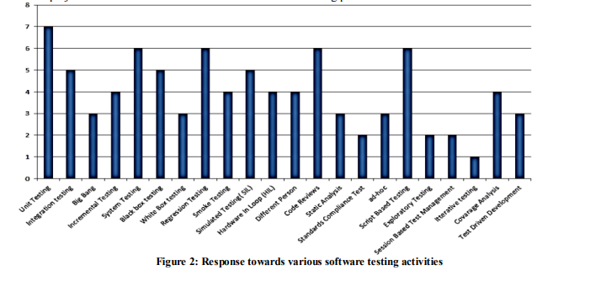
The graph shown in figure 2 represents the popularity of the different testing methods and techniques among the various project teams in VTEC.

Slide 9
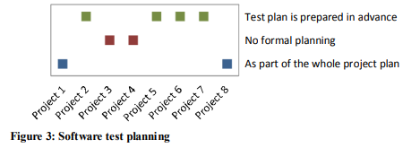
Test planning activities
This section presents the interview response related to the questions regarding test planning activities.
Figure 3 presents the data collected from interviews regarding test planning. Horizontal - axis of the graph shows the different project teams, and their responses are plotted against vertical-axis which represents the planning strategy.

Slide 10
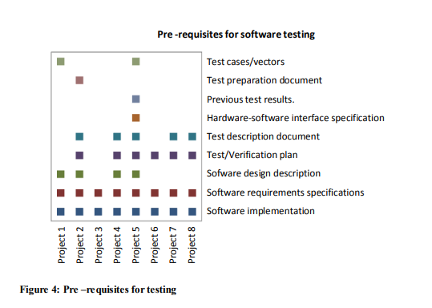
Pre-requisites for testing
This section presents and discusses about the interview responses of respondents towards the questions regarding pre-requisites for software testing.
Figure 4 presents the mapping of responses made by interviewees, all the responses are aggregated to represent the response of the project team that they belong to. There were 9 different pre-requisites for software testing identified from the interview responses, these pre-requisites are presented as vertical axis in figure 4 and the horizontal axis represents the 8 project-teams.

Slide 11
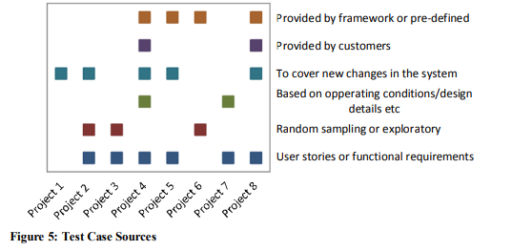
Test cases
This section presents the summary of responses made by interview respondents towards the questions regarding test case selection criteria.
Figure 5 shows the response of different project teams towards test case derivation methods.
There were 6 different test case derivation methods identified from the interviews, mentioned on the vertical axis of the graph presented in figure 5.
Horizontal axis of the graph represents the 8 different project teams in this case study.

Slide 12
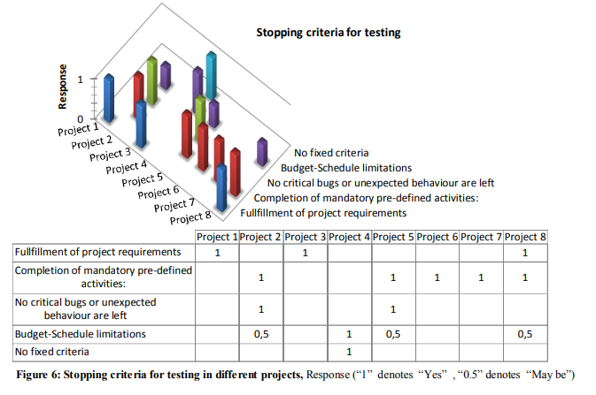
Stopping criteria
This section discusses the results of the interview questions concerned with stopping criteria employed by teams to conclude their software testing. Figure 6 shows the responses of the persons belonging to different projects towards stopping criteria for software testing. There were 5 stopping criteria identified from the interview responses, these criteria are mentioned on the right side of the graph, and the bars represent the aggregated response of the interview respondents belonging to a specific project team.
The most popular trend for stopping criteria for testing was completion of mandatory pre-defined activities such as:
Execution of all the test cases or test scripts.
Activities mentioned in verification plan.
Documentation of reports and results.
Completion of planned sessions (in case of teams with session based test management).

Slide 13
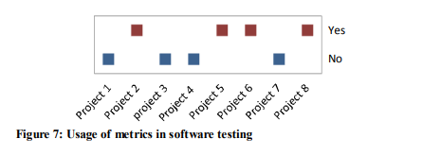
Software testing metrics
There was relatively less response received towards questions regarding software testing metrics, and on few occasions some of the interviewees found the questions regarding software testing metrics ambiguous (but explanations of questions were provided on those occasions). This suggests that usage of metrics is not very common.
Figure 7 shows preference of different project-teams towards employment of metrics in software testing. Both usage and non-usage of metrics received equal response (50% each). However this data co-relates to the data in “Stopping Criteria”, by comparing the data in both sections we can see that the project-teams that were employing software testing metrics also had more sophisticated stopping criteria for software testing.

Slide 14
Formal Methods
None of the projects reported any concrete usage of formal methods or specifications, and often interviewees found the questions regarding formal methods a bit ambiguous. These results were surprising considering the amount of research being done on formal methods.

Slide 15
Impressions and expected improvements on methodologies employed
Two other respondents had similar views, but in terms of code reviews.
The following are the points mentioned by individual respondents as positives in their practices:
Exploratory testing and session based test management .
Short iterations.
Unit testing.
Informal code reviews Page 22 of 46.
Usage of test-management tools.
Well planned and structured approach.
Good testing environment.
Modifiability of the testing system to cover new changes in system.
The following are the points mentioned by individual respondents as expected improvements in testing practices:
Introduction of better documentation, such that old test cases can be accessed.
Emphasis on the testability of the system during development.
Providing better definition of different activities to be performed during different types of testing phases.
Improvement in project planning with emphasis on testing phase.
More emphasis on unit testing
Allocation of more resources on testing.

Slide 16
Software testing tools:
software testing tools and also provides some discussion of observed trends . help tools are discussed, then the requirements for any specialized tools and the interviewee's impressions about the tools they are using are presented, and the barriers encountered to achieve more automation is discussed.
Tools employed for this research were: Cockos Reaper (recording interviews), Google Docs (for scheduling interviews) and Nvivo 9 (qualitative data analysis of collected data).

Slide 17
Thank you
for your watching !

