Slide 1
Veritly Market Intelligence Report
Telecom Customer Churn Analysis
2026-01-28

Slide 2
Executive Summary
3,333
Total Customers
14.49%
Churn Rate
483
Churned
86.38%
Model Accuracy
Key Findings:
International plan customers show significantly elevated churn rates
Customer service calls are a key predictor of churn risk
Voicemail plan subscribers demonstrate lower churn rates
Model identifies 181 high-risk customers

Slide 3
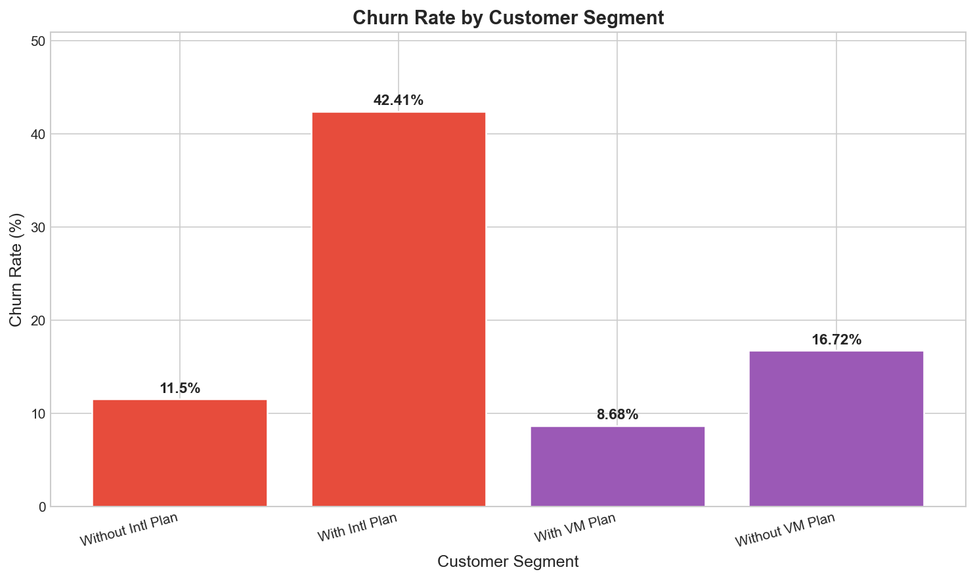
Churn By Segment

Slide 4
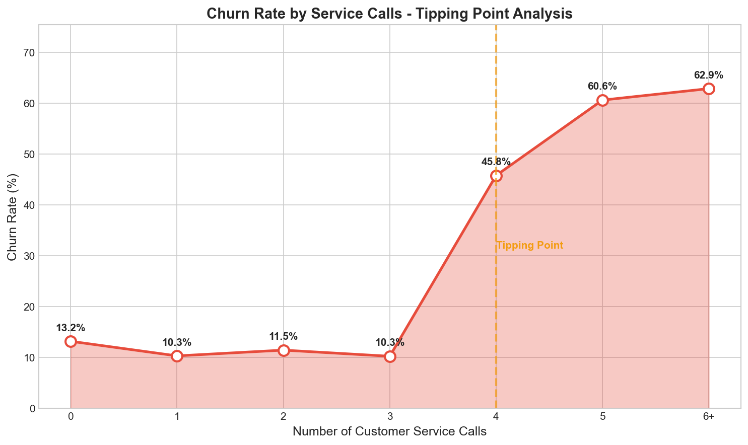
Service Calls Tipping Point

Slide 5
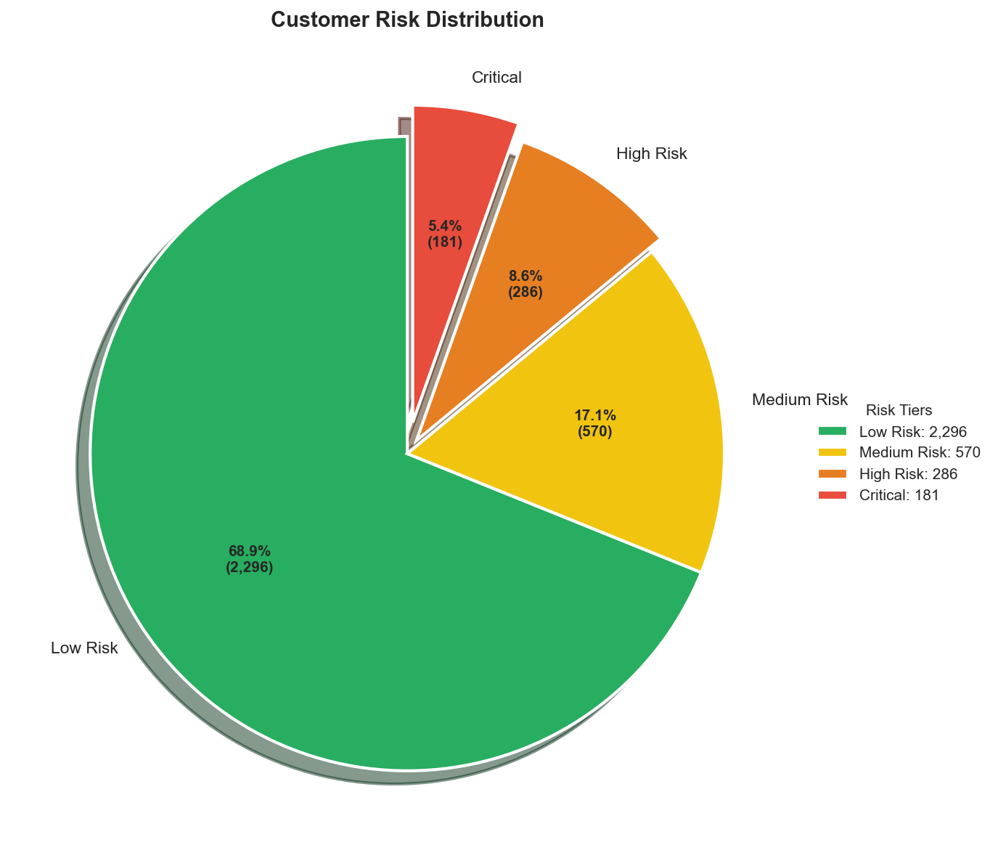
Risk Distribution

Slide 6
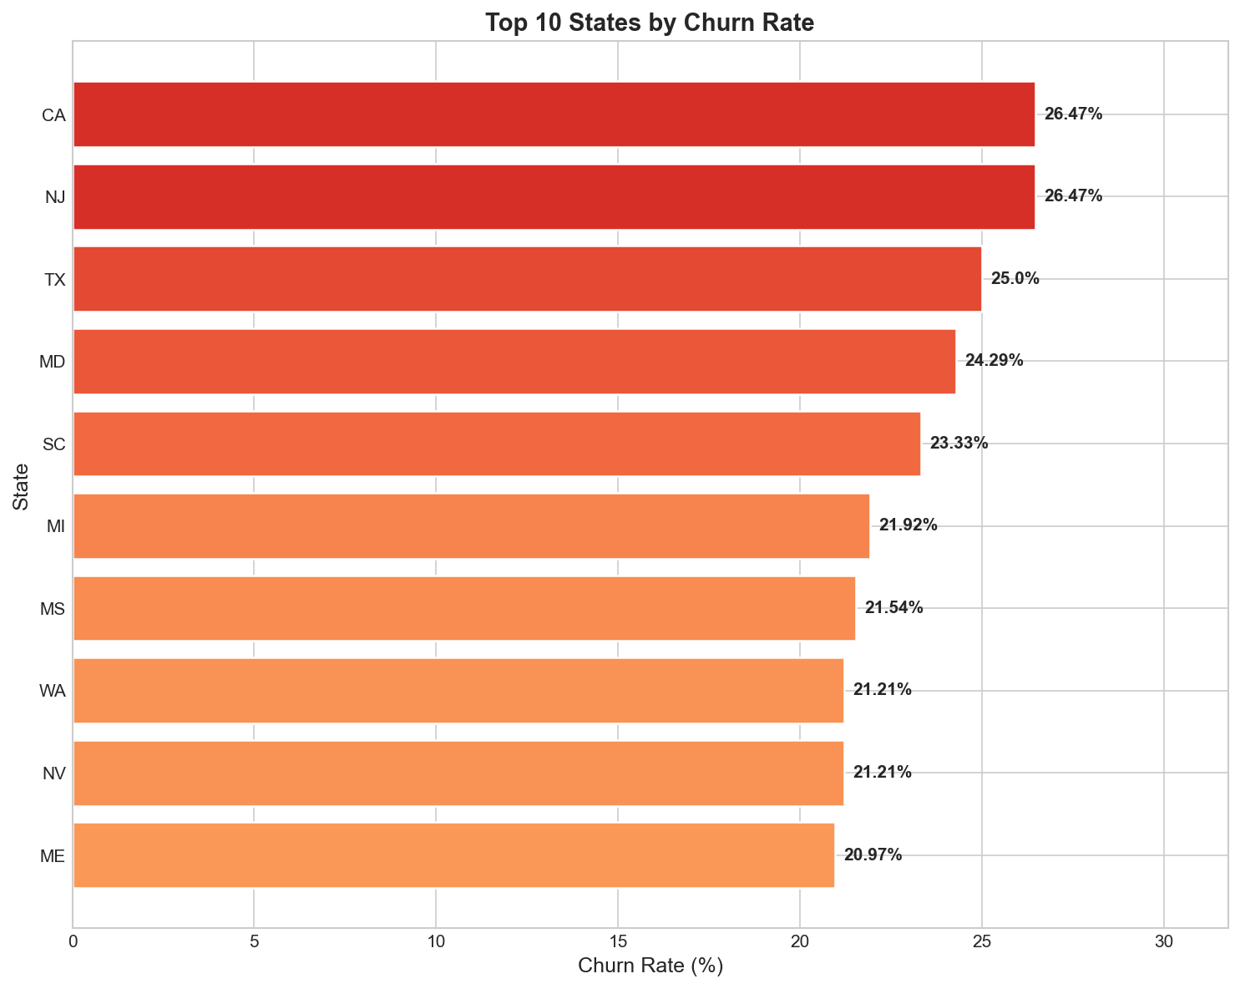
Top States Churn

Slide 7
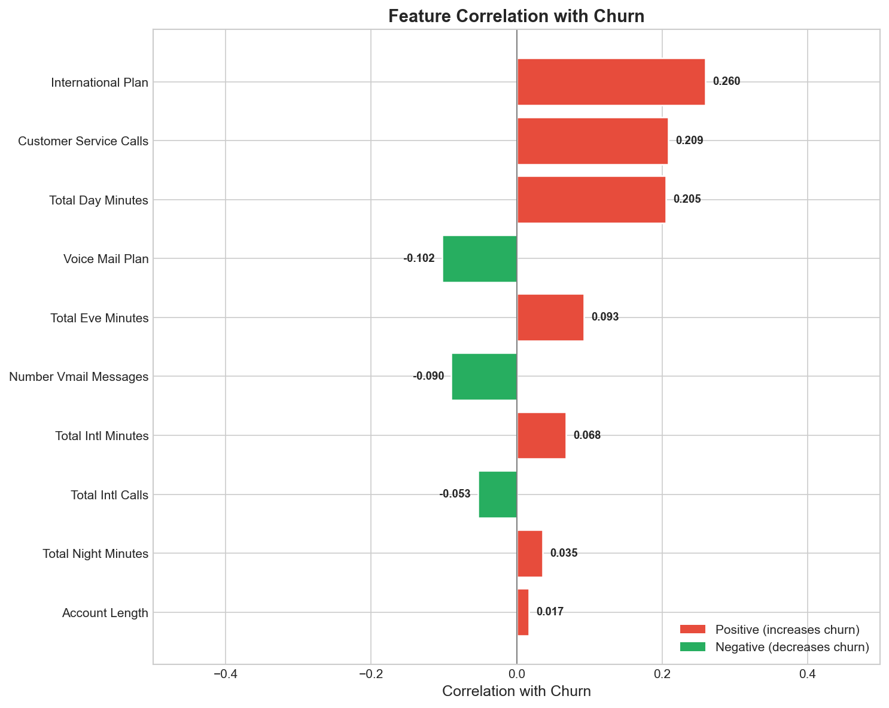
Feature Correlation

Slide 8
Risk Tier Distribution
2,296
Low Risk
570
Medium Risk
286
High Risk
181
Critical

Slide 9
Veritly AI
Market Intelligence Platform

