Slide 1


Spring Boot - Interceptor
We can use the Interceptor in Spring Boot to perform operations under the following situations.
Before sending the request to the controller
Before sending the response to the client
For example, we can use an interceptor to add the request header before sending the request to the controller and add the response header before sending the response to the client.
Controller
Request
Interceptor
Request
Response
Response

Slide 2
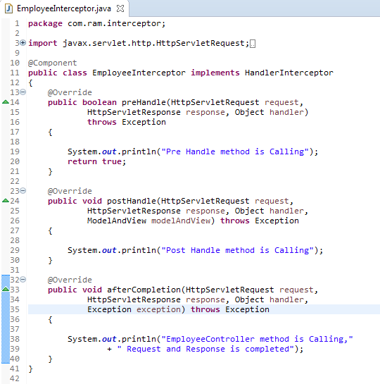
Spring Boot - Interceptor
preHandle() method − This is used to perform operations before sending the request to the controller.
postHandle() method − This is used to perform operations before sending the response to the client.
afterCompletion() method − This is used to perform operations after completing the request and response.

Slide 3
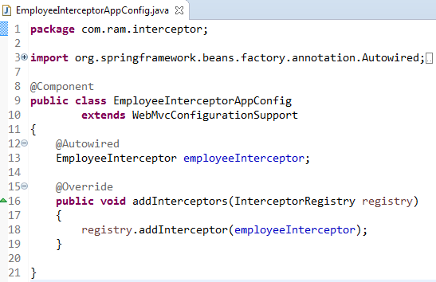
Spring Boot - Interceptor
We have to register this Interceptor with InterceptorRegistry

