Slide 1

CAPSTONE PROJECT Sentiment Analysis
Presented By
Student Name: Ranjith g
College Name: Kristu Jayanti college
Department: Computer science
Email ID: ranjithgranjith123@gmail.com
AICTE Student ID: STU68124559e58971746027865

Slide 2
OUTLINE
Problem Statement (Should not include solution)
Proposed System/Solution
System Development Approach (Technology Used)
Algorithm & Deployment
Result (Output Image)
Conclusion
Future Scope
References

Slide 3
Problem Statement
Understanding public sentiment in online platforms such as social media, reviews, and feedback forms has become increasingly vital for businesses and individuals. However, manually analyzing large volumes of text data is time-consuming and prone to human error. There is a need for an automated system that can accurately identify whether the sentiment expressed in a piece of text is positive or negative, enabling better decision-making based on public opinion.

Slide 4
Proposed Solution
The proposed system addresses the challenge of identifying sentiment from user input text, crucial for analyzing opinions from sources like reviews or social media. It applies machine learning to classify text as positive or negative. The system includes:
Data Collection: Uses pre-labeled datasets (e.g., IMDb, Twitter) with sentiment tags.
Preprocessing: Cleans text (removes stopwords, punctuation) and vectorizes it using TF-IDF.
Machine Learning: Applies Logistic Regression or Naive Bayes to train on processed data.
Deployment: Provides a Flask-based web interface for real-time sentiment analysis.
Evaluation: Measures accuracy, precision, and F1-score, with periodic tuning for better results.

Slide 5
System Approach
Frontend: HTML and CSS for form input and visual styling
Backend: Python Flask framework for handling requests and integrating the model
Model Training: Logistic Regression using scikit-learn with TfidfVectorizer
Data Storage: Trained model and vectorizer saved using joblib
Environment: Python 3.x, IDE (e.g., VS Code), browser-based interface for interaction

Slide 6
Algorithm & Deployment
Algorithm Selection: The chosen algorithm is Logistic Regression, a widely used binary classification model that performs well for text classification tasks like sentiment analysis. It is selected for its simplicity, interpretability, and effective performance on linear decision boundaries.
Data Input: Input features are created using TF-IDF vectorization of raw text. Each text input is converted into a sparse vector representation. The model uses only this feature to predict the sentiment.
Training Process: The model is trained using a labeled dataset of text and corresponding sentiment (0 for negative, 1 for positive). The dataset is split into training and test sets. Cross-validation may be used to tune hyperparameters like regularization strength.
Prediction Process: After training, the model is used to make predictions on new text data entered via the web interface. The input is first transformed using the same TF-IDF vectorizer and then passed to the trained model to predict whether the sentiment is positive or negative.

Slide 7
Result
The application allows users to type in any sentence or paragraph. Once submitted, the system processes the input and displays either “Positive 😊” or “Negative 😞” sentiment on the same page. The interface is clean and minimalistic, ensuring ease of use for users with any technical background.

Slide 8
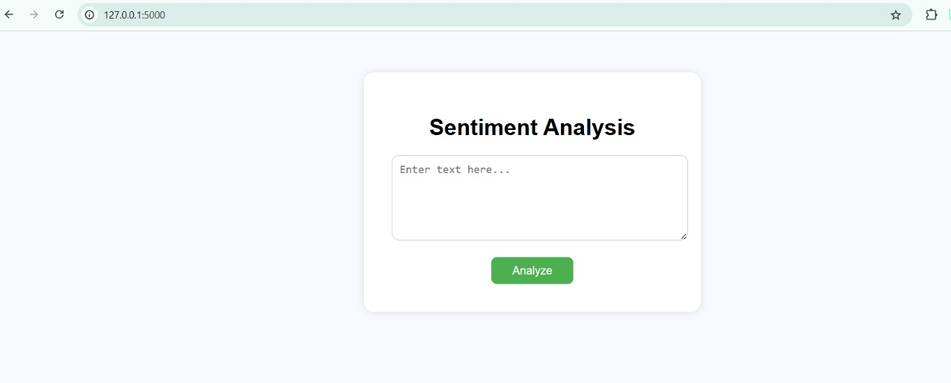
WEBSITE DESIGN

Slide 9
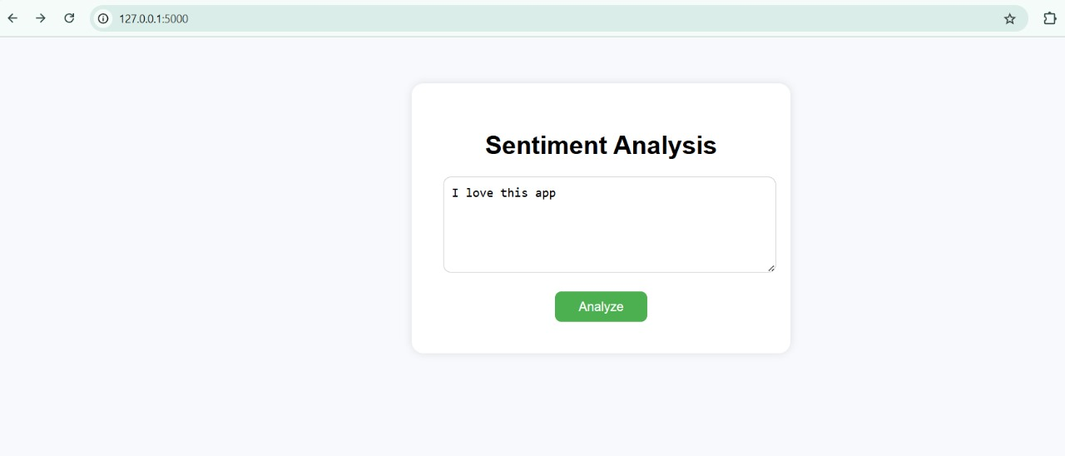
INPUT

Slide 10
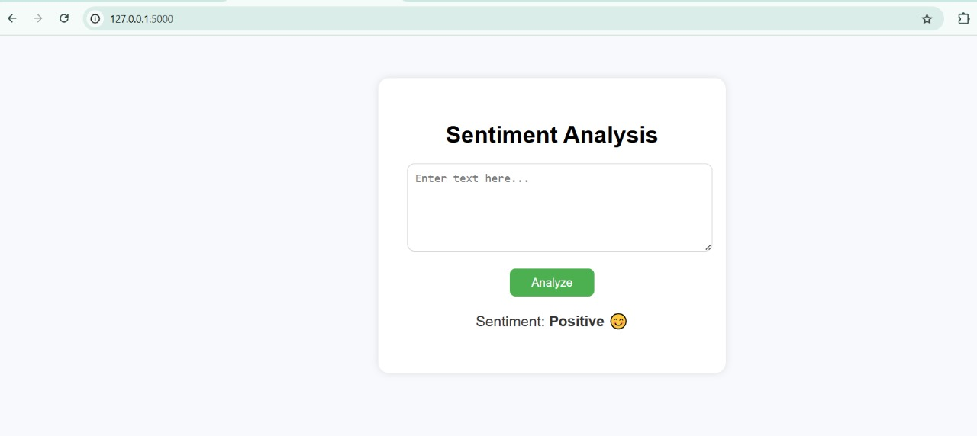
OUTPUT

Slide 11
Conclusion
The Sentiment Analysis Web App offers a simple yet effective tool to classify the sentiment of user-provided text. It demonstrates how machine learning can be integrated into web applications to provide real-time insights. The system achieves accurate results with a responsive design, making it useful for educational, commercial, and analytical purposes.

Slide 12
Future scope
In the future, the Sentiment Analysis Web App can be enhanced to support multilingual sentiment analysis, allowing users to input text in multiple languages. It could also integrate real-time data streams from social media APIs for live sentiment tracking. Another advancement could involve deep learning models, such as LSTM or BERT, to capture more complex sentence structures and improve prediction accuracy. Further, the app can be enhanced with visual analytics, such as sentiment trend graphs and dashboards for businesses to monitor public opinion dynamically.

Slide 13
References
scikit-learn documentation: https://scikit-learn.org/
Flask documentation: https://flask.palletsprojects.com/
Sentiment datasets: Kaggle, UCI Machine Learning Repository
Joblib documentation: https://joblib.readthedocs.io/
Natural Language Toolkit (NLTK): https://www.nltk.org/
GitHub Link: https://github.com/RanjithG2001/Sentiment--Analysis.git

Slide 14
Thank you

