Slide 1
RAJALAKSHMI ENGINEERING COLLEGE
Department of Artificial
Intelligence and Machine Language
Project Title
SMART TROLLEY SYSTEM USING IOT
Supervisor
Project by: Ranjith Kumar S (211501077)
Raswanth K T (211501078)
Santhosh H (211501090)
Adlin Layola J.A(Staff)

Slide 2
OUTLINE
Abstract
Introduction to Problem Domain
Literature Survey
Existing system
Limitation of the Existing System
Proposed system
Architectural design for Proposed system
Outcomes
Conclusion and Future Enhancement
References

Slide 3
ABSTRACT
The Smart Trolley System project aims to revolutionize the retail shopping experience by integrating technology into traditional shopping carts. By utilizing RFID technology, the system automatically tracks items added to the cart, enabling real-time billing and total calculation for customers. This streamlines the shopping process, providing a more efficient and convenient experience. Additionally, the system assists store owners in inventory management by monitoring stock levels and analyzing shopping trends. With enhanced security features, such as alarms for unauthorized item removal, the system helps prevent theft and shoplifting. Overall, the Smart Trolley System offers a user-friendly interface, convenient payment options, and valuable data analytics, ultimately enhancing both the customer experience and the operational efficiency of retail stores. .

Slide 4
INTRODUCTION TO PROBLEM DOMAIN
Correct form during exercises, especially squats, is crucial to prevent injuries and ensure effective workout results. Many fitness enthusiasts lack access to personal trainers who can provide immediate feedback on their form. Consequently, incorrect techniques can lead to long-term injuries and suboptimal fitness outcomes. Automating the evaluation of exercise form can democratize access to expert-level guidance, ensuring safer and more effective workouts.

Slide 5
LITERATURE SURVEY
1. Introduction to Pose Estimation in Fitness Applications :
Pose estimation has become a significant area of research within computer vision and machine learning, finding extensive applications in various fields, including health careand fitness. The goal of pose estimation is to detect human body parts, such as joints, and represent their spatial configurations accurately.
2. Pose Estimation Techniques:
Pose estimation techniques can be broadly categorized into two approaches: top-down and bottom-up methods. Top-down approaches first detect the human body within an image and then estimate the pose of each detected person. Bottom-up approaches, on the other hand, detect body parts first and then associate these parts with individuals.

Slide 6
EXISTING SYSTEM
Traditional approaches often include consulting with fitness trainers, nutritionists, or healthcare professionals to develop personalized plans based on individual goals, preferences, and health considerations.
Currently, the primary solutions for exercise form correction include:
Personal Trainers: Human trainers provide real-time feedback but are not always accessible or affordable.
Fitness Apps: Many fitness applications offer video tutorials and general tips but lack real-time, personalized feedback.
Wearable Devices: Some wearables can track movements but often lack the precision needed to assess exercise form comprehensively.

Slide 7
LIMITATIONS OF EXISTING
SYSTEM
High Cost: Personal trainers and advanced wearables can be expensive.
Lack of Real-Time Feedback: Most fitness apps cannot offer immediate corrections.
Limited Accessibility: Not everyone has access to personal trainers or high-end fitness technology.
Generalized Advice: Existing solutions often provide generic advice, not tailored to individual performance nuances.

Slide 8
PROPOSED SYSTEM
AI Fitness Builder addresses the limitations of current exercise form evaluation methods by leveraging advanced machine learning algorithms, computer vision techniques, and pose estimation models. This comprehensive solution includes real-time feedback utilizing live camera feeds with convolutional neural networks (CNNs) to analyze squats and provide immediate corrections. Users can also upload recorded videos for detailed kinematic analysis. The system employs state-of-the-art pose estimation algorithms, such as OpenCV and MediaPipe, to accurately calculate joint angles and body positions, ensuring precise biomechanical assessments. The application is implemented using Streamlit, providing a user-friendly and interactive graphical user interface (GUI) for seamless user interaction and instantaneous feedback display.

Slide 9
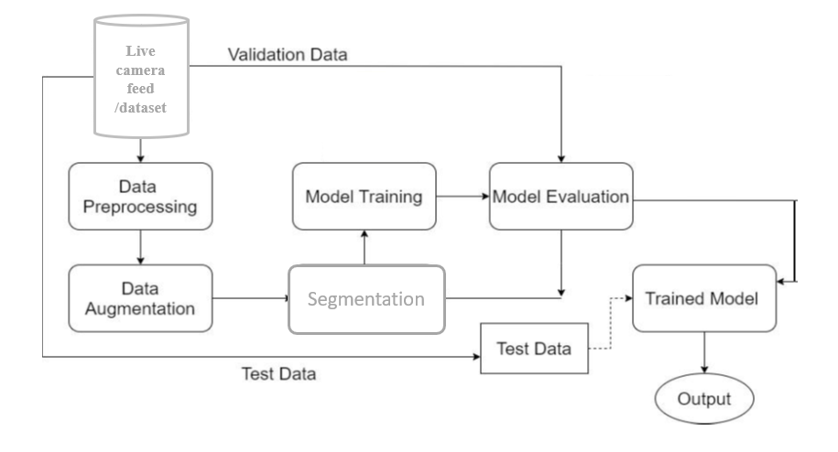
ARCHITECTURAL DESIGN
Fig1: System Architecture for Fitness Builder

Slide 10
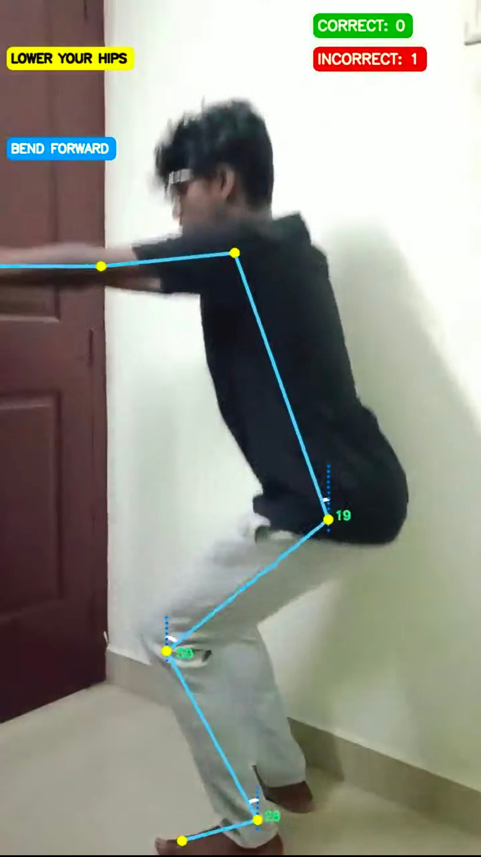
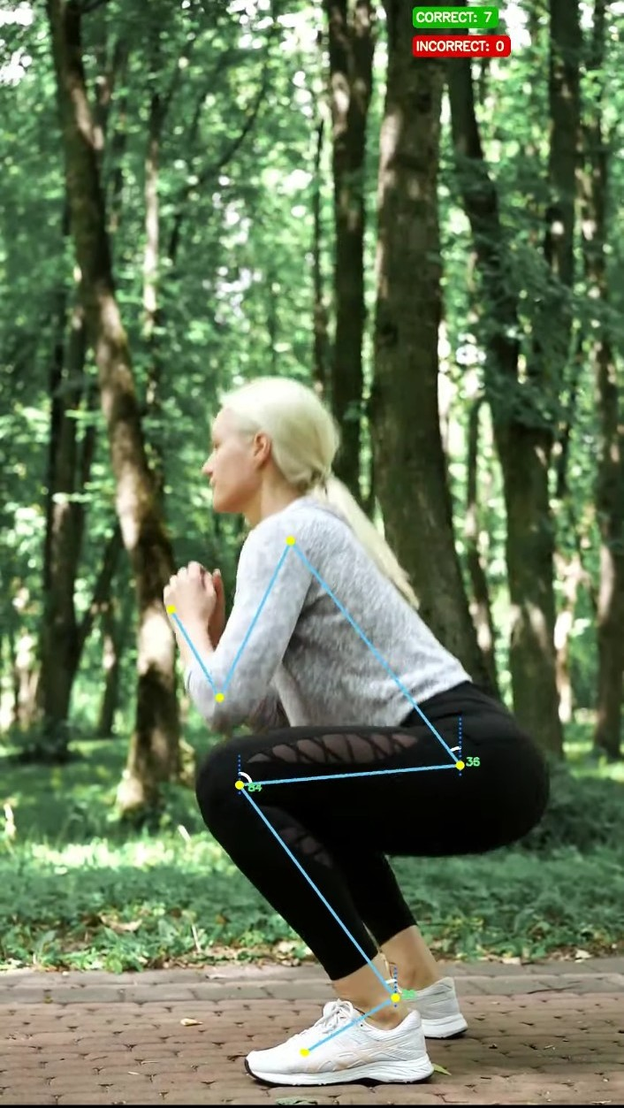
OUTCOME

Slide 11
OUTCOME

Slide 12
CONCLUSION AND FUTURE ENHANCEMENT
CONCLUSION
In this project, we developed an application to analyze squats using Media Pipe’s Pose solution. The application calculates key angles, such as shoulder-hip, hip-knee, and knee-ankle, to provide feedback on proper form. This project highlights the potential of human pose estimation for exercise analysis, with plans to extend to other exercises in the future.
FUTURE ENHANCEMENT
Future enhancements will focus on ensuring knees do not collapse inward during squats, which can be better monitored with a front-facing camera view. Adding multiple camera views can improve accuracy. We also plan to incorporate advanced techniques like Human Action Recognition using a CNN-LSTM model and wearable sensors such as Inertial Measurement Units (IMUs) for time-series analysis, enhancing exercise evaluation accuracy and effectiveness.

Slide 13
REFERENCES
Blair, S.N. Physical inactivity: The biggest public health problem of the 21st century. Br. J. Sports Med. 2009, 43, 294–305.
Kohl, H.W., 3rd; Craig, C.L.; Lambert, E.V.; Inoue, S.; Alkandari, J.R.; Leetongin, G.; Kahlmeier, S.; Lancet Physical Activity Series Working Group. The pandemic of physical inactivity: Global action for public health. Lancet 2012, 380, 294–305.
Qi, J.; Yang, P.; Hanneghan, M.; Tang, S.; Zhou, B. A Hybrid Hierarchical Framework for Gym Physical Activity Recognition and Measurement Using Wearable Sensors. IEEE Internet Things J. 2019, 6, 1384–1393.
Koskimäki, H.; Siirtola, P.; Röning, J. Myogym: Introducing an open gym data set for activity recognition collected using myo armband. In Proceedings of the UbiComp ′17: 2017 ACM International Joint Conference on Pervasive and Ubiquitous Computing.
5.Kim, Dukyun, et al. "PoseFix: Model-agnostic General Human Pose Refinement Network." IEEE Transactions on Image Processing, vol. 29, 2020, pp. 2101-2114, https://doi.org/10.1109/TIP.2019.2949555. Accessed 31 Jan. 2024.

Slide 14
THANK YOU

