Slide 1
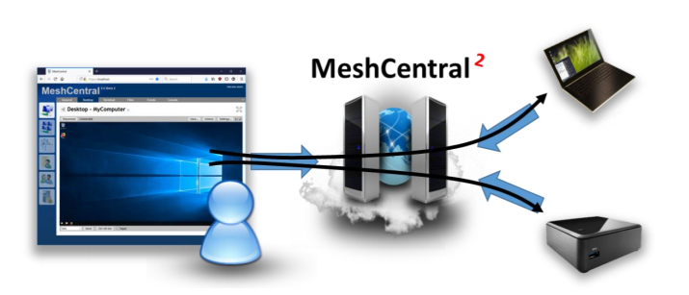
Introduction
MeshCentral is a free open source web-based remote computer management software.
We could setup your own management server on a local network or on the internet and remote control and manage computers that runs either Windows* or Linux* OS.

Slide 2
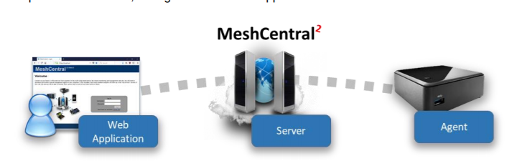
Design Overview

