Slide 1
Portfolio
Student portfolio

Slide 2
About me
Nane:V.Ranjitha
Course:B.C.A(Bachelor of computer applications)
College name: Valliammai women’s college of arts and science
Email id: ranjithav22072007@gmail.com
Phn:6384335434

Slide 3
Table of contents
Self introduction
Academic information
Skills
Project
Achievements
Extra curricular activities
Internship experience
Personal details
Conclusion

Slide 4
Self introduction
My self Ranjitha velayutham studying second year B.C.A student with a passion for programming web development and problem solving I beleive
In continuos learning and wish to contribute to the IT industry by creating efficient and user-friendly software applications My career goal is to become a web developer and work on innovative technology projects

Slide 5
Academic information
B.C.A(Bachelor of computer applications):
2024-2027(Valliammai women’s college of arts and science)-74%
Higher secondary school
2022-2024(olive tree matric higher secondary school)-61%SSLC:
2021-2022(olive tree matric higher secondary school)-89%

Slide 6
Skills:
Programming language-python,c++.
Web development HTML,Css, javascript
Ms office-photo shop
Communication and presentation
Time management
Problem solving
Leadership and project management

Slide 7
Achievements
Received merits scholarship for scoring above 80% in all semester exams

Slide 8
Extra curricular activities
Creative pursuits arts,music or other activities
Sports teams sports and individual sports
Cultural organizing participating

Slide 9
Personal details
Date of birth:22-07-2007
Father name:A.Velayutham
Mother name:V.Sangeetha
Language known: Tamil, English
Habit and interest: reading novels, singing, playing games etc.,,

Slide 10
Conclusion
“I am enthusiastic learner with strong technical and communication skills
My future aspirations is to work in a reputed company as a software engineer and later purse higher studies in Artificial intelligence.i am
Confident that my skills project and dedication will help me achieve
Goals”

Slide 11
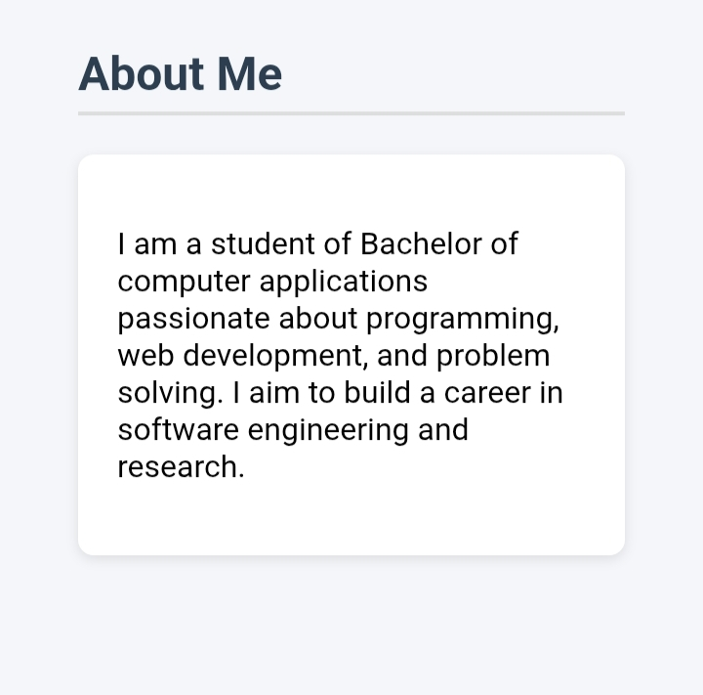

Slide 12
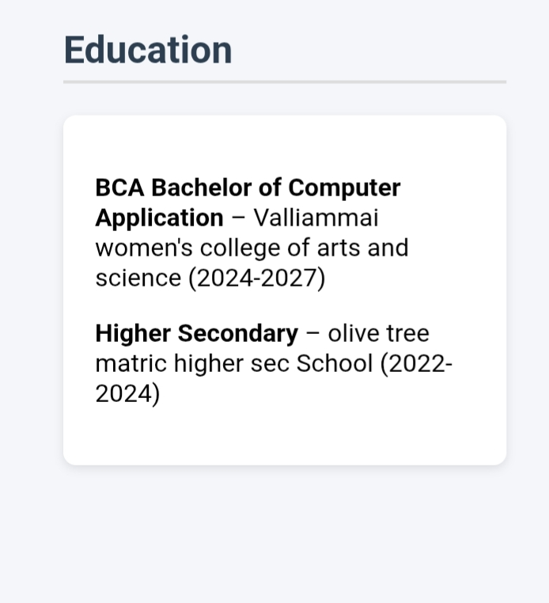

Slide 13
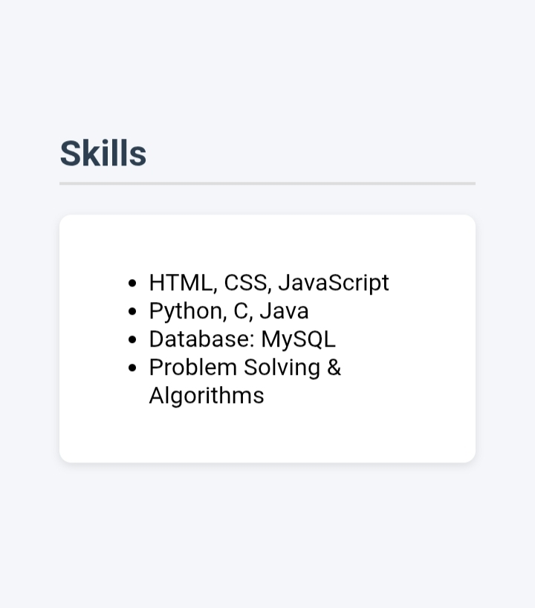

Slide 14
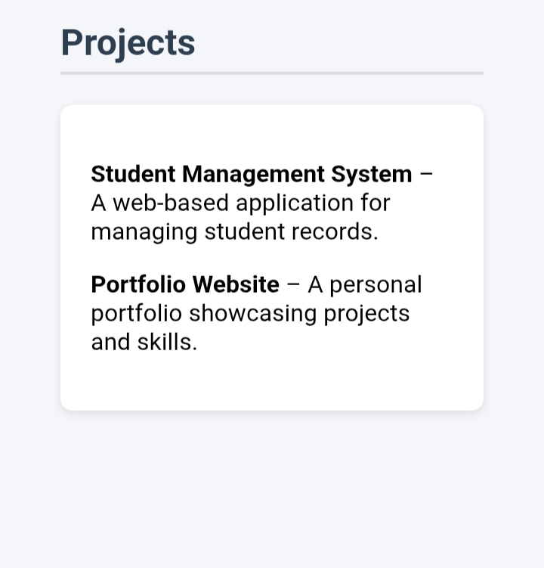

Slide 15
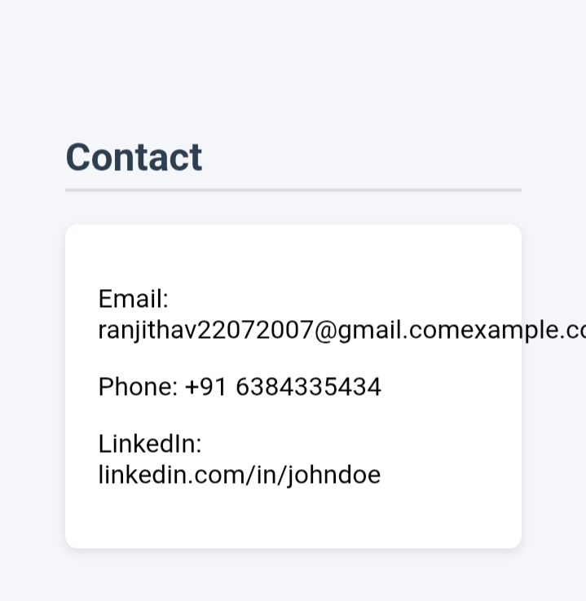

Slide 16
Git hub
Link:
https://github.com/Ranjitha1280

