Slide 1
STOCK MARKET ANALYSIS AND PREDICTION
GROUP 6
Vaishnavu Baiju
Ranjitha P V Panchami R

Slide 2
INTRODUCTION
Stock market price prediction is a challenging task due to market volatility
Objective: Predict future stock prices using machine learning
Strategy: Use historical stock data, apply preprocessing and feature engineering, then train regression models

Slide 3
PROJECT OVERVIEW
Dataset creation and merging
Preprocessing and feature creation
EDA and visualization
Regression modeling
Evaluation and insights
API Deployment

Slide 4
DATASET CREATION
Source: NSE (National Stock Exchange), Kaggle
Combined multiple stocks into a single DataFrame to allow per-symbol analysis
Period: 2017–2020
Columns: date, open, high, low, close, previous close etc
Target: 'close' price
Converted date column to proper datetime format and ensured numeric columns were correctly typed

Slide 5
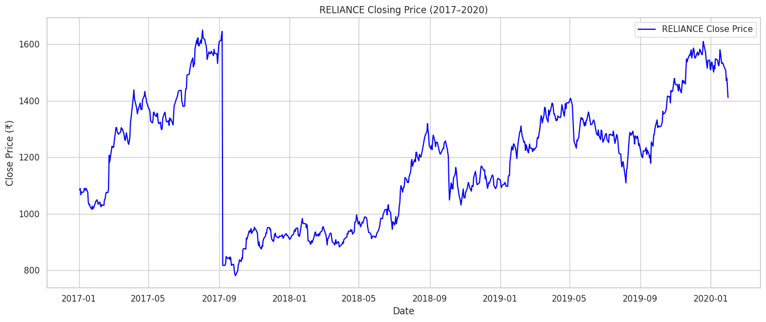
GRAPH

Slide 6
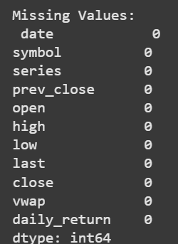
DATA PREPROCESSING
Steps performed:
Checked and filled missing values in critical columns using forward and backward fill and statistical imputation
Removed rows with missing values in 'symbol' or 'date'
Calculated a new column 'daily_return'
Ensured date sorting for each symbol before applying lag-based feature engineering
Dropped duplicate rows and unnecessary columns like 'last' and 'turnover'

Slide 7
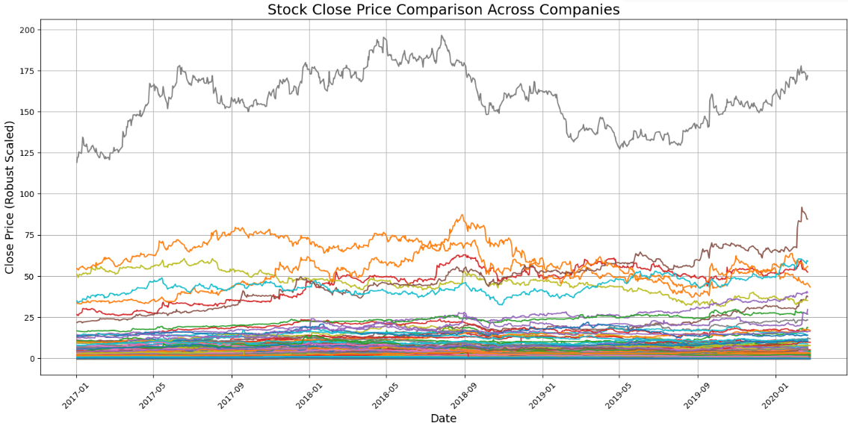
GRAPHS

Slide 8
EXPLORATORY DATA ANALYSIS (EDA)
Histogram: Distribution of closing prices to understand price spread
Correlation Heatmap: Showed strong correlation between close, vwap, and open prices
Box Plots: Used to detect and visualize outliers in high, low, close, and volume
Insight: Strong linear relationships exist among price-based features

Slide 9
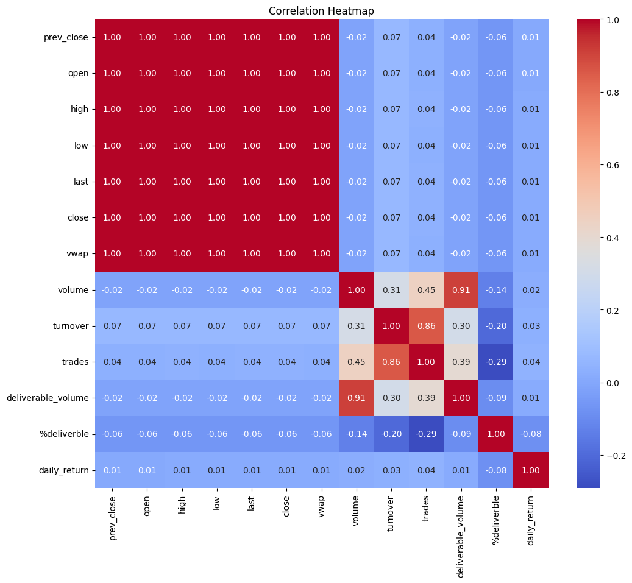
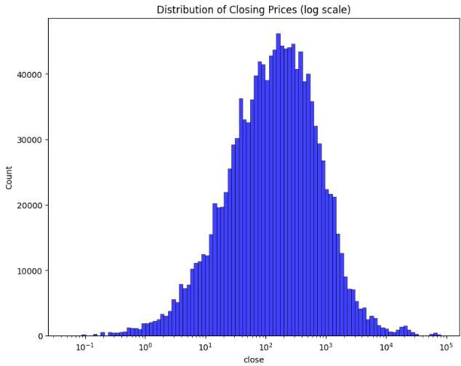
HISTOGRAM & CORRELATION HEAT MAP

Slide 10
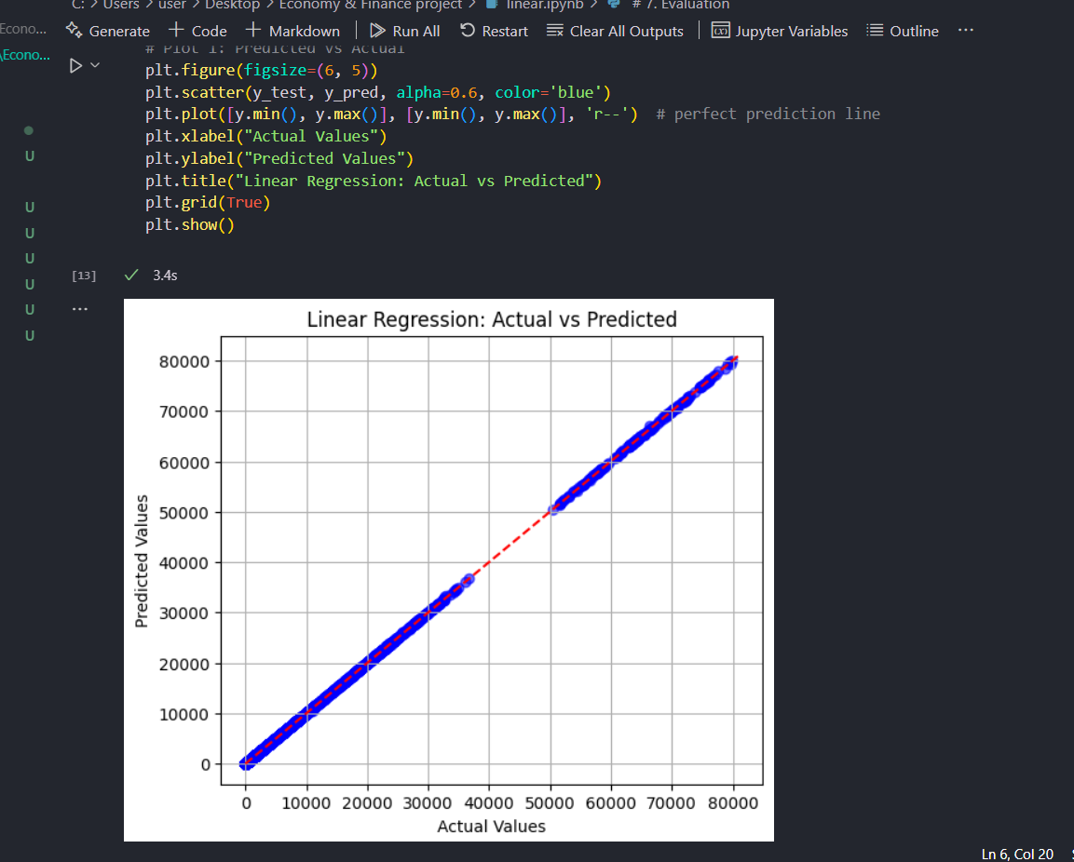
Linear Regression
Mean Squared Error: 49.14448530808404
R² Score: 0.9999912053256308

Slide 11
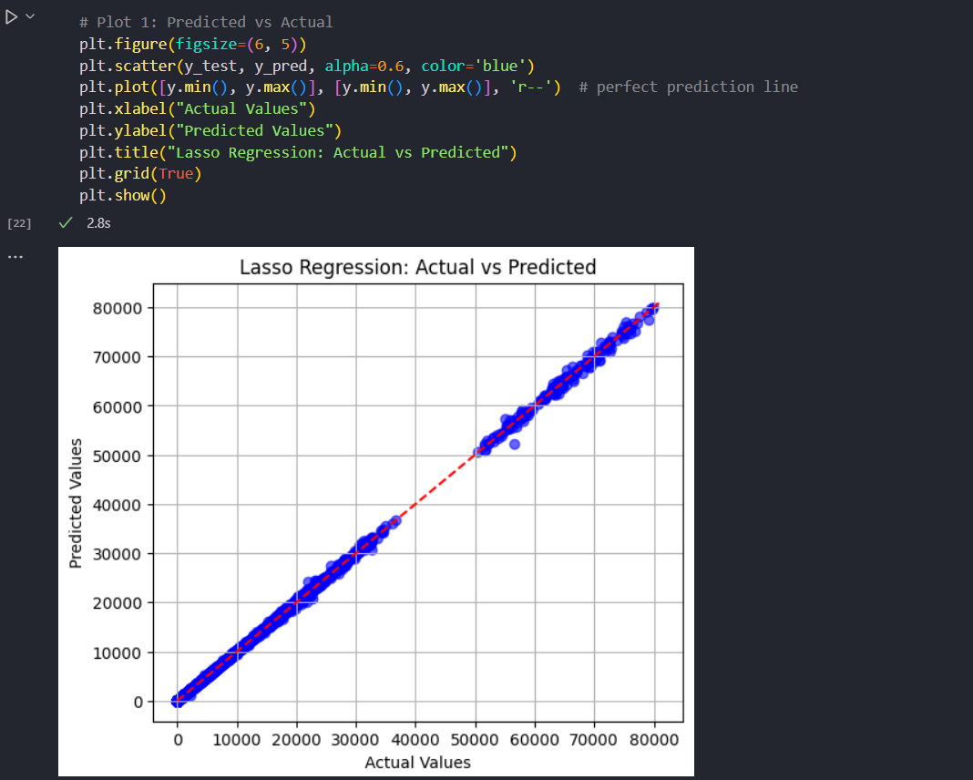
Lasso Regression
Mean Squared Error: 1063.392898864091
R² Score: 0.9998097000260892

Slide 12
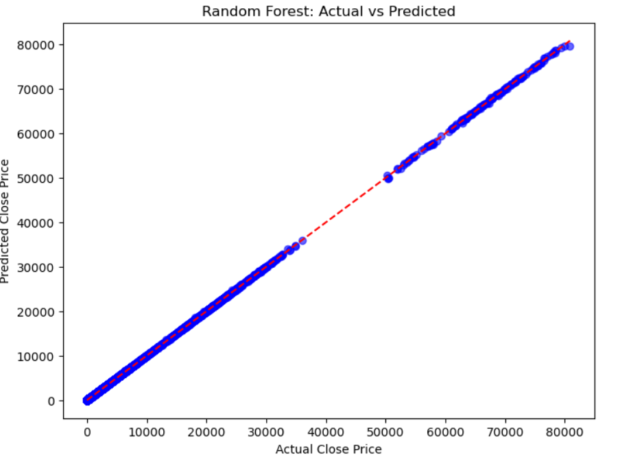

RandomForest Regression

Slide 13
REGRESSIONS DONE
Linear Regression
Assumes linear relationship; can’t capture market volatility
Lasso Regression
Still linear; may underfit despite feature selection
Random Forest
Smooths out extreme fluctuations; weaker on volatile data
XGBoost Regression
delivers high accuracy

Slide 14
REGRESSION MODELLING
Models Implemented:
XGBoost Regressor
Data Split:
80% training set
20% test set

Slide 15
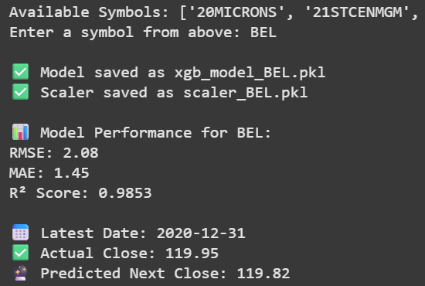
OUTPUT

Slide 16
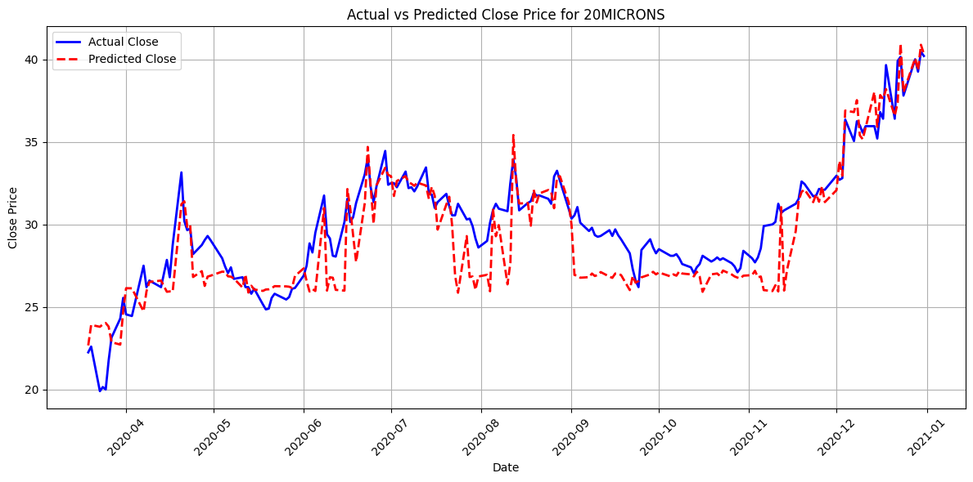
GRAPH

Slide 17
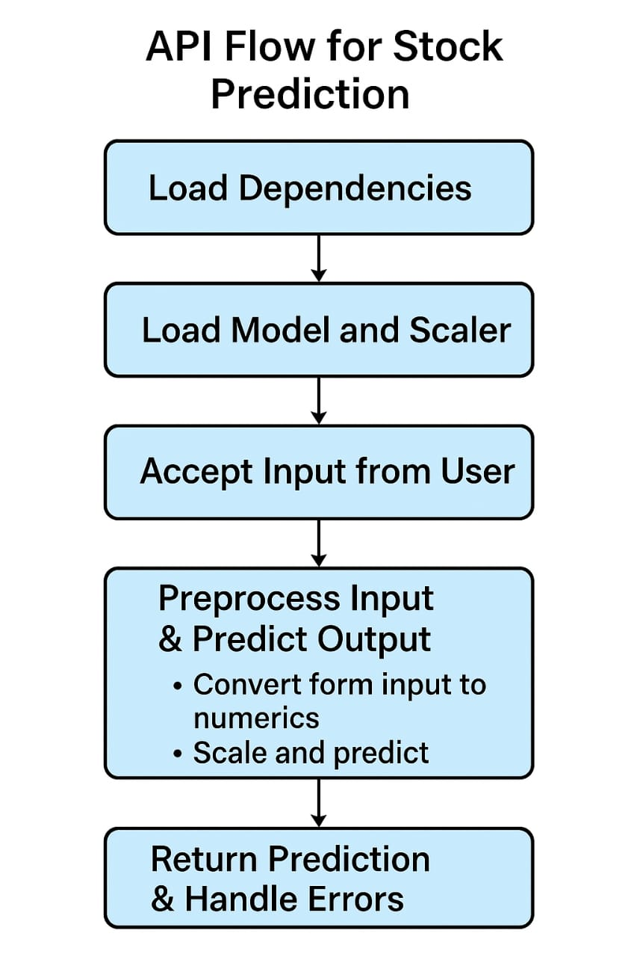

Slide 18
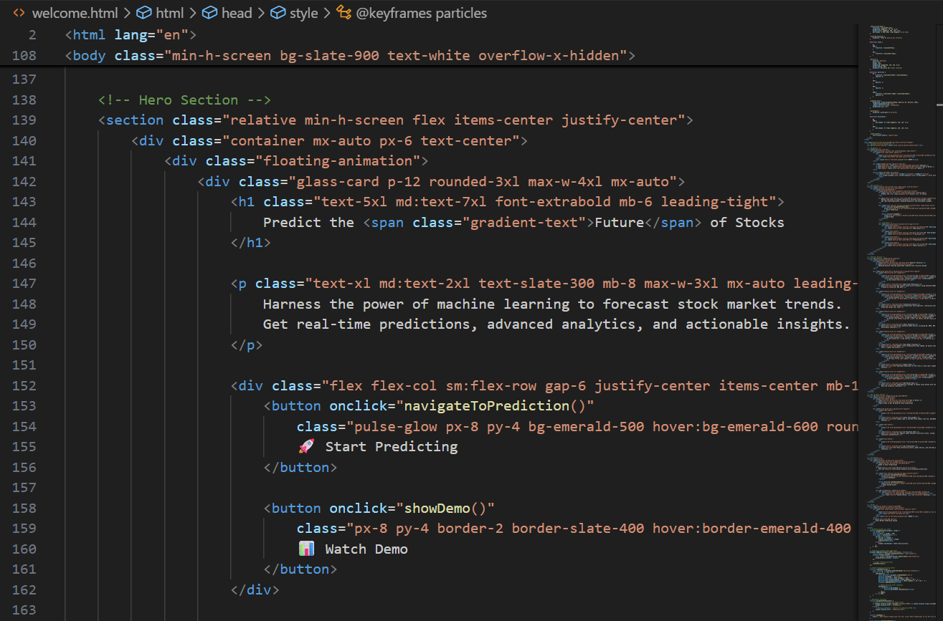
APPLICATION DEPLOYMENT - HTML
There are two html codes for welcome page and prediction page
Css javascript and html is done in the same file
A total of 1040 lines

Slide 19

WEB APP

Slide 20
CONCLUSION
Data set created
Preprocessing is done
EDA is completed
Model created
API deployed

