Slide 1
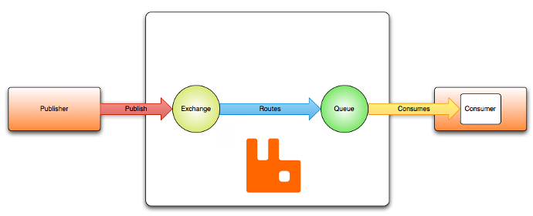
How to send/receive product object to/from Queue of RabbitMQ [Spring+JMS+RabbitMQ]
Queues [point-to-point]:
Queue’s are based on point-to-point messaging model where messages are sent to a queue.
Each message has exactly one sender and one receiver.
Message is guaranteed to be delivered to only one receiver.
Routes the message to a queue
This is container for the messages.
SpringJMSProducer Application
SpringJMSConsumer Application

Slide 2
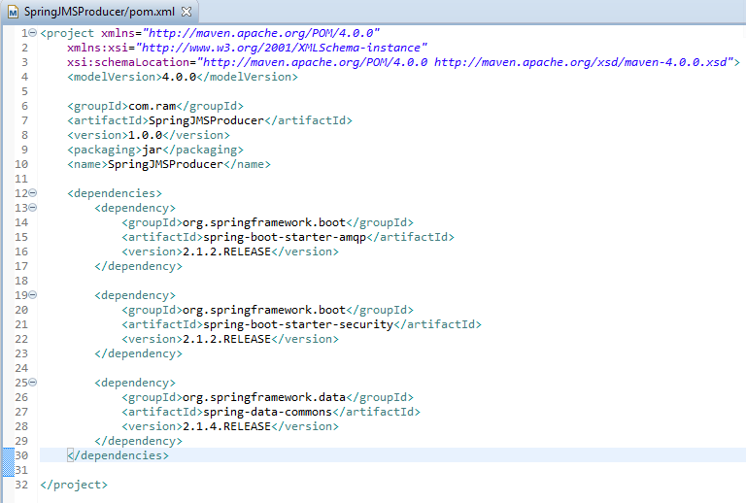
SpringJMSProducer Application

Slide 3
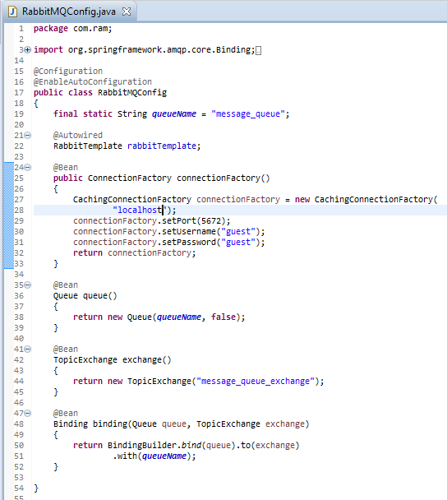
SpringJMSProducer Application
RabbitTemplate: This is helper class to send and receive messages.
Binding: Binds the queue and topic exchange for a given queue name.

Slide 4
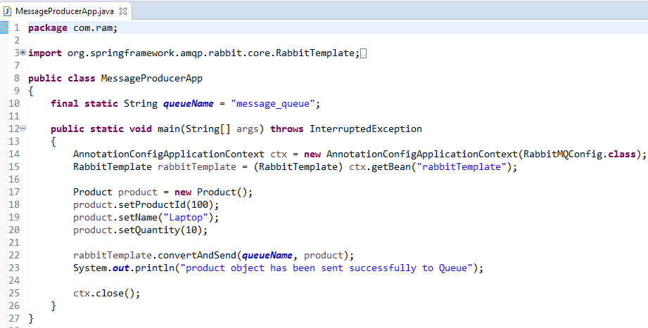
SpringJMSProducer Application
RabbitTemplate.convertAndSend method converts java object to AMQP message and is sent to default topic exchange.

Slide 5
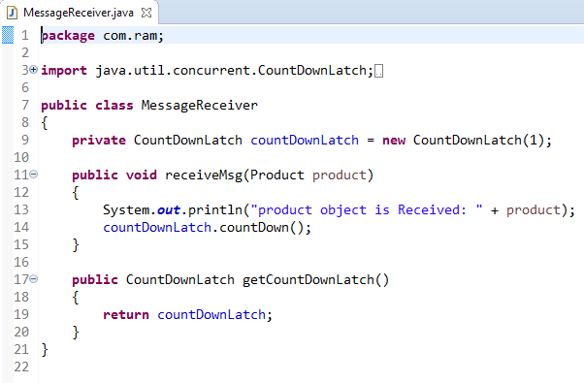
SpringJMSConsumer Application
Receiver class that will receive the message. The method implemented to receive message should be acknowledged to MessageListenerAdapter in configuration class.

Slide 6
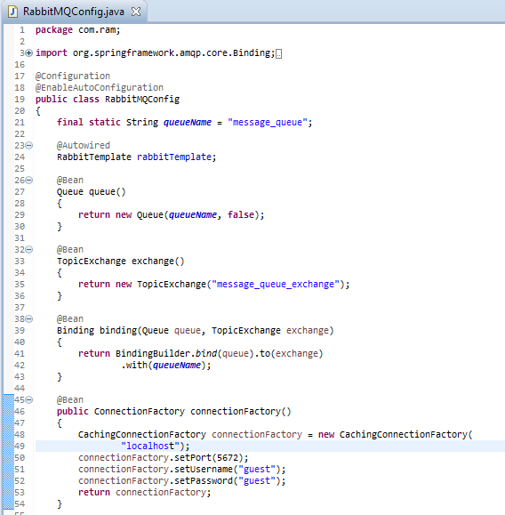
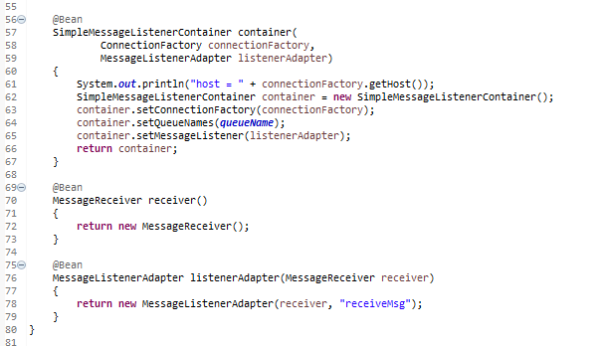
SpringJMSConsumer Application

Slide 7
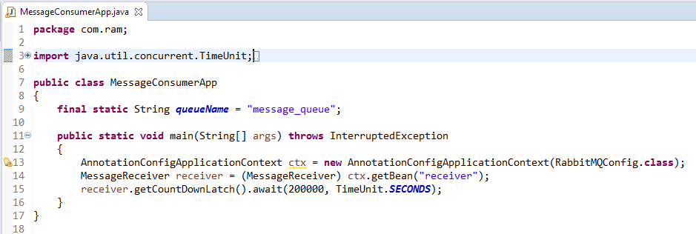
SpringJMSConsumer Application

