Slide 1
BUSMANAGEMENT
Trainer Name :Janani.V Student Name : RANJITHA.K
Enrollment Number :EBEON1122698386
Date :
Time :

Slide 2
OverView
we will learn about how to develop a CRUD full stack web application that is basic Bus management Application using Angular 10 and Spring Boot.
We will develop features:
Create BusManagement
Update BusManagement
Delete BusManagement
View BusManagement
search Bus byusing Startingpoint
View ac or non-ac busList

Slide 3
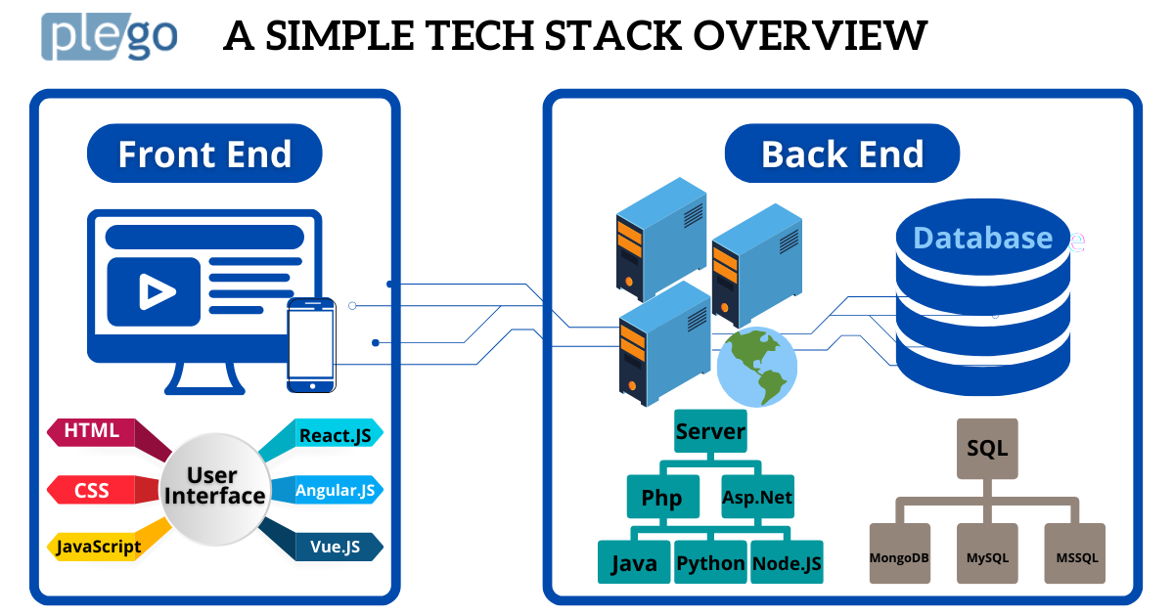
Technologies Frontend and Backend

Slide 4


Frontend Technologies
Front-end development (Client-side development) is the process of using HTML, CSS, and JavaScript to create a graphical user interface for a website or web application so that users can interact with them.
HTML : is a markup language which is used for creating attractive web pages with the help of styling, and which looks in a nice format on a web browser. It is made of many HTML tags and each HTML tag contains different content.
CSS :Cascading Style Sheets (CSS) is a stylesheet language used to describe the presentation of a document written in HTML or XML

Slide 5
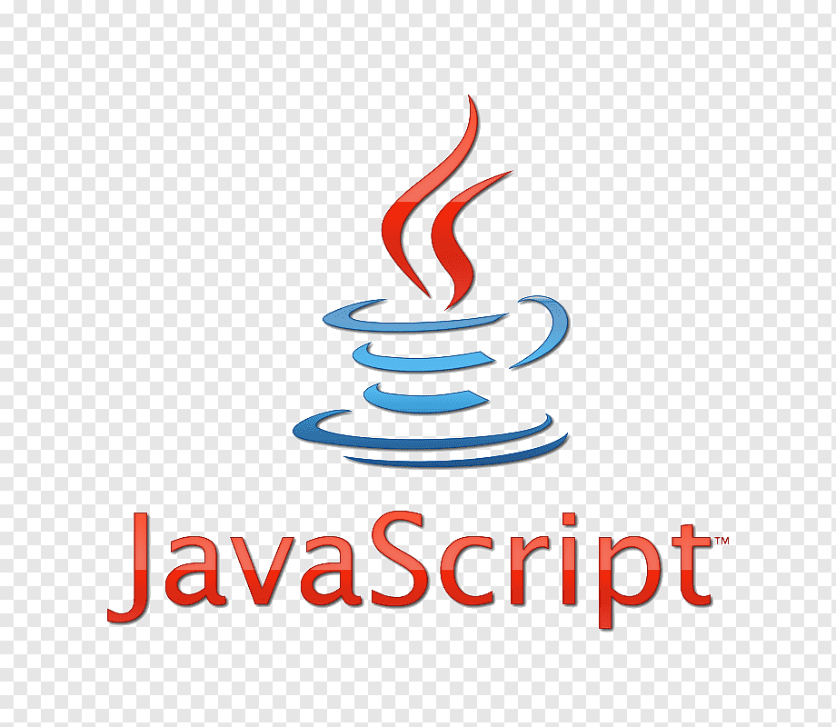

Frontend Technologies
JavaScript : is used to create client-side dynamic pages. JavaScript is an object-based scripting language which is lightweight and cross-platform. JavaScript is not a compiled language, but it is a translated language.
Angular JS : is an open source JavaScript framework that is used to build web applications. It can be freely used, changed and shared by anyone.

Slide 6

Backend Technologies
Spring Boot : Java Spring Boot (Spring Boot) is a tool that makes developing web application and microservices with Spring Framework faster and easier through three core capabilities:
RestAPI : is an application programming interface (API or web API) that conforms to the constraints of REST architectural style and allows for interaction with RESTful web services.
Hibernate : is an open source Object-Relational Persistence and Query service for any Java Application. Hibernate maps Java classes to database tables and from Java data types to SQL data types and relieves the developer from most common data persistence related programming tasks.

Slide 7
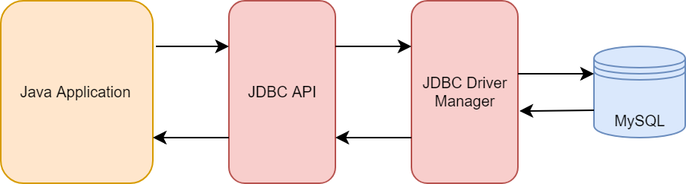
Database
DataBase Mysql : we can connect to our database(MySQL) with JDBC(Java Database Connectivity) through the Java code. JDBC is one of the standard APIs for database connectivity, using it we can easily run our query, statement, and also fetch data from the database.

Slide 8


Architecture Diagram
Angular Spring Boot
Router
components
service
HTTp
cilent
Spring Rest Controller
Spring JPA
B
D
HTT
S
se

Slide 9
Backend Explanation:
What happened when the spring boot application run? ….
If you click run spring boot application . The main application context is kicked off which in turn searches for the classes annotated with @Configuration, initializes all the declared beans in those configuration classes, and based upon the scope of those beans, stores those beans in JVM, specifically in a space inside JVM which is known as IOC container. After the creation of all the beans, automatically configures the dispatcher servlet and registers the default handler mappings, message Converts, and all other basic things. spring boot supports three embedded servers:-
Tomcat (default), Jetty and Undertow.

Slide 10
Explanation:
The Client makes an HTTP request(GET, PUT, POST, etc.)
The HTTP request is forwarded to the Controller. The controller maps the request. It processes the handles and calls the server logic.
The business logic is performed in the Service layer. The spring boot performs all the logic over the data of the database which is mapped to the spring boot model class through Java Persistence Library(JPA).
The JSP page is returned as Response from the controller.

Slide 11
Fronted Explanation:
Tool used:
Using Angular we have done Frontend Explanation:
Before Starting the Angular server we have to run Spring Boot Application. When the server is Started in Angular first it comes into index.html. In index.html there is an App root it went to app module and app Component .ts(app .component . html , app .component .css) and then it goes to app.routing.module.ts(path is given for all the sub components). After that we have to create Subcomponent like create.update,list,view,login,logout,feedback,homepage,etc…. By Using these subcomponent there is service class in that we have to give base Url to connect backend Using @crossorgin annotation in service class.

Slide 12
Tools used:
session storage for login
auth guard servies,
used roting
handled exceptions
cross orgin

Slide 13
Future Work:
Booking tickets total cost price
Sorting of values
Adding spring security
Some extended features

Slide 14
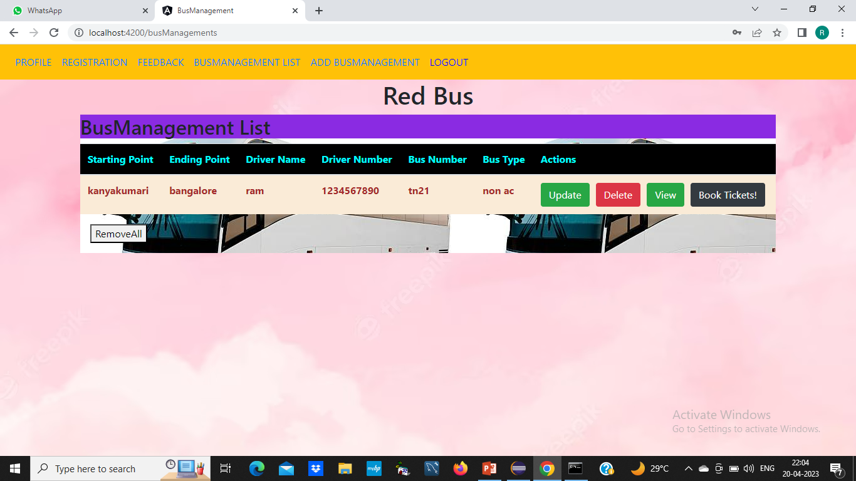
Create BusManagement

Slide 15
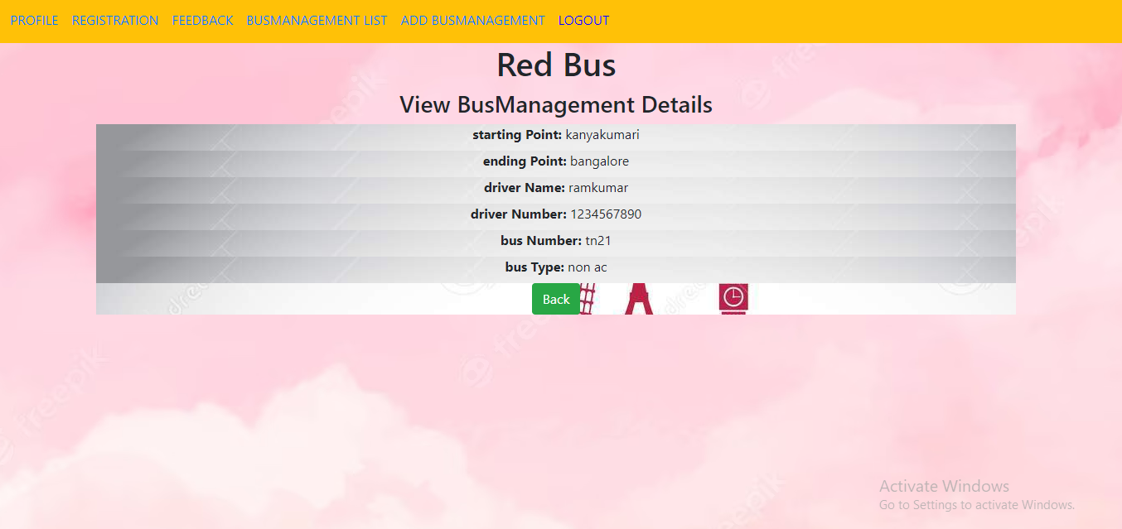
View BusManagement

Slide 16
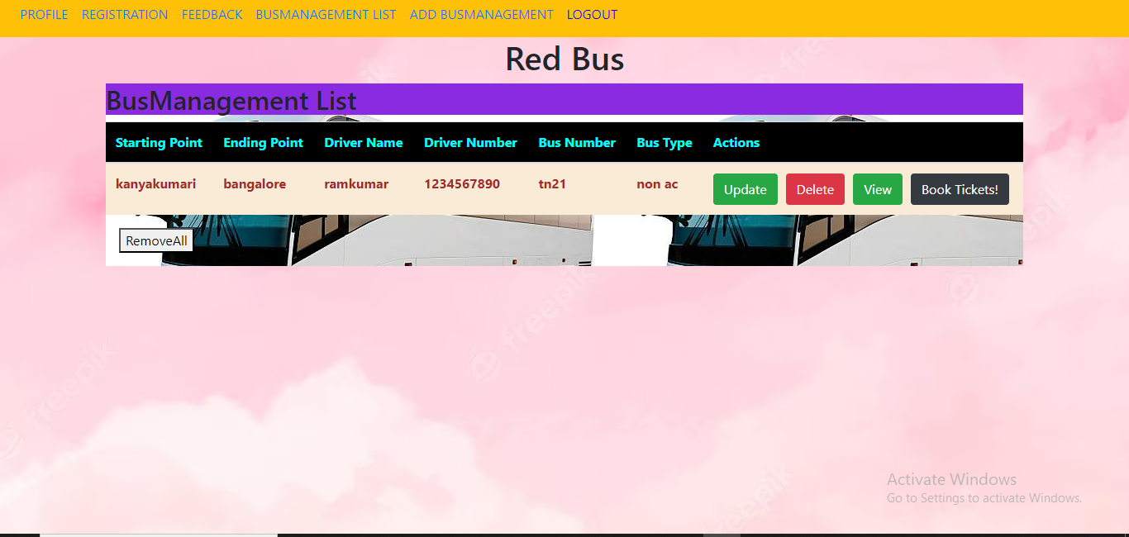
Update BusManagement

Slide 17
Delete BusManagement

Slide 18
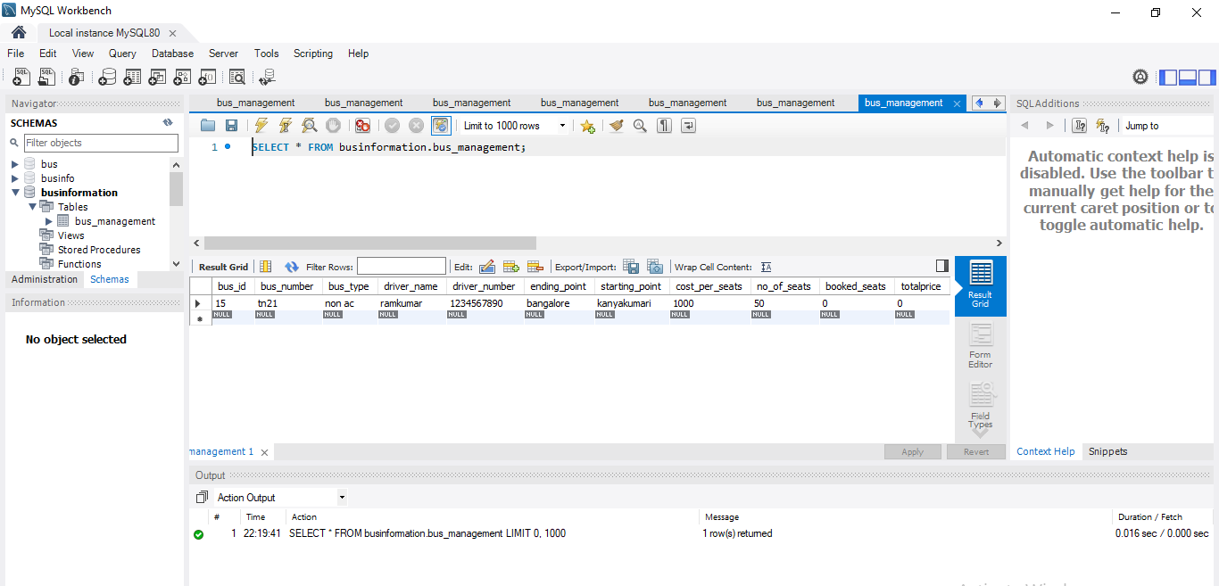
Backend Output

Slide 19
THANK YOU

