Slide 1
Ansible
Ansible is an IT automation tool
Ansible is an Open source IT configuration Management, Deployment(master and slave) and Orchestration tool
It is used for configuration(customize) management
It automates the configuration of all systems.
Used in infrastructure team , Linux team etc.…
Mechanisms- push and pull
Ansible(agent based)-push

Slide 2
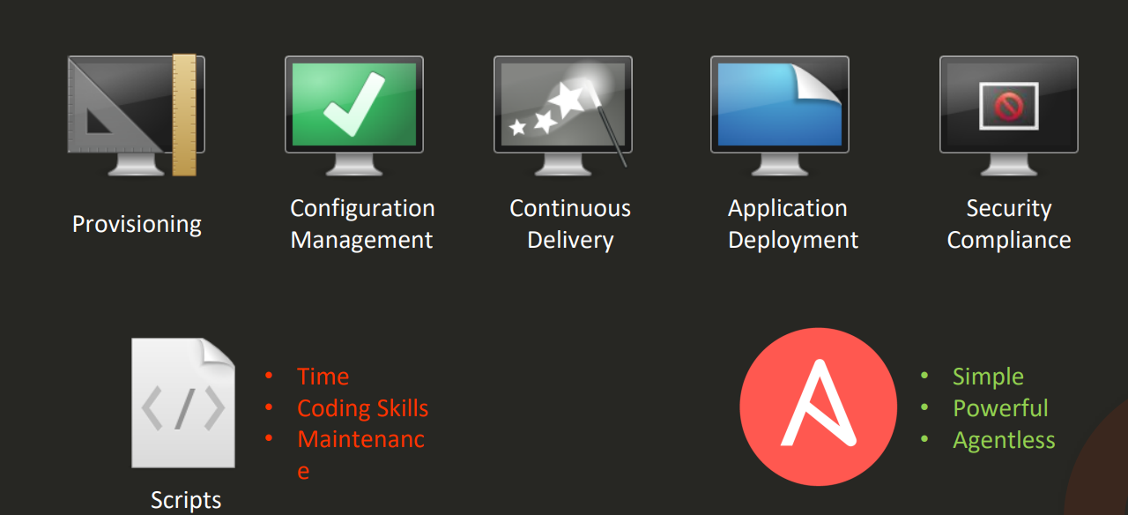
Ansible

Slide 3
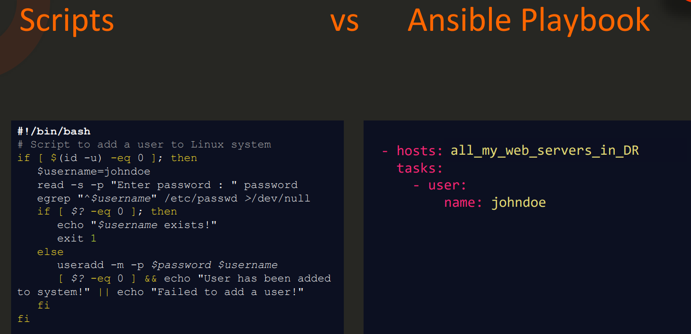
Ansible

Slide 4
Ansible – how it works
Connects nodes and pushes small programs called modules to them and removed when they are done
The management node controls whole execution of the playbook
The inventory file provides the list of hosts where the modules need to be run
The management node does an ssh connection and executes the modules and installs the software

Slide 5
Mechanism in Ansible
1.PUSH --- ansible
-Transferring command from master to slaves
2.PULL --- chef, puppet -Getting all information from slaves to master
1.Adhoc commands – single commands
2.Playbook – yaml
3.Roles
4.Vault
Windows not supported for master
Important files in Ansible
1.Inventory file /etc/ansible/host.txt ----- slave ip
2.Configuration file /etc/ansible/ansible.cf

Slide 6
Ansible - installation
1.Create an EC2 instance
#! /bin/bash
yum update
yum install python-pip –y
pip install ansible
Add key in pageant
2.connect with the ec2 instance and connect the master through putty
3.In putty enable allow agent forwarding
4. Connect with ssh – ec2-user
5.Try connecting the slaves in master through private IP
ssh ec2-user@privateip

Slide 7
Ansible - installation
6.Check the ssh key ls –lrta
Make sure to have authorized_keys and known_hosts
7.Create inventory file
Vi slaves.txt
Add all the slaves private IP in the file
8.Create ansible file
Vi ansible.cfg
https://gist.githubusercontent.com/alivx/2a4ca3e577ead4bd38d247c258e6513b/raw/fe2b9b1c7abc2b52cc6998525718c9a40c7e02a5/ansible.cfg

Slide 8
Ansible - installation
9.Adhoc commands
ansible all –i slaves.txt –m ping
The master should connect with all the slaves
10.To check the OS in all the slaves
ansible all –i slaves.txt –a “uname –a”

Slide 9
Ansible- Grouping
1.To enable the grouping function login to slaves.txt
ansible greens –i slaves.txt –m ping
Install – present
Uninstall – absent
Start – started
Stop –stoped
Restart –restarted
2.To install Apache
ansible greens –i slaves.txt –m yum –a “name=httpd state=present” -b

Slide 10
Ansible- Grouping
3.To start the server
ansible greens –i slaves.txt –m service –a “name=httpd state=started” –b
4.To verify whether it started check with public IP
5.To uninstall the server
ansible greens –i slaves.txt –m yum –a “name=httpd state=absent” –b

Slide 11
Ansible-playbook
-Ansible Playbooks are lists of tasks that automatically execute for your specified inventory or groups of hosts.
Create a playbook
1.Install apache
2.Start the apache server
3.In master – index.html - /var/www/html
Ansible module configuration
https://docs.ansible.com/ansible/2.9/modules/list_of_all_modules.html
https://docs.ansible.com/ansible/2.9/modules/list_of_files_modules.html

Slide 12
Ansible-playbook (one package)
1.Create a index.html file
2.Create a vi new.yml (write code for playbook)
3.To run the playbook
ansible-playbook –i slaves.txt new.yml --syntax-check
ansible-playbook –i slaves.txt new.yml
4.To check the installation status copy any slaves public IP and paste it in browser

Slide 13
PLAYBOOK
- hosts: all
remote_user: ec2-user
become: yes
tasks:
- name: install the latest version of Apache
yum:
name: httpd
state: present
- name: start apache
service:
name: httpd
state: started
- name: index file
copy:
src: ./index.html
dest: /var/www/html/index.html
mode: '0777'

Slide 14
Ansible-playbook ( multiple package )
Installing many packages together
1.Ansible loop modules
https://docs.ansible.com/ansible/2.7/user_guide/playbooks_loops.html
After creating the playbook run it
2.To run a playbook
ansible-playbook –i slave.txt loop.yml --syntax-check
ansible-playbook –i slave.txt loop.yml

Slide 15
PLAYBOOK (MULTIPLE PACKAGE)
- hosts: all
remote_user: ec2-user
become: yes
tasks:
- name: install package mysql
yum:
name: "{{ item }}"
state: present
loop:
- mysql
- php
- unzip
- csk

Slide 16
Ansible – Installing Jenkins
1.Jenkins installation repo
https://pkg.jenkins.io/redhat-stable/
https://pkg.jenkins.io/redhat-stable/jenkins.repo - base URL
2.Write the playbook and add the details
Create Jenkins.yml file
3.To run the playbook
ansible-playbook –i slave.txt Jenkins.yml --syntax-check
ansible-playbook –i slave.txt Jenkins.yml

Slide 17
Ansible – Installing Jenkins
4.Once Jenkins installed login to the privateip
Ssh ec2-user@privateip
Cat /var/lib/Jenkins/secrets/initialAdminPassword
To see the secret key
Cd /usr/lib/systemd/system
Vi Jenkins.service

Slide 18
PLAYBOOK – JENKINS
- hosts: greens
remote_user: ec2-user
become: yes
tasks:
- name: Add repository
yum_repository:
name: jenkins
description: download
baseurl: http://pkg.jenkins.io/redhat-stable
gpgkey: https://pkg.jenkins.io/redhat-stable/jenkins.io-2023.key
- name: java and jenkins
yum:
name: "{{ item }}"
state: present
loop:
- java
- jenkins
- name: start jenkins
service:
name: jenkins
state: started

Slide 19
Ansible idempotency
1.Red – failed state
2.Green-already existing file
3.Yellow- new file(changed)

