Slide 1

CSYE 7105 - High Performance Parallel Machine Learning & AI Final Project Parallel Deep Learning for Leukemia Classification from Blood Smear Images
Advisor:
Dr. Handan Liu
Done by Team 7:
Kaavya Loganathan Ranjithnath Karunanidhi

Slide 2
Contents
Introduction (Background, Motivation, Goal)
Methodology (Dataset Preprocessing, Visualization, Deep Learning Model)
Parallelization Techniques
HPC Implementation
Model Evaluation
Performance metrics
Conclusion

Slide 3
Introduction
Background & Motivation
Manual leukemia diagnosis is time-consuming and subjective - deep learning, especially CNNs, offers faster, scalable, and more accurate classification of blood smear images.
High-Performance Computing (HPC) significantly reduces training time and boosts efficiency, enabling real-time AI-assisted leukemia diagnostics for large-scale screening.

Slide 4
Introduction
Project Goal
Develop an HPC-optimized deep learning framework using CNNs (ResNet50) for accurate classification of leukemia subtypes (ALL, AML, CLL, CML) and Healthy.
Apply parallel computing techniques:
DDP
DDP+AMP
FSDP
FSDP+AMP

Slide 5
Introduction
GPUs used : v100-sxm2 & a100
Dataset :
https://www.kaggle.com/datasets/priyaadharshinivs062/leukemia-dataset/data
Size: 25.27GB
Classes: ALL, AML, CLL, CML, and Healthy

Slide 6
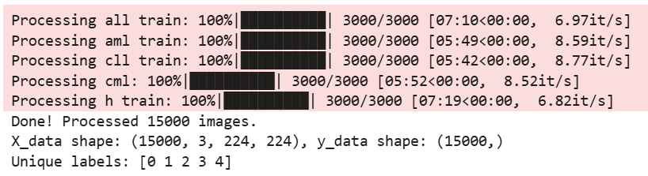
Methodology
Resizing – 224x224
Normalization
Processed 5000 images in each class, total 15000 images

Slide 7
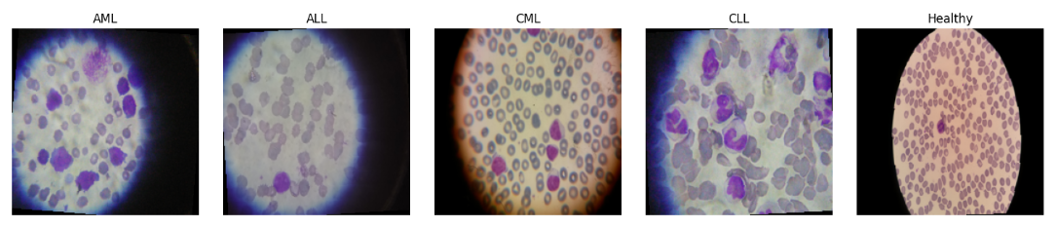
Methodology
Visualizing the images of 5 classes:

Slide 8
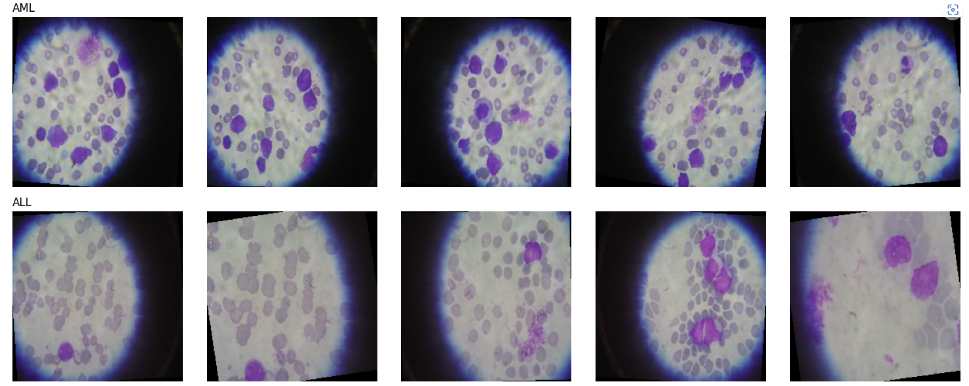
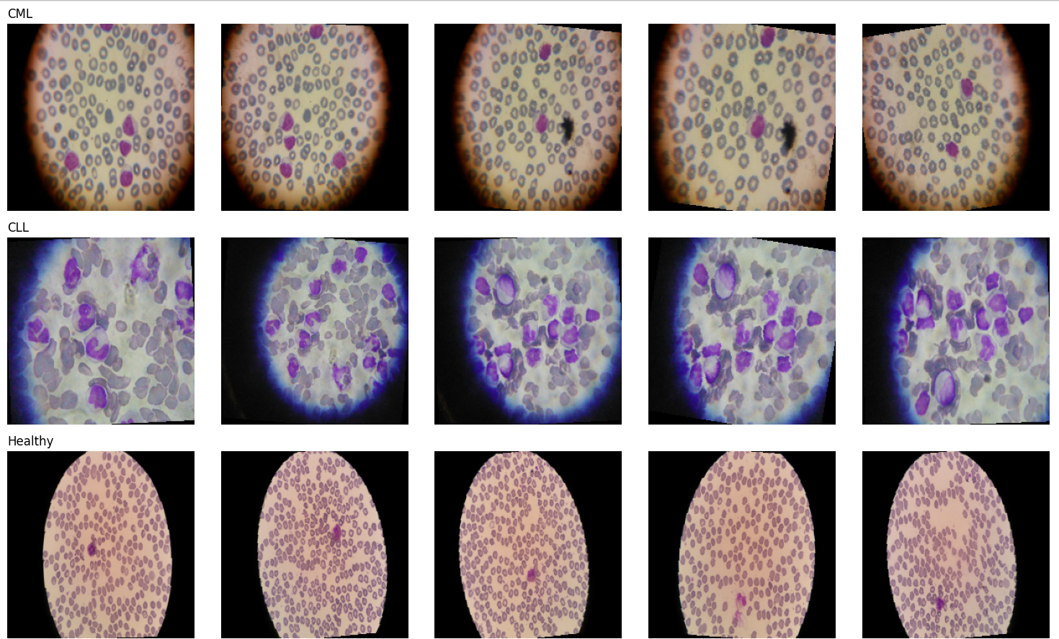
Methodology

Slide 9
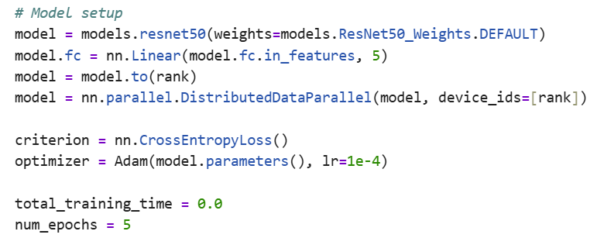
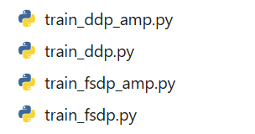
Methodology
Data Modelling:
CNN – Pretrained ResNet50
Loss Function: CrossEntropyLoss
Optimizer: Adam
Epochs: 5
4 .py files to run in both
v100-sxm2 and a100

Slide 10
Methodology
Parallelization Techniques on GPUs
DDP
DDP+AMP
FSDP
FSDP+AMP
GPUs : V100-SXM2, A100
Number of GPUs : 1, 2, 4
Cuda: 12.1.1
Total GPUs used: 4

Slide 11
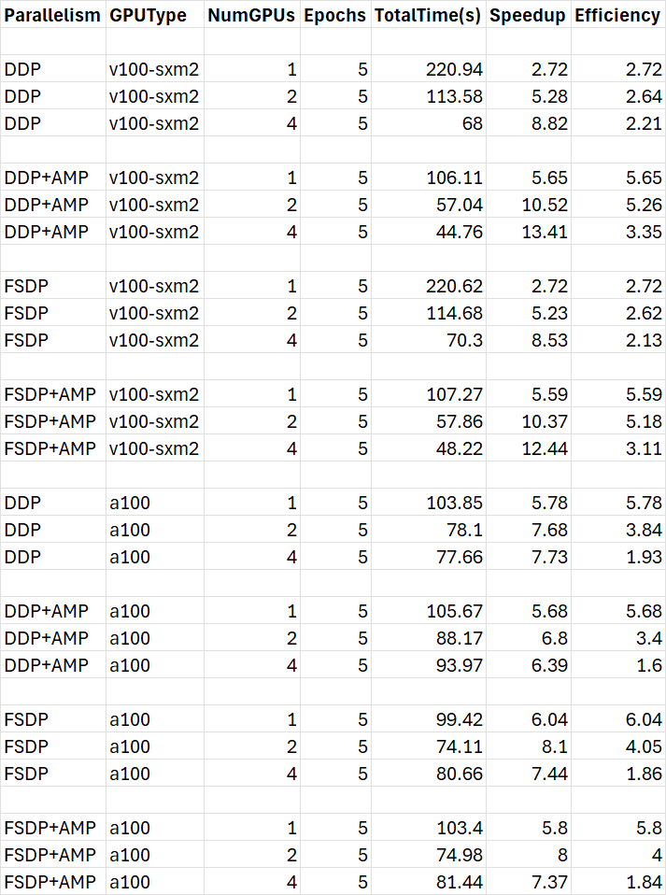
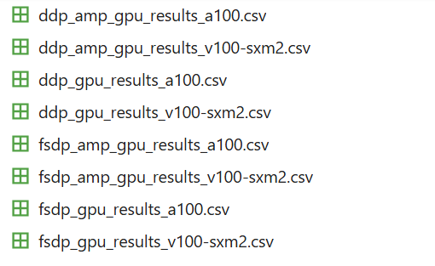
Methodology
Batch Size: 64
Epochs: 5
GPUs: 1,2,4
Calculated Total Training Time,
Speedup and Efficiency

Slide 12
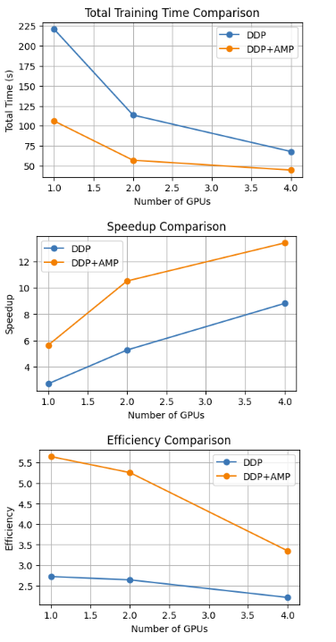
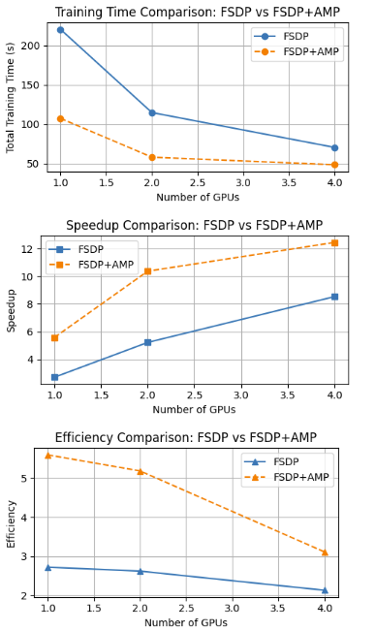
Performance Comparison: (v100-sxm2) DDP vs DDP+AMP FSDP vs FSDP+AMP

Slide 13
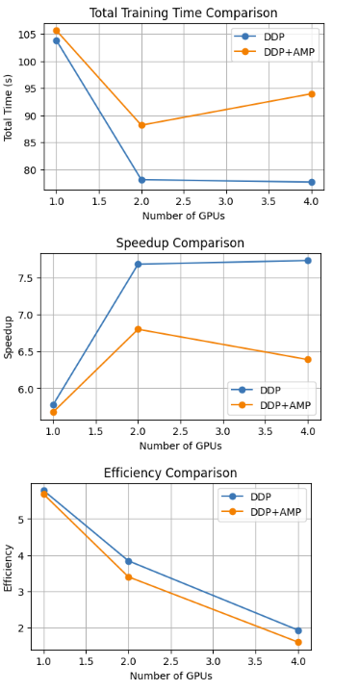
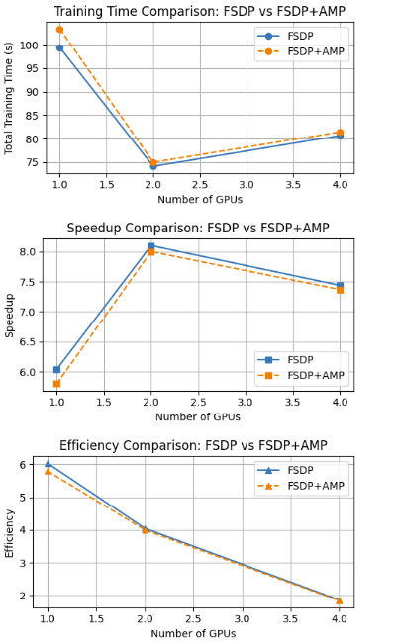
Performance Comparison: (a100) DDP vs DDP+AMP FSDP vs FSDP+AMP

Slide 14
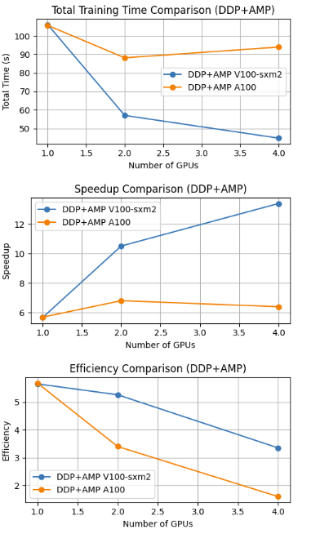
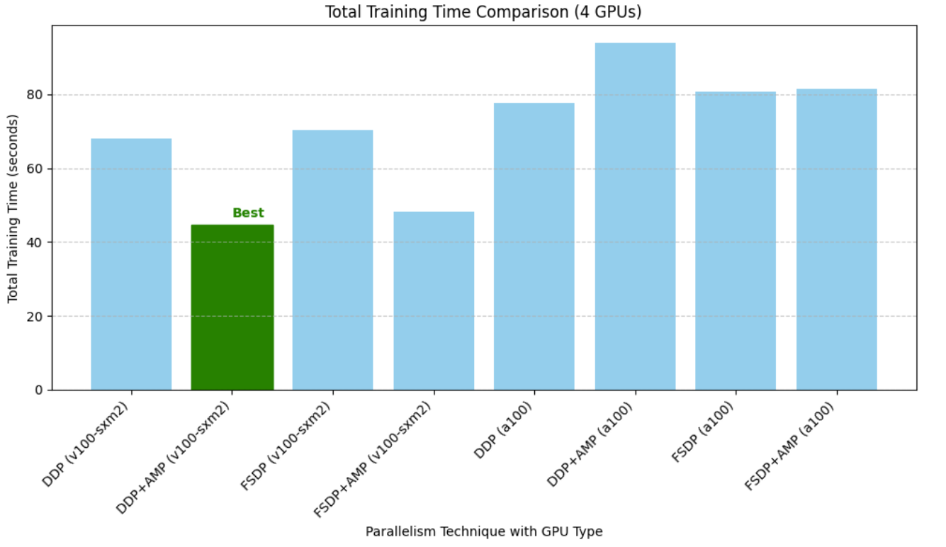
Performance: DDP vs DDP+AMP and FSDP vs FSDP+AMP
Best Model : DDP+AMP (v100-sxm2)

Slide 15
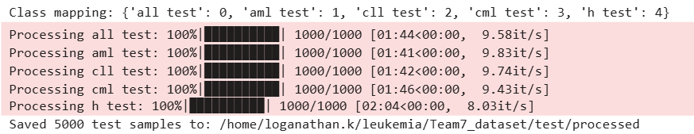
Performance: DDP vs DDP+AMP and FSDP vs FSDP+AMP
Processed 1000 images in each class, total 5000 images

Slide 16

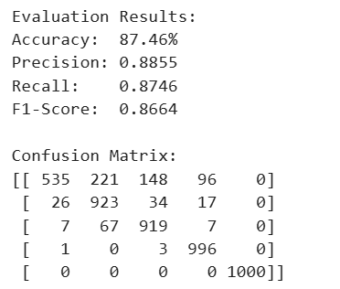
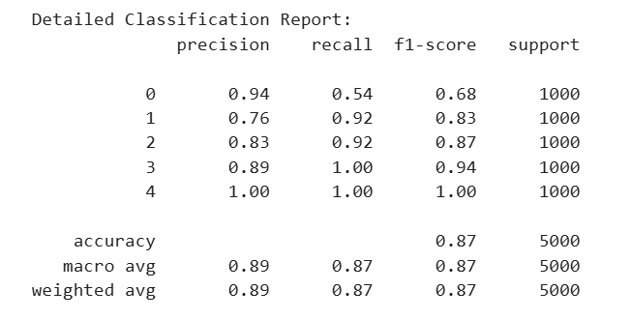
Performance: DDP vs DDP+AMP and FSDP vs FSDP+AMP
Performance metrics of the best model (DDP+AMP in v100-sxm2),
Accuracy: 87.46%
Precision: 0.8855
Recall: 0.8746
F1-Score: 0.8664

Slide 17
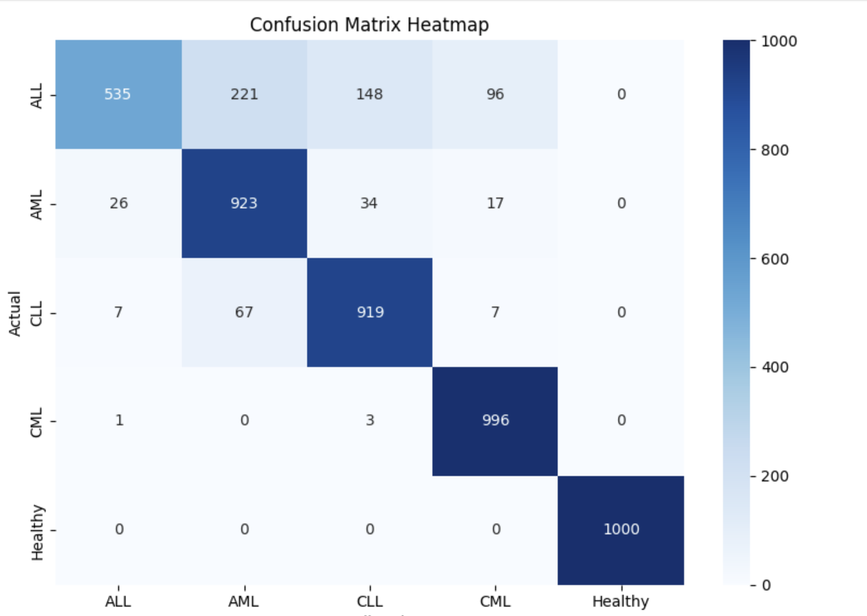
Performance metrics:
Below are the performance metrics of the best model (DDP+AMP in v100-sxm2),
Accuracy: 87.46%
Precision: 0.8855
Recall: 0.8746
F1-Score: 0.8664

Slide 18
Conclusions:
1. Out of 8 models with 4 GPUs, DDP+AMP in v100-sxm2 is considered as the best model, hence evaluated the test data with that model.
2. The accuracy of the model is 87.46% which is good.
3. Out of 5 classifications, four (AML, CLL, CML, Healthy) were predicted very well with more than 90% success rate. The first one - (ALL) classification was poor. As per the confusion matrix, out of 1000 test data, only 535 were precited correctly as ALL. Good thing is, the balance data were not marked as Healthy, they are into other different valid Leukemia classifications.
4. Best thing is, all 1000 people who were healthy and predicted correctly with 100% success rate.

Slide 19
Future work:
Fine tune the models with a100 GPU and more than 4 GPUs
Use Optuna or Ray Tune for advanced hyperparameter tuning to optimize model performance
Explore EfficientNet, ViTs, or CNN-Transformer hybrids for improved classification accuracy
Fine tune and rebuild DDP+AMP model to increase Performance
Deploy models on AWS/GCP/Azure HPC for real-time leukemia classification and scalability test
Expand dataset and analyze misclassifications to improve model accuracy and generalization

