Slide 1

AI POWERED SIEM
Reducing Alert Fatigue for SOC Analysts and Improving MTTD/MTTR
TEAM : CYBERVENGERS

Slide 2
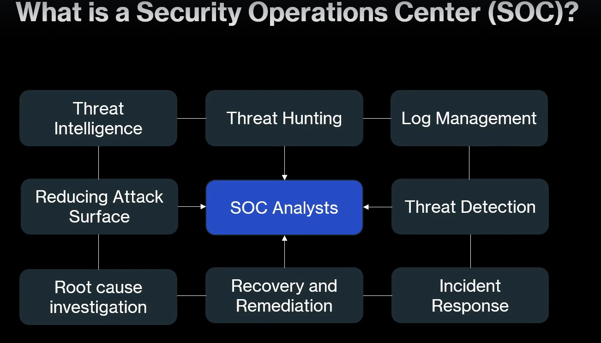

Slide 3
Problem Statement
SOC Analysts are drowned with tons of alerts on daily basis.
Need to manually review the alerts to identify false positives and also low-priority alerts
Analyst determines severity and scope manually
For Critical and High Alerts, doing further investigation and enrichment of IOCs is also done manually.
MTTD (Mean Time to Detect) and MTTR (Mean Time to Repair/Recovery) are usually high due to manual investigation and correlation of alerts where AI can help if we provide the right context.
Analyst searches logs, threat intel and asset information manually
Analysts need to formulate different queries(KQL, SQL) and need specific SIEM expertise to search for relevant information but with AI integration it can be done through simple natural language queries.

Slide 4
How AI Can Help Here?
Group related alerts and prioritize potentially important incidents
Learn context and identify benign patterns
Correlate events into a single attack story
Retrieve and summarize relevant evidence automatically
AI can combine information from multiple tools, IOC Enrichment can be automated
LLM can translate natural language investigation questions into SIEM specific queries like KQL, SPL etc.
AI can provide evidence-based triage and explain why an alert matters
AI agents can automate standard investigation workflows

Slide 5
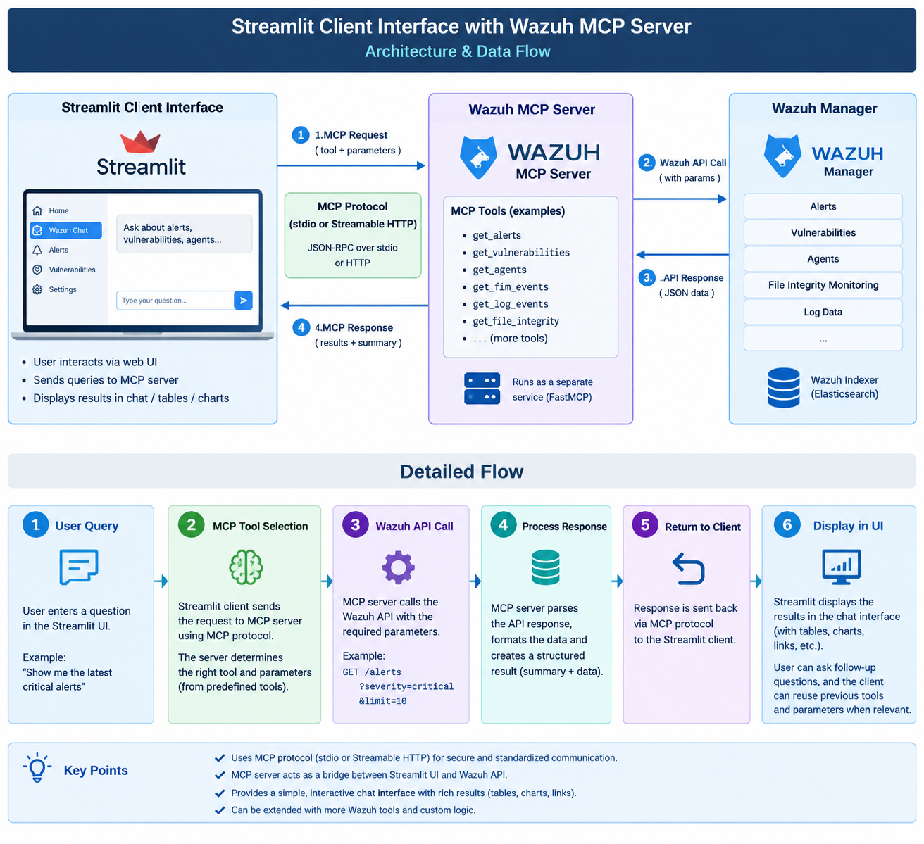
High Level Flow Diagram

Slide 6
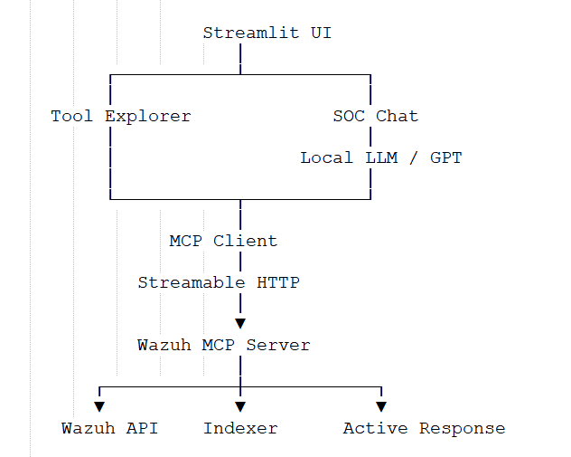
High Level Flow Diagram

Slide 7
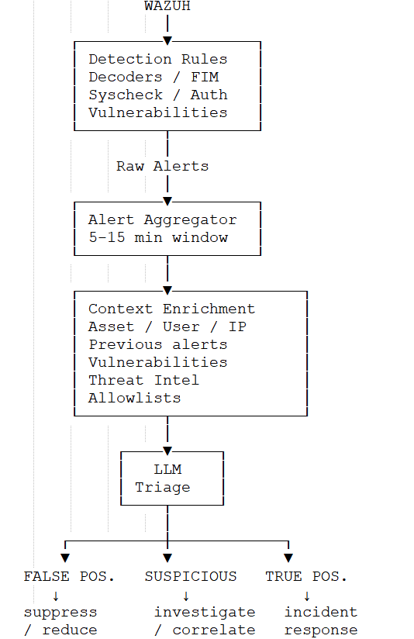
Using Local LLM with Ollama for Initial Triaging of Alerts

Slide 8
Example: SSH authentication failure → alert.
{
"rule": {
"id": "5710",
"level": 5,
"description": "sshd: authentication failed"
},
"agent": {
"name": "web-server-01"
},
"data": {
"srcip": "10.10.10.25",
"srcuser": "admin"
}
}
Who is 10.10.10.25?
Is this an internal management server?
Does admin normally connect from there?
Has admin connected to web-server-01 before?
How many failures occurred?
Was there a successful login afterward?
What happened after login?
Is the destination server critical?

Slide 9
SSH brute-force false positive
10:00:01 SSH authentication failed
10:00:02 SSH authentication failed
10:00:03 SSH authentication failed
10:00:04 SSH authentication failed
10:00:05 SSH authentication failed
Source IP: 10.10.1.20 Source hostname: jump-server Destination: prod-web-01 Username: admin
10.10.1.20 = approved IT jump server
admin = system administrator admin regularly connects to prod-web-01
Traditional SIEM will return 5 failed SSH attempts ↓ Brute force ↓ HIGH

Slide 10
SSH brute-force false positive
Alert:
5 SSH failures in 10 seconds.
Context:
Source: 10.10.1.20
Source hostname: jump-server
Destination: prod-web-01
User: admin
Historical behavior:
admin normally accesses prod-web-01 from 10.10.1.20
Average failed attempts per session: 3
Successful login occurred 8 seconds later.
Asset:
prod-web-01 = production server
{
"classification": "LIKELY_BENIGN",
"confidence": 0.93,
"reason": "Authentication failures originated from the organization's
approved jump server and match historical behavior.",
"recommended_action": "reduce_priority"
}

Slide 11
PowerShell encoded command
User: administrator
Host: win-admin-01
Command:
powershell.exe -ExecutionPolicy Bypass -File C:\Scripts\patch.ps1
patch.ps1
→ executed every Sunday
→ same administrator
→ same server
→ same hash
→ same parent process
→ same destination servers
{
"classification": "BENIGN_ADMIN_ACTIVITY",
"confidence": 0.97,
"risk_reduction": "high",
"reason": "Execution matches an established patching automation pattern."
}
PowerShell execution
+
ExecutionPolicy Bypass
+
known script
+
known hash
+
known user
+
known schedule
+
known server
=
likely administrative automation

Slide 12
File Integrity Monitoring false positive
/etc/passwd modified
Package update
↓
apt
↓
passwd modified
↓
package installation
FIM alert:
/etc/passwd modified
Process:
apt
Package:
openssl
User:
root
Change:
expected package installation
Previous behavior:
monthly patch cycle
LIKELY_BENIGN
Reason:
The modification occurred as part of a known package-management
operation during the organization's normal maintenance window.

Slide 13
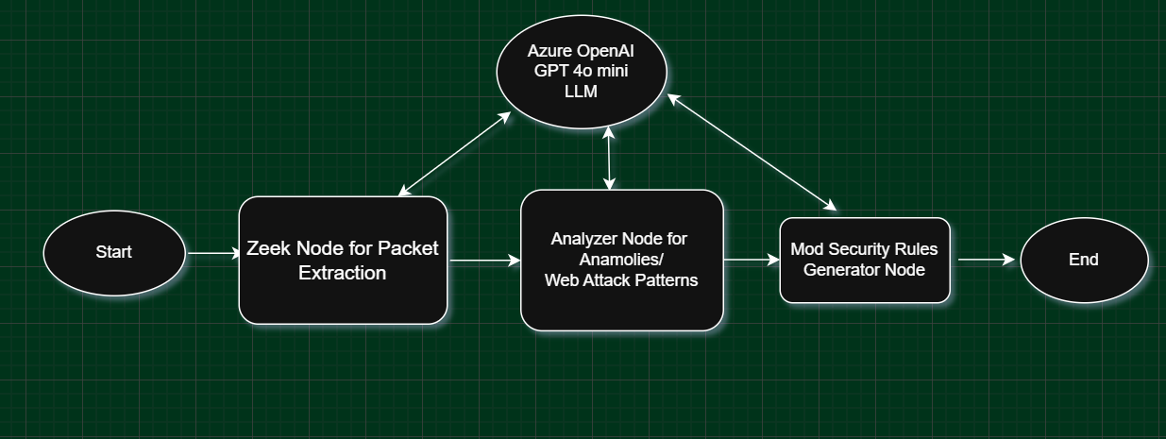
LangGraph Based WAF Rule Generation Agent

Slide 14
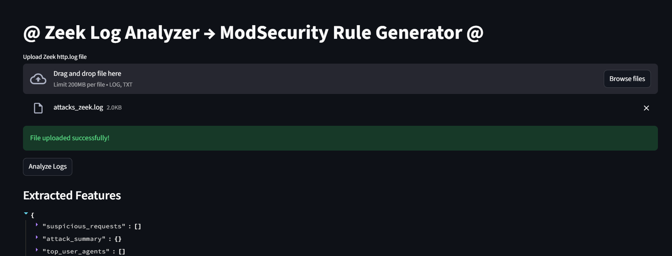
LangGraph Based WAF Rule Generation Agent

Slide 15
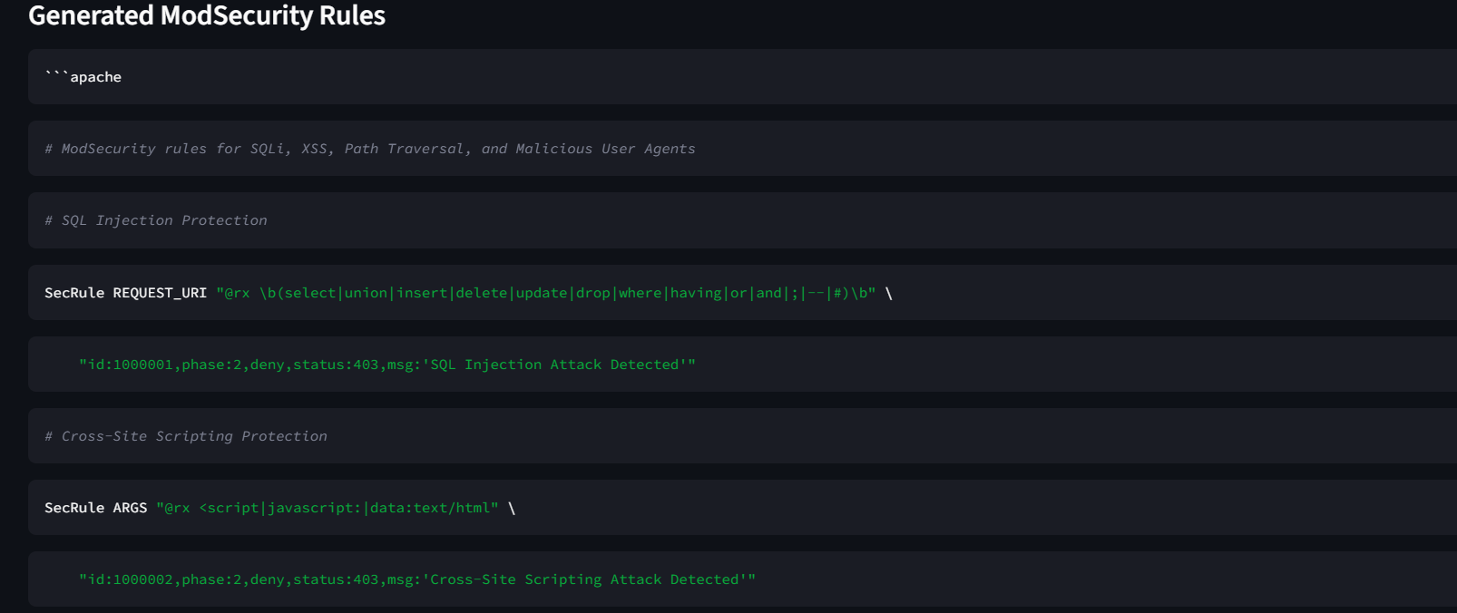
LangGraph Based WAF Rule Generation Agent

Slide 16
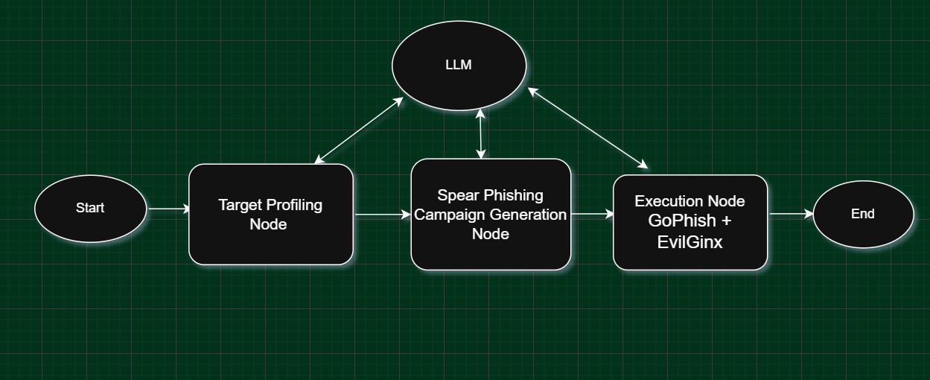
LangGraph Based Phishing Simulation Agent

Slide 17
LangGraph Agent Sample Code
# -------------------------
# Build Graph
# -------------------------
builder = StateGraph(RedTeamState)
builder.add_node("recon", recon_node)
builder.add_node("payload", payload_node)
builder.add_node("exploit", exploit_node)
builder.add_node("analysis", analysis_node)
builder.add_node("report", report_node)
builder.set_entry_point("recon")
builder.add_edge("recon", "payload")
builder.add_edge("payload", "exploit")
builder.add_edge("exploit", "analysis")
builder.add_edge("analysis", "report")
graph = builder.compile()
# -------------------------
# Run Agent
# -------------------------
if __name__ == "__main__":
result = graph.invoke({
"target": “192.168.0.0/24”
})

Slide 18
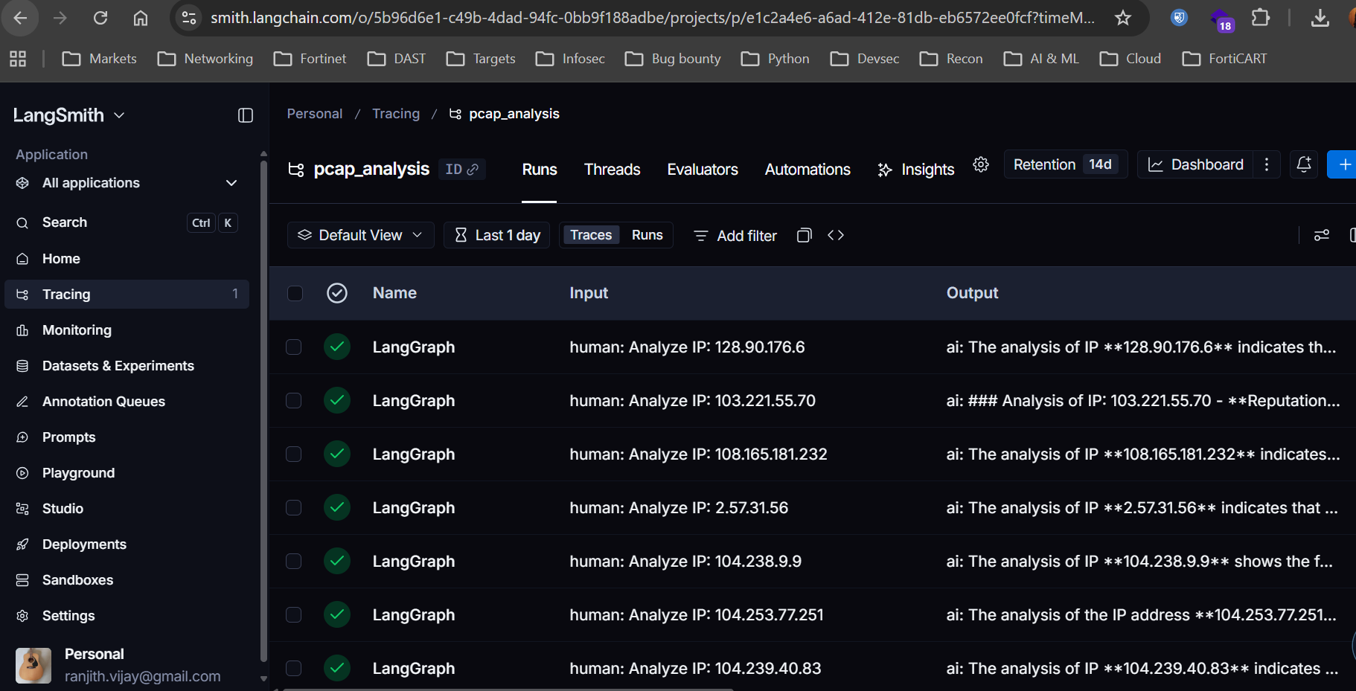
LangSmith for LLM Observability and Debugging
‍
LangSmith is a framework-agnostic platform for developing, debugging, and deploying AI agents and LLM applications.
It helps you trace requests, evaluate outputs, test prompts, and manage deployments in one place.
LangSmith works with any agent stack, whether you’re using an existing framework or building your own. Prototype locally, then move to production with integrated monitoring and evaluation to build more reliable AI agents.
LangSmith Observability gives you complete visibility into agent behavior.

Slide 19
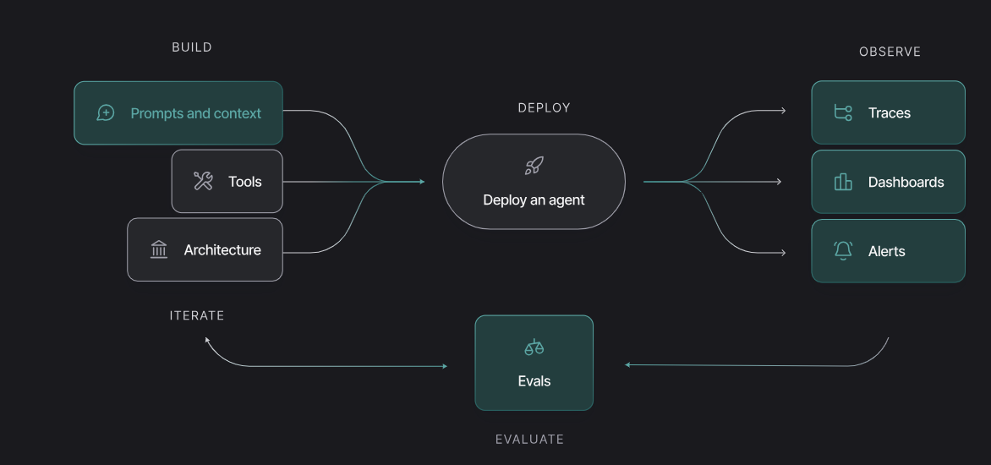
LangSmith Studio to build Agents

