Slide 1

Employee Data Analysis using Excel
STUDENT NAME: C.RAMANI
REGISTER NO: 312200798
DEPARTMENT: B.COM(G) COMMERCE
COLLEGE: PACHAIYAPPA’S COLLEGE FOR WOMEN

Slide 2

PROJECT TITLE
Employee performance analysis using Excel

Slide 3
AGENDA
Problem Statement
Project Overview
End Users
Our Solution and Proposition
Dataset Description
Modelling Approach
Results and Discussion
Conclusion

Slide 4
PROBLEM STATEMENT
The goal of employees data analysis is to enhance worker decision –making through the collection and interpretation of data.
Better workforce planning is supported by this analysis, which also improves motivation of employees.
In the end, it harmonizes personal development with overall organisational expansion.

Slide 5
PROJECT OVERVIEW
It helps assess compensation, engagement, and satisfaction levels. This analysis suppots better workforce planning and enhances employee motivation.
Ultimately, it aligns individual progress with overall organizational growth.
The performance of employees plays an important role in driving the growth of organisational structure.

Slide 6
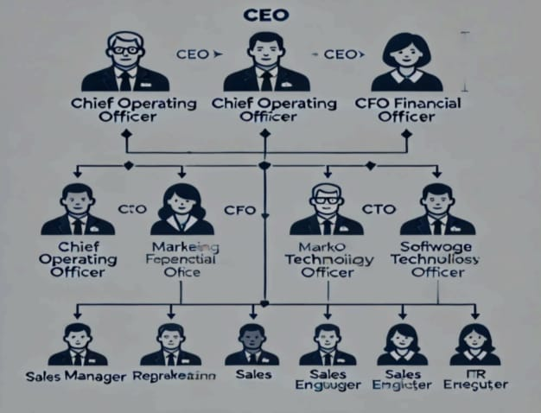
WHO ARE THE END USERS?

Slide 7
OUR SOLUTION AND ITS VALUE PROPOSITION
Conditional formatting – Missing values
Filter – Filter out missing values
Pivot table – Summary of data
Graph – Data visualization

Slide 8
DATASET DESCRIPTION
Employee dataset – Kaggle
Features – 26
Considered – 9
Names – Text
Gender – Text (male and female)
Department – Text
Monthly salary – Numericals
Starting date of job – Numerical

Slide 9
THE “WOW” IN OUR SOLUTION
=IFS(Z8>=5,”VERY HIGH”,Z8>=4,”HIGH”,Z8>=3,”MED”,TRUE,”LOW”)

Slide 10
MODELLING
DATA COLLECTION
Download – Kaggle
Edunet dashboard – File download
FEATURES COLLECTION
Names
Gender
Department
Monthly salary
Starting date of job
DATA CLEANING
Missing values identification
Filter out missing values
SUMMARY
Pivot table – Summary of data
DATA VISALIZATION
Graph – Data visualization ( bar chart )

Slide 11
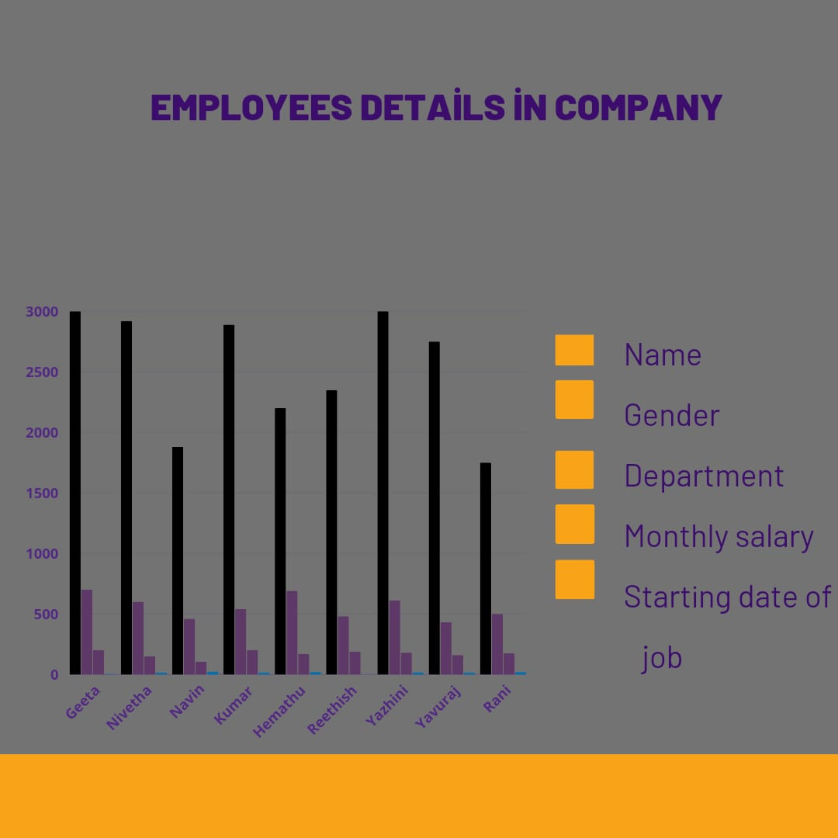
RESULTS

Slide 12
CONCLUSION
The data set can be used for various HR and workforce-related anlysis, including employees retention, salary structure assessments, diversity and inclusion studies, and leave pattern analyses.
Researchers, data analysts, and HR professionals can gain valuable insights from this data set.
Effective employees data analysis is crucial for organizations achieving to balance employees growth with success. This approach not only enhances job satisfaction but also creates a faster work environment.

Slide 13
Thank you

